Slide 1
Random Search
Assignment 1a
This presentation is not a substitute for reading the assignment description

Slide 2
Quick Submission Clarification
You finalize your assignment by running finalize.sh from your main repo directory and pushing the files it generates
You can push finalized repos as many times as you want before the deadline
  If you do this, we grade the most recent push before the deadline
  Finalizing preemptively is discouraged in general
If you finalize for the first time and push after the deadline, we grade the earliest finalized push
  Please do not push multiple times after the deadline
  We will ignore all later finalized pushes

Slide 3
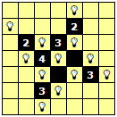
Quick Light Up (Akari) Recap
Goal: Light up the entire board
Constraints:
  Lights may not shine directly on each other
  Black cells with numbers 0-4 must have that number of bulbs directly adjacent
    Diagonal adjacency doesn’t count
    Black cells with the number 5 encode black cells without constraints

Slide 4
Random Solution Generation
Implement a random search which generates uniform random placement for a uniform random number of bulbs between 1 and the number of white cells, to find the valid solution which maximizes the number of white cells which are lit up where a cell containing a bulb is also considered lit.
Note that this means that you cannot use problem specific knowledge to shrink the search space, for instance by automatically placing bulbs on all four sides of a black cell containing a 4.
  However, you should know not to place bulbs in black cells

Slide 5
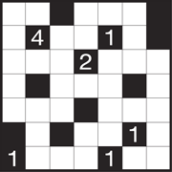
Example
35 white cells
Select a random number between 1 and 35 with a uniform random distribution
  Let’s call this number R
Place R bulbs in uniform random white cell locations
  Don’t place 2 bulbs in the same location

Slide 6
Solution Evaluation
Valid solutions are those where no two bulbs shine on each other and the number of adjacent bulbs to a black cell containing a number is obeyed.
  Invalid solutions have a fitness (score) of zero.
  Invalid solutions still count towards the total number of fitness evaluations per run.
Your configuration file should allow you to specify how many runs a single experiment consists of and how many fitness evaluations each run is allotted.

Slide 7
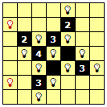
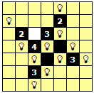
Invalid Examples
Bulbs placed in light of one another
Black cell constraints not satisfied

Slide 8
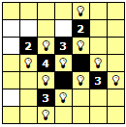
Valid Examples
All constraints met
Perfect solution

Slide 9
Quick Note on Vocabulary
Experiments consist of multiple runs
  Necessary when analyzing stochastic algorithms
Runs consist of multiple evaluations
  Each run is essentially a new search
Evaluations (evals) consist of analyzing the a single potential solution

Slide 10
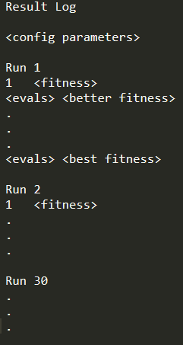
Results log
Headed with the label “Results Log”
Empty-line separated blocks of rows headed by label “Run i”
  i is the run of the experiment
Each row is of the form
<evals><tab><fitness>
  Number of evals performed so far
  Rows added as better fitnesses are found in the current run

Slide 11
Solution Files
The solution file for an experiment should contain the best solution found during any runs of that experiment
In other words, the best solution your algorithm found during the entire multi-run experiment

Slide 12
Black Cell Constraint Parameter
Random search is expected to perform very poorly for larger, more complex puzzles
You should specify a user parameter in the configuration file which controls whether the black cell number constraint is enforced or not (i.e., required for a solution to be counted as valid) and use that parameter to configure your experiments to not enforce that particular constraint.
  This should allow random search to find some valid solutions.
Also note that your program still needs to be able to enforce the black cell number constraint if the user specifies that.

Slide 13
Deliverables (All Green)
your source code, configured to compile and run with the run script
  Specifically ’./run.sh <problem1-filepath> <configuration-filepath>’
  including any necessary support files such as makefiles, project files, etc.
for each problem instance, a configuration file configured for 10,000 fitness evaluations, timer initialized random seed, and 30 runs, along with the corresponding log file and the corresponding solution file (these should go in the repo’s logs and solutions directories).
a document headed by your name, AU E-mail address, and the string “COMP x66y Fall 2020 Assignment 1a”, where x and y need to reflect the section you are enrolled in, containing for each provided problem instance, the evals versus fitness plot corresponding to your log file which produced the best solution.

Slide 14
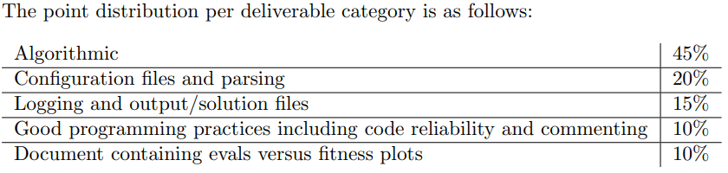
Rubric

Slide 15
Tips (from Deacon)
Start early
Pay attention to what changes between assignments
Remember that your code is being manually reviewed by humans
  i.e., write code that communicates to humans instead of simply commanding a machine
Use a programming language you’re at least proficient in (if possible)
Segment solution generation and solution evaluation earlier rather than later
  Modular code design is highly useful in this course

