Slide 1

Genetic Programming Tree Implementation for Pac-Man Controller
Deacon Seals
Modified from slides by Josh Wilkerson

Slide 2
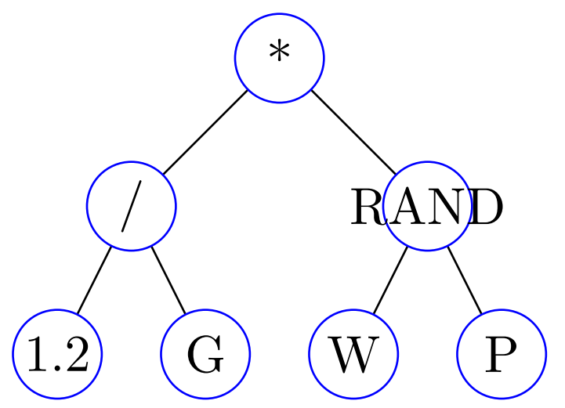
The Setup
The Pac-man controller
Scores game states
Uses a function to do scoring
We want to evolve this function
The scoring function
Will be represented as a tree (hence the GP)
Depth first, in-order traversal
Should use basic operations: + - * / RAND
Should use sensor functions:
Distance to nearest ghost G
Distance to nearest pill P
Distance to nearest fruit F
Number of adjacent walls W
Constant float value #.#
All distances are Manhattan distances ignoring walls
Select move based on score of game states from valid actions
Represents the function
H(State) = (1.2 / G) * RAND(W, P)

Slide 3
The Scoring Tree: Nodes
Nodes in the tree
Represent atomic elements of the scoring function
Nodes will need to have
An associated type
A place to store a value
A place to store children of the node
Node Type
Communicates what kind of node we are looking at
G, P, W, F, #.#, +, -, *, /, RAND
G, P, W, F, and #.# are leaf (terminal) nodes
+, -, *, /, RAND are internal (operator) nodes

Slide 4
The Scoring Tree: Nodes
Node Value
This is only used if the node is a #.# (constant value) node
Will contain the value for numeric nodes
Node Children
This is only used if the node is an internal node
The children are the operands for this node
All of our internal nodes have two operands
Left hand side and right hand side

Slide 5
The Scoring Tree: Evaluation
Ok, so we have a scoring tree, how do we get a score from it? Recursion.
Depth first, in order tree traversal pseudocode:
Eval: takes in a node n, returns a floating point score
if n is type `plus’:
return Eval(left child) + Eval(right child)
if n is type `minus’:
return Eval(left child) - Eval(right child)
...
if n is type `random’:
return random number between Eval(left) and Eval(right)
if n is type `ghostDist’:
return ghostDist()
if n is type `pillDist’:
return pillDist()
if n is type `number’:
return the value for node n

Slide 6
Other Implementation Details
Basic Tree Initialization Approach
Generate a random type for the current node
Grow Initialization Method
Nodes above the depth level are randomly assigned a type that can be operator or sensor
Full Initialization Method
Nodes above the depth limit are randomly assigned operator values
If node is an operator, recursively generate values for its children
If the node is a sensor, it has no children
Nodes at the depth limit are sensors
Generates sufficiently random trees with bounded depth
Nodes at the depth limit are sensors
Generates full trees with uniform depth

Slide 7
Other Implementation Details
Possible Random Sub-Tree Selection Method
Count how many nodes are in a tree
Generate a random value between 1 and that number
Walk through the tree, counting nodes until you reach the number selected
Possible Sub-Tree Crossover Method
Create copies of the parents
Randomly select a sub-tree from each parent copy
Swap the two sub-trees
Creates two children
Other methods possible that create one child

Slide 8
Other Implementation Details
Possible Sub-Tree Mutation Methods
Randomly change the node type
Changing from internal node to leaf node
Just trim off current children
Changing from leaf node to internal node
Have to generate random children nodes
Randomly select node type, generate operands (children) if necessary
Recursion may be useful here…
Randomly change node value
Only applicable to number nodes
Possible Parsimony Penalty Methods to Battle Tree Bloat
Limit the number of nodes a tree can have
Limit the total height a tree can reach

