Slide 1
GPac Introduction
A Genetic Programming & Coevolution Approach to the Game of Pac-Man
Slides by Deacon Seals

Slide 2
Simplified Pac-Man
Pac-Man always starts in the top left cell
Ghosts always start in the bottom right cell
Units can move up, down, left, and right
  Pac-Man can also hold position, but ghosts can’t
All units move at the same time
Units can’t move off the edge
Ghosts may occupy the same cell as each other
If Pac-Man swaps locations with a ghost or occupies the same cell, the game ends
The game also ends if the timer expires or all pills are consumed

Slide 3
Maps
We provide a set of 100 solvable maps
  These only describe wall locations
  Uniform randomly sample a map for each game
Pills need to be stochastically placed before each game based on a pill density parameter
  At least one pill
  No pills in walls or on Pac-Man’s starting location
Fruit spawn based on a fruit spawn probability parameter
  Only if a fruit doesn’t already exist on the map

Slide 4
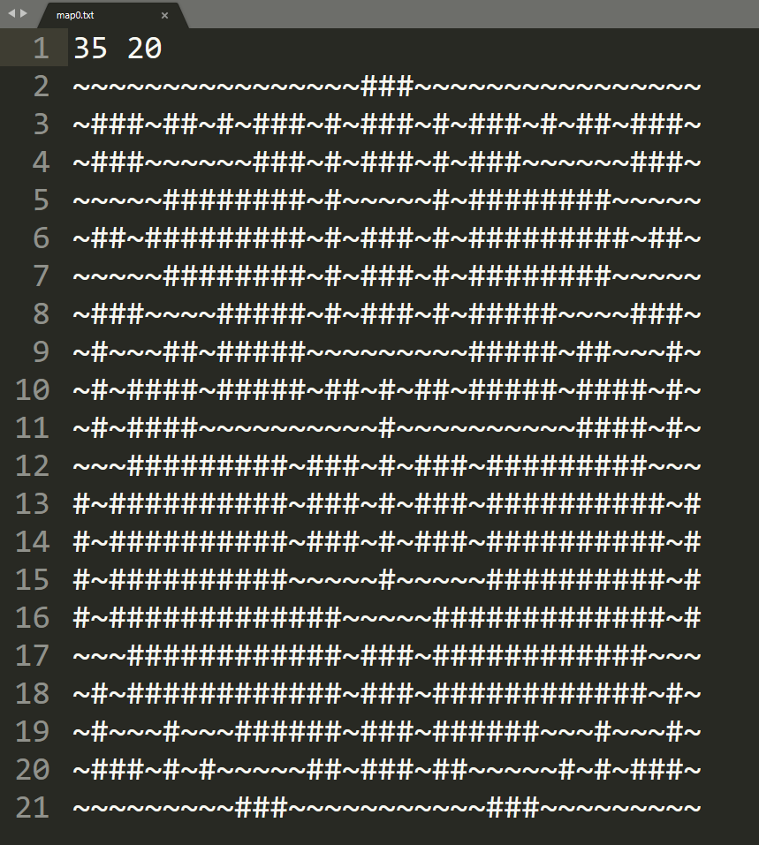
Map example

Slide 5
Additional Details
Time
  Calculated as the number of cells on the board multiplied by a user parameter
  Each turn is one time step
    Recall that all units move simultaneously
Score
  The percentage of total pills consumed truncated to an integer
  Bonuses
    Consumed fruit (based on fruit score parameter)
    If all pills were consumed, the percentage of remaining time truncated to an integer

Slide 6
Controller Basics
Enumerate all valid moves
Generate the resulting state from making each valid action
Based on the characteristics of the resulting state score the action
  Use your controller to do this
Select the action with the best score
  2a prescribes selecting based on the maximum score
  Max or min are fine for 2b and 2c (just be consistent for all controllers)

Slide 7
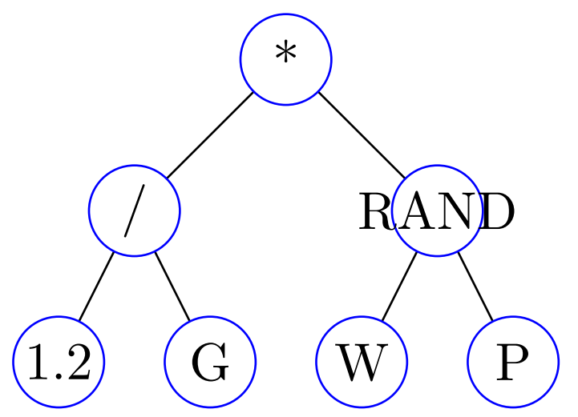
The Endgame Controller
The scoring function
Will be represented as a tree (hence the GP)
Depth first, in-order traversal
Should use basic operations: + - * / RAND
Should use sensor functions:
Distance to nearest ghost G
Distance to nearest pill P
Distance to nearest fruit F
Number of adjacent walls W
Constant float value #.#
All distances are Manhattan distances ignoring walls
Represents the function
H(State) = (1.2 / G) * RAND(W, P)

Slide 8
GPac Roadmap
Assignment 2a: Random search with a simplified controller
  Weighted sum of sensor nodes G, P, W, and F
  Randomly generate weights
  Defers tree controller implementation to assignment 2b
  Ghosts make random moves
Assignment 2b: Genetic programming
  Use genetic programming to evolve tree-based controllers
  Ghosts make random moves
Assignment 2c: Competitive genetic programming coevolution
  Use competitive coevolution to evolve tree-based controllers of Pac-Man and the ghosts

Slide 9
Output Files
Please consult assignment description for full detail
World file: contains the actions of a specific game
  The initial locations of all elements and units
  Updated unit locations, time, and score for each move
Solution file: contains a formatted description of a specific controller
  Tree format for 2b and 2c
  Equation format acceptable for 2a
    1.2*G + -0.2*P + 3.2*W + 0.4*F
Log files: similar to assignment series 1

Slide 10

GPacFormatCheck repo
Public GitHub repo containing CLI tools to help identify issues in your output files
  Your repo contains a snapshot
  https://github.com/DeaconSeals/GPacFormatCheck
Helps identify problems in world files and solution files (for trees only)

Slide 11
GPac Visualizer
Lets you watch your world files in fully-animated glory
Posted on the course website
  https://bonsai.auburn.edu/dtauritz/courses/ec/intro/2020fall/visualizer.html

