Slide 1
AI Software Development
Tips, tricks, and pitfalls for writing AI (mostly EC) code in 2021
By Deacon Seals and Nate Kamrath

Slide 2
Disclaimer
Software development is an inherently subjective topic filled with lots of opinions
There is no “one size fits all” approach to writing software as any supposedly optimal approach often varies by expertise, resources, and domain
Goals:
  Make you aware of tools
  Avoid selling any of those tools to you

Slide 3
Required Development time by Programming language
Pure
Python*
Python with C++
Pure C++
(or other low-level language)

Slide 4
Python Selling Points
High Level of Abstraction
Enables rapid development and prototyping
Can also be a footgun (more on this later)
Diverse Set of high-quality libraries
First-party libraries like multiprocessing and random
Third-party libraries distributed via pip and conda
Large developer community
Better first-party documentation
Lots of Stack Overflow posts, GitHub repos, and libraries

Slide 5
Caveats of Python
Prone to abusive programming practices
  Using dictionaries instead of classes
  Inconsistent use of variable names and data types
High-level abstractions can obscure computational cost
  Example:
  if individual in population:
  # do something
  O(n) if population is a list
  O(1) if population is a set or dictionary

Slide 6
Caveats of Python
Python doesn’t support sharing Python variables in memory between processes
  Must use shared ctype variables or a manager process that host variables
Python has quirks that are unintuitive when compared to other languages
  Implicit pass-by-reference and pass-by-value
  Multithreading vs multiprocessing

Slide 7
“Python is slow”
Optimized compiled code is typically faster than equivalent interpreted code (Python)
Algorithmic time complexity still dominates language-based performance differences in most cases
Development time is often far more expensive/valuable than compute time
  The primary exceptions to this are caused my severe computation resource constraints (e.g., embedded devices or very large amounts of data)

Slide 8
Making Python “Fast enough”
Many Python Libraries have C/C++ cores
PyTorch, Tensorflow, NumPy, JAX, scikit-learn, iGraph, and many more
A very common trend for domains known for high computation cost
Just-in-time compilation
Compile portions of Python code at runtime (e.g., PyPy, Numba, and JAX)
Potential performance improvements vary by workload
Use a profiler (please)
python –m cProfile -s tottime myPythonProgram.py

Slide 9
Tips for Writing better Python
Know when to use different data structures
  List vs set vs heap
  Applicable to all programming languages
Pay attention to data type and what’s happening “under the hood”
  Membership check on list vs set
Use multiprocessing pools and multiprocessing.pool.starmap_async() to easily parallelize function calls
  Know when to use multiprocessing (concurrent execution) vs multithreading (sequential execution) too

Slide 10
Tips for Writing better Python
List comprehension can be faster than a for loop
  Be careful to maintain legibility though
  Tutorial: https://realpython.com/list-comprehension-python/
Generators can improve memory utilization and compute time
  Tutorial: https://realpython.com/introduction-to-python-generators/

Slide 11
Tips for Better Research
Don’t waste your dev time
  Minimize development tangential to your research
  Ideally, most of your dev time should directly advance what you’re specifically researching
Search for and use existing tools/libraries whenever possible
  Standing on the shoulders of giants > reinventing the wheel
Progress is more important than productivity (unless you’re stuck)

Slide 12



Takeaways
Dev time is valuable
Know when to use a language
Use Existing tools
More valuable than compute time
There is no perfect programming language for all tasks (even Python)
Avoid reinventing the wheel (unless you’re specifically researching better wheels)

Slide 13
What about using Python with C++?

Slide 14

Cython:
C-Extensions for Python​
C types can be used for variables and class attributes​
Python classes can be used to generate C/C++ structures ​
C functions can be called from pure python wrapper functions​
Entire C++ libraries can be easily wrapped in Cython classes and directly used in pure python​
Generates C/C++ code and python wrapper code​

Slide 15
Cython is Magic?​
Layers​
  Pure Python (highest layer)​
  Cython (wrappers, middle layer)​
  C++ (lowest layer)​
Data and calls must follow the layers​

Slide 16
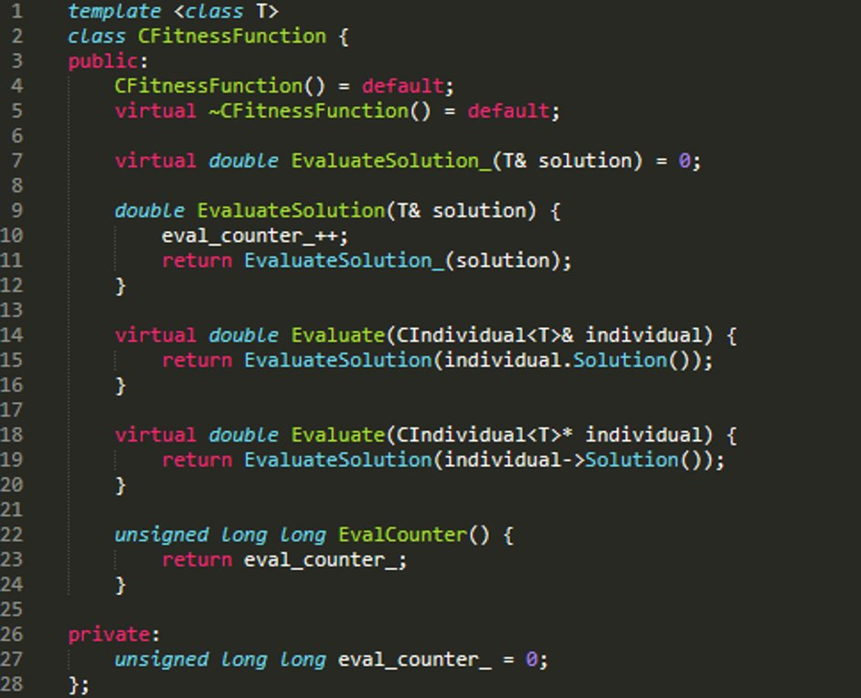
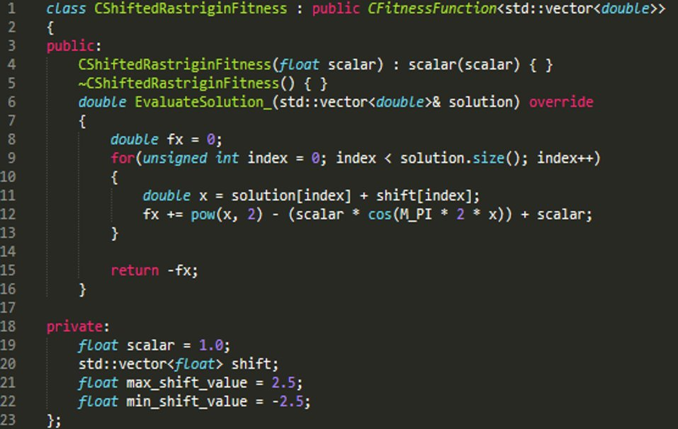
C++ Fitness Function

Slide 17
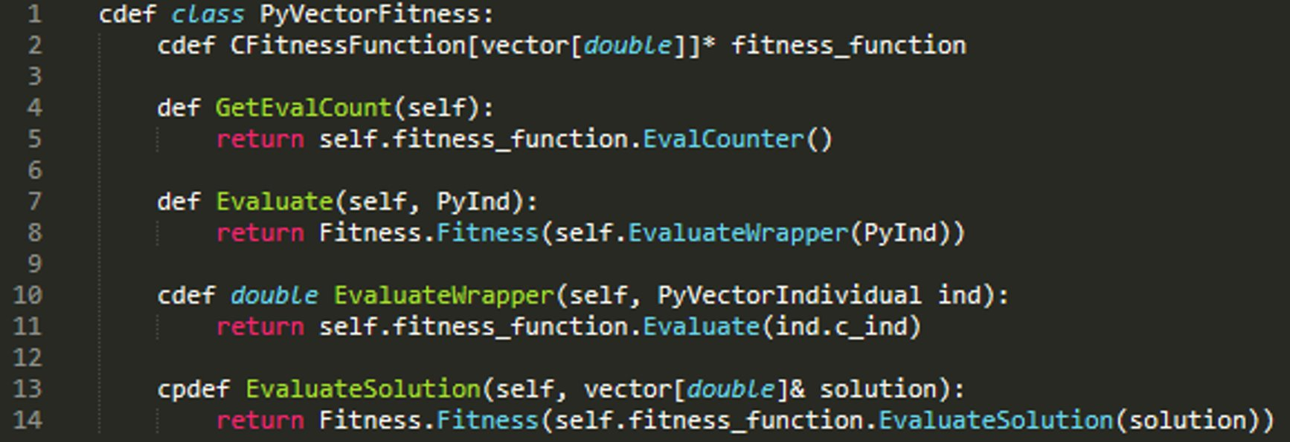
Cython Wrapper

Slide 18
ctypes
Foreign function library for python​
Provides C-compatible data types for python​
Allows calling functions from libraries (C/C++ code usually)​
Much more manual effort to use ctypes since Cython provides a lot of utility features, but it is another option if for some reason Cython can't be used​

Slide 19
THANK YOU
Questions?

