Slide 1
Methods for Competitive Fitness in Coevolutionary Algorithms
Sean Harris
For COMP 5660/6660

Slide 2
Overview
Competitive fitness depends on the relative capability of opponents
Evaluating against every possible opponent is ideal, but infeasible
Instead, we sample a subset of possible opponents
While random sampling is the most common, other methods of opponent sampling have advantages

Slide 3
Random Sampling
Pair each individual with n random opponents, then average the fitnesses
Tradeoff between accuracy and time spent
Advantages: easy to implement, minimal bias
Disadvantages: inefficient use of evaluations

Slide 4
Single-Elimination Tournament
Award fitness based on which round of a tournament individuals finished in
Advantages: greatly limits number of evaluations
Disadvantages: difficult to use for multiple populations, games need winners/losers, strong transitivity assumption
3
2
1

Slide 5
Aside: Transitive and Intransitive Games
When a game is transitive, A > B and B > C implies that A > C
An intransitive game has cycles in its dominance graph, e.g. Rock Paper Scissors
Basically all real-world games have some amount of intransitivity
However, many algorithms assume a transitive game
A
Intransitive
B
R
C
S
P
Transitive

Slide 6
Aside: Converting to Winners and Losers
Compare two individuals against a mutual opponent
The winner is whoever scored highest against that opponent
This creates an artificial “game” between two individuals who may not have directly competed
3.45 | 1.20
3.45 > 2.66
2.66 | 0.10

Slide 7
Sample High-Fitness Opponents
Pair each individual with the n highest-fitness opponents from last generation
Advantages: doesn’t waste time evaluating against bad opponents
Disadvantages: Top-fitness individuals are often very similar, behaves poorly for intransitive games
Generation t
Generation t-1

Slide 8
Aside: Competitive Fitness Sharing
Method of rewarding individuals who beat rarely-defeated opponents
Assigns a bounty to each individual, divided between each opponent who beats them
Helps encourage phenotypic diversity and preserve counter-strategies
6
6/1
3
6/2
3+2+3
6/3
2+3
6/2
2+6
6/1

Slide 9
Shared Sampling
Iteratively construct a sample with high competitive fitness sharing scores relative to each other, used for all opponents
Like sampling high-fitness opponents, but more diverse
Advantages: opponents are tested against a diverse sample of good opponents
Disadvantages: requires games that have winners/losers
Generation t
Generation t-1

Slide 10
Similar-Strength Opponent Sampling
(My research, not yet an established sampling method)
Pair individuals over n rounds against opponents with similar skill rating from previous rounds
Raw fitness can’t be used as this method biases opponents
Advantages: provides much more information per evaluation, flexible w.r.t. games
Disadvantages: heavily reliant on performance of the skill rating
2200
2200
1400
1400
600
600

Slide 11

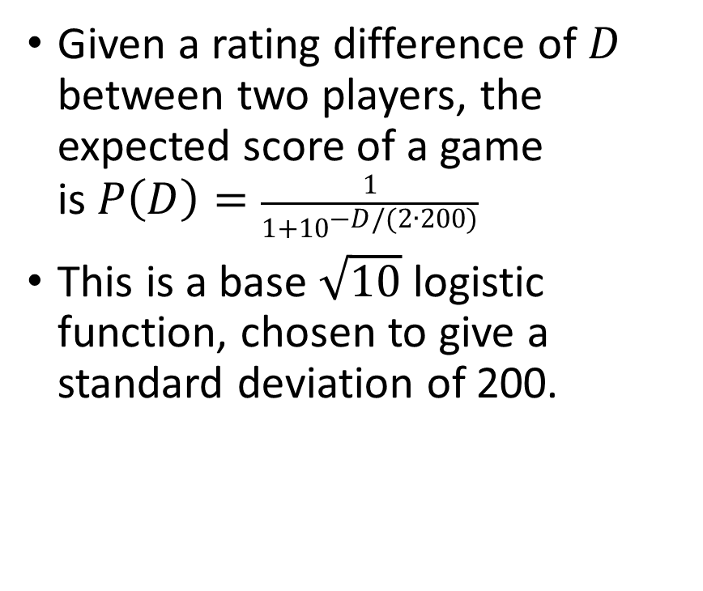



Aside: Elo Rating System
Given a rating difference of $D$ between two players, the expected score of a game is$P\left(D\right)=\frac{1}{1+{10}^{−D/(2∙200)}}$
This is a base $\sqrt{10}$ logistic function, chosen to give a standard deviation of 200.
$$R_{1}=1400$$
$$R_{2}=1800$$
$$D=−400$$
$$P\left(D\right)=.09$$
Notes:
Given a rating difference of $D$ between two players, the expected score of a game is$P\left(D\right)=\frac{1}{1+{10}^{−D/(2∙200)}}$
This is a base $\sqrt{10}$ logistic function, chosen to give a standard deviation of 200.

Slide 12
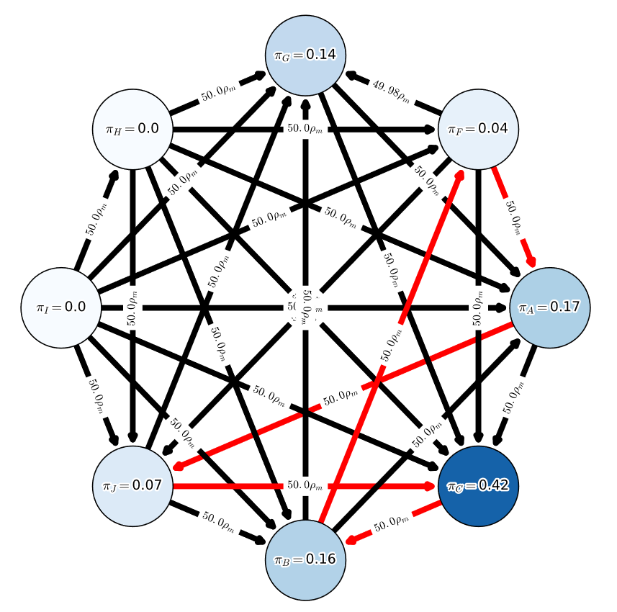
Aside: Alpha-Rank
Skill rating system based on Markov chain modelling
Finds the stationary distribution of a Markov chain, where edges represent a chance to switch to a strategy that beat you
The strategy distribution of the game’s resulting “meta”
Extremely well-suited for modelling intransitive games

Slide 13
References
Competitive fitness sharing, shared sampling:
Christopher D. Rosin and Richard K. Belew. 1997. New methods for competitive coevolution.
Similar-strength opponent sampling:
Sean N. Harris and Daniel R. Tauritz. 2021. Competitive Coevolution for Defense and Security: Elo-Based Similar-Strength Opponent Sampling,
Sean N. Harris and Daniel R. Tauritz. 2021. Elo-based Similar-Strength Opponent Sampling for Multiobjective Competitive Coevolution
Alpha-Rank:
Shayegan Omidshafiei et al. 2019. 𝛼-rank: Multi-agent evaluation by evolution.

