Slide 1
GPac Map Generation Fitness Function
Deacon Seals

Slide 2
Map Generation Technique
Create a random list of values {0,1} where 1 indicates the existence of a wall in a flattened 2D grid
Convert this list to a 2D array
Perform repair operations on this array to create a valid GPac map

Slide 3
Random 1-D List
Given an input length equal to the area of a map (height x width)
Example:
  [1, 0, 1, 1, 1, 0, 0, 0, 1, 1, 0, 0, 0, 1, 0, 1, 0, 0, 1, 1, 1, 0, 0, 1, 1, 1, 0, 1, 1, 0, 0, 0, 0, 0, 0, 0, 1, 1, 0, 1, 0, 0, 0, 0, 1, 1, 0, 1, 1, 1, 0, 1, 0, 1, 0, 0, 0, 1, 1, 0, 0, 0, 0, 1, 0, 1, 1, 1, 0, 1, 0, 1, 0, 0, 0, 1, 0, 1, 0, 0, 0, 0, 0, 0, 1, 1, 1, 1, 1, 0, 0, 0, 0, 0, 1, 1, 1, 0, 1, 1, 1, 0, 1, 1, 1, 1, 0, 0, 1, 0, 1, 1, 1, 1, 0, 1, 1, 1, 0, 0, 1, 1, 1, 0, 1, 1, 0, 0, 0, 0, 0, 1, 0, 1, 0, 0, 1, 1, 1, 1, 1, 1, 0, 1, 1, 0, 1, 1, 1, 1, 0, 1, 1, 0, 1, 0, 1, 0, 1, 1, 1, 0, 0, 0, 0, 1, 0, 1, 1, 0, 1, 1, 1, 1, 0, 1, 1, 0, 1, 0, 0, 1, 1, 1, 0, 0, 1, 0, 1, 0, 1, 0, 0, 1, 0, 0, 0, 0, 1, 1, 1, 0, 0, 1, 0, 1, 1, 1, 0, 1, 1, 1, 1, 0, 0, 0, 0, 1, 1, 0, 0, 1, 0, 0, 1, 1, 0, 0, 0, 0, 1, 0, 1, 0, 0, 0, 0, 0, 0, 0, 0, 1, 1, 1, 0, 1, 0, 1, 1, 1, 0, 0, 1, 0, 1, 1, 1, 0, 1, 1, 0, 1, 0, 0, 0, 1, 1, 0, 0, 0, 1, 1, 0, 1, 0, 1, 0, 1, 0, 1, 1, 0, 1, 1, 1, 1, 0, 0, 0, 1, 0, 1, 0, 1, 1, 1, 1, 1, 0, 1, 0, 0, 1, 0, 0, 0, 1, 1, 0, 1, 1, 0, 1, 1, 0, 0, 1, 0, 1, 0, 1, 0, 0, 1, 1, 1, 0, 1, 1, 0, 1, 0, 1, 1, 0, 1, 0, 0, 0, 0, 1, 0, 0, 1, 0, 1, 0, 1, 0, 1, 0, 0, 1, 0, 1, 1, 0, 0, 1, 1, 0, 0, 1, 0, 1, 0, 1, 0, 0, 1, 1, 1, 0, 0, 1, 1, 1, 0, 1, 0, 0, 0, 0, 0, 1, 1, 1, 1, 1, 1, 1, 0, 1, 1, 1, 0, 0, 0, 1, 0, 0, 1, 1, 0, 1, 1, 1, 0, 1, 1, 0, 1, 1, 1, 1, 1, 1, 0, 1, 0, 0, 0, 1, 0, 1, 0, 1, 1, 1, 0, 1, 1, 0, 0, 1, 0, 1, 1, 1, 0, 1, 0, 0, 1, 1, 1, 0, 1, 1, 0, 0, 1, 0, 0, 1, 0, 0, 0, 1, 1, 1, 1, 1, 0, 0, 0, 0, 1, 0, 1, 1, 0, 0, 1, 1, 0, 1, 0, 1, 1, 0, 0, 1, 1, 0, 1, 0, 0, 1, 1, 0, 0, 1, 1, 0, 1, 0, 0, 1, 1, 1, 1, 0, 0, 0, 0, 1, 0, 0, 1, 0, 1, 1, 0, 1, 1, 1, 0, 0, 0, 0, 0, 1, 0, 1, 0, 0, 0, 1, 0, 1, 1, 0, 0, 1, 0, 0, 1, 0, 1, 0, 1, 1, 1, 1, 1, 1, 0, 1, 1, 1, 1, 0, 0, 1, 0, 1, 0, 1, 1, 1, 1, 1, 0, 1, 1, 1, 1, 0, 0, 1, 1, 1, 1, 0, 0, 0, 0, 0, 0, 1, 1, 0, 0, 1, 0, 1, 1, 0, 1, 1, 0, 1, 0, 1, 1, 0, 1, 0, 1, 0, 0, 0, 0, 1, 1, 0, 1, 1, 0, 0, 1, 0, 1, 0, 0, 0, 0, 1, 0, 1, 1, 1, 0, 0, 1, 1, 1, 0, 1, 1, 0, 1, 0, 1, 0, 1, 0, 1, 0, 1, 1, 0, 1, 1, 0, 0, 1, 1, 1, 1, 0, 0, 1, 1, 0, 1, 1, 1, 0, 1, 0, 0, 0, 0, 0, 0, 0, 1, 0, 0, 1, 1, 0, 1, 1, 0, 1, 0, 0, 1, 1, 0, 1, 0, 0, 1, 1, 1, 0, 1, 0, 0, 0, 0, 0, 0, 0, 1, 0]

Slide 4
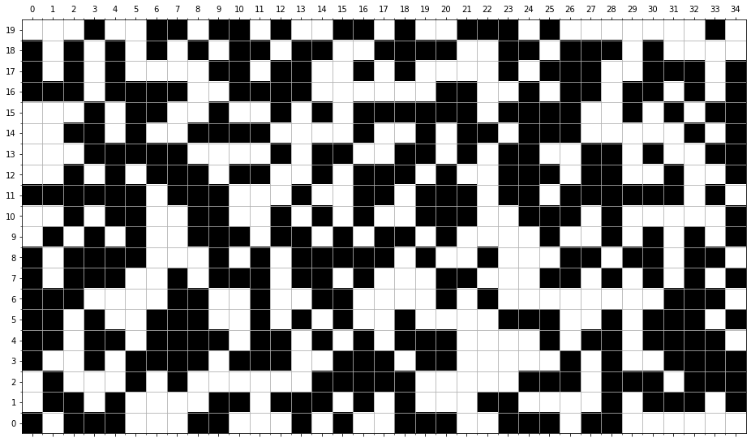
Form 2-D Array

Slide 5
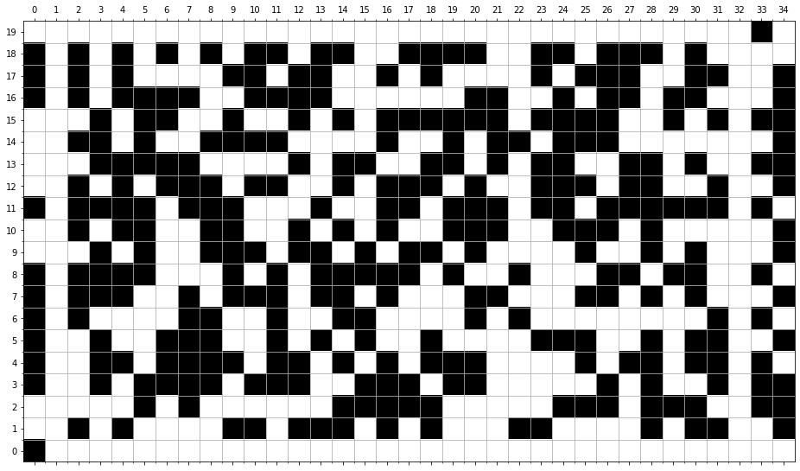
Repair Step 1: Connect Closest Reachable Cells from Pac-Man and Ghost Spawns

Slide 6
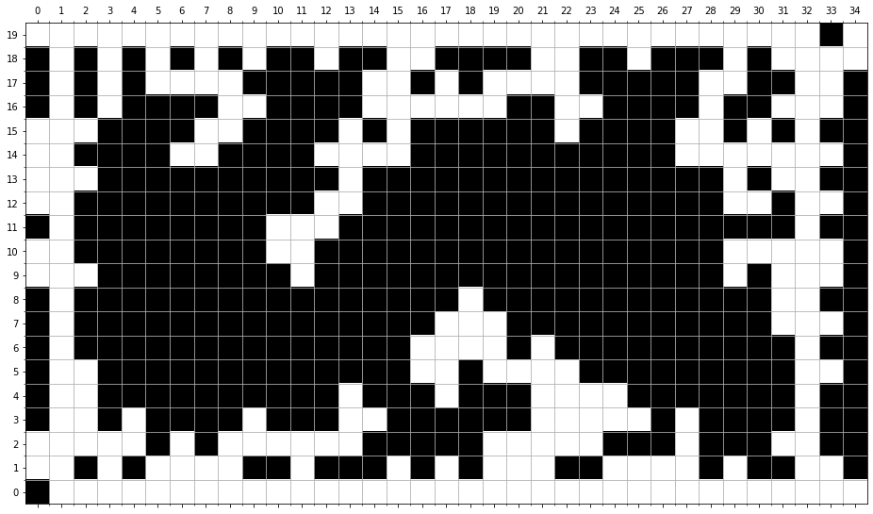
Repair Step 2: Place Walls in All Cells Unreachable by Players

