Slide 1
Employing Supportive Coevolution for the Automated Design and Configuration of Evolutionary Algorithm Operators and Parameters
Nathaniel Kamrath
Evolutionary Computing – Fall 2021

Slide 2
Outline
Introduction
Using SuCo to Evolve Self-Configuring Crossover
The Automated Design of Local Optimizers for Memetic Algorithms Employing SuCo
The Evolution of Deme Specific Local Optimizers in a Diffusion Memetic Algorithm Employing SuCo
Solving the Traveling Thief Problem with a Diffusion Memetic Algorithm Employing SuCo

Slide 3
Introduction GP
Tree GP:
(a*2) + (b^3)
Stack GP:
(a*2) + (b^3)
EXEC | INPUT | INT
 | a, b
INPUT.TO_INT | b | a
INT.2 | b | 2, a
INT.MULTIPLY | b | 2a
INT.3 |  | b, 2a
INPUT.TO_INT |  | b, 3, 2a
INT.POWER |  | b^3, 2a
INT.ADD |  | (b^3 + 2a)
+
*
^
a
2
b
3

Slide 4
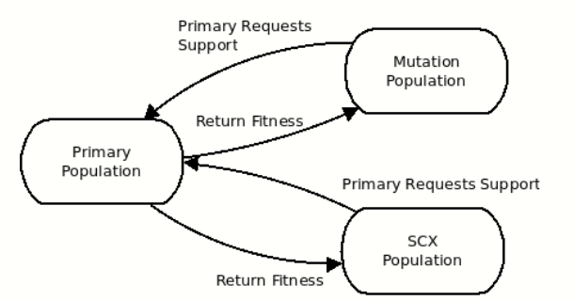
Introduction SuCo
Supportive Coevolution (SuCo)
  Technique for online parameter and operator evolution

Slide 5
Using SuCo to Evolve SCX
Self-Configuring Crossover (SCX)
  Self-adaptive technique for dynamic crossover operator design
  Linear Genetic Programming (LGP) structure
  Primitives
    Swap – represents crossovers that move genetic information between parents and between positions in a single parent (n-point, uniform, permutation)
    Merge – represents crossovers that create genetic material by combining genes (arithmetic crossover)

Slide 6
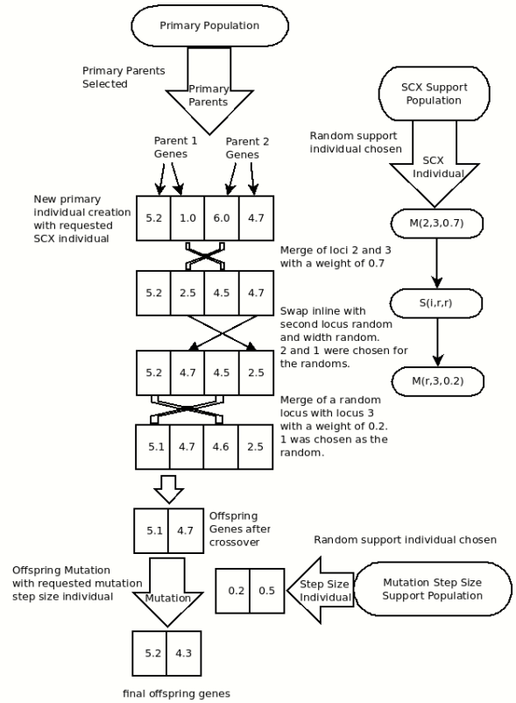
SCX Design
SuCo + SCX
  Two support populations
    SCX for crossover operator
    Mutation Step Size parameter

Slide 7
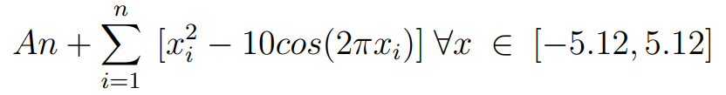
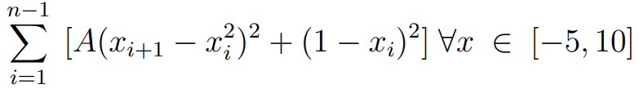
SuCo SCX Experiments
Rastrigin
Rosenbrock
Shifted Rastrigin

Slide 8
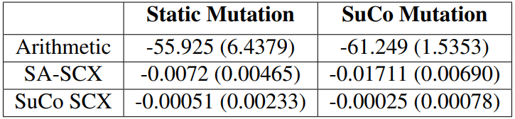
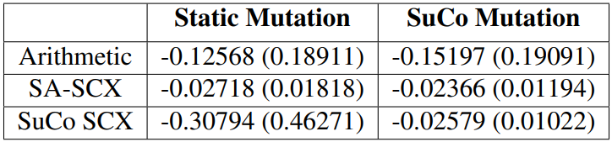
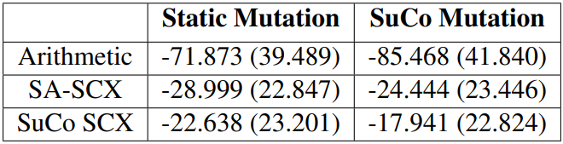
SuCo SCX Results
Man-Whitney U tests with α = 0.01
  SuCo Mutation + SuCo SCX was found to be the best combination on Rastrigin and Rosenbrock
  SuCo Mutation + SuCo SCX was the same as SuCo Mutation + SA SCX on Shifted Rastrigin
Rastrigin Results
Shifted Rastrigin Results
Rosenbrock Results

Slide 9
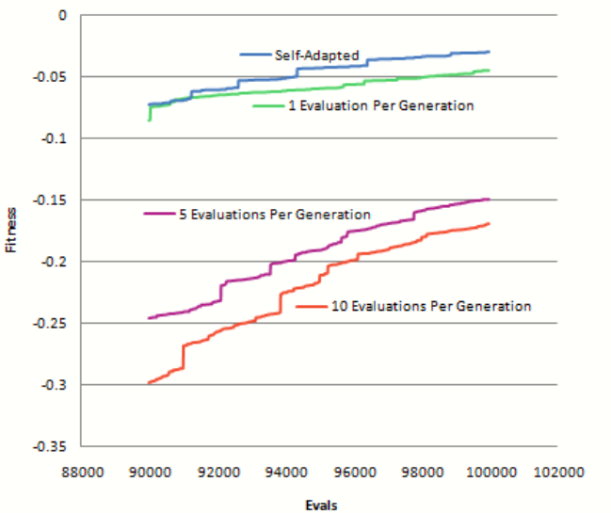
SuCo SCX Discussion
Evals Per Generation
  Mean best fitness over 50 runs on Shifted Rastrigin
  Less evaluations per generation results in faster adjustments from support population
Notes:
SA outperforms SCX. Looks like a longer run might allow other configurations to catch up in performance. Note that these results are smoothed so the large changes in fitness are indicators of either multiple runs that saw large improvements at the same point in evolution, or a single run which experienced a very large change in fitness at that point.

Slide 10
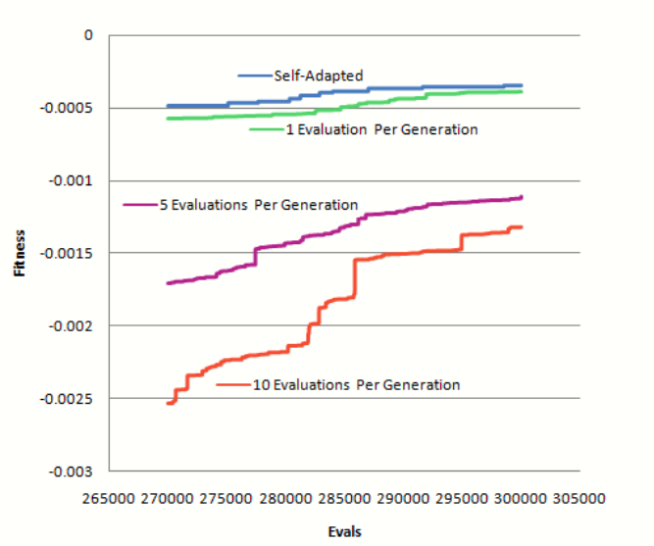
SuCo SCX Discussion
300k evaluations averaged over 10 runs
  Relative positions unchanged
  Self-adapted vs 1 Eval Per Generation
Notes:
Self-adapted SCX is not explicitly evaluated since it is evaluated as part of the offspring. However, SuCo+SCX must always use at least one evaluation per offspring generated

Slide 11
SuCo SCX Conclusions
SuCo + SCX can improve EA performance through flexibility
  Can outperform self-adaptation
SuCo is a promising way of evolving multiple parameters and operators

Slide 12
SuCo MA
Supportive Coevolution Memetic Algorithm (SuCo MA)
Single support population of local optimizers encoded using PushGP to create a generative hyper-heuristic
  PushGP is a stack based, linear programming language that is well suited for program evolution
  Support population explores the space of local optimization algorithms

Slide 13
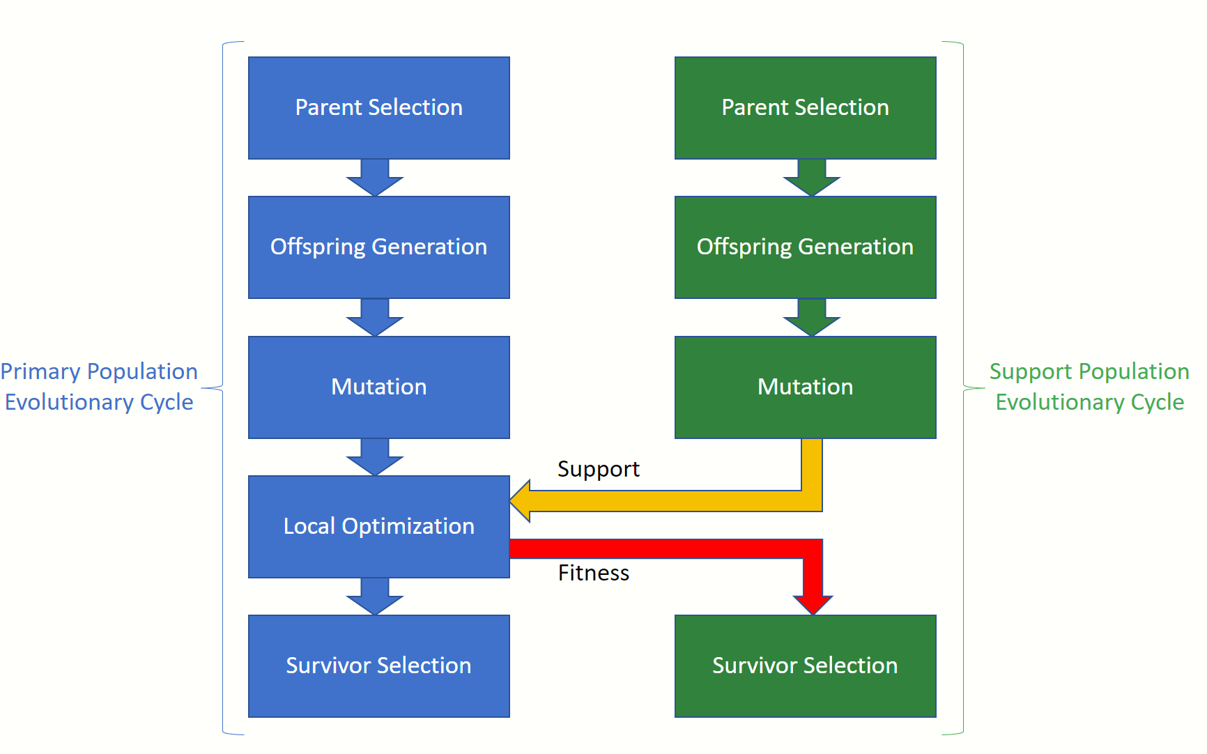
SuCo MA Structure

Slide 14
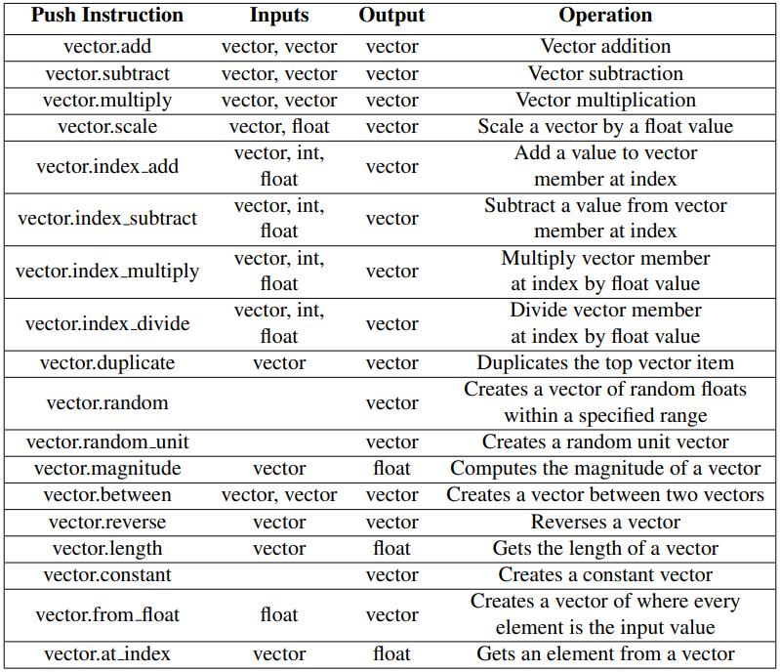
PushGP Vector Stack Instructions

Slide 15


SuCo MA Experiments
Shift Vector
Shifted Rastrigin
Shifted Rosenbrock

Slide 16
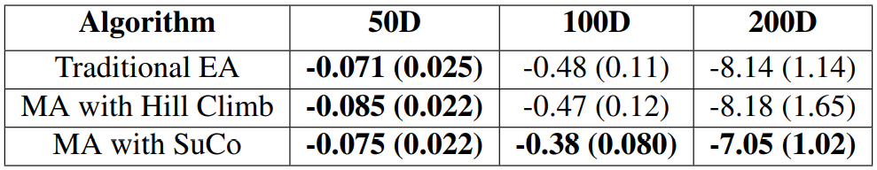
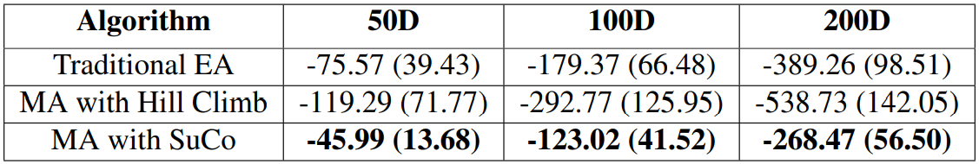
SuCo MA Results
Shifted Rastrigin Results
Shifted Rosenbrock Results
Notes:
Best in bold, f-tests/t-tests with confidence of 0.05

Slide 17
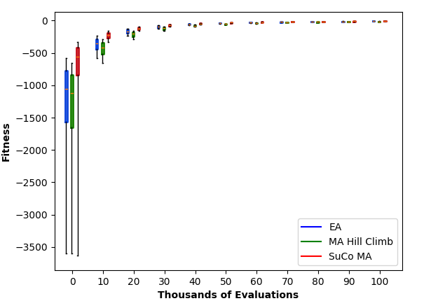
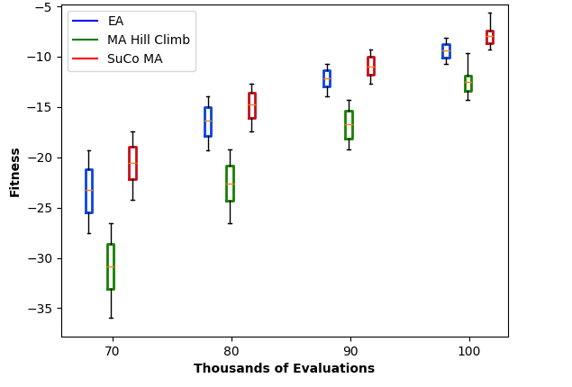
SuCo MA Results
Fitness vs. evals for Shifted Rastrigin in 200 dimensions

Slide 18
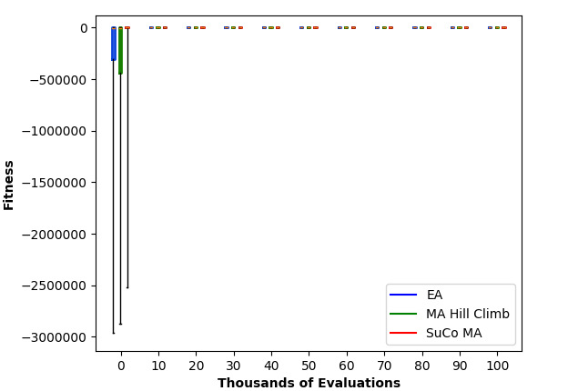
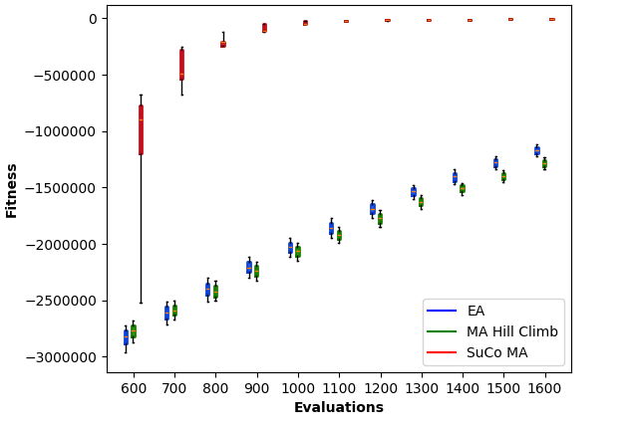
SuCo MA Results
Fitness vs. evals Shifted Rosenbrock in 50 dimensions

Slide 19
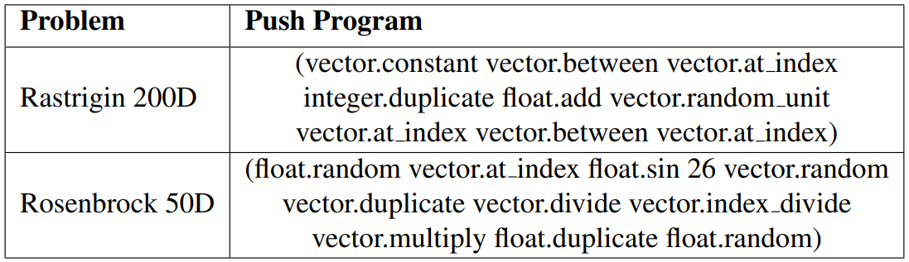
SuCo MA Evolved Optimizers

Slide 20
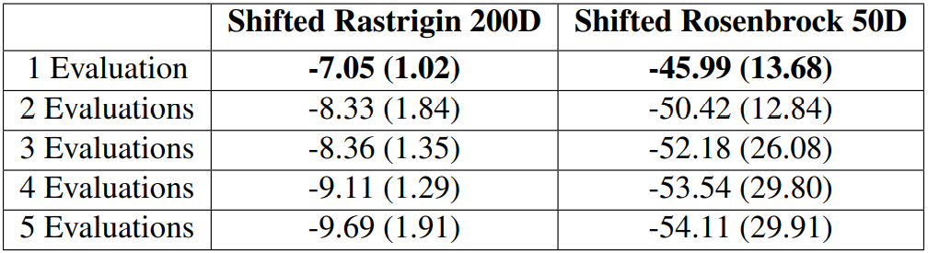
SuCo MA Discussion
Evaluations Per Local Optimizer
  Each local optimizer can be applied to multiple primary individuals

Slide 21
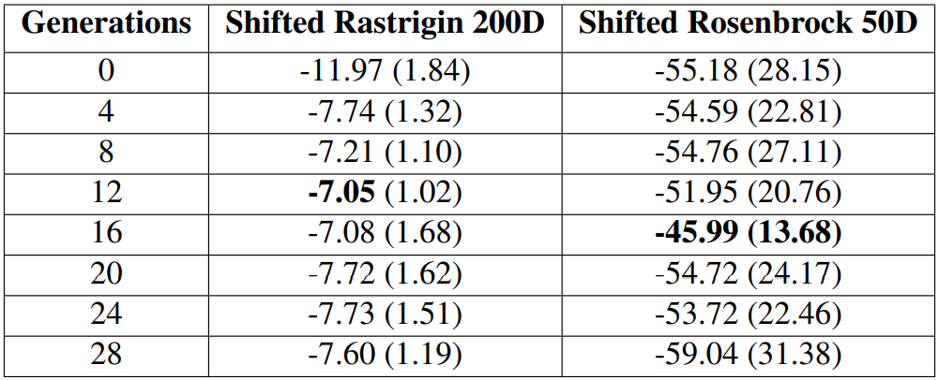
SuCo MA Discussion
Selective Optimization
  It is not necessary to perform optimization every generation of the primary population

Slide 22
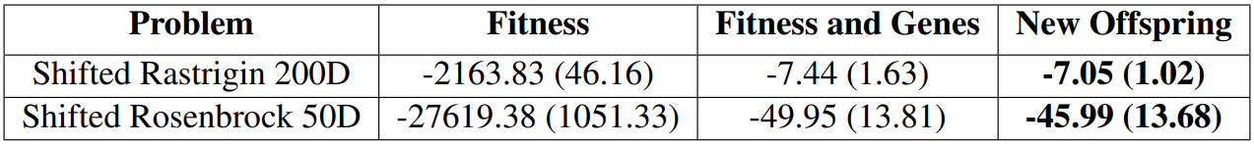
SuCo MA Discussion
Handling Optimization Results
  After local optimization, the resulting genes and fitness value can be handled in different ways

Slide 23
SuCo MA Conclusions
Using SuCo to evolve PushGP encoded local optimizers can improve performance
This can reduce MA configuration by automatically designing optimization algorithms
It can also improve performance since the local optimization strategy can adapt to the current state of the EA throughout the evolutionary run

Slide 24
SuCo-Dif-MA
Extends SuCo MA by adding a diffusion model to create SuCo-Dif-MA
Diffusion model can encourage the evolution of deme specific strategies

Slide 25
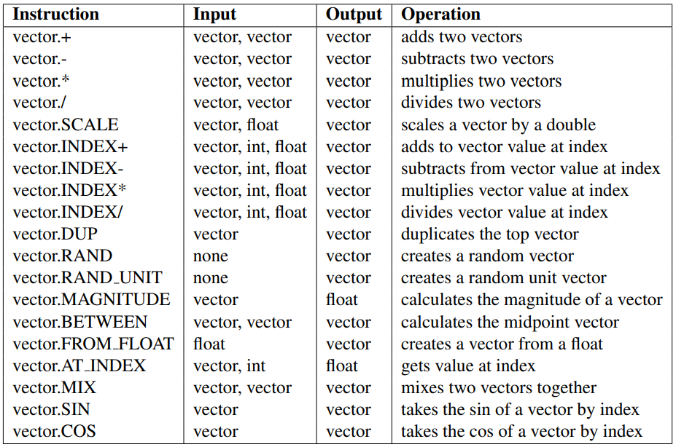
SuCo-Dif-MA PushGP Vector Instructions

Slide 26

SuCo-Dif-MA Experiments
Shift Vector
Shifted Schwefel
Shifted Rosenbrock

Slide 27
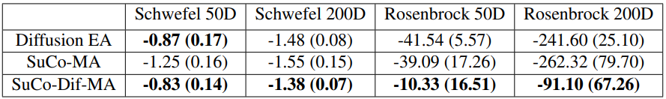
SuCo-Dif-MA Results
Notes:
Best in bold, f-tests/t-tests with confidence of 0.05

Slide 28
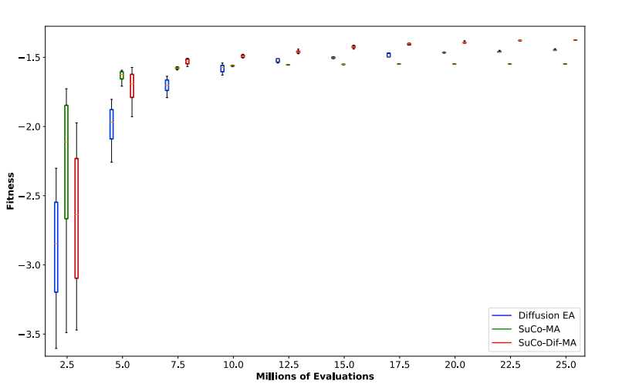
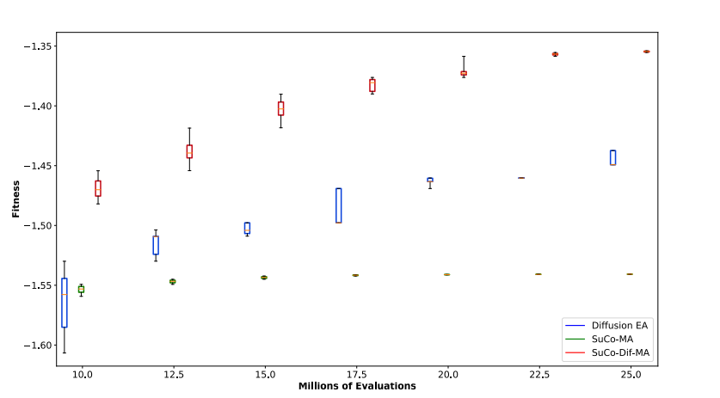
SuCo-Dif-MA Results
Shifted Schwefel fitness vs evals in 200 dimensions

Slide 29
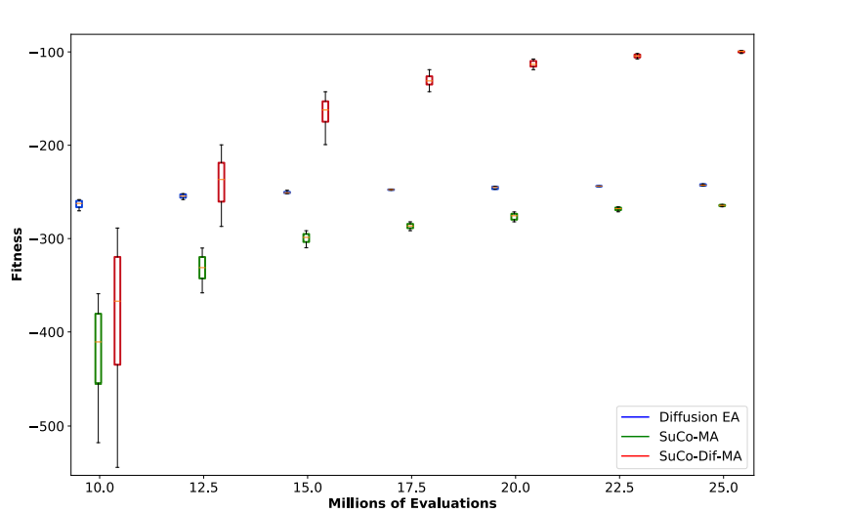
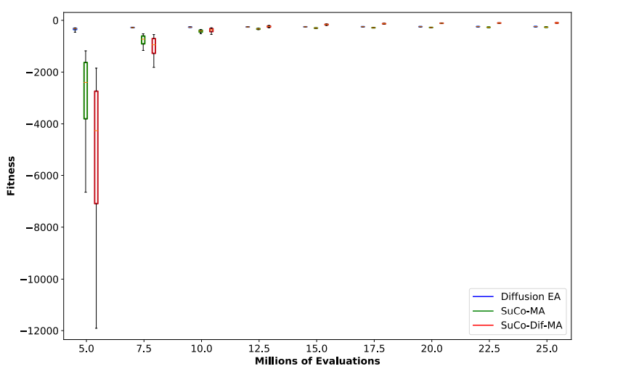
SuCo-Dif-MA Results
Shifted Rosenbrock fitness vs evals in 200 Dimensions

Slide 30
SuCo-Dif-MA Discussion
Local optimizer fitness function
  In contrast with SuCo-MA, SuCo-Dif-MA performance was improved by using the maximum improvement found across 4 optimization trials against different primary individuals
  Encouraged deme specific strategies

Slide 31
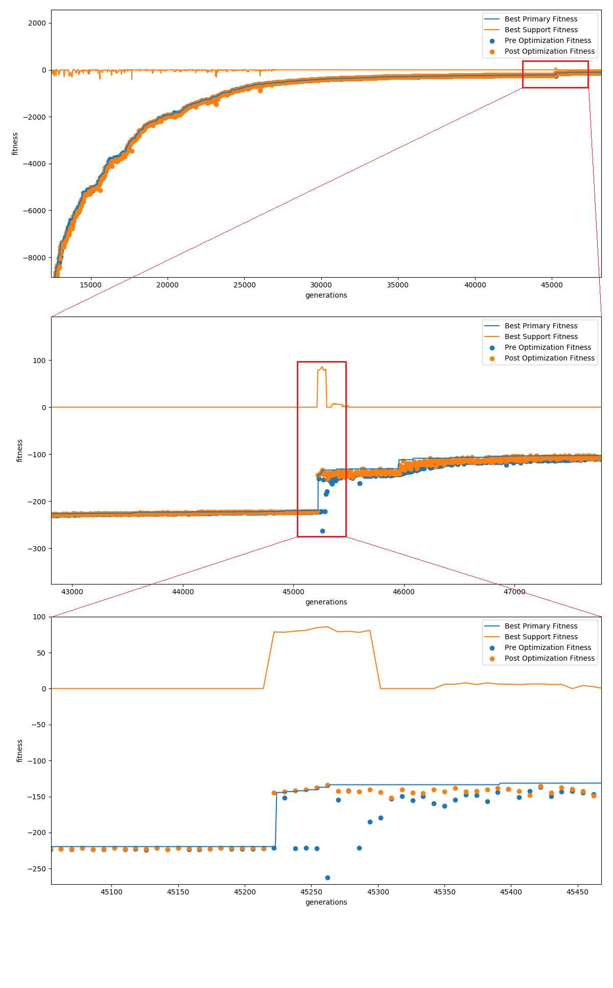
High Performance Optimizer Discovery
High performance optimizer discovery can take time, but can yield large improvements in fitness

Slide 32
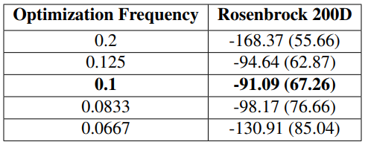
SuCo-Dif-MA Discussion
Optimization Frequency
  Improvement on previous work’s study of Selective Optimization parameter

Slide 33
SuCo-Dif-MA Conclusions
SuCo-Dif-MA can improve performance when compared to SuCo-MA
High performance, deme specific optimization strategies can be evolved, but their evolution takes time and is not consistent

Slide 34
SuCo-Dif-MA and TTP
Traveling Thief Problem (TTP) is a combination of the classical Traveling Salesman Problem (TSP) and the Knapsack Problem (KP)
High quality TTP solutions must consider both the TSP and KP sub-problems simultaneously
TTP has been shown to be a good benchmark for simulating the complexity and difficulty of real world problems.

Slide 35
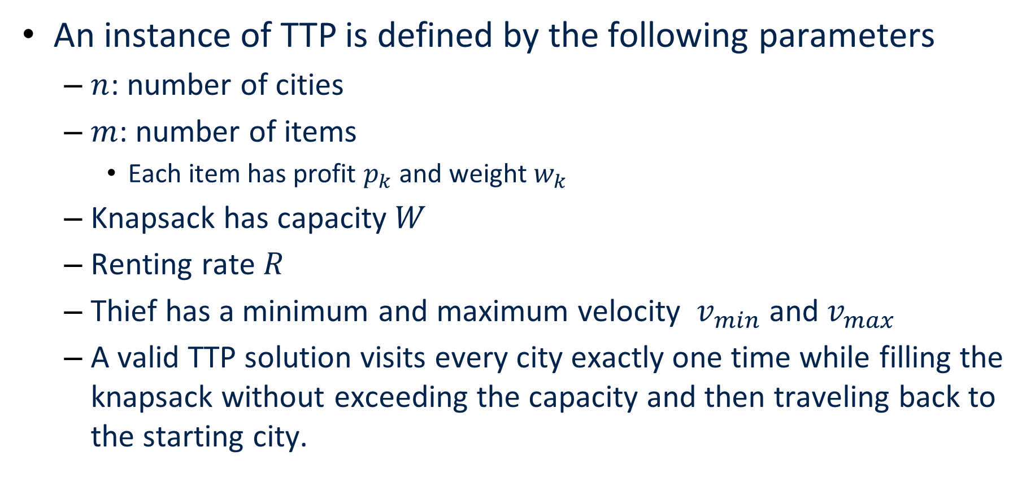
TTP Problem Definition
An instance of TTP is defined by the following parameters
  $n$: number of cities
  $m$: number of items
    Each item has profit $p_{k}$ and weight $w_{k}$
  Knapsack has capacity $W$
  Renting rate $R$
  Thief has a minimum and maximum velocity $v_{min}$ and $v_{max}$
  A valid TTP solution visits every city exactly one time while filling the knapsack without exceeding the capacity and then traveling back to the starting city.

Slide 36

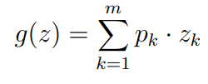
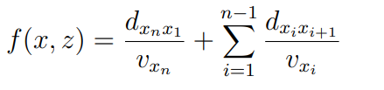

TTP Problem Definition
Thief velocity calculation:
Total knapsack profit:
Total thief travel time:
Objective Function:

Slide 37
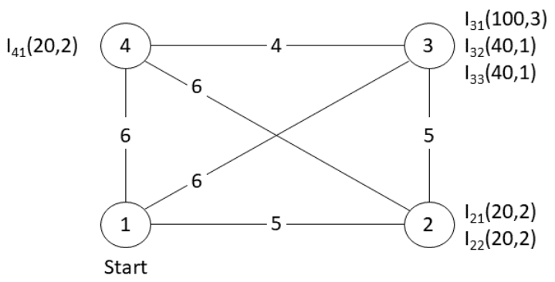

TTP Example
${W=3, v}_{min}=0.1, v_{max}=1.0$
Tour $x=(1, 2, 4, 3)$
Packing plan $z=\left(0, 0, 0, 1, 1, 0\right)$

Slide 38

TTP Example
$z=(0, 0, 0, 1, 1, 0)$
$g\left(z\right)=\left(20∙0\right)+\left(30∙0\right)+\left(100∙0\right)+\left(40∙1\right)+\left(40∙1\right)+\left(20∙0\right)=80$

Slide 39

TTP Example
$x=\left(1, 2, 4, 3\right)$
$f\left(x, z\right)=\frac{5}{(1−\frac{1−0.1}{3}∙0) }+\frac{6}{(1−\frac{1−0.1}{3}∙0) }+\frac{4}{(1−\frac{1−0.1}{3}∙0) }+\frac{6}{(1−\frac{1−0.1}{3}∙2) }$
$f\left(x, z\right)=5+6+4+15=30$

Slide 40

TTP Example
$g\left(z\right)=80$
$f\left(x, z\right)=30$
$G\left(x, z\right)=g\left(z\right)−R∙f\left(x,z\right)=80−\left(1∙30\right)=50$

Slide 41
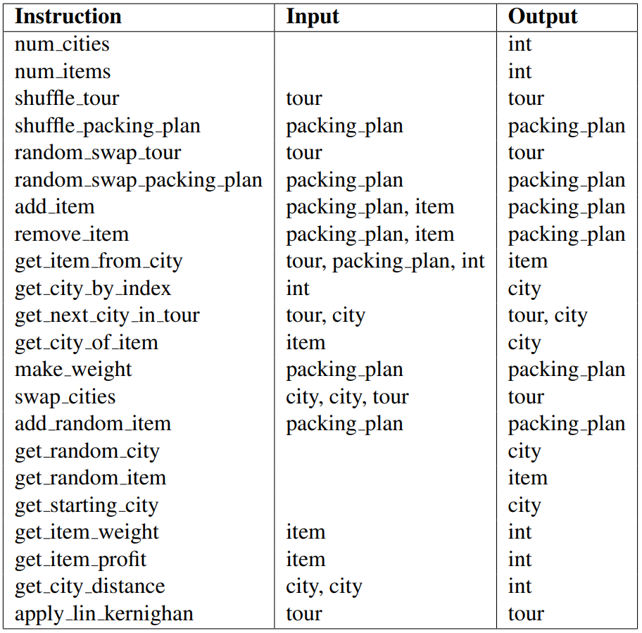
SuCo-Dif-MA TTP Instructions

Slide 42
Experiments
Representative benchmark set of community adopted TTP instances ranging from smallest to largest
TTP Categories
  Category 1 – 1 item per city, bounded strongly correlated item weight/profit, small knapsack capacity
  Category 2 – 5 items per city, uncorrelated similar weight/profit, average knapsack capacity
  Category 3 – 10 items per city, uncorrelated weight/profit, large knapsack capacity

Slide 43
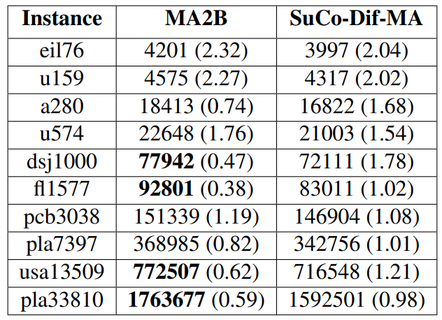
SuCo-Dif-MA TTP Results
Category 1 instance results

Slide 44
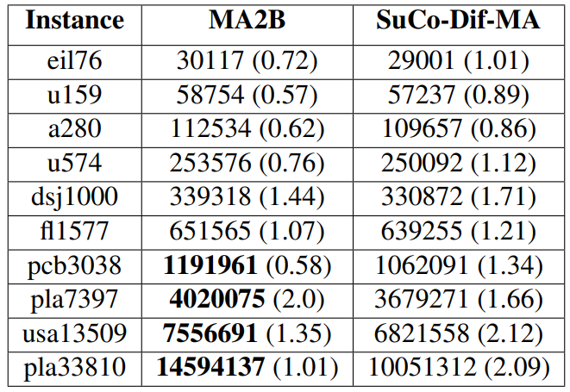
SuCo-Dif-MA TTP Results
Category 2 instance results

Slide 45
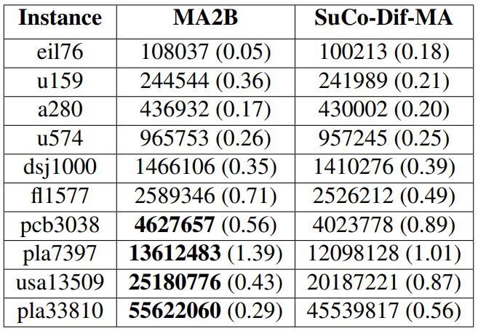
SuCo-Dif-MA TTP Results
Category 3 instance results

Slide 46
TTP Discussion
Selective optimization
  Larger impact on TTP
  Best found approach was to skip a number of primary generations between each support generation (similar to previous work), but execute several support generations in a row
Evaluations per local optimizer
  Previous work found the optimal setting for this parameter was small (1 for SuCo-MA and 4 for SuCo-Dif-MA), however on TTP the optimal setting was 7 or 8 depending on the problem instance

Slide 47
TTP Discussion
Local optimizer programs are very sensitive to change
Strategies that worked in previous generations may not be effective in the current generation due to changes in the primary population
A method to aid the support population in offspring generation
  Which primitives are effective?
  What combinations of primitives are effective?

Slide 48
TTP Conclusions
SuCo-Dif-MA can be applied to TTP with minimal changes (new instruction set)
SuCo-Dif-MA is a promising approach producing competitive results
More work is required to solve some underlying problems but could result in performance improvements

Slide 49
Final Conclusions
SuCo has been used to successfully evolve mutation step size, crossover operators, and local optimization operators
  SuCo can improve performance when compared to both static parameters and operators as well as self-adapted parameters
SuCo-MA and SuCo-Dif-MA evolved mainly stochastic local optimizers
  Creating high quality deterministic optimizers is probably much harder than simple, random, “lucky” operators
  It is challenging to create deterministic strategies instead of informed mutators

Slide 50
Future Work
Evolve more operators and parameters
  Selection operators, population size, etc.
Perform experiments with more than two support populations
Determine if performance improvements from diffusion model benefits other operators/parameters in SuCo
Improve upon local optimizer evolution
  General improvements to program evolution to address stability/sensitivity issues
  Address challenges of online dynamic program evolution

Slide 51
Questions
Thank you!
Questions?

