Slide 1
AI Software Development
Tips, tricks, and pitfalls for writing AI (mostly EC) code in 2022
By Deacon Seals

Slide 2
Disclaimer
Software development is an inherently subjective topic filled with lots of opinions
There is no “one size fits all” approach to writing software as any supposedly optimal approach often varies by expertise, resources, and domain
Goals:
  Make you aware of tools
  Avoid selling any of those tools to you

Slide 3
Required Development time by Programming language
Pure
Python*
Python with C++
Pure C++
(or other low-level language)

Slide 4
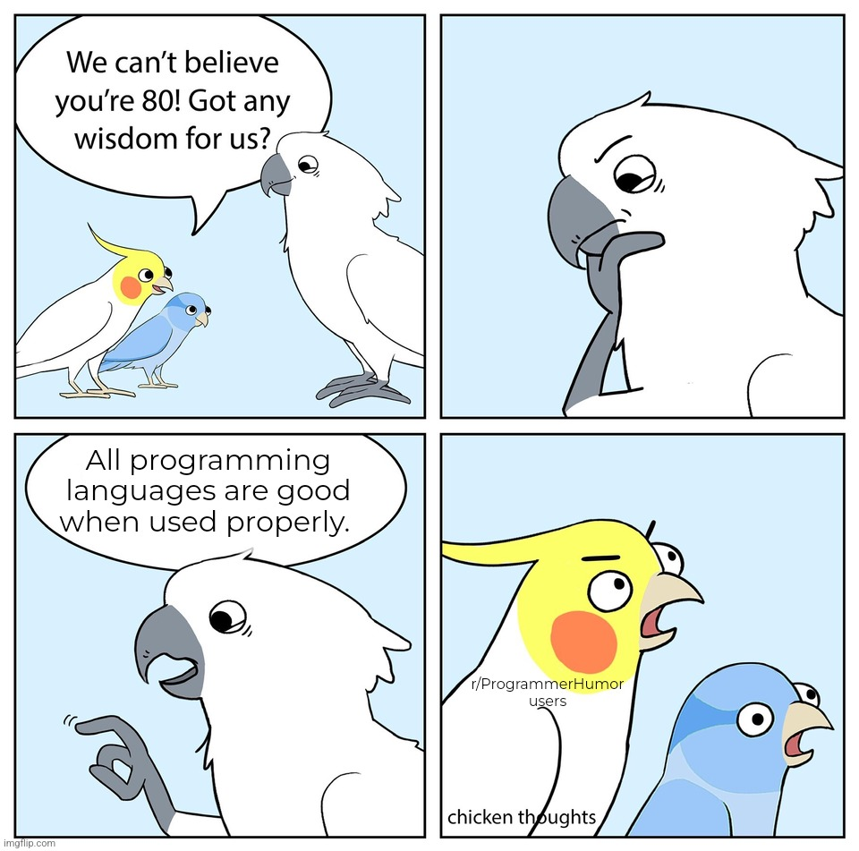
https://www.reddit.com/r/ProgrammerHumor/comments/wy7uxi/even_html/

Slide 5
Python Selling Points
High Level of Abstraction
Enables rapid development and prototyping
Can also be a footgun (more on this later)
Diverse Set of high-quality libraries
First-party libraries like multiprocessing and random
Third-party libraries distributed via pip and conda
Large developer community
Better first-party documentation
Lots of Stack Overflow posts, GitHub repos, and libraries

Slide 6
Caveats of Python
Prone to abusive programming practices
  Using dictionaries instead of classes
  Inconsistent use of variable names and data types
High-level abstractions can obscure computational cost
  Example:
  if individual in population:
  # do something
  O(n) if population is a list
  O(1) if population is a set or dictionary

Slide 7
Caveats of Python
Python doesn’t support sharing Python variables in memory between processes
  Must use shared ctype variables or a manager process that host variables
Python has quirks that are unintuitive when compared to other languages
  Implicit pass-by-reference and pass-by-value
  Multithreading vs multiprocessing

Slide 8
“Python is slow”
Optimized compiled code is typically faster than equivalent interpreted code (Python)
Algorithmic time complexity still dominates language-based performance differences in most cases
Development time is often far more expensive/valuable than compute time
  The primary exceptions to this are caused my severe computation resource constraints (e.g., embedded devices or very large amounts of data)

Slide 9
Making Python “Fast enough”
Many Python Libraries have C/C++ cores
PyTorch, Tensorflow, NumPy, JAX, scikit-learn, iGraph, and many more
A very common trend for domains known for high computation cost
Just-in-time compilation
Compile portions of Python code at runtime (e.g., PyPy, Numba, and JAX)
Potential performance improvements vary by workload
Use a profiler (please)
python –m cProfile -s tottime myPythonProgram.py

Slide 10
Tips for Writing better Python
Know when to use different data structures
  List vs set vs heap
  Applicable to all programming languages
Pay attention to data type and what’s happening “under the hood”
  Membership check on list vs set
Use multiprocessing pools and multiprocessing.pool.starmap_async() to easily parallelize function calls
  Know when to use multiprocessing (concurrent execution) vs multithreading (sequential execution) too

Slide 11
Tips for Writing better Python
List comprehension can be faster than a for loop
  Be careful to maintain legibility though
  Tutorial: https://realpython.com/list-comprehension-python/
Generators can improve memory utilization and compute time
  Tutorial: https://realpython.com/introduction-to-python-generators/

Slide 12
Tips for Better Research
Don’t waste your (dev) time
  Minimize development tangential to your research
  Ideally, most of your dev time should directly advance what you’re specifically researching
  Beware of never-ending “infrastructure” projects
Search for and use existing tools/libraries whenever possible
  Standing on the shoulders of giants > reinventing the wheel
  Go where the tools are (even if that isn’t Python)
Progress is more important than productivity (unless you’re stuck)
  Results > Data

Slide 13


What About using Python with Other Languages?
Cython
PyO3
C extensions for Python
  Not to be confused with CPython (the default Python interpreter written in C)
Generates C/C++ code and Python wrapper code
C functions can be called from pure Python wrapper functions
Rust bindings for Python
Creates native Python modules from compiled Rust
Interoperable with PyPy just-in-time compiler
Allows Rust code to call Python as well

Slide 14
Notable Libraries
Jax
Tensorflow / Pytorch
Accelerated linear algebra for Python
NumPy with auto-differentiation and GPU/TPU support
Deep learning libraries for accelerated gradient-based optimization
Feature rich with some caveats
Gym
OpenSpiel
RL environments with a standardized interface
Brax (gym in JAX)
May have migrated
RL environment for games
C++ (typically) wrapped for Python use
Link

Slide 15
Notable Libraries
evosax
QDax
Evolution strategies in JAX
Accelerated neuroevolution library
Primarily focused on CMA-ES
Accelerated Quality-Diversity
QD neuroevolution library
DEAP
Stable Baselines3
Distributed Evolutionary Algorithms in Python
GP, GA, MOEA, CMA-ES
Reliable reference implementation of deep RL algorithms
Useful if applicable

Slide 16
Legacy Libraries
ECJ
PyTorch NEAT
Java-based Evolutionary Computation Research System
Useful if your application domain meshes with Java
Support for wide variety of NEAT algorithms
Uses a very old version of PyTorch

Slide 17



Takeaways
Dev time is valuable
Know when to use a language
Use Existing tools
More valuable than compute time
There is no perfect programming language for all tasks (even Python)
Avoid reinventing the wheel (unless you’re specifically researching better wheels)

Slide 18
THANK YOU
Questions?

