Slide 1
Methods for Competitive Fitness in Coevolutionary Algorithms
Sean Harris
For COMP 5660/6660

Slide 2
Overview
Competitive fitness depends on the relative capability of opponents
Evaluating against every possible opponent is ideal, but infeasible
Instead, we sample a subset of possible opponents
While random sampling is the most common, other methods of opponent sampling have advantages

Slide 3
Random Sampling
Pair each individual with n random opponents, then average the fitnesses
Tradeoff between accuracy and time spent
Advantages: easy to implement, minimal bias
Disadvantages: inefficient use of evaluations

Slide 4
Round-Robin Evaluation
Pair each individual with each opponent, then average the fitnesses
Advantages: very accurate measure of fitness for a given population size
Disadvantages: extreme time cost, quadratic with population size

Slide 5
Single-Elimination Tournament
Award fitness based on which round of a tournament individuals finished in
Advantages: greatly limits number of evaluations
Disadvantages: difficult to use for multiple populations, games need winners/losers, strong transitivity assumption
3
2
1

Slide 6
Aside: Converting to Winners and Losers
Compare two individuals against a mutual opponent
The winner is whoever scored highest against that opponent
This creates an artificial “game” between two individuals who may not have directly competed
3.45 | 1.20
3.45 > 2.66
2.66 | 0.10

Slide 7
Aside: Transitive and Intransitive Games
When a game is transitive, A > B and B > C implies that A > C
An intransitive game has cycles in its dominance graph, e.g. Rock Paper Scissors
Nearly all real-world games have some amount of intransitivity
However, many algorithms assume a transitive game
A
Intransitive
B
R
C
S
P
Transitive

Slide 8
Sample High-Fitness Opponents
Pair each individual with the n highest-fitness opponents from last generation
Advantages: doesn’t waste time evaluating against bad opponents
Disadvantages: Top-fitness individuals are often very similar, behaves poorly for intransitive games
Generation t
Generation t-1

Slide 9
Aside: Competitive Fitness Sharing
Method of rewarding individuals who beat rarely-defeated opponents
Assigns a bounty to each individual, divided between each opponent who beats them
Helps encourage phenotypic diversity and preserve counter-strategies
6
6/1
3
6/2
3+2+3
6/3
2+3
6/2
2+6
6/1

Slide 10
Shared Sampling
Iteratively construct a sample with high competitive fitness sharing scores relative to each other, used for all opponents
Like sampling high-fitness opponents, but more diverse
Advantages: opponents are tested against a diverse sample of good opponents
Disadvantages: requires games that have winners/losers
Generation t
Generation t-1

Slide 11
Selecting a Sampling Method
Direct comparison of resulting individuals
  Not always easy to do in competitive coevolution
Comparison of sampling accuracy
  Need to compare sampled fitnesses to a “ground truth”
Analysis of transitivity properties
  Determine whether sampling methods with transitivity assumptions are valid
Analysis of phenotype space
  Determine how different strategy groups are organized and relate to each other

Slide 12
Measuring Sampling Accuracy
Compare estimated fitness from a sampling technique to a “ground truth” fitness value
One method: Perform round-robin evaluation on a population to get the ground truth
Fitness error or rank error can be computed between estimated fitness and ground truth

Slide 13
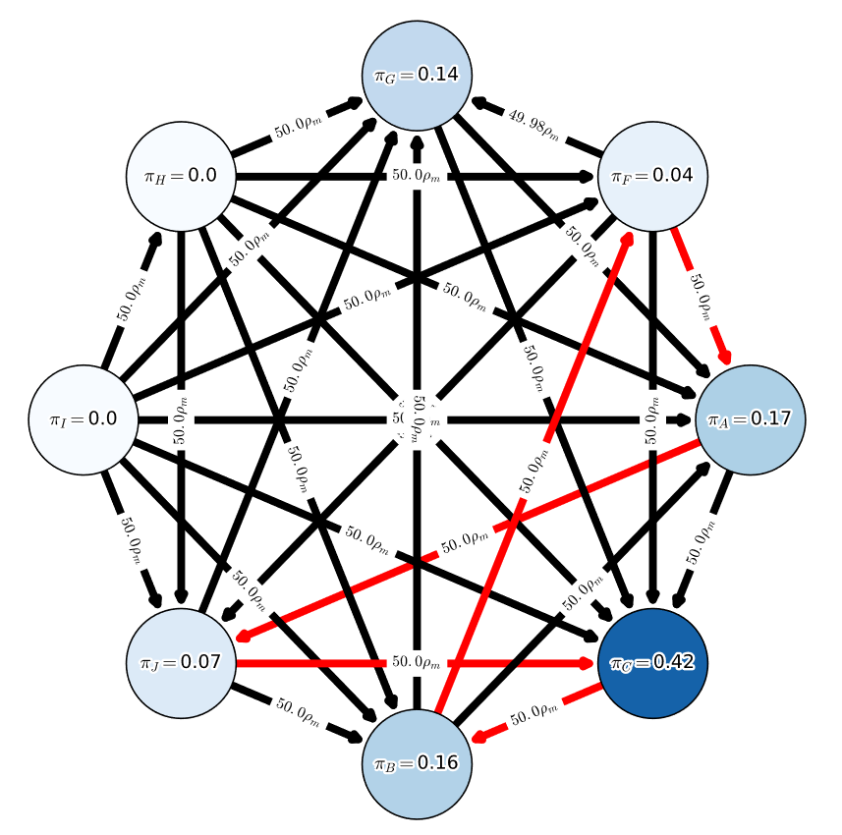
Alpha-Rank
Skill rating system based on Markov chain modelling
Finds the stationary distribution of a Markov chain, where edges represent a chance to switch to a strategy that beat you
The strategy distribution of the game’s resulting “meta”
Extremely well-suited for modelling intransitive games

Slide 14
References
Competitive fitness sharing, shared sampling:
Christopher D. Rosin and Richard K. Belew. 1997. New methods for competitive coevolution.
Alpha-Rank:
Shayegan Omidshafiei et al. 2019. 𝛼-rank: Multi-agent evaluation by evolution.

