Slide 1

Directing Evolution
The Automated Design of Evolutionary Pathways Using Directed Graphs
Braden Tisdale | Deacon Seals | Aaron Scott Pope | Daniel R. Tauritz
BONSAI Lab | BONSAI Lab | Advanced Research in Cyber Systems | BONSAI Lab
Auburn University | Auburn University | Los Alamos National Laboratory | Auburn University
Auburn, Alabama, USA | Auburn, Alabama, USA | Los Alamos, New Mexico, USA | Auburn, Alabama, USA
braden@auburn.edu | djs0080@auburn.edu | apope@lanl.gov | dtauritz@acm.org
The Genetic and Evolutionary Computation Conference 2021
LA-UR-21-25566

Slide 2
Meta-Optimization
Meta-Optimizer
Optimizers for tuning optimizers
Many parameters/dimensions
  Interdependent
  Unpredictable
Extremely costly evaluations
Many different methods
  Manually
  Heuristically
  Meta-EA
  Statistical modeling (REVAC)
  Sequential Parameter Optimization (SPOT)
  Racing (irace)
Optimizes
Optimizer
Optimizes
Problem

Slide 3
What makes an EA?
Initialization
Parent Selection
Reproduction
Initialization
Selection
Reproduction
Survival Selection
Termination

Slide 4
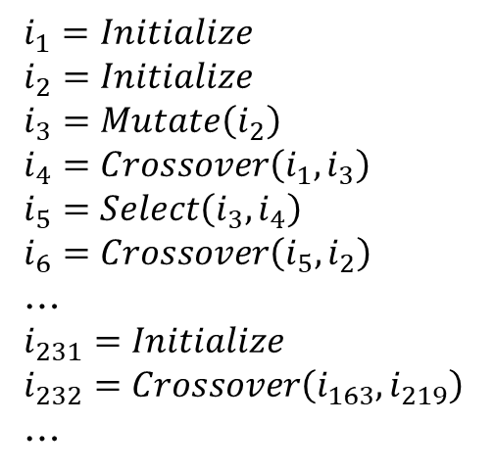
$$i_{1}=Initialize$$
$$i_{2}=Initialize$$
$$i_{3}=Mutate\left(i_{2}\right)$$
$$i_{4}=Crossover\left(i_{1},i_{3}\right)$$
$$i_{5}=Select\left(i_{3},i_{4}\right)$$
$$i_{6}=Crossover\left(i_{5},i_{2}\right)$$
…
$$i_{231}=Initialize$$
$$i_{232}=Crossover\left(i_{163},i_{219}\right)$$
…
Initialization
Selection
Reproduction
Mihai Oltean and Crina Groşan. 2003. Evolving Evolutionary Algorithms Using Multi Expression Programming. In Advances in Artificial Life. Springer-Verlag, Berlin, Heidelberg.

Slide 5
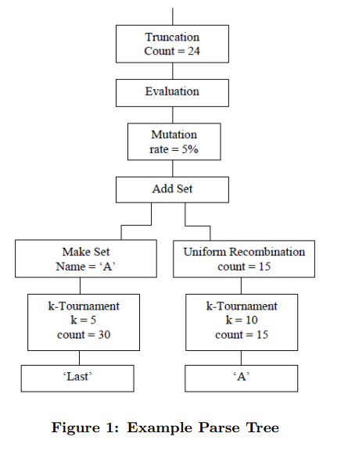
Initialization
Selection
Reproduction
Matthew A. Martin and Daniel R. Tauritz. 2013. Evolving Black-Box Search Algorithms Employing Genetic Programming. In Proceedings of the 15th Genetic and Evolutionary Computation Conference Companion (GECCO ’13 Companion). Association for Computing Machinery, New York, NY, USA.

Slide 6
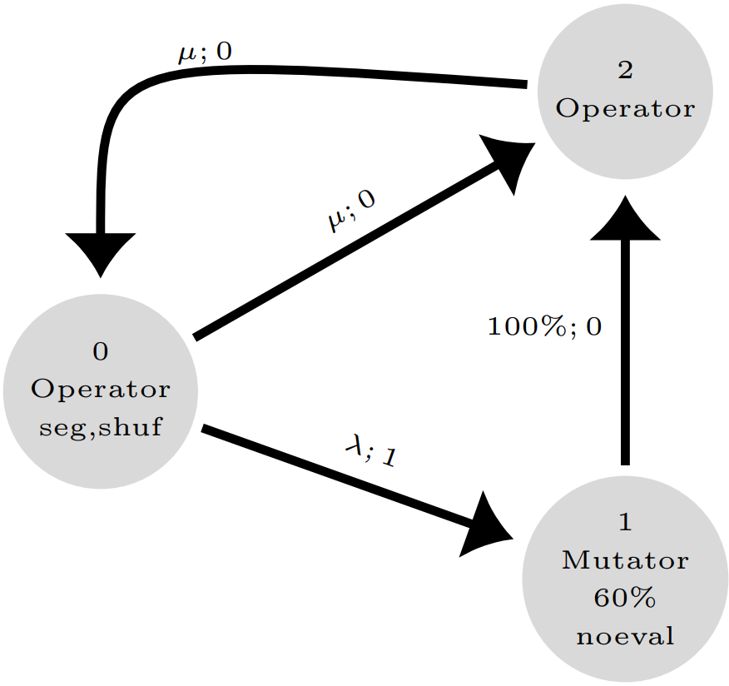

$$\left(μ+λ\right)$$
Initialization
Selection
Reproduction

Slide 7
0 | 1 | 2
Notes:
Linear vector of vertices
Edges involved – imagine you’re at vertex 1

Slide 8
$$\left(μ+λ\right)$$
A
B
in
A+B
|in|>|out|
|in|<|out|
parent selection
survival selection
adults
recomb.
out
X+Y+Z
X
Z
Y

Slide 9


$$\left(μ,λ\right)$$
$$\left(μ+λ\right)$$
 | !seg | seg
!shuf | eval(kids) eval(uneval’d inputs) sort(inputs+kids) | eval(kids) eval(uneval’d inputs) sort(inputs)+sort(kids)
shuf | shuffle(inputs+kids) | shuffle(inputs)+ shuffle(kids)
cull
X; 1
X+Y+Z
Z; 2
Y; 0

Slide 10


0 | 1 | 2 | 3
$$α∈\left(0.1, 0.9\right)$$
$$α=0.5$$
0 | 1
3 | 4 | 5
0 | 1 | 2 | 3 | 4
0 | 1 | 2 | 3 | 4 | 5

Slide 11
Mutation
Ridiculous list of self-adaptive parameters
  Min/max edge weight
  Probabilities for each of the vertex flags
  Graph’s density
  Tons of parameters used in the mutation process
Add/remove vertices/edges
Add/remove vertex flags
Change edge weights, order
Change vertex primitives

Slide 12
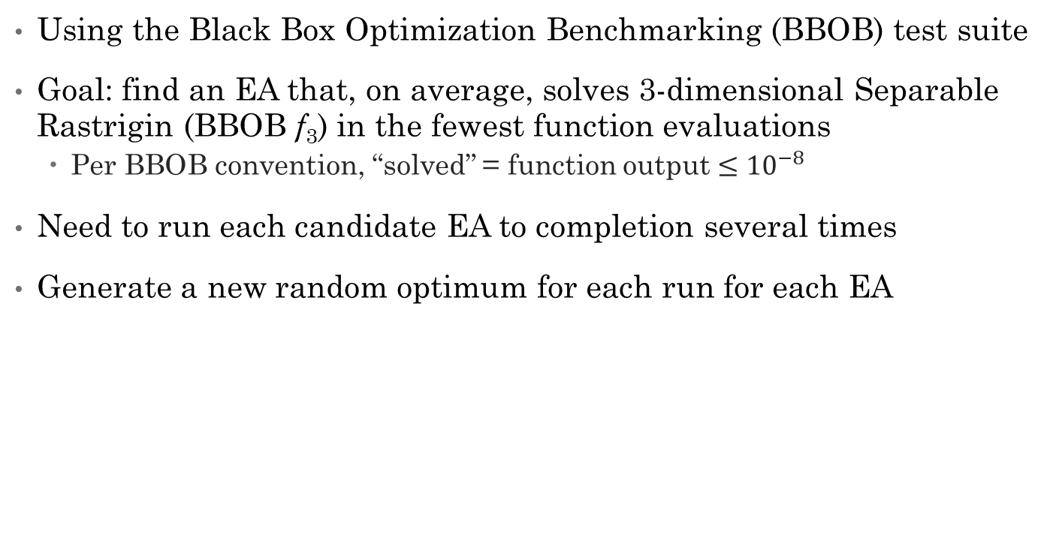
Tuning for Separable Rastrigin
Using the Black Box Optimization Benchmarking (BBOB) test suite
Goal: find an EA that, on average, solves 3-dimensional Separable Rastrigin (BBOB f₃) in the fewest function evaluations
  Per BBOB convention, “solved” = function output $≤{10}^{−8}$
Need to run each candidate EA to completion several times
Generate a new random optimum for each run for each EA

Slide 13
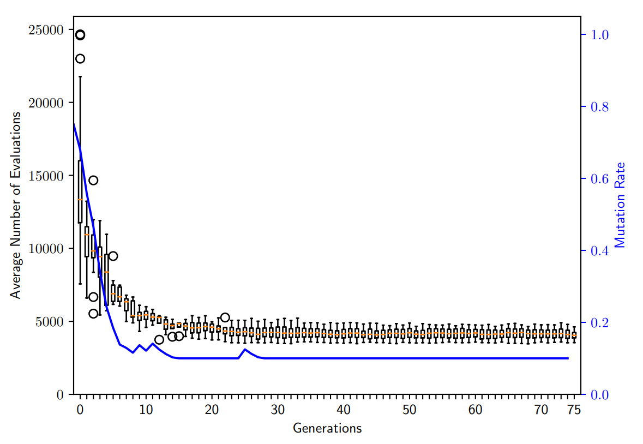
13
5
50

Slide 14
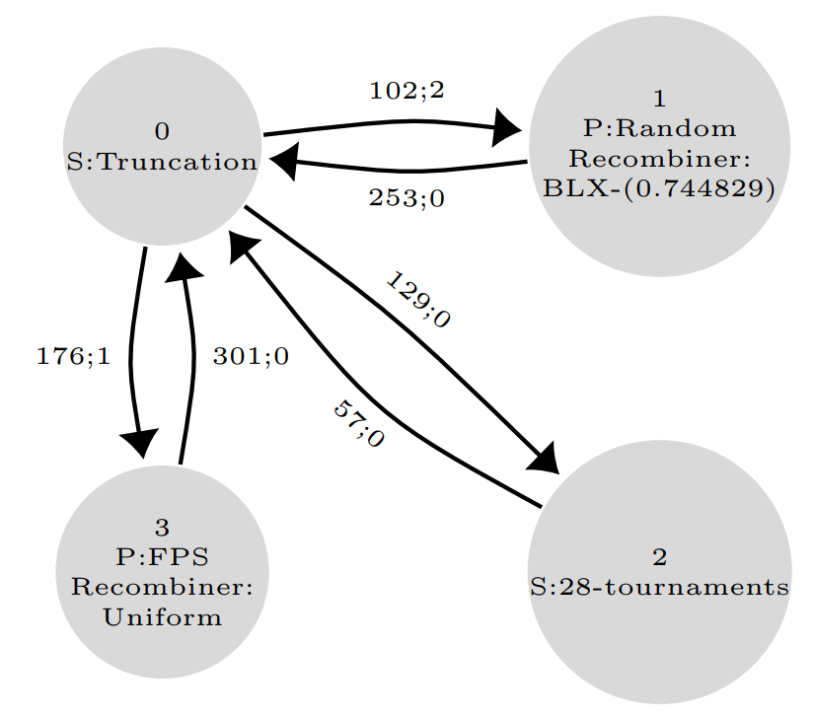

Slide 15
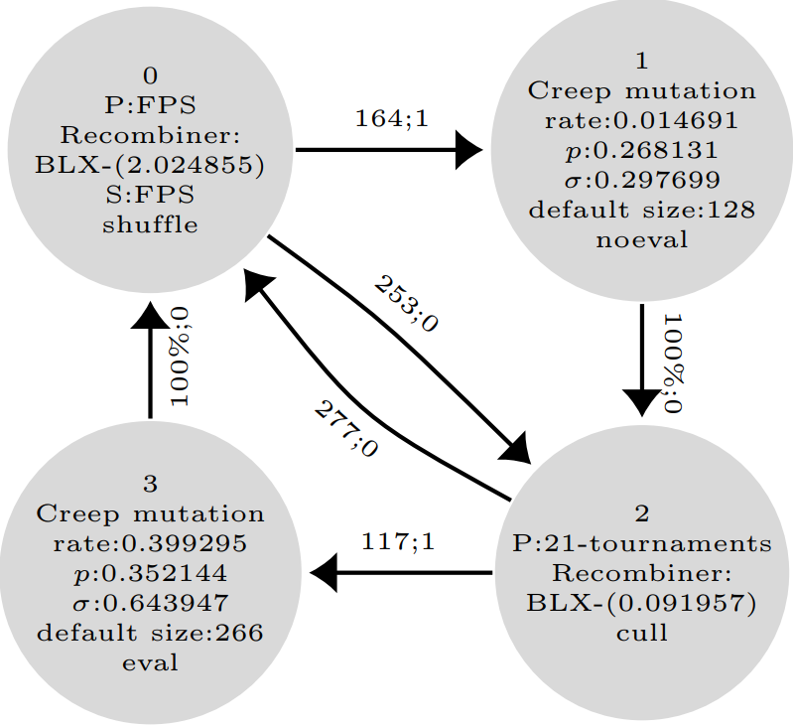

Slide 16
Traditional Optimization
Used irace, a popular and highly-regarded optimization tool
  Ran to completion 10 independent times
  Ran an 11th time using the first 10 runs’ winners as seeds
Comparable amount of processing time as used to evolve the graphs
  ~1,500 CPU hours each!

Slide 17
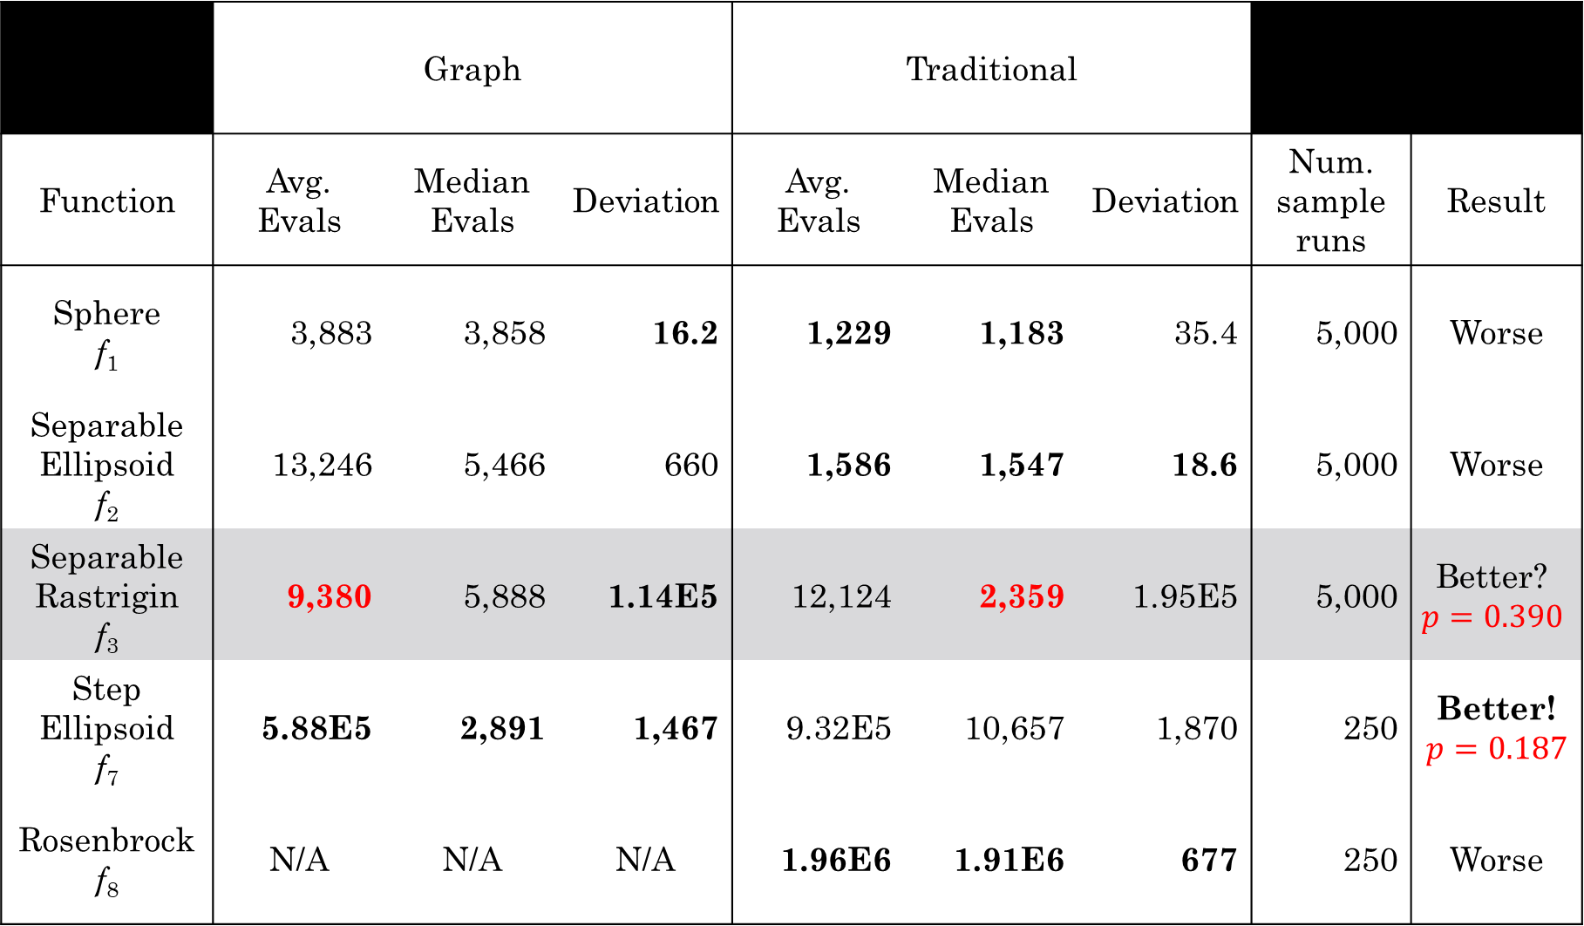
 | Graph |  |  | Traditional
Function | Avg. Evals | Median Evals | Deviation | Avg. Evals | Median Evals | Deviation | Num. sample runs | Result
Sphere f₁ | 3,883 | 3,858 | 16.2 | 1,229 | 1,183 | 35.4 | 5,000 | Worse
Separable Ellipsoid f₂ | 13,246 | 5,466 | 660 | 1,586 | 1,547 | 18.6 | 5,000 | Worse
Separable Rastrigin f₃ | 9,380 | 5,888 | 1.14E5 | 12,124 | 2,359 | 1.95E5 | 5,000 | Better? $$p=0.390$$
Step Ellipsoid f₇ | 5.88E5 | 2,891 | 1,467 | 9.32E5 | 10,657 | 1,870 | 250 | Better! $$p=0.187$$
Rosenbrock f₈ | N/A | N/A | N/A | 1.96E6 | 1.91E6 | 677 | 250 | Worse

Slide 18
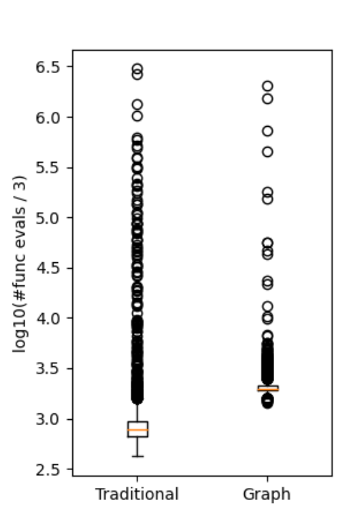
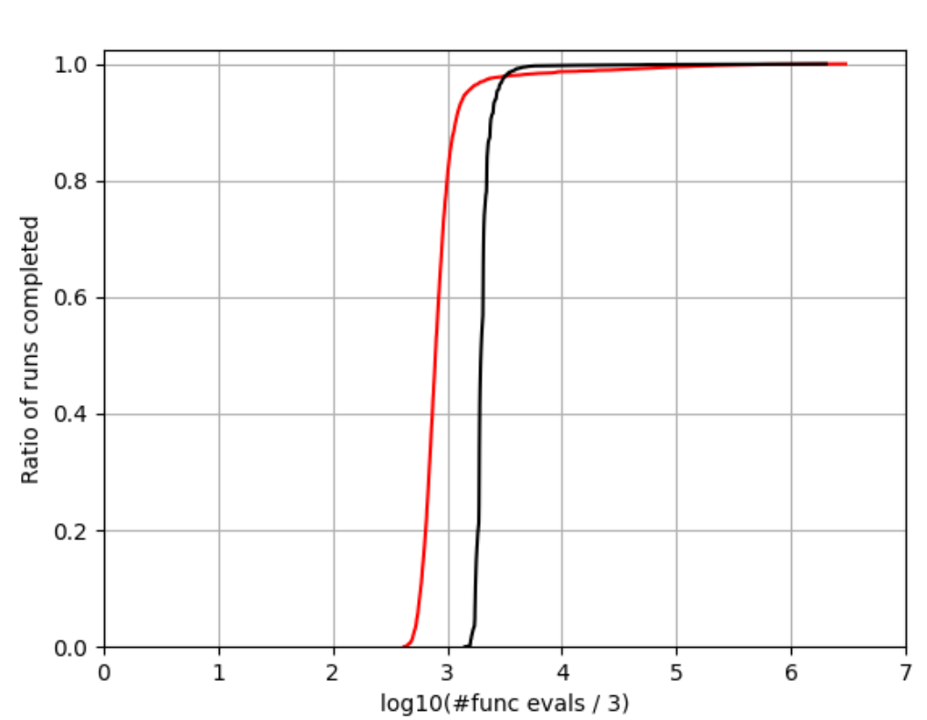
Separable Rastrigin f₃ | 9,380 | 5,888 | 1.14E5 | 12,124 | 2,359 | 1.95E5
Traditional
Graph

Slide 19
 | Graph |  |  | Traditional
Function | Avg. Evals | Median Evals | Deviation | Avg. Evals | Median Evals | Deviation | Num. sample runs | Result
Sphere f₁ | 3,883 | 3,858 | 16.2 | 1,229 | 1,183 | 35.4 | 5,000 | Worse
Separable Ellipsoid f₂ | 13,246 | 5,466 | 660 | 1,586 | 1,547 | 18.6 | 5,000 | Worse
Separable Rastrigin f₃ | 9,380 | 5,888 | 1.14E5 | 12,124 | 2,359 | 1.95E5 | 5,000 | Better? $$p=0.390$$
Step Ellipsoid f₇ | 5.88E5 | 2,891 | 1,467 | 9.32E5 | 10,657 | 1,870 | 250 | Better! $$p=0.187$$
Rosenbrock f₈ | N/A | N/A | N/A | 1.96E6 | 1.91E6 | 677 | 250 | Worse

Slide 20
Conclusions
EAs with a freeform structure
  MUCH larger search space
  Minimal human bias
Generates high-performance EAs
  (Arguably) surpassed irace in our experiment
Potential for insights into EA dynamics

Slide 21
Future Work
Evolutionary process needs work
  Mutation did very poorly
  Now mutation is treated as a form of reproduction
    Utilize existing flags to handle standard in-place mutation vs copying mutation
    Ability to represent wider range of EAs
    Increases problems with genetic drift and introns
Possibility to remove some constraints
  All vertices require input(s) and output(s)
  Graph is strongly connected
Change objective function to obtain better distribution
  i.e., not simply the average
  Built-in tolerance for outliers?

Slide 22
Questions?
Feel free to contact me!
braden@auburn.edu
This work was supported by Los Alamos National Laboratory via the Cyber Security Sciences Institute under subcontract 570204

