Slide 1
Common 1b Mistakes
Braden Tisdale

Slide 2
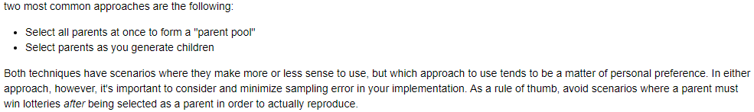
Parent Selection
parents = self.parent_selection(self.population,…)
for i in range(self.num_children):
p1 = random.sample(parents)
p2 = random.sample(parents)
parents = self.parent_selection(self.population,
n=2*self.num_children…)
for i in range(0, len(parents), 2):
p1 = parents[i]
p2 = parents[i+1]
for i in range(self.num_children):
parents = self.parent_selection(self.population, n=2…)
p1 = parents[0]
p2 = parents[1]

Slide 3
Evaluations
1 evaluation = getting fitness of 1 solution
1 evaluation = 1 call of basic_simulation()
Exact same definition as in 1a
Random search’s evaluation = EA’s evaluation = any BBSA’s evaluation
Same number of solutions no matter the algorithm
Perform exactly 1 evaluation per solution generated
  (For assignment series 1)

Slide 4
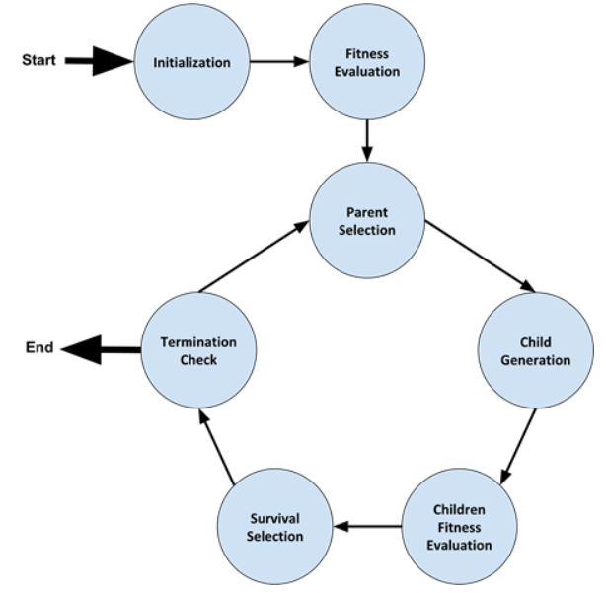
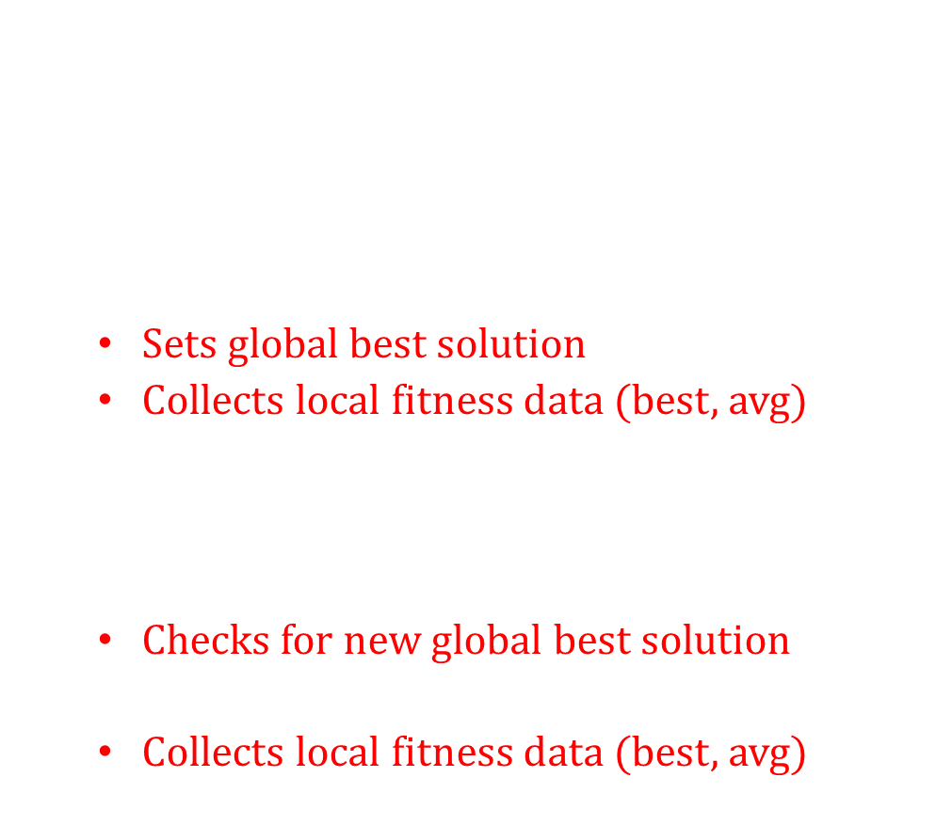
Generations
A generation:
  Is not an evaluation
  Includes $≥$ 1 evaluation(s)
The first generation:
  Creates & evaluates $μ$ solutions
  Sets global best solution
  Collects local fitness data (best, avg)
All other generations:
  Selects parents
  Creates & evaluates $λ$ solutions (children)
  Checks for new global best solution
  Selects $μ$ survivors
  Collects local fitness data (best, avg)

Slide 5

Generations
An EA needs a loop
for _ in range(number_evaluations):
while evals_so_far < eval_limit:
Approx. formula for number of generations
$$\left\lceil \frac{N−μ}{λ}\right\rceil +1$$

Slide 6

5000 evaluations
$μ$ = 4955
First step in an EA: make $μ$ solutions
How are these $μ$ solutions made?
Randomly, not evolved
No evolution in the first $μ$ evaluations
How many solutions will be evolved?
5000 – 4955 = 45
>99% random solutions
<1% evolved solutions
Almost identical to random search

Slide 7

Bigger $μ⇒$ less evolution
Should $μ$ be minimized?
NO
$μ$ affects:
population stability
premature convergence
number of unique alleles
etc, etc, etc
No “correct” value
No easy answer to tuning

Slide 8
parent_selection = k_tournament_with_replacement
k = 1
Describe a 1-tournament
Uniform random
Zero selective pressure

Slide 9

Impacts of parameters are predictable (to an extent)
Humans are not black-box search algorithms
Understand, then optimize
The ability to reason about the effects of parameters like $μ$ and k should be one of the key things every student learns in this course

Slide 10


DATA LOGGING
Best solution:
13.12, 9.32
32.54, -8.21
120.32, 12.93
…
Example for $μ=4955 \& λ=10$
Eval Local/current average Local/current best
Run 1
4955 3239811.45321 18000000
4965 3242134.59581 18000000
4975 3245134.13258 19000000
4985 3248483.94381 19000000
4995 3251943.34782 21000000
5005 3253912.12304 20000000
Run 2
4955 3489510.12394 11000000
4965 3492149.59321 13000000
…
Best global fitness
For stats:
20000000
15000000
32000000
…
For stats:
22000000
15000000
32000000
…
$$≤$$
Local
Global

Slide 11
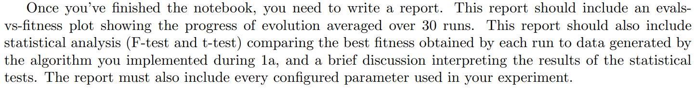
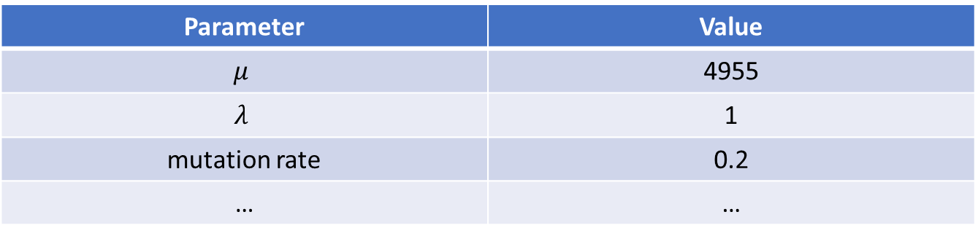
“The config used for this experiment can be found in configs/my_experiment.txt”
OR:
“The parameters used for this experiment were: $μ$ = 4955, $λ$= 1, mutation rate = 0.2…”
OR:
Parameter | Value
$$μ$$ | 4955
$$λ$$ | 1
mutation rate | 0.2
… | …

Slide 12
You will be penalized for any unfixed issues with any code that gets reused in later assignments. You have to fix everything in .py files based on our feedback.
You should not wait for feedback on each assignment before starting the next one. Grading these assignments is incredibly time-consuming and even with 4 TAs we cannot get feedback to you quickly enough for that.
You don’t need your old code to be fixed until you start actually collecting data.

Slide 13
Reinventing the Wheel & Bad Practices
https://docs.python.org/3/library/random.html
https://docs.python.org/3/howto/sorting.html
best_fitness = max(fitnesses)
for contestant in contestants:
if contestant.fitness == best_fitness:
winners.append(contestant)
winner = sorted(contestants, key=lambda x:x.fitness, reverse=True)[0]
winner = max(contestants, key=lambda x:x.fitness)
“a in b” depends on what b is – try to carefully consider your data structures

