Slide 1

Assignment 1c Overview
Deacon Seals
Sea of Invalidity

Slide 2
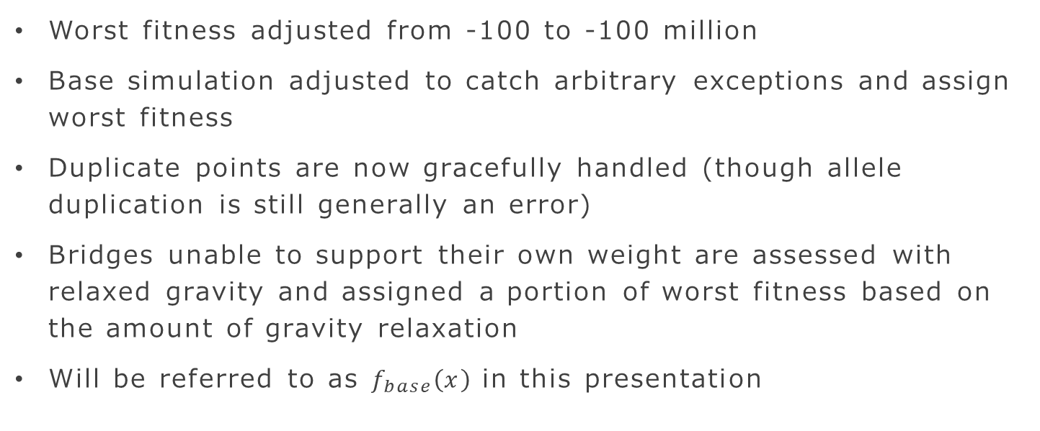
Base Fitness Function Modifications
Worst fitness adjusted from -100 to -100 million
Base simulation adjusted to catch arbitrary exceptions and assign worst fitness
Duplicate points are now gracefully handled (though allele duplication is still generally an error)
Bridges unable to support their own weight are assessed with relaxed gravity and assigned a portion of worst fitness based on the amount of gravity relaxation
Will be referred to as $f_{base}\left(x\right)$ in this presentation

Slide 3
Constraint Satisfaction

Slide 4

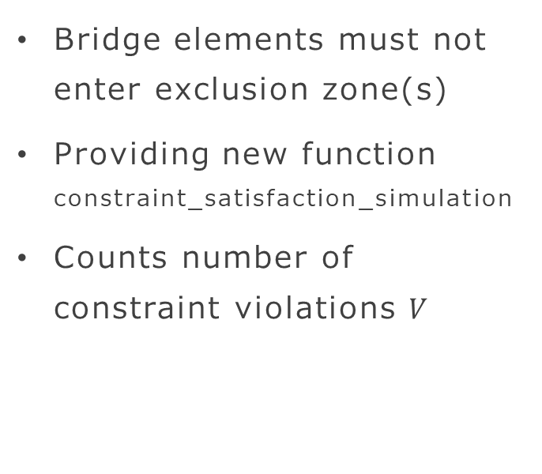
Bridge Master Constraint
Bridge elements must not enter exclusion zone(s)
Providing new function constraint_satisfaction_simulation
Counts number of constraint violations $V$
Exclusion Zone

Slide 5
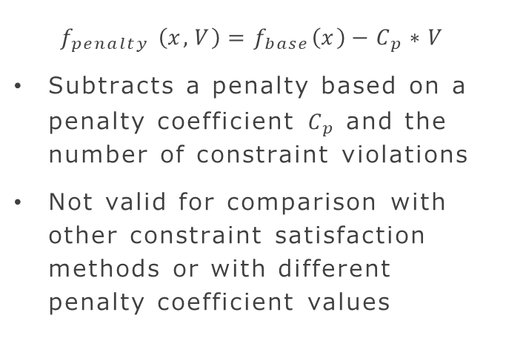
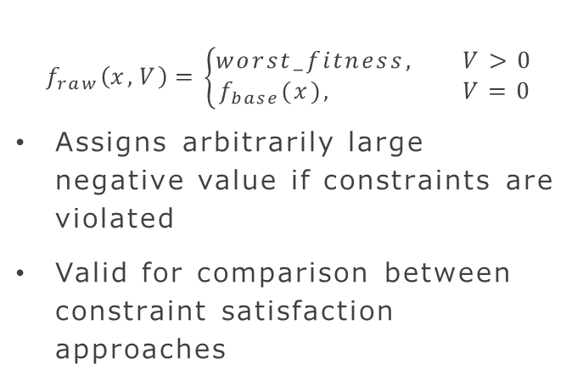
New Definitions of Fitness
Raw fitness
Penalized Fitness
$$f_{raw}\left(x, V\right)=\left\{\begin{aligned}worst_fitness, V>0 \\ &f_{base}(x), V=0\end{aligned}\right.$$
Assigns arbitrarily large negative value if constraints are violated
Valid for comparison between constraint satisfaction approaches
$$f_{penalty} \left(x, V\right)=f_{base}\left(x\right)−C_{p}∗V$$
Subtracts a penalty based on a penalty coefficient $C_{p}$ and the number of constraint violations
Not valid for comparison with other constraint satisfaction methods or with different penalty coefficient values

Slide 6
Constraint Satisfaction Methods
Ignore constraints
Penalty Function
Use raw fitness for evolution and logging
Use penalized fitness for evolution
Use raw fitness for logging

Slide 7
Perform statistical analysis with raw fitness only!

Slide 8
Multi-objective
(No direct relation to constraint satisfaction)

Slide 9
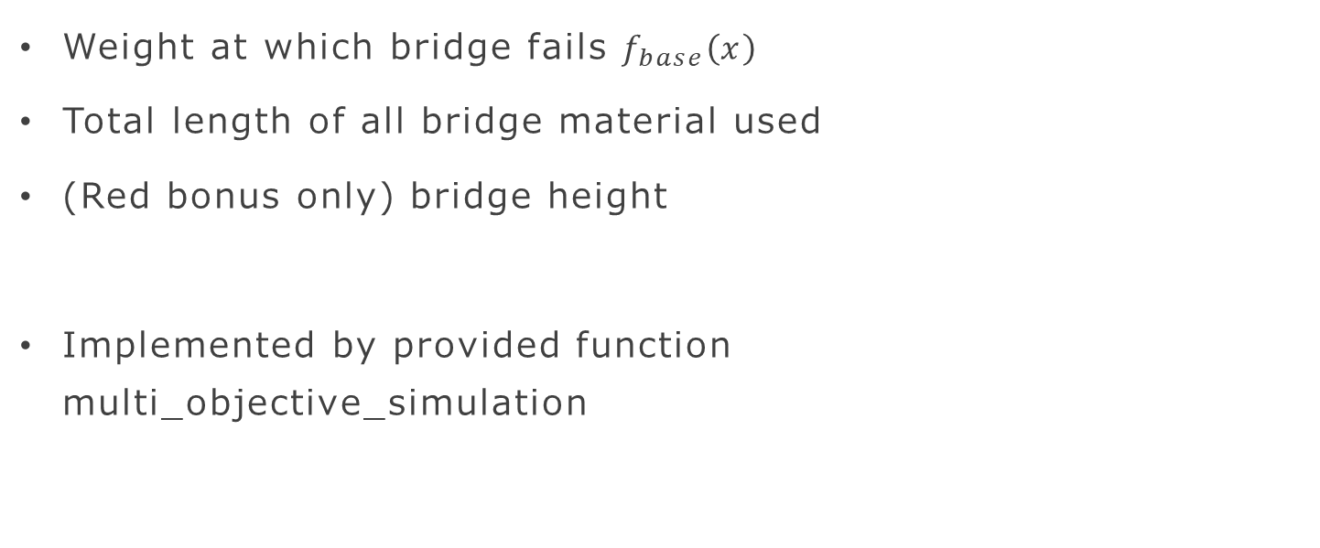
Objectives
Weight at which bridge fails $f_{base}\left(x\right)$
Total length of all bridge material used
(Red bonus only) bridge height
Implemented by provided function
multi_objective_simulation

Slide 10
Multi-objective Analysis
Typically, non-trivial
Green is single-experiment and asks for subjective analysis of the best non-domination front discovered (method for determining best in assignment description doc)
Yellow adds an extra experiment and asks for comparison of per-run best non-domination fronts based on a diversity metric of your choice (diversity w.r.t. objectives)

Slide 11
Bonuses
Be careful not to deprecate or overwrite green or yellow deliverables

Slide 12
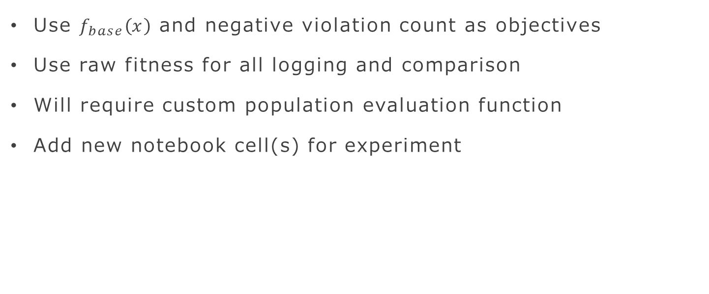
Implement Constraint Satisfaction with an MOEA
Use $f_{base}\left(x\right)$ and negative violation count as objectives
Use raw fitness for all logging and comparison
Will require custom population evaluation function
Add new notebook cell(s) for experiment

Slide 13
Repair Function
Permanently modifying a potential solution so that it is valid
Use raw fitness for evolution and logging
Add new notebook cell(s) for experiment
Maintain similarity to the original genotype as much as possible
Biased repair functions can exacerbate premature convergence on local optima

Slide 14
Add Height as a 3rd Objective
The mayor of Auburn wants a landmark!
Generate bridge designs considering strength, material required, and height
Add new notebook cell(s) for experiment
Perform informal comparison of results obtained when searching for strength and material required

Slide 15
Hypervolume Metric
Form stair-step plot of best non-domination front
Compute area under front (taking care not to double-count areas or interpolate between points in the non-domination front)
Normalization recommended

