Slide 1
Island Models
And
Competitive Co-Evolution
Deacon Seals

Slide 2
Parallel EA

Slide 3
An EA is “Embarrassingly Parallel”
A family of algorithms that parallelize trivially and scale very well
Fitness evaluations within the same generation are independent
An EA is a stochastic search algorithm typically ran multiple times
Sometimes an individual fitness evaluation has parallelizable components
  But this isn’t an inherent characteristic of the EA

Slide 4
Why make a “parallel EA?”

Slide 5
Parallel EA Goals
Allow distribution of an evolutionary search before multi-core CPUs existed
Inhibit premature convergence through search partitioning
  Slow the propagation of genetic information
  Concurrently explore different parts of the search space
Improve search efficiency
  Find better results with fewer evaluations

Slide 6
Types of Parallel EA
Coarse-Grain Parallel EA
Fine-Grain Parallel EA
Island model EA
Search with multiple isolated populations
Search populations infrequently interact
More on this later
Diffusion model EA
Search with sub-populations distributed about some geometry
Adjacent sub-populations have shared “overlap” individuals
Genetic information slowly diffuses through the population
Diverse demes have greater chance to improve before being dominated

Slide 7
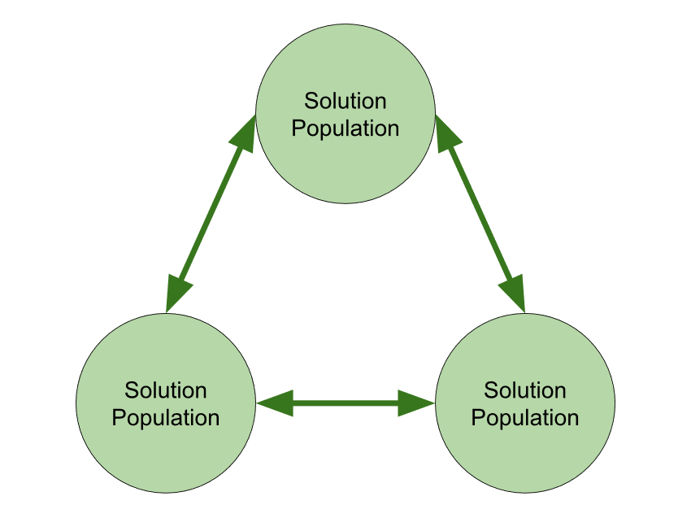
Canonical
Island Model
Multiple populations evolving concurrently
Infrequently migrate individuals from one island to another
  Frequent migrations exacerbate premature convergence
  Too infrequent migration results in diminished improvements to search
  Size of migration isn’t very important
  Migrant selection is important
  Island topology can be impactful as well
  Skolicki, Z., & de Jong, K. (2005). The influence of migration intervals on island models. GECCO 2005 - Genetic and Evolutionary Computation Conference, 1295–1302. https://doi.org/10.1145/1068009.1068219

Slide 8
Island Model Benefits
Improved diversity of global search
Improved search efficiency
  Superlinear speedup in GP
    Andre, D., & Koza, J. R. (1996). Parallel genetic programming: A scalable implementation using the transputer network architecture. In Advances in genetic programming: volume 2 (pp. 317–337).
  Speedup only occurs with appropriately sized populations
    Punch, W. F. . (1998). How Effective are Multiple Populations in Genetic Programming. Genetic Programming, 98, 308–313.

Slide 9
Other Island Model EA
Injection Island Model (1999)
  Eby, D., & Averill, R. (1999). The optimization of flywheels using an injection island genetic algorithm. Evolutionary Design by Computers, 13, 167–190.
Speciating Island Model (2006)
  Gustafson, S., & Burke, E. K. (2006). The Speciating Island Model: An alternative parallel evolutionary algorithm. Journal of Parallel and Distributed Computing, 66(8), 1025–1036. https://doi.org/10.1016/j.jpdc.2006.04.017

Slide 10
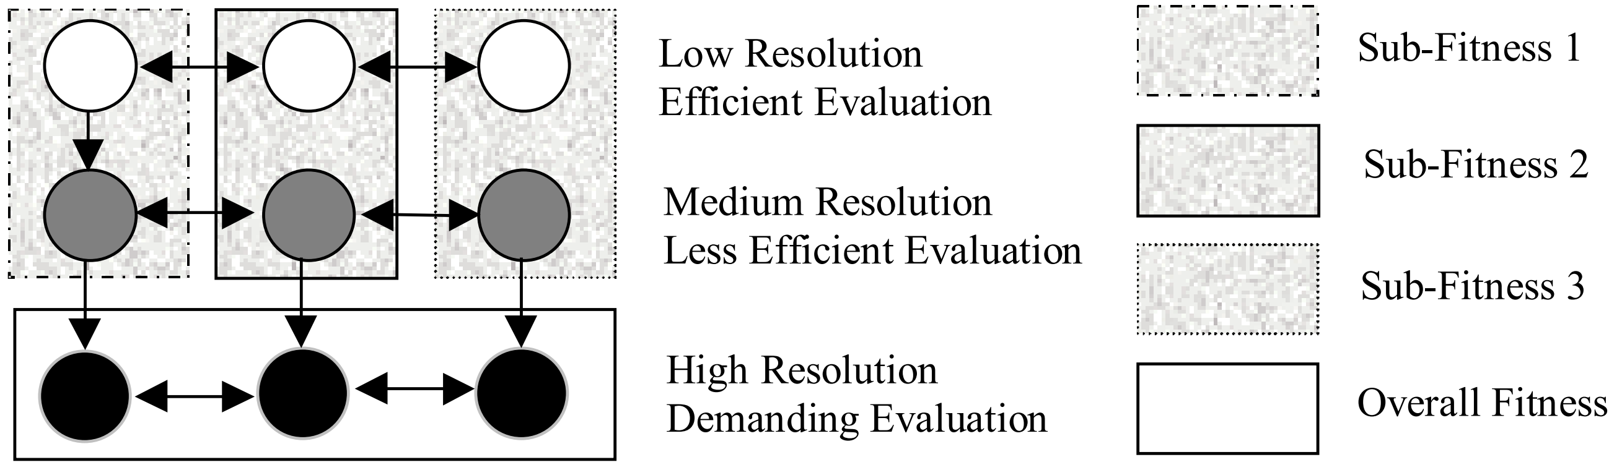
Injection Island Model
Heterogeneous islands of variable fidelity solutions
  Large populations of low-fidelity solutions
  Small populations of high-fidelity solutions
Islands evaluate fitness at different resolutions
  Islands can also evaluate fitness based on sub-problems
Inspired by human design
  Quick iteration on a rough draft before refinement

Slide 11
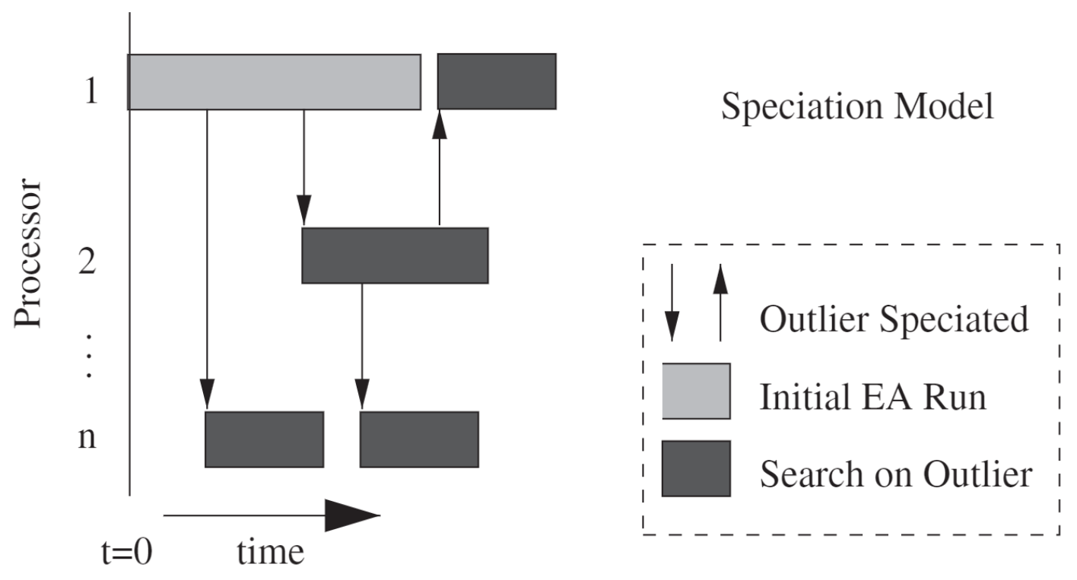
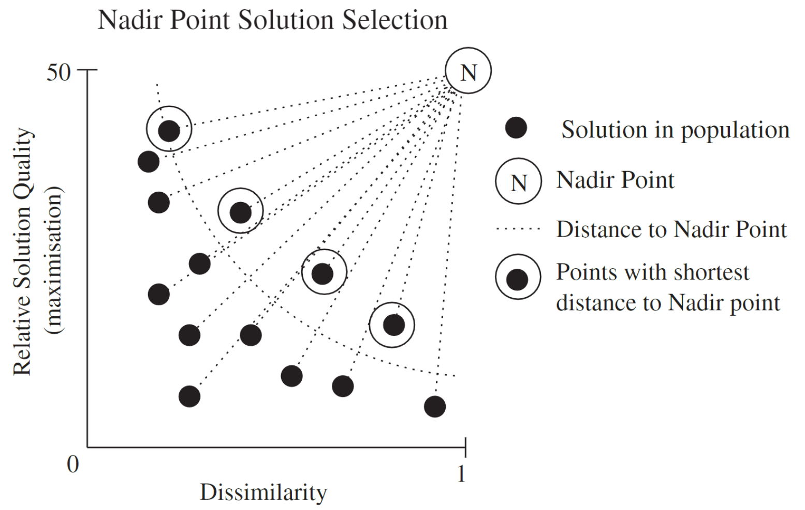
Speciating Island Model
Dynamic island creation
  Identify outlier individual
  Migrate the individual to new island
  Populate island with mutations
  Islands halt on a no improvement criteria
Aims to exploit outlier individuals through speciation

Slide 12
Co-Evolutionary Algorithms
Pause for questions

Slide 13
Co-Evolution In a Nutshell
Parent Selection
Child Generation
Fitness Evaluation
Survival Selection
Termination Check
Parent Selection
Child Generation
Fitness Evaluation
Survival Selection
Termination Check
Fitness Evaluation Interaction

Slide 14
Types of Co-Evolution
Co-operative co-evolution
  Evolving subcomponents of a whole solution
  Ghost and map co-evolution
Competitive co-evolution
  Evolving conflicting solutions with conflicting fitness values
  Test-based co-evolution
    Evolve a harder challenge to encourage refinement of the primary solution of interest
    Pac-Man and map co-evolution
    Hillis, W. D. (1990). Co-evolving parasites improve simulated evolution as an optimization procedure. Physica D: Nonlinear Phenomena, 42(1–3), 228–234. https://doi.org/10.1016/0167-2789(90)90076-2
  Interactive co-evolution
    Evolve solutions that dynamically interact with one another
    Ghost and Pac-Man co-evolution

Slide 15
Interactive Competitive Problems
Often games
Symmetric games
  Players conflict over shared objective(s)
  Players typically have access to the same capabilities
  Can be explored with single-population self-play
Asymmetric games
  Players have distinct notions of success that may conflict indirectly
  Players may have access to different capabilities
  Canonically explored using multiple types of agent (species)

Slide 16
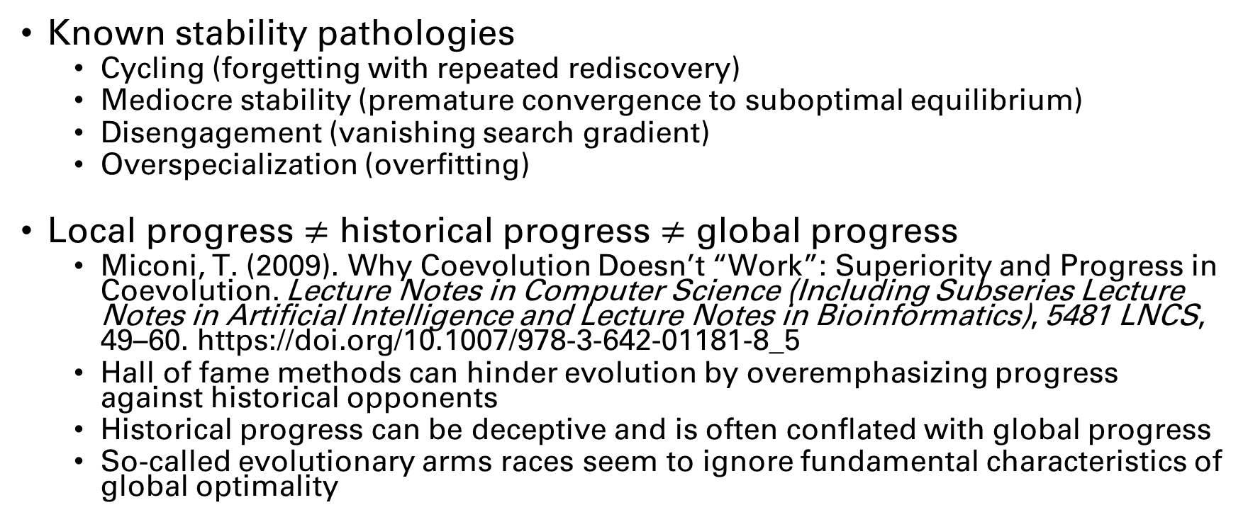
Caveats of Competitive Co-Evolution
Known stability pathologies
  Cycling (forgetting with repeated rediscovery)
  Mediocre stability (premature convergence to suboptimal equilibrium)
  Disengagement (vanishing search gradient)
  Overspecialization (overfitting)
Local progress $≠$ historical progress $≠$ global progress
  Miconi, T. (2009). Why Coevolution Doesn’t “Work”: Superiority and Progress in Coevolution. Lecture Notes in Computer Science (Including Subseries Lecture Notes in Artificial Intelligence and Lecture Notes in Bioinformatics), 5481 LNCS, 49–60. https://doi.org/10.1007/978-3-642-01181-8_5
  Hall of fame methods can hinder evolution by overemphasizing progress against historical opponents
  Historical progress can be deceptive and is often conflated with global progress
  So-called evolutionary arms races seem to ignore fundamental characteristics of global optimality

Slide 17

Competitive Co-Evolution
Problems

Slide 18
More Problems!
Fitness sampling cost
  Required number of fitness evaluations to achieve accurate estimation can grow exponentially with population sizes
  Exacerbated by intransitivity in the problem
  Methods like genetic programming are known to benefit from very large population sizes
    Koza used population sizes in the millions
Asymmetric games can exacerbate disengagement
  Species may have an easier or harder improving/finding a search gradient

Slide 19
Resolving Competitive Co-Evolution Problems
Reduce the number of evaluations required to approximate fitness
  Improve sampling efficiency via Sean’s work
Improve search efficiency with parallel EA
  My work being presented

Slide 20
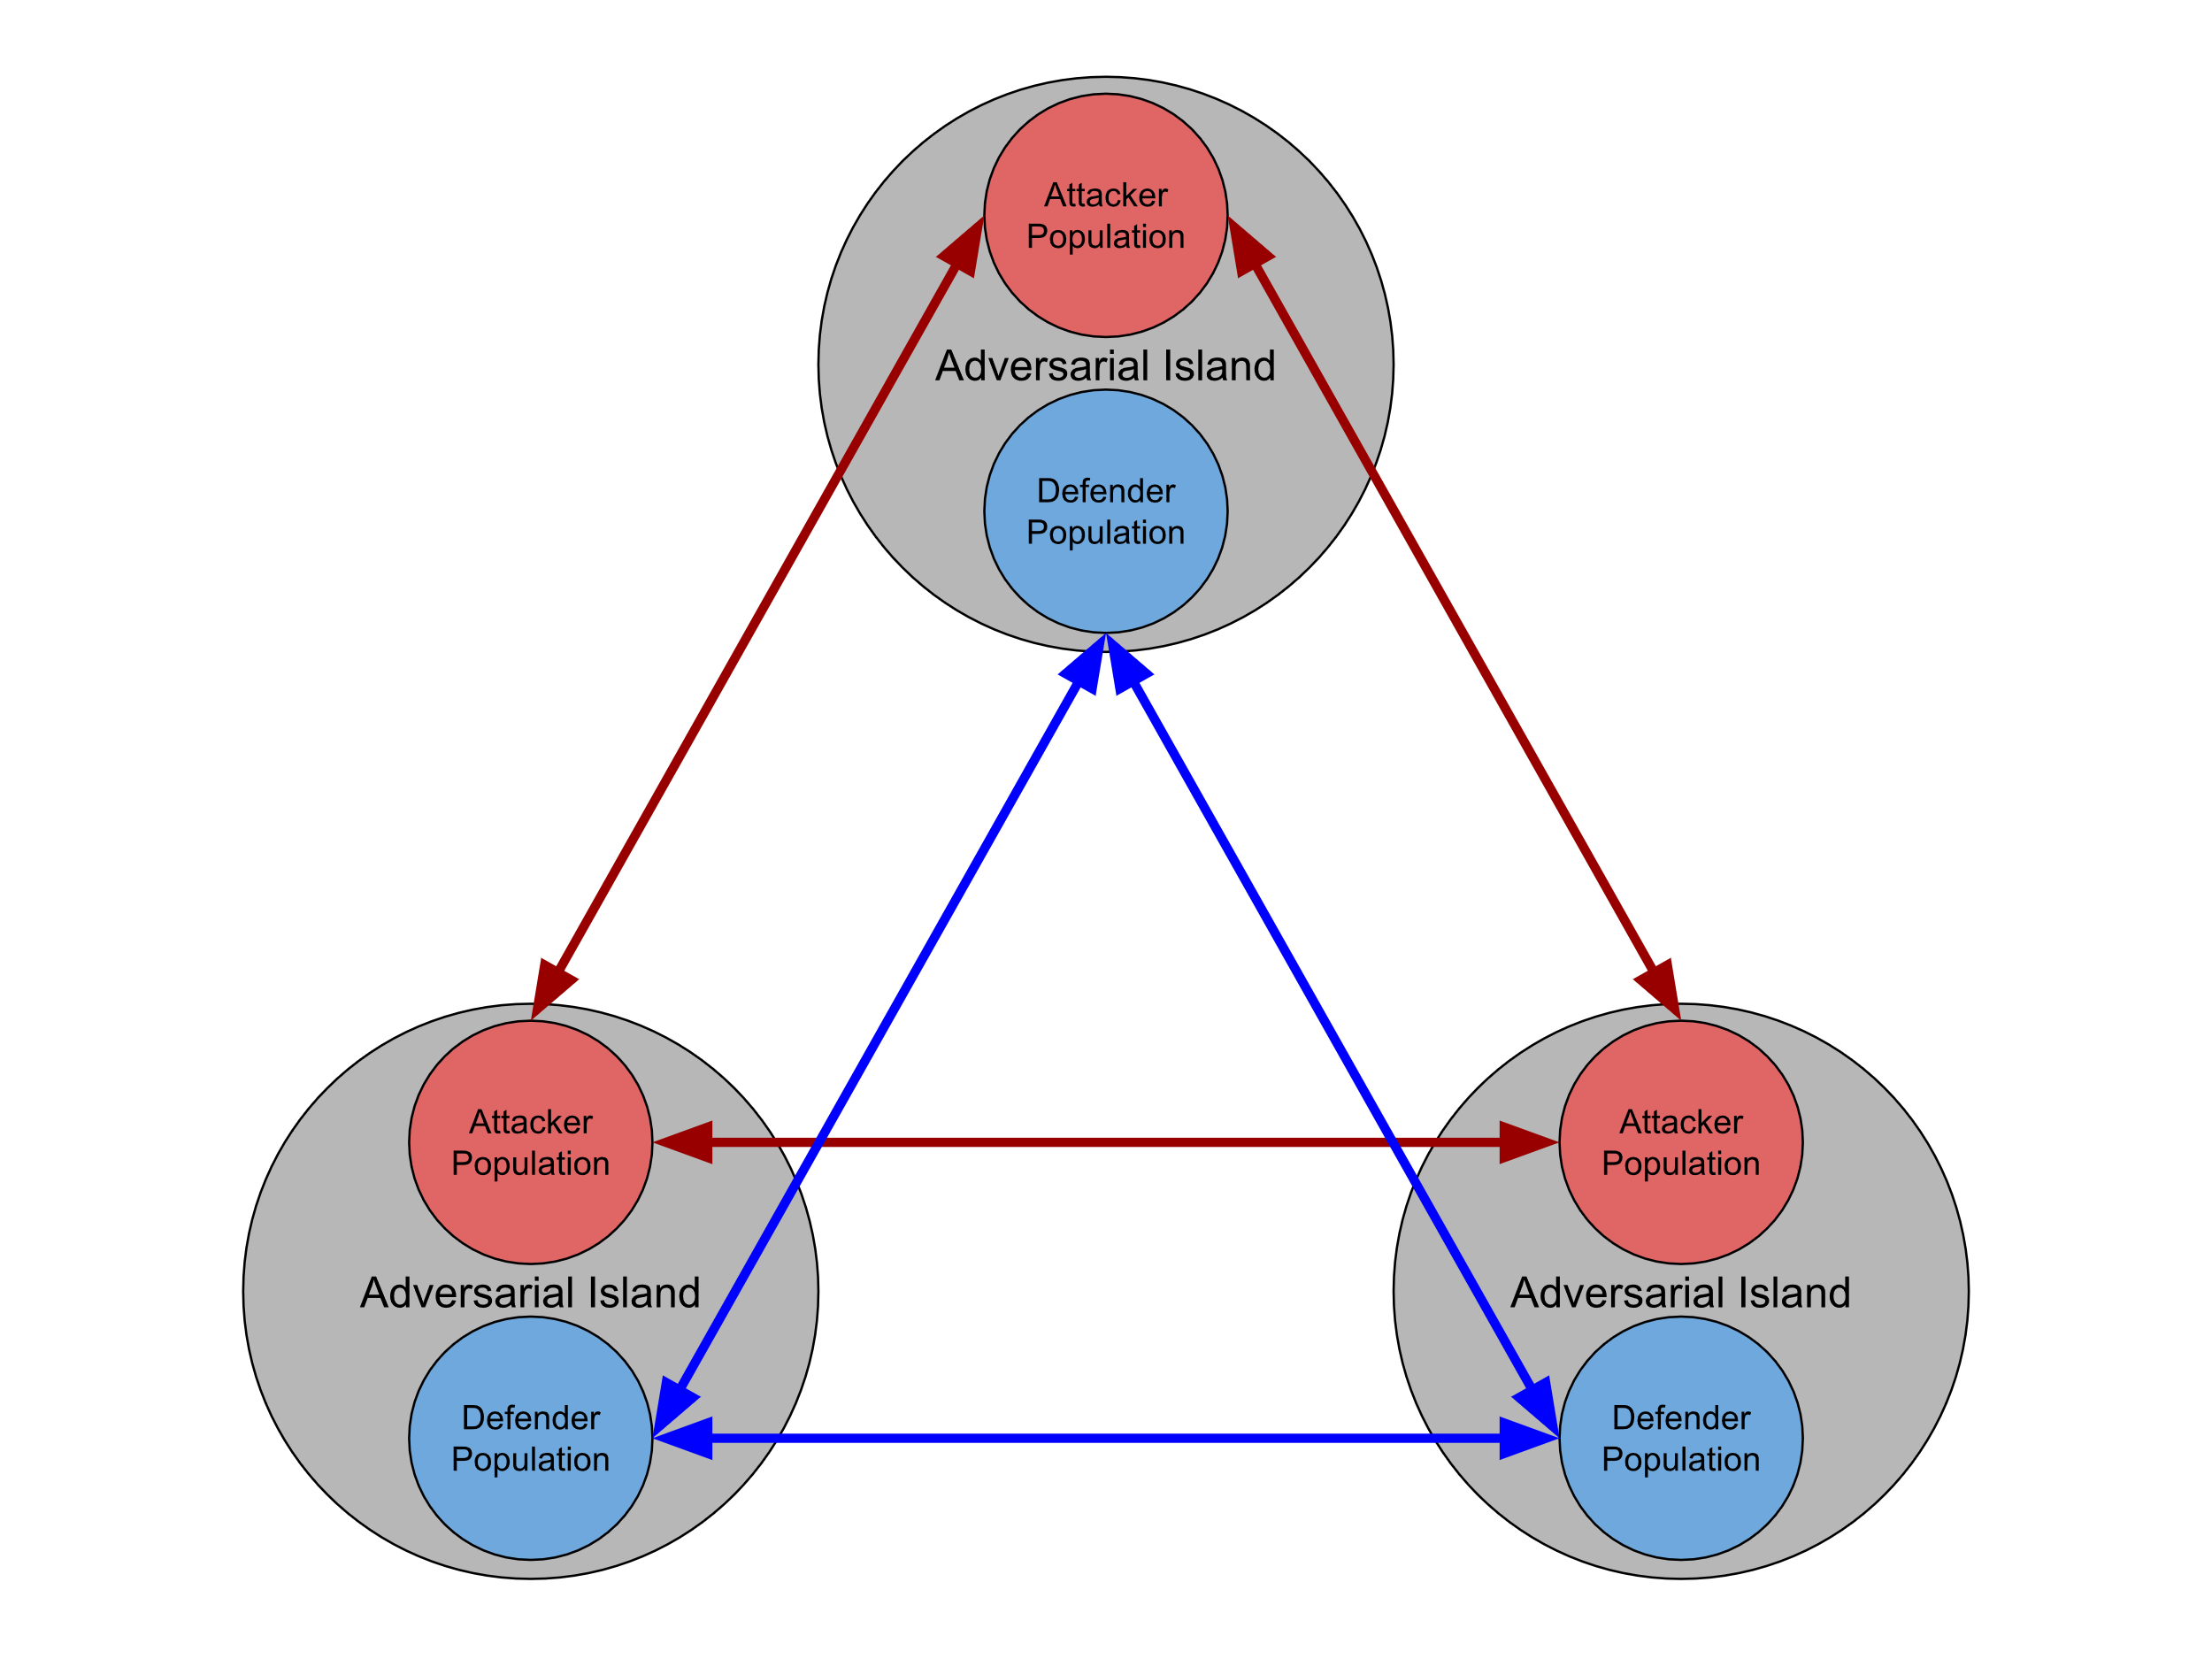
Maelstrom Model
Adversarial islands
  Perform interactive asymmetric co-evolution
  Generate local relative fitness estimates
Migrant selection algorithms use relative local fitness
Duplicates of migrants are sent to prevent loss of progress due to intransitivity
Migrants are re-evaluated against new local populations
  Migrants take the place of children that would have been produced that generation

Slide 21
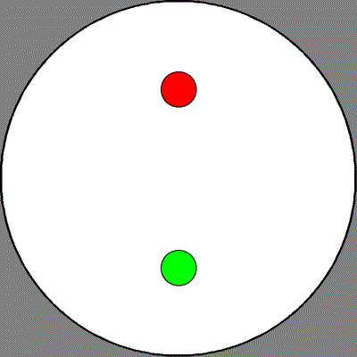
Predator Prey
Predators (red) aims to capture the prey (green) as fast as possible
Prey wants to survive as long as possible
Distance moved is based on static speed parameter
  Prey is faster than predator
Controllers return the angle (direction) to move
  Strong-type genetic programming trees
Implementation graciously provided by Sean Harris

Slide 22
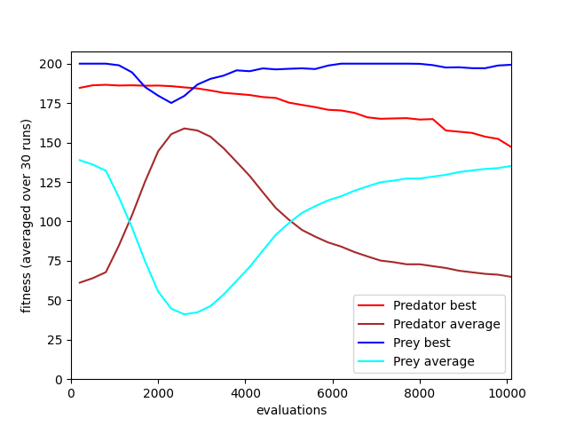
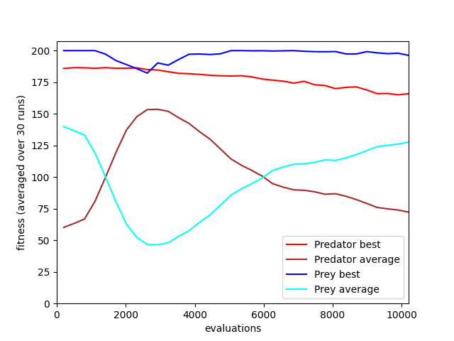
Relative Fitness Results (2019)
Traditional
Maelstrom (Random Migrants)

Slide 23
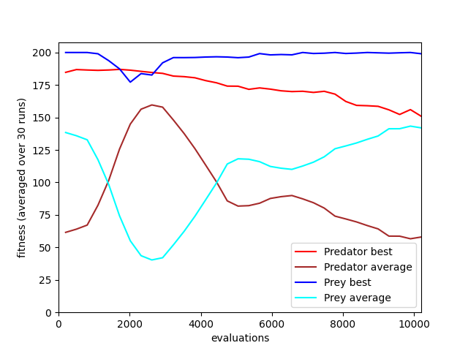
Relative Fitness Results (2019)
Traditional
Maelstrom (Best Migrants)

Slide 24
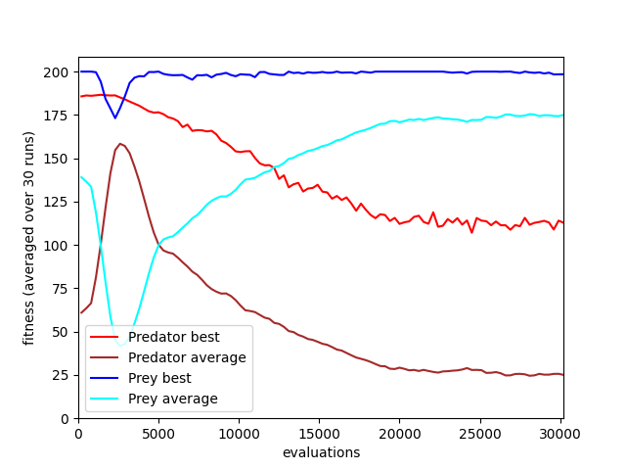
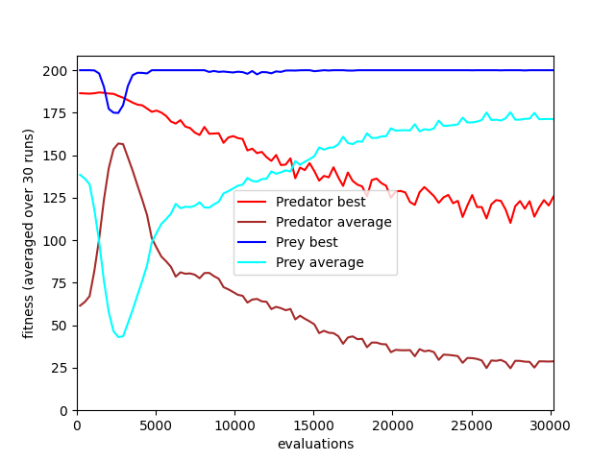
Relative Fitness Results (2019)
Traditional
Maelstrom (Best Migrants)

Slide 25
Maelstrom Findings (2019)
Results are inconclusive due to disengagement
  Some indication that Maelstrom accelerated instability
Discovered large gaps in literature relating to methods for comparing competitive co-evolutionary algorithms
  This impacted the ability to compare results and tune

Slide 26
Analyzing competitive co-evolutionary Algorithms
Competition against a static baseline
  Baseline may be an out-of-distribution strategy not generated during evolution (not inherently bad)
  Global quality of baseline may be unknown
Measure stability of evolution in terms of historical progress then compare individuals from final generation
  CIAO (current individual verses ancestral opponent) plots or Master Tournament Matrix
  Invalidated by ~2009 findings that historical progress can be deceptive and should not be conflated with global progress

Slide 27

Analyzing competitive co-evolutionary Algorithms
$α$-rank (2019) may be a promising technique
  May be able to operate with partial information
  Decent for determining the single best agent
  Results are winner-takes-all and little information is gleamed about non-first place agents
Round-robin competition with the best individuals from each algorithm
  Unclear how to identify best individuals prior to competition
  Competition prohibitively expensive $O\left(n^{2}\right)$
  Mean and median fitness values can be deceptive

Slide 28
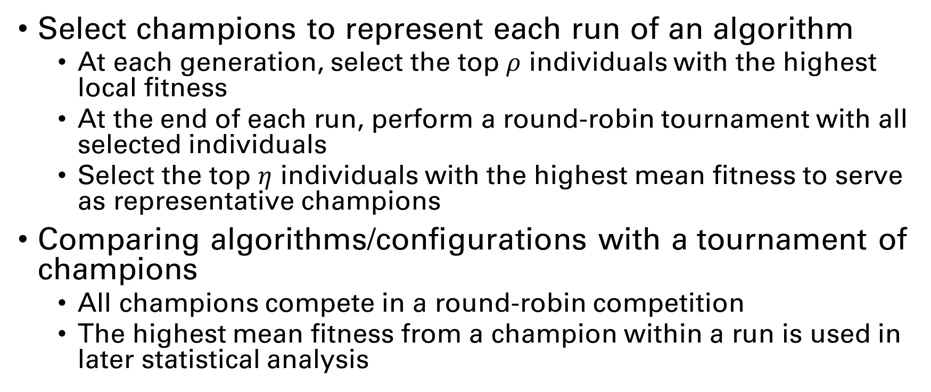
Comparative Analysis via Global Fitness Estimation (Spring 2022)
Select champions to represent each run of an algorithm
  At each generation, select the top $ρ$ individuals with the highest local fitness
  At the end of each run, perform a round-robin tournament with all selected individuals
  Select the top $η$ individuals with the highest mean fitness to serve as representative champions
Comparing algorithms/configurations with a tournament of champions
  All champions compete in a round-robin competition
  The highest mean fitness from a champion within a run is used in later statistical analysis

Slide 29
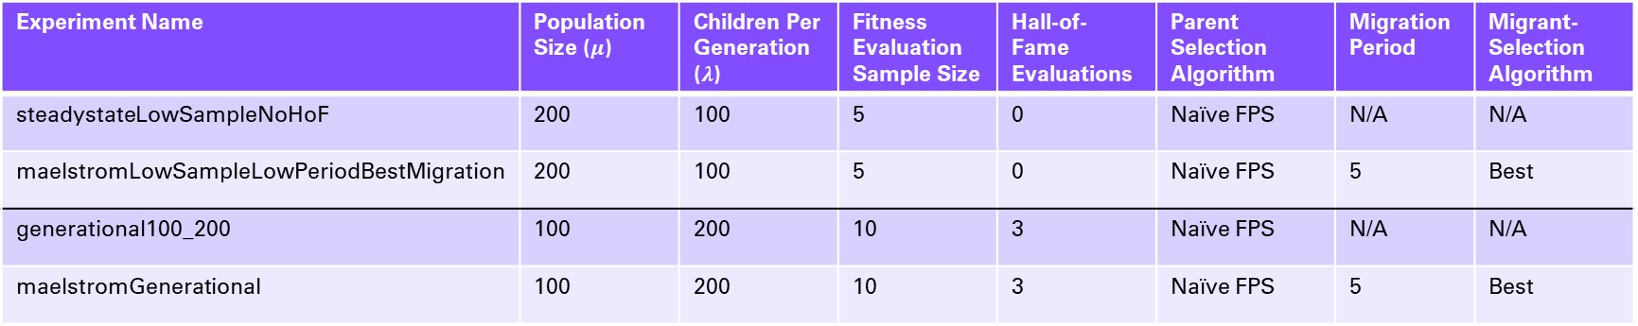
Spring 2022 Experiment Parameters
Experiment Name | Population Size ($μ$) | Children Per Generation ($λ$) | Fitness Evaluation Sample Size | Hall-of-Fame Evaluations | Parent Selection Algorithm | Migration Period | Migrant-Selection Algorithm
steadystateLowSampleNoHoF | 200 | 100 | 5 | 0 | Naïve FPS | N/A | N/A
maelstromLowSampleLowPeriodBestMigration | 200 | 100 | 5 | 0 | Naïve FPS | 5 | Best
generational100_200 | 100 | 200 | 10 | 3 | Naïve FPS | N/A | N/A
maelstromGenerational | 100 | 200 | 10 | 3 | Naïve FPS | 5 | Best
All algorithms use truncation for survival selection and have a 5% chance of producing a child via mutation instead of recombination.

Slide 30
Spring 2022 Experiment Results
Experiment Name | Predator Mean | Predator Std. Dev. | Prey Mean | Prey Std. Dev.
steadystateLowSampleNoHoF | 148.67 | 18.66 | 78.44 | 35.98
maelstromLowSampleLowPeriodBestMigration | 160.21 | 6.81 | 93.04 | 21.55
generational100_200 | 149.2 | 22.28 | 81.88 | 23.8
maelstromGenerational | 152.82 | 13.0 | 87.23 | 22.42
We have not yet conducted the necessary tests to determine if these results are statistically significant.

Slide 31
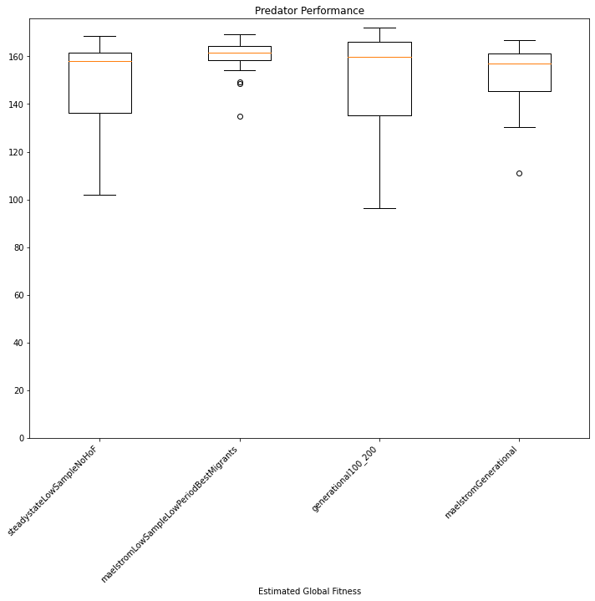

Slide 32
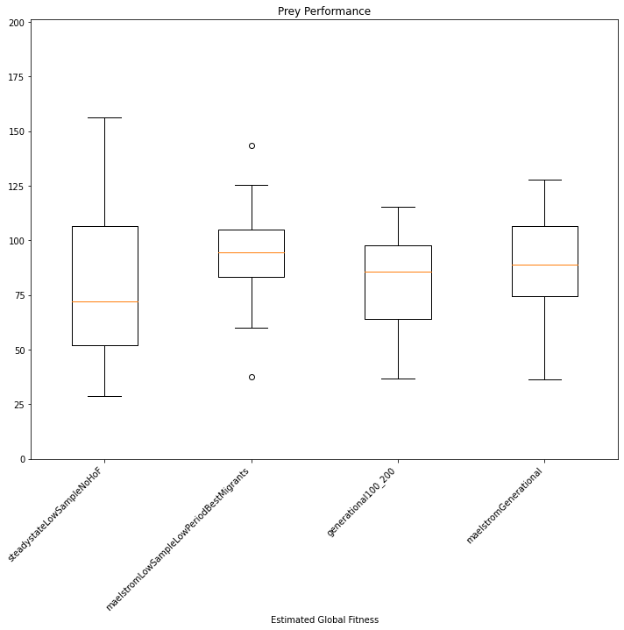

Slide 33
Open Questions (things that keep me up at night)
Are control problems suitable for automated design algorithms?
  State-of-the-art methods in complex discrete and continuous competitive and non-competitive control problems are almost all deep reinforcement learning algorithms
  Many contemporary competitive co-evolution publications have adopted neuroevolution techniques instead of automated design techniques like GP
  Empirical research has shown that GP can outperform neural networks for some low-complexity problems, but Deep RL outperforms on complex tasks by a very large margin

Slide 34
Open Questions (things that keep me up at night)
How do we hybridize evolutionary and deep learning techniques for competitive problems?
  Gupta, A., Savarese, S., Ganguli, S., & Fei-Fei, L. (2021). Embodied Intelligence via Learning and Evolution. Nature Communications, 12(1). https://arxiv.org/abs/2102.02202v1
    Demonstrated a potent combination of evolutionary body design with deep RL control
  Miikkulainen, R., Francon, O., Meyerson, E., Qiu, X., Sargent, D., Canzani, E., & Hodjat, B. (2021). From Prediction to Prescription: Evolutionary Optimization of Nonpharmaceutical Interventions in the COVID-19 Pandemic. IEEE Transactions on Evolutionary Computation, 25(2), 386–401. https://doi.org/10.1109/TEVC.2021.3063217
    Demonstrated a surrogate neuroevolution model that outperformed both pure EC and pure deep RL techniques
  Yet to see applications on a competitive problem

Slide 35
Miscellaneous Additional Publications
Multi-population (island model) single species co-evolution with comparison of GP and neuroevolution
  Togelius, J., Burrow, P., & Lucas, S. M. (2007). Multi-population competitive co-evolution of car racing controllers. 2007 IEEE Congress on Evolutionary Computation, CEC 2007, 4043–4050. https://doi.org/10.1109/CEC.2007.4424998
Stable competitive co-evolution with clustering-based opponent selection and alternating population freezing
  Simione, L., & Nolfi, S. (2018). Achieving long-term progress in competitive co-evolution. 2017 IEEE Symposium Series on Computational Intelligence, SSCI 2017 - Proceedings, 2018-January, 1–8. https://doi.org/10.1109/SSCI.2017.8280898
  Skirts the analysis problem by “observing behavioral complexification?”

Slide 36
Insights Since These Works
Competitive co-evolution needs compelling analysis techniques!
  Convincingly improving algorithm performance is otherwise very difficult
GP needs a revolution (to perform well on control tasks)
  Neuroevolution methods like CMA-ES and, more recently, MAP-Elites have demonstrated the ability to outperform deep learning methods on some control tasks
  GP may have something to offer in terms of solution interpretability (if emphasized in the implementation)

Slide 37
Closing remarks
Island models seem to have yet-discovered contributions to provide
Competitive co-evolution has a lot of open problems
  Aside: some of these problems are also shared with population-based and multi-agent reinforcement learning
Neuroevolution methods seem to have a lot to offer
  GP methods may perform well enough and provide interpretable solutions

Slide 38
Questions?

Slide 39
Generation 0

Slide 40
Generation 1

Slide 41
Generation 2

Slide 42
Generation 3

Slide 43
Generation 4

Slide 44
Generation 5

Slide 45
Generation 6

Slide 46
Generation 7

Slide 47
Generation 8

Slide 48
Generation 9

Slide 49
Generation 10

Slide 50
Questions?

