Slide 1
Population Models and Selection Algorithms
Presenter: Deacon Seals
Based on slides by Dr. Daniel Tauritz

Slide 2
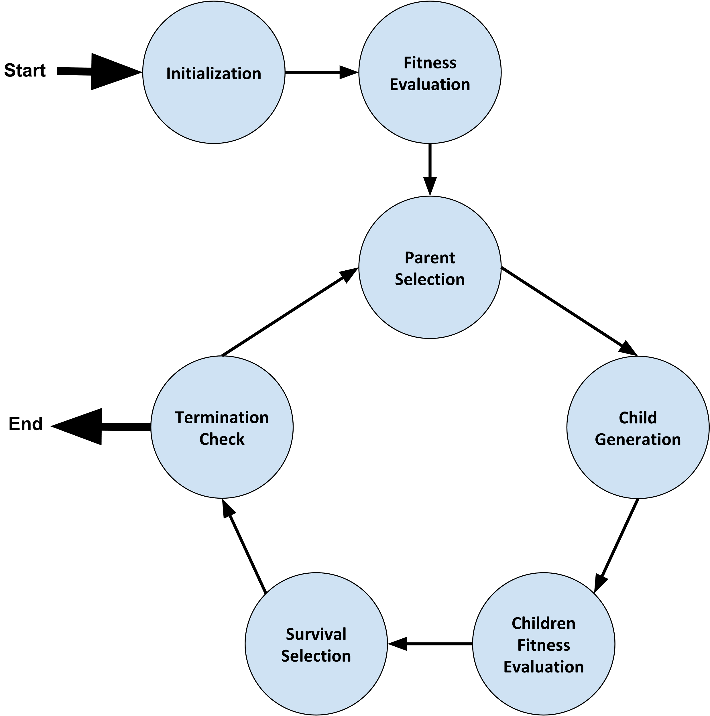
General Population Model Parameters
Population size (µ)
Offspring pool size (λ)
Mating pool size
  Optional
  Alternative is to select enough parents to make 1 or 2 children and repeat until you have λ children

Slide 3
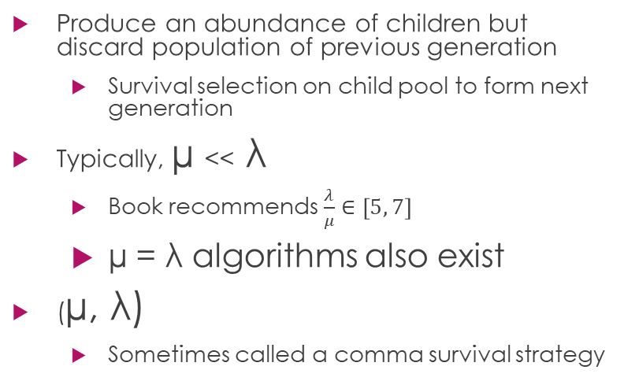
Historical Population Models
Generational Model
Steady State Model
Produce an abundance of children but discard population of previous generation
  Survival selection on child pool to form next generation
Typically, µ << λ
  Book recommends $\frac{λ}{μ}∈\left[5, 7\right]$
  µ = λ algorithms also exist
(µ, λ)
  Sometimes called a comma survival strategy
Combine population with child pool
  Survival selection on cumulative population to form next generation
Typically, µ > λ
  µ < λ can work well if there is a high probability to create malformed children
(µ + λ)
  Sometimes called a plus survival strategy

Slide 4
Parent Selection
Random
Fitness based
  Fitness Proportional Selection (FPS)
  Rank-Based Selection
  Tournament Selection
Genotypic/phenotypic based
  Select similar parents
  Select maximally different parents
  Consider novel phenotypic characteristics

Slide 5
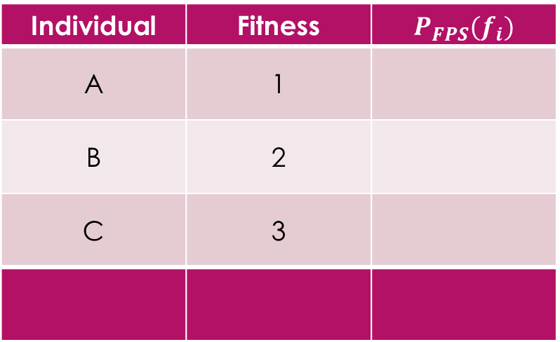

Fitness Proportional Selection
$P_{FPS}\left(f_{i}\right)=\frac{f_{i}}{\sum_{k=0}^{n}{f_{k}}}$
  Where $f_{i}$ is the fitness of an individual in a population of size $n$
Individual | Fitness | $$P_{FPS}(f_{i})$$
A | 1
B | 2
C | 3

Slide 6
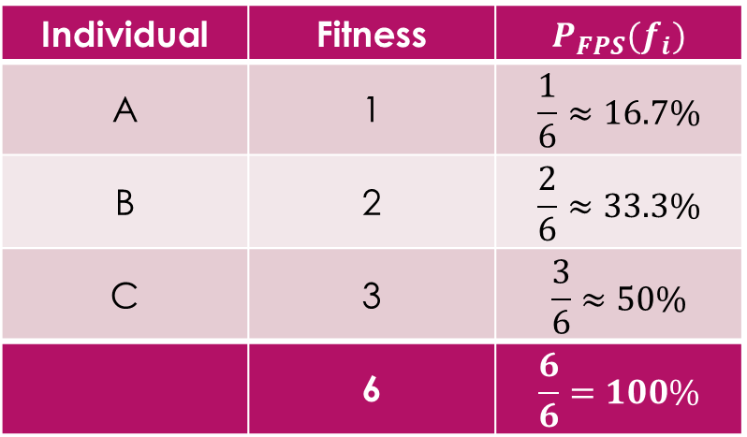
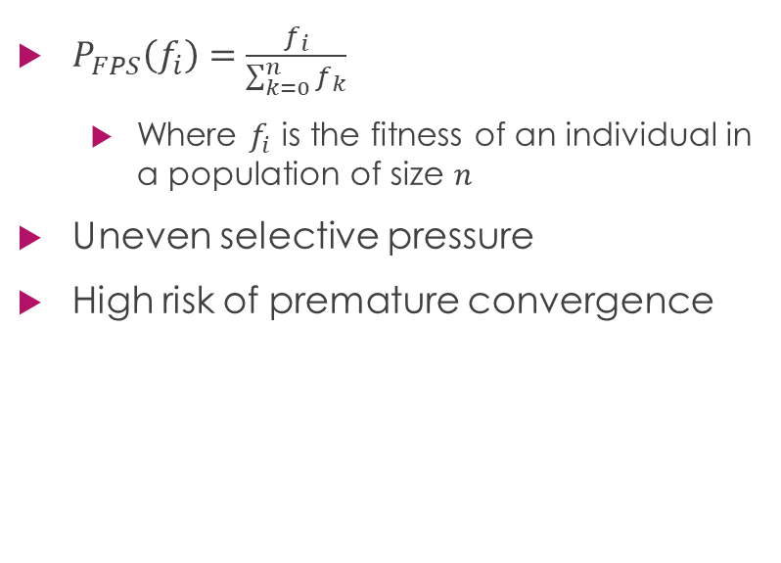
Fitness Proportional Selection
$P_{FPS}\left(f_{i}\right)=\frac{f_{i}}{\sum_{k=0}^{n}{f_{k}}}$
  Where $f_{i}$ is the fitness of an individual in a population of size $n$
Uneven selective pressure
High risk of premature convergence
Individual | Fitness | $$P_{FPS}(f_{i})$$
A | 1 | $$\frac{1}{6}≈16.7\%$$
B | 2 | $$\frac{2}{6}≈33.3\%$$
C | 3 | $$\frac{3}{6}≈50\%$$
 | 6 | $$\frac{6}{6}=100\%$$

Slide 7
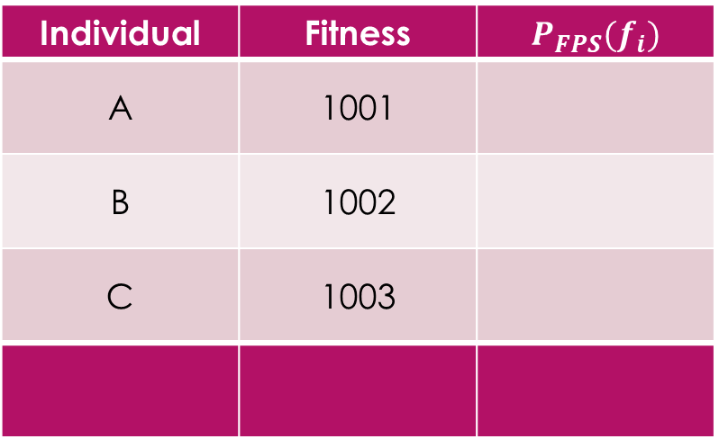
Fitness Proportional Selection
$P_{FPS}\left(f_{i}\right)=\frac{f_{i}}{\sum_{k=0}^{n}{f_{k}}}$
  Where $f_{i}$ is the fitness of an individual in a population of size $n$
Uneven selective pressure
High risk of premature convergence
Individual | Fitness | $$P_{FPS}(f_{i})$$
A | 1001
B | 1002
C | 1003

Slide 8
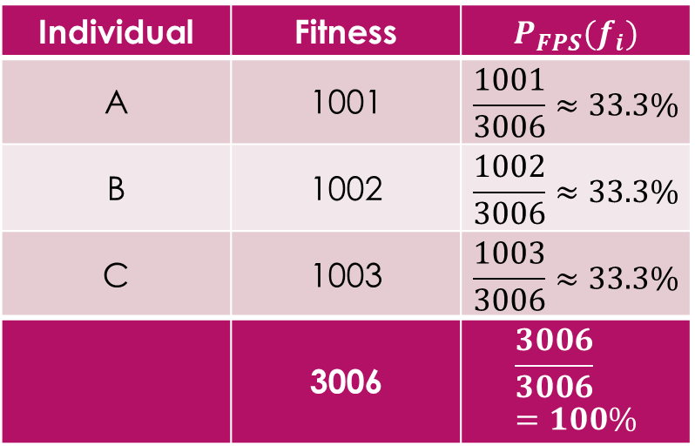
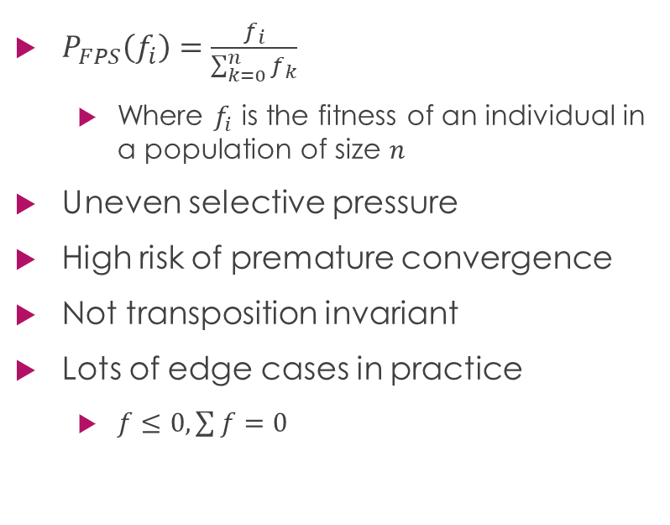
Fitness Proportional Selection
$P_{FPS}\left(f_{i}\right)=\frac{f_{i}}{\sum_{k=0}^{n}{f_{k}}}$
  Where $f_{i}$ is the fitness of an individual in a population of size $n$
Uneven selective pressure
High risk of premature convergence
Not transposition invariant
Lots of edge cases in practice
  $f≤0, \sum{f}=0$
Individual | Fitness | $$P_{FPS}(f_{i})$$
A | 1001 | $$\frac{1001}{3006}≈33.3\%$$
B | 1002 | $$\frac{1002}{3006}≈33.3\%$$
C | 1003 | $$\frac{1003}{3006}≈33.3\%$$
 | 3006 | $$\frac{3006}{3006}=100\%$$

Slide 9
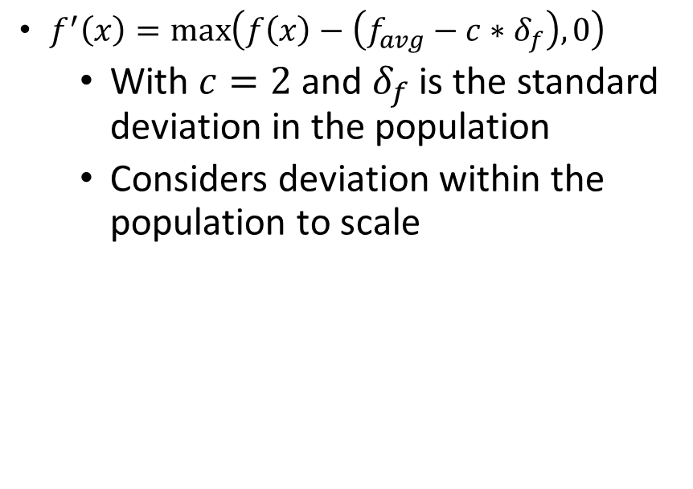
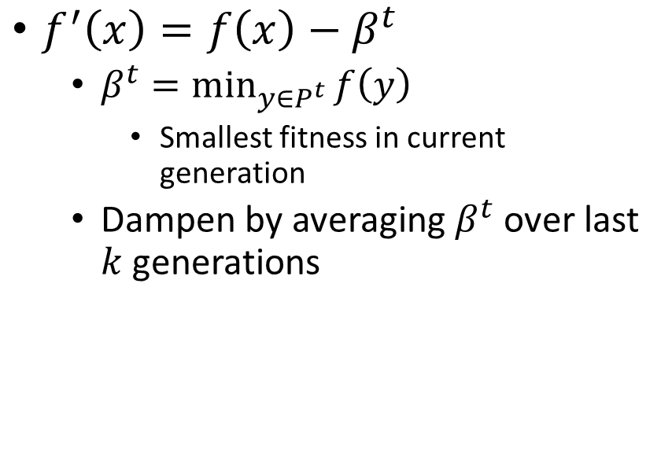
FPS++
Windowing
Goldberg’s Sigma Scaling
$f^{′}\left(x\right)=f\left(x\right)−β^{t}$
  $β^{t}=\min_{y∈P^{t}}{f\left(y\right)}$
    Smallest fitness in current generation
  Dampen by averaging $β^{t}$ over last $k$ generations
$f^{′}\left(x\right)=\max\left(f\left(x\right)−\left(f_{avg}−c∗δ_{f}\right), 0\right)$
  With $c=2$ and $δ_{f}$ is the standard deviation in the population
  Considers deviation within the population to scale

Slide 10

Rank-Based Selection
Map function
  Map rank to some selection probability
  Similar to Simulated Annealing cooling schedule
    More flexible during high temperature
    Probability to select lower-rank individual higher when “temperature” is high
Fitness | Rank
2.3 | 3
1.4 | 0
1.8 | 1
42.0 | 4
2.0 | 2

Slide 11
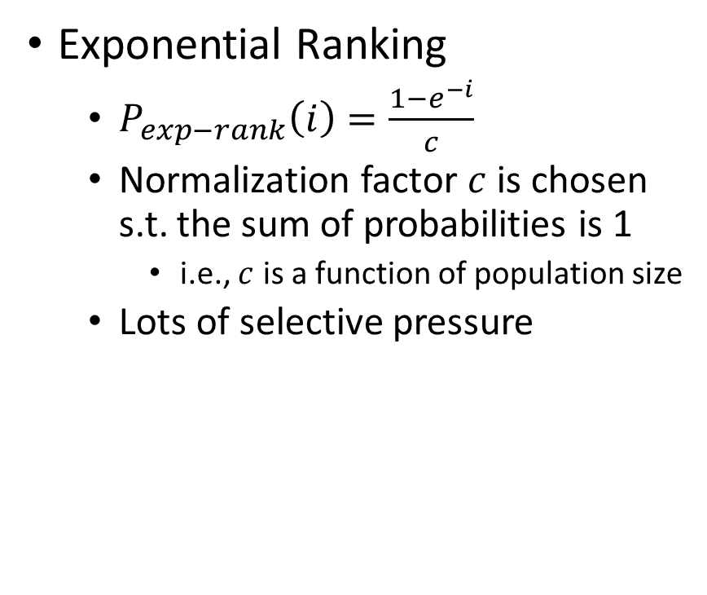
Rank-Based Selection
Exponential Ranking
  $P_{exp−rank}\left(i\right)=\frac{1−e^{−i}}{c}$
  Normalization factor $c$ is chosen s.t. the sum of probabilities is 1
    i.e., $c$ is a function of population size
  Lots of selective pressure
Fitness | Rank
2.3 | 3
1.4 | 0
1.8 | 1
42.0 | 4
2.0 | 2

Slide 12
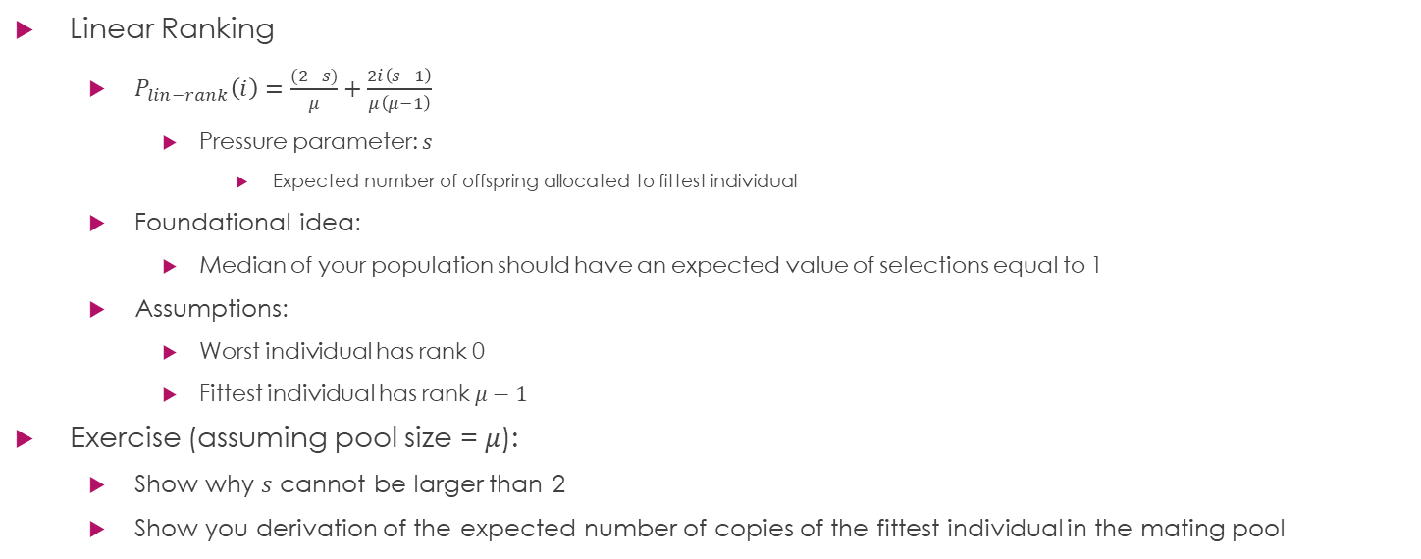
Rank-Based Selection
Linear Ranking
  $P_{lin−rank}\left(i\right)=\frac{(2−s)}{μ}+\frac{2i\left(s−1\right)}{μ\left(μ−1\right)}$
    Pressure parameter: $s$
      Expected number of offspring allocated to fittest individual
  Foundational idea:
    Median of your population should have an expected value of selections equal to 1
  Assumptions:
    Worst individual has rank 0
    Fittest individual has rank $μ−1$
Exercise (assuming pool size = $μ$):
  Show why $s$ cannot be larger than 2
  Show you derivation of the expected number of copies of the fittest individual in the mating pool

Slide 13

Sampling Methods
Roulette Wheel
Stochastic Universal Sampling (SUS)
Approximate selection distribution
  Each section of the roulette wheel is sized based on selection distribution
Repeated selection exacerbates sampling error in approximation
Roulette wheel with $n$ arms
Select everyone at once to reduce sampling error

Slide 14
Rank-Based Sampling Methods
Tournament Selection
  Sample participants for a tournament and then select the most fit
    Book uses alternate (arguably incorrect) definition of replacement to indicate if a participant can be repeatedly selected while forming a tournament
    Useful for scenarios with imprecise fitness differences
  K-Tournament with replacement
    Tournament winner is placed back into the population to compete again
    Appropriate for parent selection
  K-Tournament without replacement
    Tournament winner is removed from population (and placed into a winner's pool)
    Appropriate for survival selection
    Enforces k-1 elitism

Slide 15
Survival Selection
Fitness based
  Truncation
Elitism
  K-elitism
  Can be used to augment other selection algorithms
Age based
  Probability of survival decreases with age

