Slide 1
Advanced Topics: Island Models
And
Competitive CoEvolution
Deacon Seals

Slide 2
Context
Transfer to Auburn in 2019 as member of CEADS-LIN Team
  Co-Evolving Attacker and Defender strategies for Large Infrastructure Networks (using Genetic Programming)
  Currently the Technical Project Lead of this team
Problem:
  Competition between cybersecurity agents occurs in high fidelity
  Real network security scenarios can play out over months
  Evolution isn’t particularly fast (e.g., many generations required)
  Accurate approximation of competitive fitness requires a lot of samples
Goal: address these problems with new coevolution techniques

Slide 3
CoEvolutionary Algorithms

Slide 4
Coevolution In a Nutshell
Parent Selection
Child Generation
Fitness Evaluation
Survival Selection
Termination Check
Parent Selection
Child Generation
Fitness Evaluation
Survival Selection
Termination Check
Fitness Evaluation Interaction

Slide 5
Types of Coevolution
Cooperative coevolution
  Evolving subcomponents of a whole solution
  Ghost and map co-evolution
Competitive coevolution
  Evolving conflicting solutions with conflicting fitness values
  Test-based coevolution
    Evolve a harder challenge to encourage refinement of the primary solution of interest
    Pac-Man and map coevolution
    Hillis, W. D. (1990). Co-evolving parasites improve simulated evolution as an optimization procedure. Physica D: Nonlinear Phenomena, 42(1–3), 228–234. https://doi.org/10.1016/0167-2789(90)90076-2
  Interactive coevolution
    Evolve solutions that dynamically interact with one another
    Ghost and Pac-Man coevolution

Slide 6
Interactive Competitive Problems
Often games
Symmetric games
  Players conflict over shared objective(s)
  Players typically have access to the same capabilities
  Can be explored with single-population self-play
Asymmetric games
  Players have distinct notions of success that may conflict indirectly
  Players may have access to different capabilities
  Canonically explored using multiple types of agent (species)

Slide 7
Caveats of Competitive Coevolution
Known stability pathologies
  Cycling (forgetting with repeated rediscovery)
  Mediocre stability (premature convergence to suboptimal equilibrium)
  Disengagement (vanishing search gradient)
  Overspecialization (overfitting)
Fitness sampling cost
  Required number of fitness evaluations to achieve accurate estimation can grow exponentially with population sizes
  Exacerbated by intransitivity in the problem
  Methods like genetic programming are known to benefit from very large population sizes
    Koza used population sizes in the millions
Asymmetric games can exacerbate disengagement
  Species may have an easier or harder improving/finding a search gradient

Slide 8
Parallel EA
(Pause for questions)

Slide 9
An EA is “Embarrassingly Parallel”
Embarrassingly Parallel:
  That a class of algorithms or tasks parallelize trivially and scale very well
Fitness evaluations within the same generation are independent
Typical to execute multiple independent runs of an EA
Sometimes an individual fitness evaluation has parallelizable components
  But this isn’t an inherent characteristic of the EA

Slide 10
Why make a “parallel EA” then?

Slide 11
Aside:
Global Search VS Local Search
Searching for gold!

Slide 12
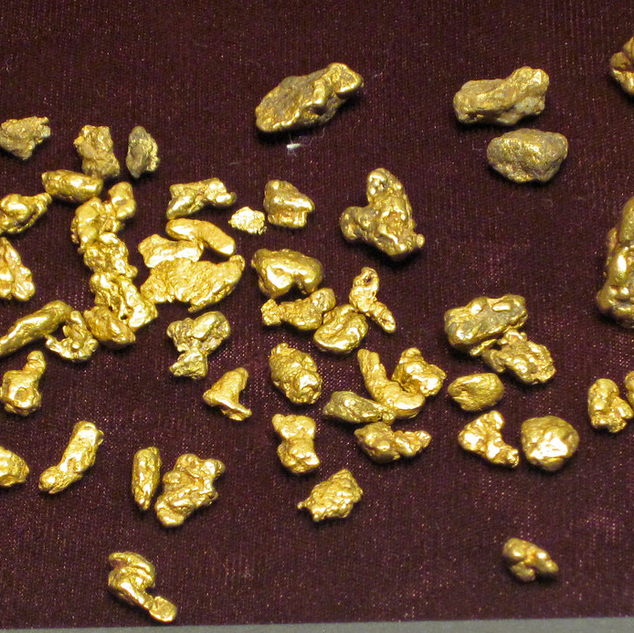
Scenario
Find and collect the most gold as quickly as possible!
No knowledge about where to find gold
Must choose one of two strategies to find and collect gold
This Photo by Unknown Author is licensed under CC BY

Slide 13

Option 1:
Small Space Lasers
You are a basement dweller with access to a network of advanced satellites
Satellites can travel to arbitrary locations and fire a laser straight down
  Laser diameter: 2 ft
  All gold within radius is vaporized, collected by a drone, and measured
  Each shot takes 1 hour to recharge, collect gold, etc.
10 satellites
Click on a map fires a laser at that location (there is no zoom)

Slide 14
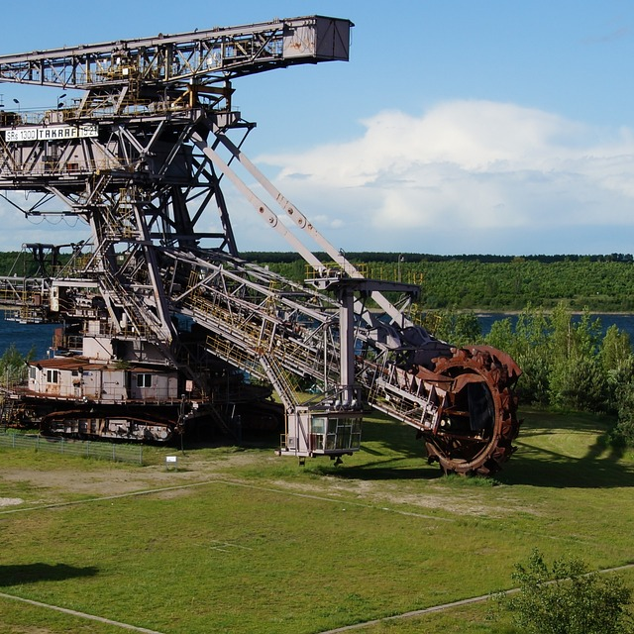
Option 2:
Proper Gold Mining Equipment
All the equipment you could want to mine gold and extract it from soil/water/rock
Heavy and slow to move
You have help to move and operate equipment, but must do all prospecting (searching) yourself

Slide 15


Lasers VS Mining Equipment
Who finds gold first?
Who can extract gold faster?
Would you continue searching after finding gold?
Probably space lasers
Probably proper mining equipment (once they find gold)
Exploration with space laser is easier
Proper mining equipment is slow to move around
This Photo by Unknown Author is licensed under CC BY-NC

Slide 16
Getting To The Point
An ideal strategy probably hybridizes our two strategies
  Search for gold with the space laser
  Extract discovered gold with proper mining equipment
Space laser is more akin to global search
  Can easily search the entire globe
  Has a harder time fine-tuning harvesting
Proper mining equipment is more akin to local search
  Excellent at extracting gold
  Has a harder time discovering gold
  More likely to stop exploration once gold is found

Slide 17
Why make a “parallel EA” then?

Slide 18
Parallel EA Goals
Allow distribution of an evolutionary search before multi-core CPUs existed
Inhibit premature convergence through search partitioning
  Slow the propagation of genetic information
  Concurrently explore different parts of the search space
Improve search efficiency
  Find better results with fewer evaluations

Slide 19
Types of Parallel EA
Coarse-Grain Parallel EA
Fine-Grain Parallel EA
Island model EA
Search with multiple isolated populations
Search populations infrequently interact
More on this later
Diffusion model EA
Search with sub-populations distributed about some geometry
Adjacent sub-populations have shared “overlap” individuals
Genetic information slowly diffuses through the population
Diverse demes have greater chance to improve before being dominated

Slide 20
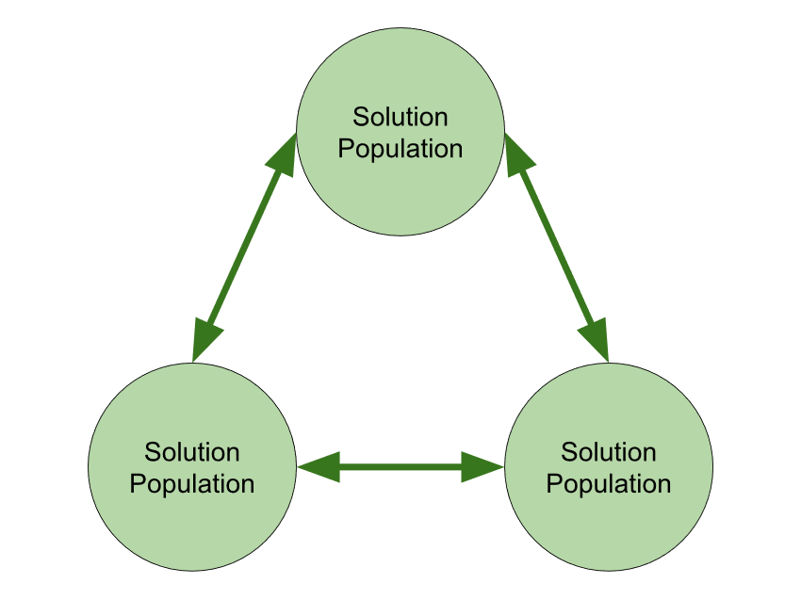
Canonical
Island Model
Multiple populations evolving concurrently
Infrequently migrate individuals from one island to another
  Frequent migrations exacerbate premature convergence
  Too infrequent migration results in diminished improvements to search
  Size of migration isn’t very important
  Migrant selection is important
  Island topology can be impactful as well
  Skolicki, Z., & de Jong, K. (2005). The influence of migration intervals on island models. GECCO 2005 - Genetic and Evolutionary Computation Conference, 1295–1302. https://doi.org/10.1145/1068009.1068219

Slide 21
Island Model Benefits
Improved diversity of global search
Improved search efficiency
  Superlinear speedup in GP
    Andre, D., & Koza, J. R. (1996). Parallel genetic programming: A scalable implementation using the transputer network architecture. In Advances in genetic programming: volume 2 (pp. 317–337).
  Speedup only occurs with appropriately sized populations
    Punch, W. F. . (1998). How Effective are Multiple Populations in Genetic Programming. Genetic Programming, 98, 308–313.

Slide 22
Other Island Model EA
Injection Island Model (1999)
  Eby, D., & Averill, R. (1999). The optimization of flywheels using an injection island genetic algorithm. Evolutionary Design by Computers, 13, 167–190.
Speciating Island Model (2006)
  Gustafson, S., & Burke, E. K. (2006). The Speciating Island Model: An alternative parallel evolutionary algorithm. Journal of Parallel and Distributed Computing, 66(8), 1025–1036. https://doi.org/10.1016/j.jpdc.2006.04.017

Slide 23
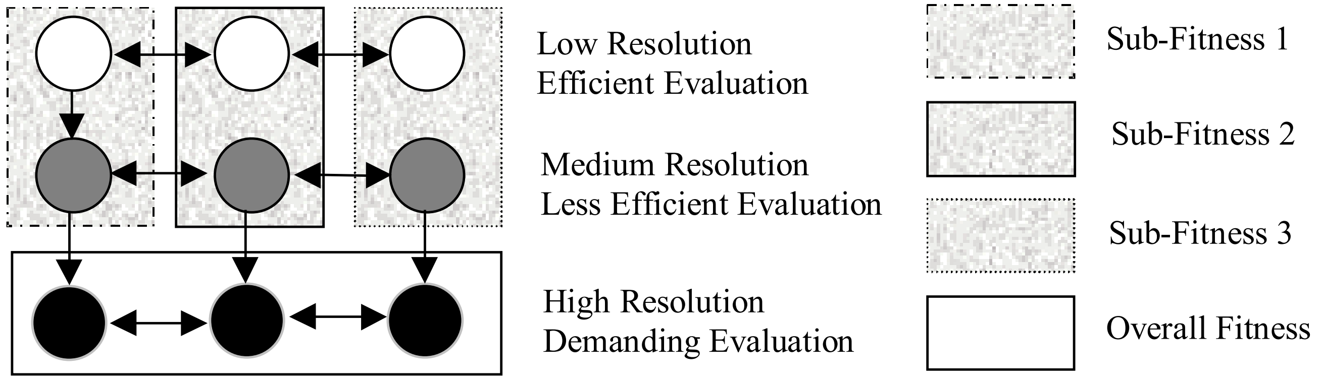
Injection Island Model
Heterogeneous islands of variable fidelity solutions
  Large populations of low-fidelity solutions
  Small populations of high-fidelity solutions
Islands evaluate fitness at different resolutions
  Islands can also evaluate fitness based on sub-problems
Inspired by human design
  Quick iteration on a rough draft before refinement
  Image from
  Eby, D., & Averill, R. (1999). The optimization of flywheels using an injection island genetic algorithm. Evolutionary Design by Computers, 13, 167–190.

Slide 24
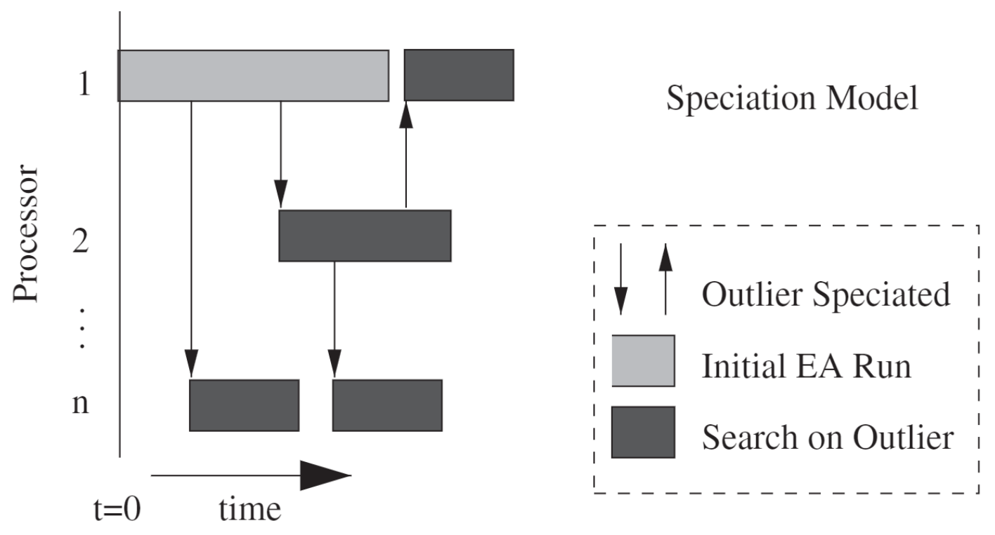
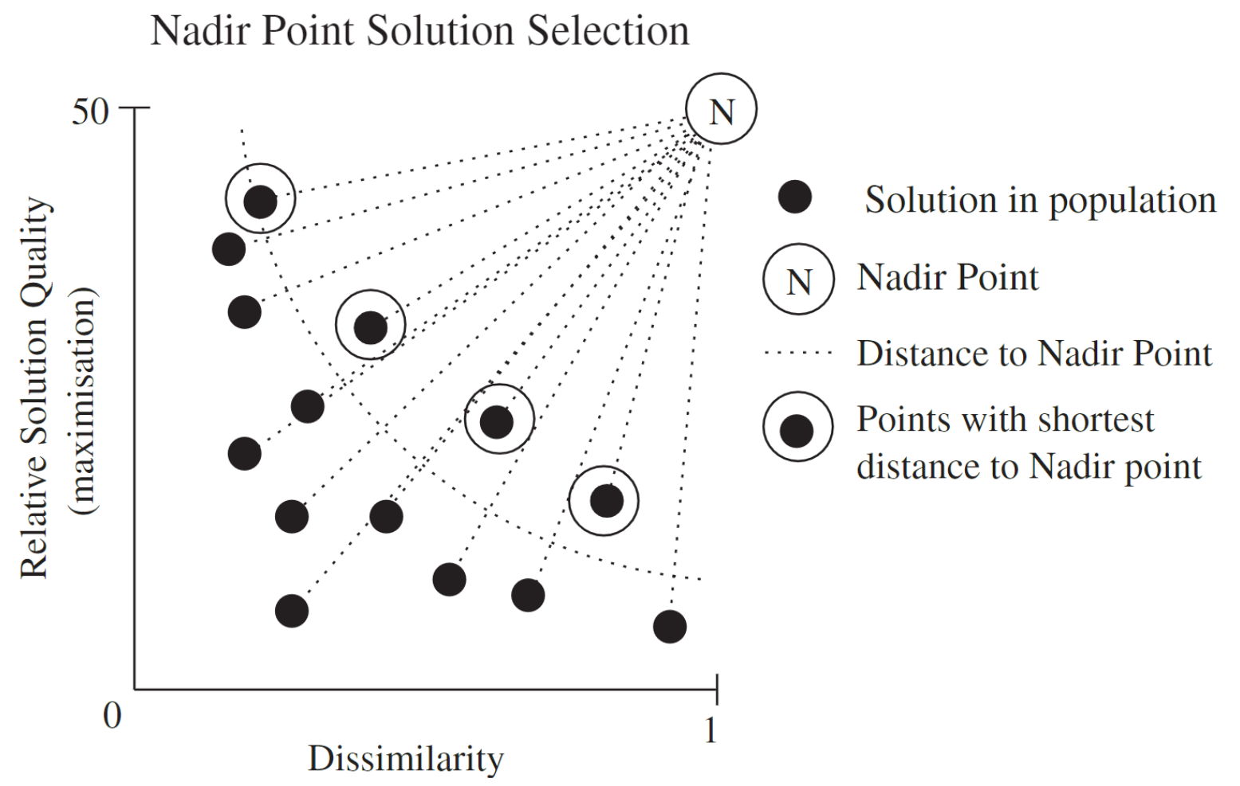
Speciating Island Model
Dynamic island creation
  Identify outlier individual
  Migrate the individual to new island
  Populate island with mutations
  Islands halt on a no improvement criteria
Aims to exploit outlier individuals through speciation
Images from
Gustafson, S., & Burke, E. K. (2006). The Speciating Island Model: An alternative parallel evolutionary algorithm. Journal of Parallel and Distributed Computing, 66(8), 1025–1036. https://doi.org/10.1016/j.jpdc.2006.04.017

Slide 25
Resolving Competitive Co-Evolution Problems
Reduce the number of samples required to approximate fitness
  Improve sampling efficiency via Sean’s work
Improve search efficiency with parallel EA
  Reduce number of fitness approximations required
  My work being presented

Slide 26
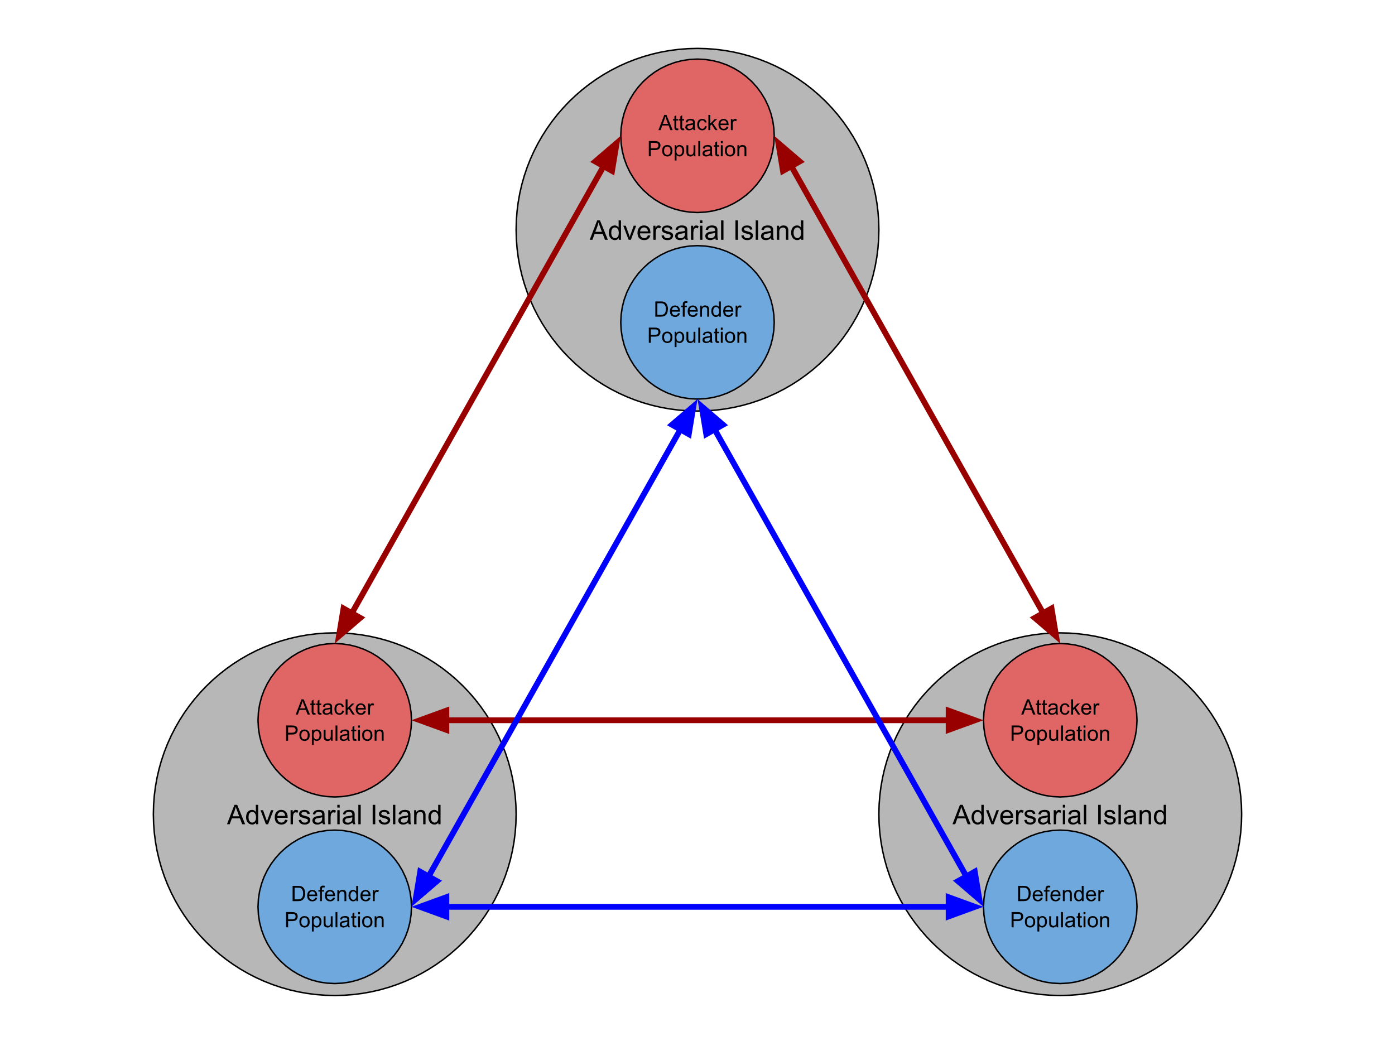
Maelstrom Model
Adversarial islands
  Perform interactive asymmetric co-evolution
  Generate local relative fitness estimates
Migrant selection algorithms use relative local fitness
Duplicates of migrants are sent to prevent loss of progress due to intransitivity
Migrants are re-evaluated against new local populations
  Migrants take the place of children that would have been produced that generation

Slide 27
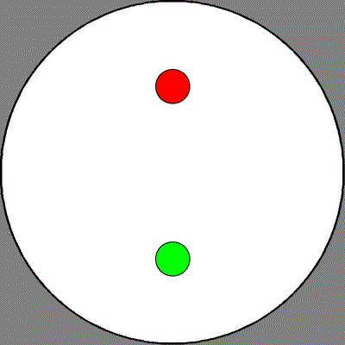
Predator Prey
Predators (red) aims to capture the prey (green) as fast as possible
Prey wants to survive as long as possible
Distance moved is based on static speed parameter
  Prey is faster than predator
Controllers return the angle (direction) to move
  Strong-type genetic programming trees
Implementation graciously provided by Sean Harris

Slide 28
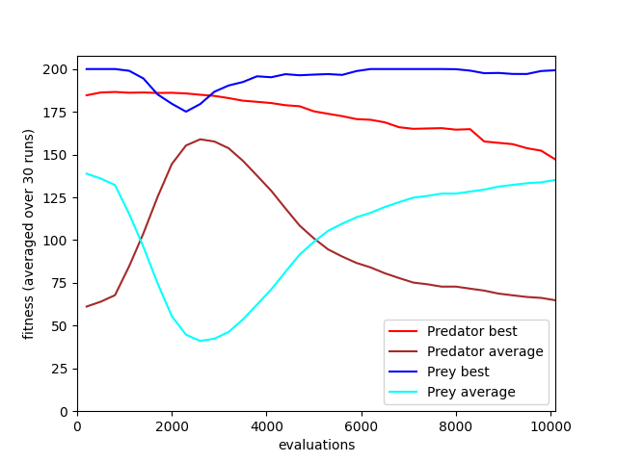
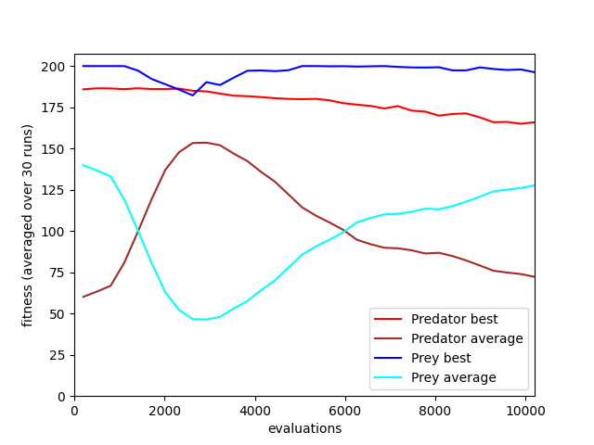
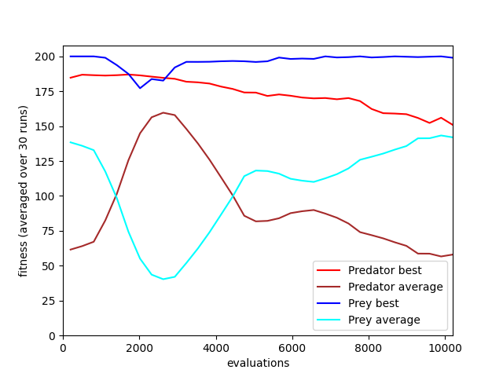
Relative Fitness Results (2019)
Traditional
Maelstrom (Random Migrants)
Maelstrom (Best Migrants)

Slide 29
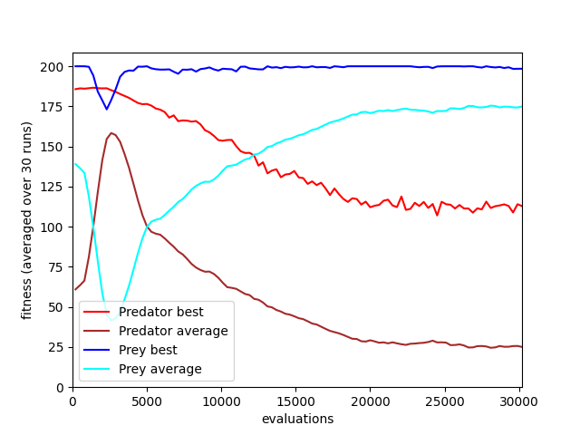
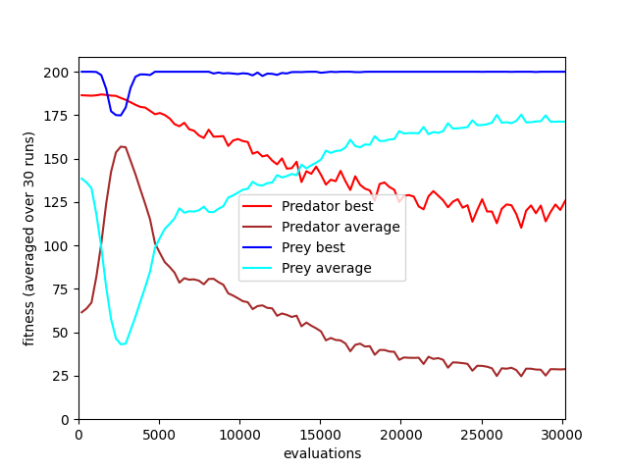
Relative Fitness Results (2019)
Traditional
Maelstrom (Best Migrants)

Slide 30
Statistical Analysis (2019)
Methodology
Results
Select top n agents of each species from the last generation of each run (called champions)
Champions from multiple experiments compete in a round robin competition
The fitness of the highest-scoring champion from each run is used in statistical analysis
No statistically significant difference in performance
Evidence found of disengagement due to Prey domination
Unclear if cycling or other pathologies were present
Highlighted need for better analysis techniques

Slide 31
How Do We Compare Coevolutionary Performance? (2019)
What if cycling is present?
  Selecting champions from the final generation might catch the “wrong” part of the cycle
  Should one only perform analysis using runs without cycling?
  What about other pathologies?
Should coevolution converge? Does it stagnate?
  Does this lead to disengagement in a species?
  If so, should champions be selected from an earlier generation of evolution?
  How can we determine that point?

Slide 32

Competitive Coevolution
Problems

Slide 33
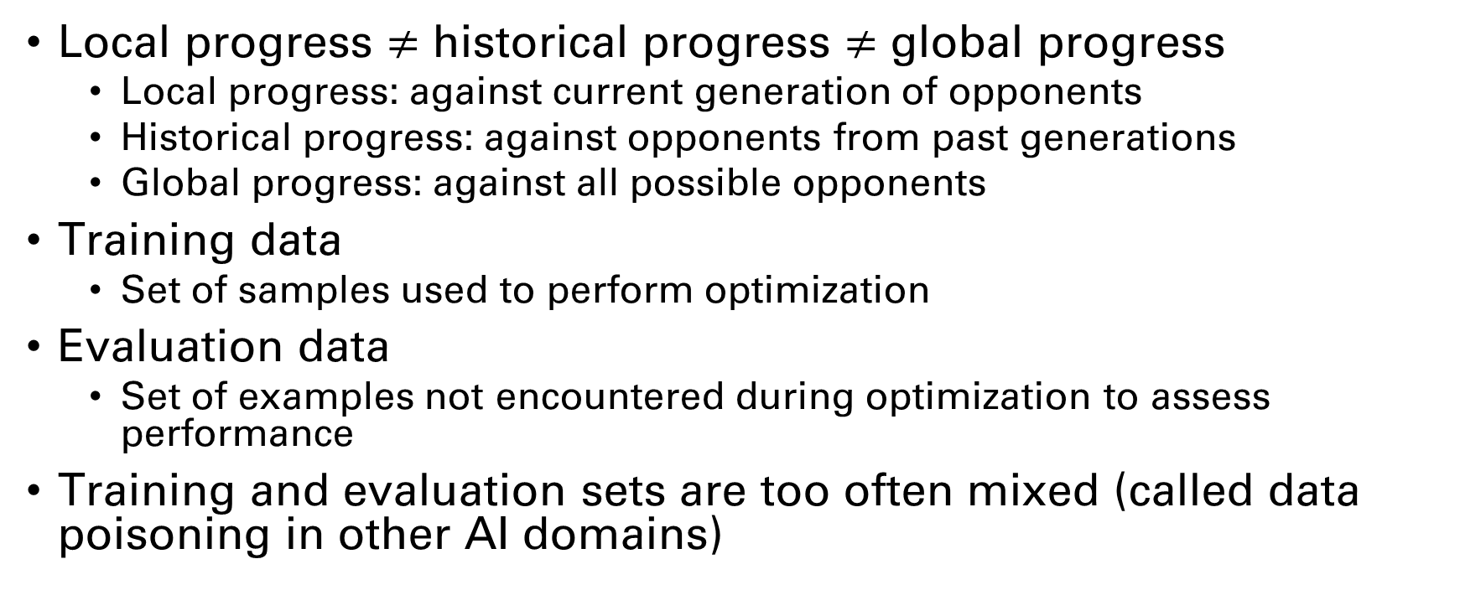
Why Coevolution Doesn’t “Work”
Local progress $≠$ historical progress $≠$ global progress
  Local progress: against current generation of opponents
  Historical progress: against opponents from past generations
  Global progress: against all possible opponents
Training data
  Set of samples used to perform optimization
Evaluation data
  Set of examples not encountered during optimization to assess performance
Training and evaluation sets are too often mixed (called data poisoning in other AI domains)
Miconi, T. (2009). Why Coevolution Doesn’t “Work”: Superiority and Progress in Coevolution. Lecture Notes in Computer Science (Including Subseries Lecture Notes in Artificial Intelligence and Lecture Notes in Bioinformatics), 5481 LNCS, 49–60. https://doi.org/10.1007/978-3-642-01181-8_5

Slide 34
Why Coevolution Doesn’t “Work”
Historical progress can be deceptive and is often conflated with global progress
  Run with poor historical progress outperformed run with good historical progress in global performance approximation
  My take: this calls into question the impact of pathologies predicated on historical progress in interactive competitive problems
Hall of fame methods can hinder global progress by overemphasizing progress against historical opponents
So-called evolutionary arms races seem to ignore fundamental characteristics of global optimality
Personal aside: how is anyone tuning?!
Miconi, T. (2009). Why Coevolution Doesn’t “Work”: Superiority and Progress in Coevolution. Lecture Notes in Computer Science (Including Subseries Lecture Notes in Artificial Intelligence and Lecture Notes in Bioinformatics), 5481 LNCS, 49–60. https://doi.org/10.1007/978-3-642-01181-8_5

Slide 35
Analyzing competitive coevolutionary Algorithms
Competition against a static baseline
  Baseline may be an out-of-distribution strategy not generated during evolution (not inherently bad)
  Global quality of baseline may be unknown
Measure stability of evolution in terms of historical progress then compare individuals from final generation
  CIAO (current individual verses ancestral opponent) plots or Master Tournament Matrix
  Invalidated by ~2009 findings that historical progress can be deceptive and should not be conflated with global progress

Slide 36
Analyzing competitive coevolutionary Algorithms
Competition against randomly-generated opponents
  Wojciech Jaśkowski, Paweł Liskowski, Marcin Szubert, and Krzysztof Krawiec. 2013. Improving coevolution by random sampling. In Proceedings of the 15th annual conference on Genetic and evolutionary computation (GECCO '13). Association for Computing Machinery, New York, NY, USA, 1141–1148. https://doi.org/10.1145/2463372.2463512
  Randomly generate 500,000 opponents play another 1,000 randomly-generated players
    Each opponent is placed into one of 100 bins based on their average performance against the 1,000 players
  An assessed player competes against all players in each bin and per-bin performance is calculated
    Akin to measuring performance against GM, diamond, platinum, gold, silver, and bronze players in contemporary games

Slide 37
Analyzing competitive coevolutionary Algorithms
Competition against randomly-generated opponents
  Wojciech Jaśkowski, Paweł Liskowski, Marcin Szubert, and Krzysztof Krawiec. 2013. Improving coevolution by random sampling. In Proceedings of the 15th annual conference on Genetic and evolutionary computation (GECCO '13). Association for Computing Machinery, New York, NY, USA, 1141–1148. https://doi.org/10.1145/2463372.2463512
  Used Othello
    Agent representation is static vector of weights that encode preference to make particular moves in each game state
  Unclear if technique is applicable to agents with complex dynamics
    E.g., GP agents with flow control or neural network agents
    Randomly generated agents may perform poorly using more complex representations

Slide 38

Analyzing competitive coevolutionary Algorithms
$α$-rank (2019) to consider intransitivity between strategies
  Omidshafiei, Shayegan, et al. "α-rank: Multi-agent evaluation by evolution." Scientific reports 9.1 (2019): 9937.
  Unrelated to competitive coevolution
  May be able to operate with partial information (i.e., opponent sampling)
  Decent for determining the single best agent
  Results are winner-takes-all and little information is gleamed about non-first place agents (i.e., not useful for large comparisons)
Round-robin competition with the best individuals from each algorithm
  Unclear how to identify best individuals prior to competition
  Competition prohibitively expensive $O\left(n^{2}\right)$
  Mean and median fitness values can be deceptive
    We’ll come back to this in a moment

Slide 39
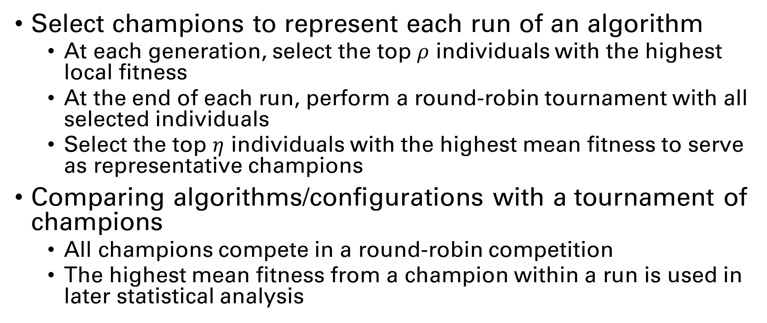
Comparative Analysis via Global Fitness Estimation (Spring 2022)
Select champions to represent each run of an algorithm
  At each generation, select the top $ρ$ individuals with the highest local fitness
  At the end of each run, perform a round-robin tournament with all selected individuals
  Select the top $η$ individuals with the highest mean fitness to serve as representative champions
Comparing algorithms/configurations with a tournament of champions
  All champions compete in a round-robin competition
  The highest mean fitness from a champion within a run is used in later statistical analysis

Slide 40
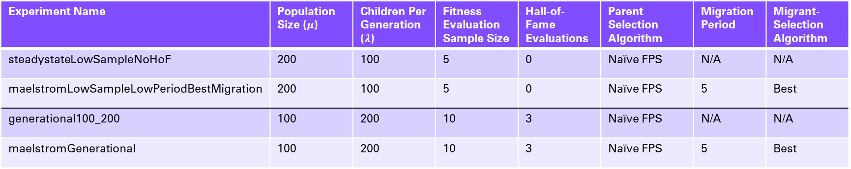
Spring 2022 Experiment Parameters
Experiment Name | Population Size ($μ$) | Children Per Generation ($λ$) | Fitness Evaluation Sample Size | Hall-of-Fame Evaluations | Parent Selection Algorithm | Migration Period | Migrant-Selection Algorithm
steadystateLowSampleNoHoF | 200 | 100 | 5 | 0 | Naïve FPS | N/A | N/A
maelstromLowSampleLowPeriodBestMigration | 200 | 100 | 5 | 0 | Naïve FPS | 5 | Best
generational100_200 | 100 | 200 | 10 | 3 | Naïve FPS | N/A | N/A
maelstromGenerational | 100 | 200 | 10 | 3 | Naïve FPS | 5 | Best
All algorithms use truncation for survival selection and have a 5% chance of producing a child via mutation instead of recombination.

Slide 41
Spring 2022 Experiment Results
Experiment Name | Predator Mean | Predator Std. Dev. | Prey Mean | Prey Std. Dev.
steadystateLowSampleNoHoF | 148.67 | 18.66 | 78.44 | 35.98
maelstromLowSampleLowPeriodBestMigration | 160.21 | 6.81 | 93.04 | 21.55
generational100_200 | 149.2 | 22.28 | 81.88 | 23.8
maelstromGenerational | 152.82 | 13.0 | 87.23 | 22.42
We have not yet conducted the necessary tests to determine if these results are statistically significant.

Slide 42
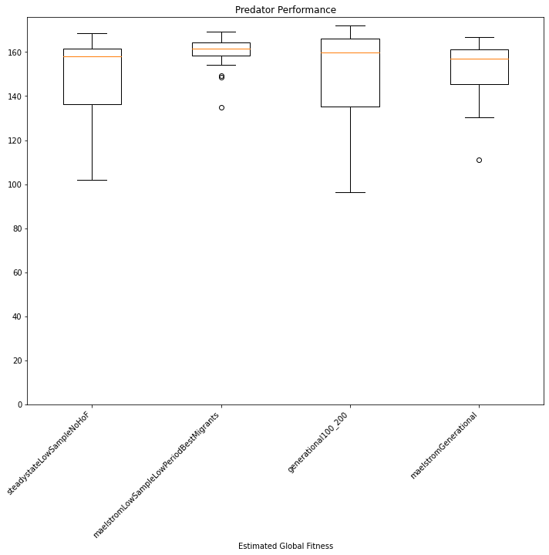

Slide 43
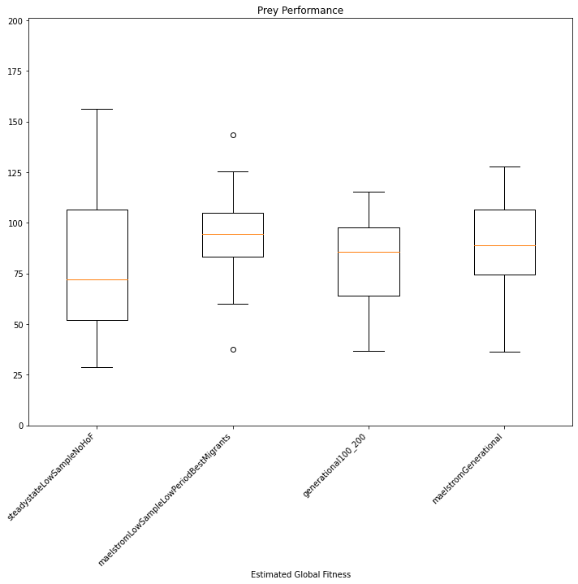

Slide 44
Criticisms of Spring 2022 Experiment
Analysis method fails to prevent same-run champions from competing (i.e., data poisoning)
  Comparisons should be between champions from independent runs
  Should use predator champs from first half of runs, prey champs from last half
Analysis method fails to consider distribution of opponent performance
  Ala Improving Coevolution by Random Sampling (2013)
  See next slide

Slide 45
Open Questions
How to deal with intransitivity?
  Agent A outperforms agent B against opponent X
  Agent B outperforms agent A against opponent Y
  Determining the best agent requires making a trade-off
    Not unlike multi-objective optimization
Should agent performance be represented as a singleton?
  Using average performance is an under-acknowledged design decision
  If not a singleton, what dimensionality is appropriate to represent agent performance?
    This likely varies by problem and explorable strategy space

Slide 46

Current Research Directions
GPU Accelerated GP
  Vectorized GP trees enable Round-Robin complexity of $O(n+m)$ with games vectorized about 2 dimensions
  Maelstrom framework published in 2023
Investigating correlation between local, historical, and global fitness
  Follow up investigation to Why Coevolution Doesn’t “Work” (2013)
  Considering out-of-distribution strategies (GP vs GA vs neuroevolution)

Slide 47
Miscellaneous Additional Publications
Multi-population (not quite island model) single species co-evolution with comparison of GP and neuroevolution
  Togelius, J., Burrow, P., & Lucas, S. M. (2007). Multi-population competitive co-evolution of car racing controllers. 2007 IEEE Congress on Evolutionary Computation, CEC 2007, 4043–4050. https://doi.org/10.1109/CEC.2007.4424998
Stable competitive co-evolution with clustering-based opponent selection and alternating population freezing
  Simione, L., & Nolfi, S. (2018). Achieving long-term progress in competitive co-evolution. 2017 IEEE Symposium Series on Computational Intelligence, SSCI 2017 - Proceedings, 2018-January, 1–8. https://doi.org/10.1109/SSCI.2017.8280898
  Skirts the analysis problem by “observing behavioral complexification?”

Slide 48
Closing remarks
Island models seem to have yet-discovered contributions to provide
Competitive co-evolution has a lot of open problems
  Some of these problems are also shared with population-based and multi-agent reinforcement learning
  Most competitive coevolution publications have a very narrow scope

Slide 49
Questions?

Slide 50
Generation 0

Slide 51
Generation 1

Slide 52
Generation 2

Slide 53
Generation 3

Slide 54
Generation 4

Slide 55
Generation 5

Slide 56
Generation 6

Slide 57
Generation 7

Slide 58
Generation 8

Slide 59
Generation 9

Slide 60
Generation 10

Slide 61
Questions?

