Slide 1
Introduction to Neuroevolution
Deacon Seals

Slide 2
Disclaimer
You could make an entire course over neuroevolution
This is not my direct area of expertise
  I’ve only relatively recently started learning this topic
There are multiple generations of research on neuroevolution
There are many tangential research areas that relate to and sometimes intermingle with neuroevolution

Slide 3
Disclaimer
Neural networks can be somewhat divisive in the EC community
  Success of deep learning has led to an us vs them mentality
  This seems especially prevalent in the old guard of EC
    Though there are notable exceptions
Due to the success of deep learning, neuroevolution appears to be booming in the EC community
  Many great examples of up-and-coming researchers
  Hybridizing deep learning and EC
  Discovering new areas where EC can offer novel contributions

Slide 4
What is Neuroevolution?
The application of evolutionary algorithms to tune the numerical parameters within a neural network
  Some of these techniques also involve autonomous design of the network topology
Many of these algorithms originated for generic numerical optimization tasks
Architecture search algorithms may explore topology space and leave network tuning to other algorithms
  E.g., training with deep learning
  This is distinct from neuroevolution as far as I’m aware

Slide 5
Overview
A Brief Intro to Neural Networks
Neuroevolution
  Comparison with Deep Learning
  Simple GA/ES
  CMA-ES
  NEAT
Quality Diversity
  MAP-Elites

Slide 6
A Brief Intro to Neural Networks
Non-exhaustive!!

Slide 7
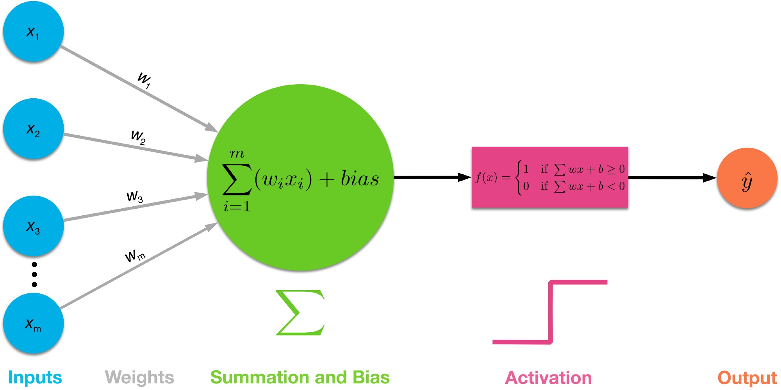
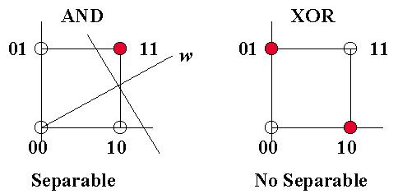
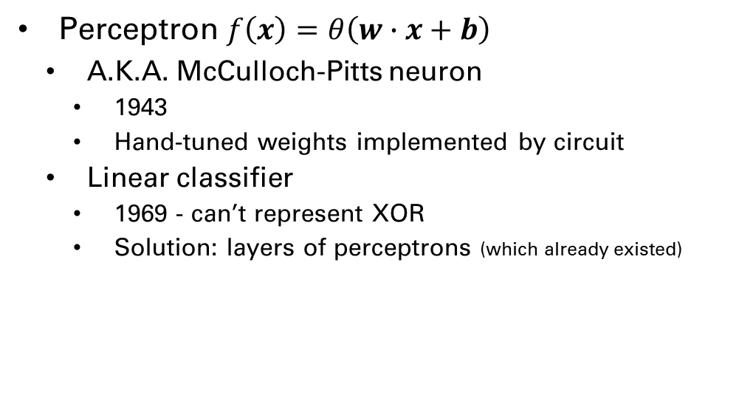
Brief History
Perceptron $f\left(x\right)=θ\left(w∙x+b\right)$
  A.K.A. McCulloch-Pitts neuron
    1943
    Hand-tuned weights implemented by circuit
  Linear classifier
    1969 - can’t represent XOR
    Solution: layers of perceptrons (which already existed)
This Photo by Unknown Author is licensed under CC BY-SA
This Photo by Unknown Author is licensed under CC BY-SA-NC

Slide 8
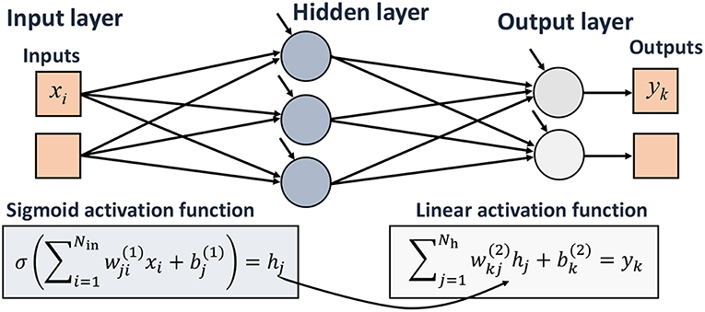
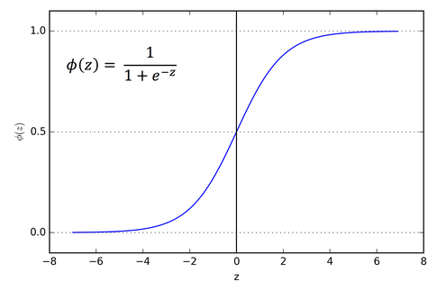
Brief History
Multi-layer Perceptron (MLP)
  A.K.A. Dense Neural Network
  1958 - Frank Rosenblatt
    Also introduced learnable weights and threshold
  Eventually incorporated nonlinear activation functions
  1986 – Rumelhart, Hinton, Williams
    Modern gradient-based tuning
    Use chain rule to backpropagate though nonlinear activation functions
This Photo by Unknown Author is licensed under CC BY
This Photo by Unknown Author is licensed under CC BY-SA

Slide 9
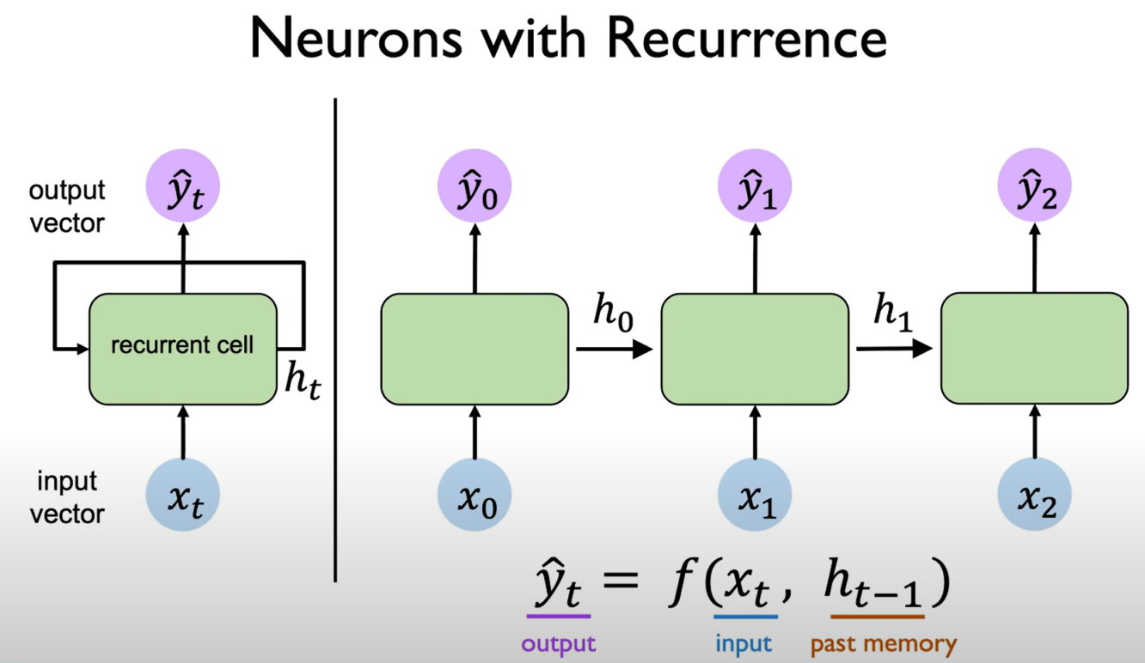
Brief History
Recurrent Neural Network (RNN)
  Provides memory to networks
  Starts with a state of all zeros
  Outputs new state which is fed back in
  1997 – Long short-term memory (LSTM)
    Hochreiter and Schmidhuber
    Not the first, but the most famous
This Photo by Unknown Author is licensed under CC BY-SA

Slide 10
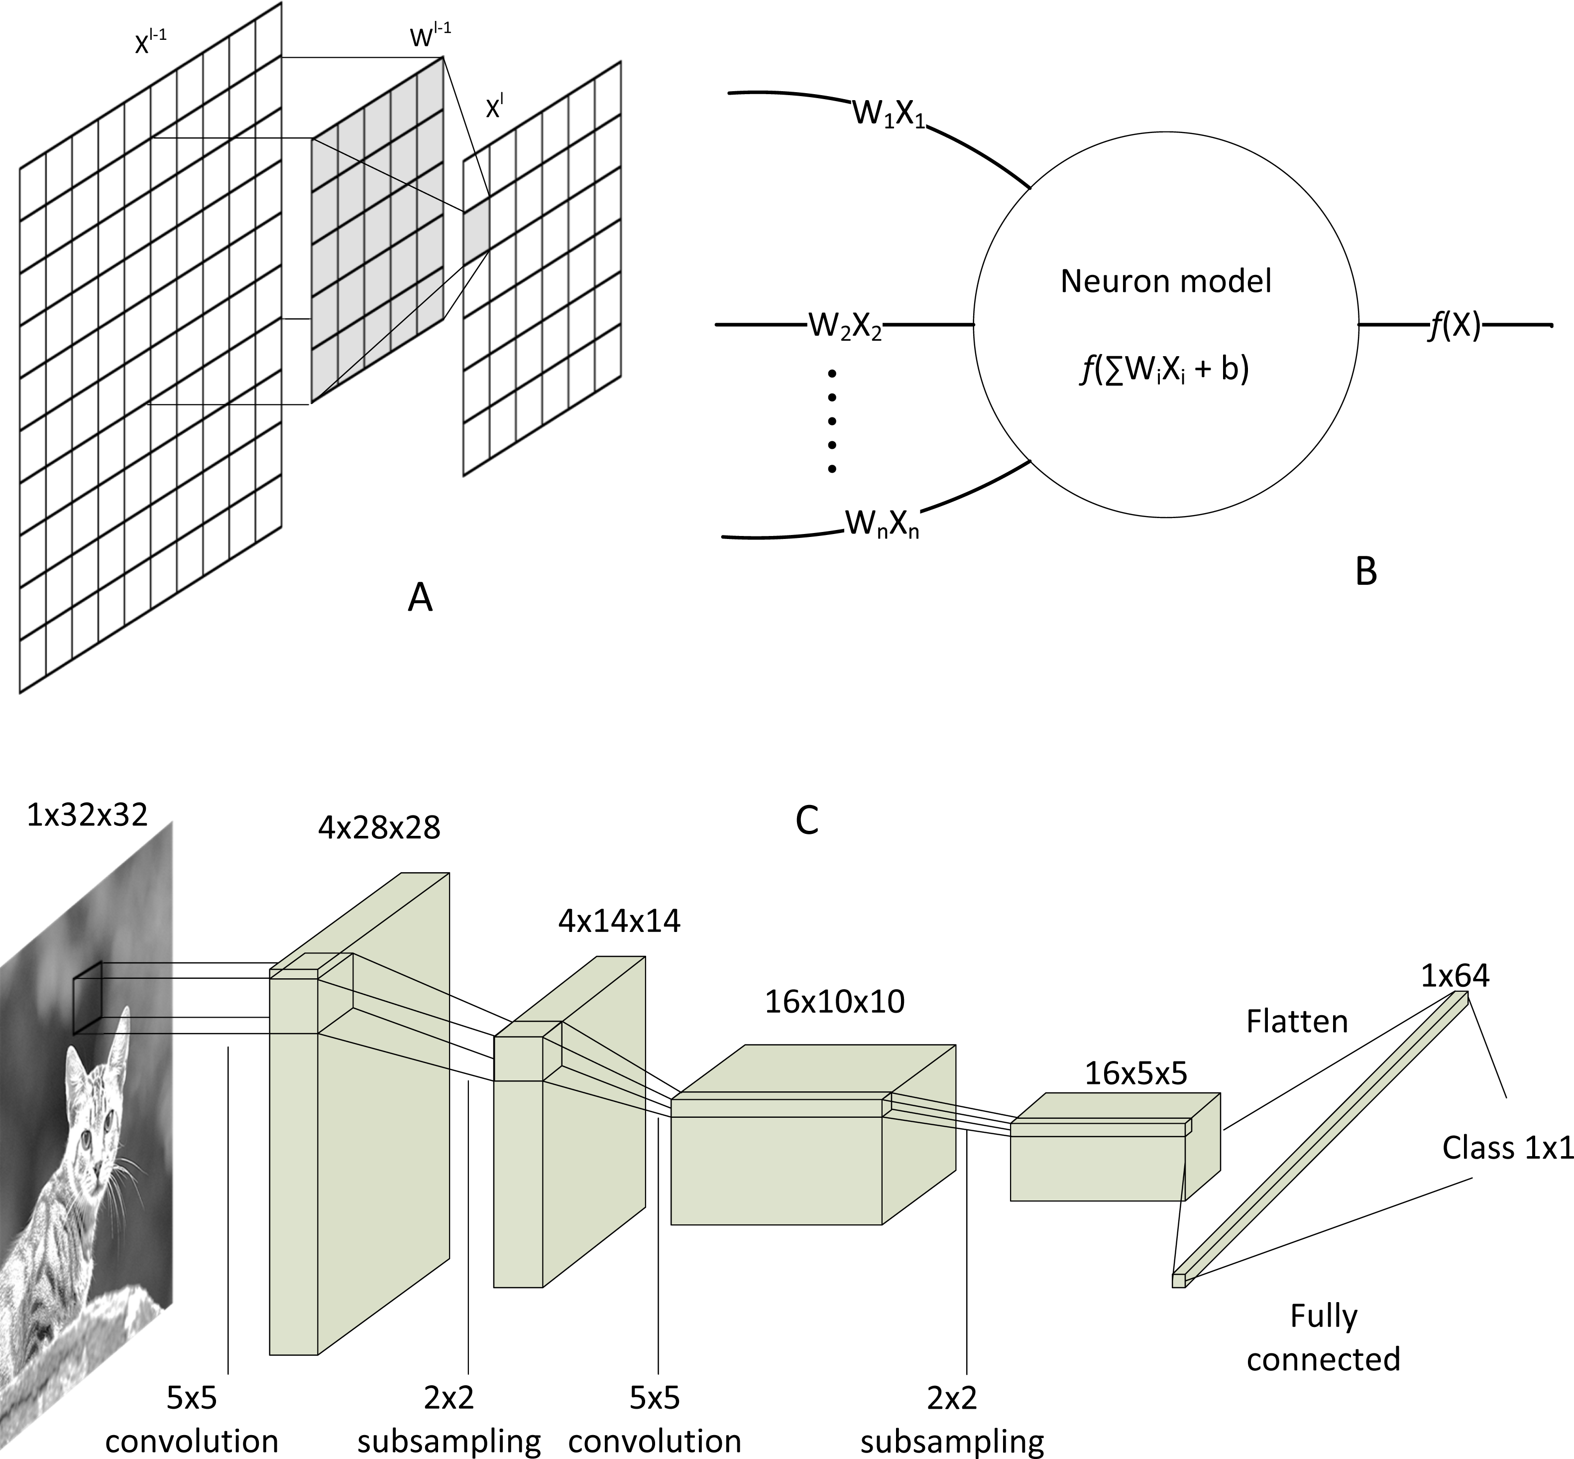
Brief History
Convolutional Neural Network (CNN)
  Slides a filter of weights about a 2D input
  Generates a subsampled 2D output (i.e., smaller 2D output unless filter is 1x1)
  Multiple filters may be used and the 2D output of each are stacked to a 3D output
  Outputs typically flattened to 1 dimension and passes through dense layer
  Popularized by LeNet
    1995 – LeCun et al.
This Photo by Unknown Author is licensed under CC BY

Slide 11
Notable Additional Events
2013 – AlexNet demonstrates GPU training
  Drastically improved performance on image classification task afforded by efficient training
  Deep learning wins the “hardware lottery”
  Kickstarts current AI boom
2017 – Transformer networks
  Uses attention mechanism to replace memory
  Outperforms LSTMs on most applicable tasks
  Benefits from gradient-based optimization more than RNNs
  Revolutionizes natural language processing (NLP)
    E.g., foundation of Chat-GPT
    GPT: generative pre-trained transformer

Slide 12
Fine Points
Neural networks consist of numerical parameters which can be tuned
  Deep learning is a gradient-based tuning approach
  Neuroevolution is a gradient-free tuning approach
Architectural advances to neural networks are directly impactful to neuroevolution
  The use of dense, CNN, and LSTM components
Some of these advances are biased towards deep learning methods
  E.g., transformers make more effective use of backpropagation than LSTMs
  Transformers may still lend themselves to neuroevolution though

Slide 13
Neuroevolution

Slide 14
Comparison With Deep Learning
Deep Learning
Neuroevolution
Requires differentiability of all components
  Allows for clear indicators of search direction
  Requires differentiable loss or reward functions
    Can optimize during multi-step tasks (e.g., games)
Does not require differentiability
  Enables non-differentiable network components
    Spiking neural networks
  Allows for non-differentiable problems
    Meaningfully more flexible
    Requires many full episodes of multi-step tasks (e.g., games)

Slide 15
Comparison With Deep Learning
Deep Learning
Neuroevolution
Explicitly calculates a performance gradient
  Cannot tolerate discontinuities
Uses hill-climbing-like gradient traversal algorithms
  Benefits from making gradient smoother
  Incorporates mechanisms to leave local optima
Optimizes about an implicit search gradient
  Still stumbles with deceptive fitness landscapes
    E.g., discontinuities
  Meaningfully less sample efficient on many problems
    I.e., requires more fitness evaluations than deep learning
  Can operate on arbitrary non-binary performance metrics

Slide 16
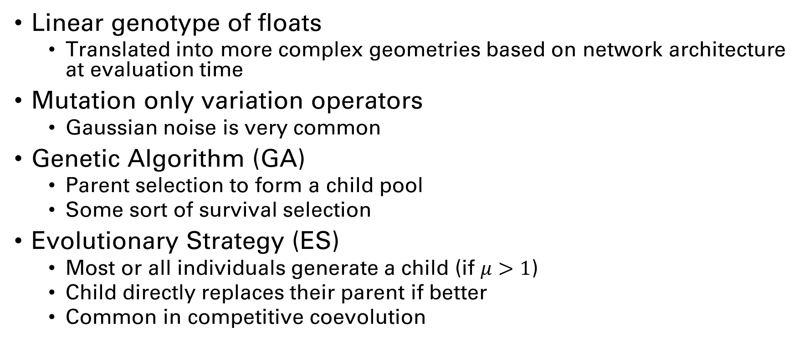
Simple GA/ES
Linear genotype of floats
  Translated into more complex geometries based on network architecture at evaluation time
Mutation only variation operators
  Gaussian noise is very common
Genetic Algorithm (GA)
  Parent selection to form a child pool
  Some sort of survival selection
Evolutionary Strategy (ES)
  Most or all individuals generate a child (if $μ>1$)
  Child directly replaces their parent if better
  Common in competitive coevolution

Slide 17
CMA-ES
Covariance Matrix Adaptation Evolutionary Strategy
  Covariance matrix describes variances between dimensions in a multivariate normal distribution
Does not adhere to typical EA loop
  Uses ask-eval-tell loop instead
Does not adhere to typical EA population-based search
  Population is generational
  Children are not directly created from parents
Akin to searching for a multivariate normal distribution
  Sampling this distribution yields good solutions

Slide 18
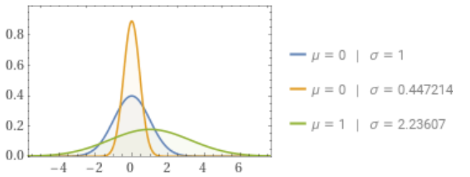
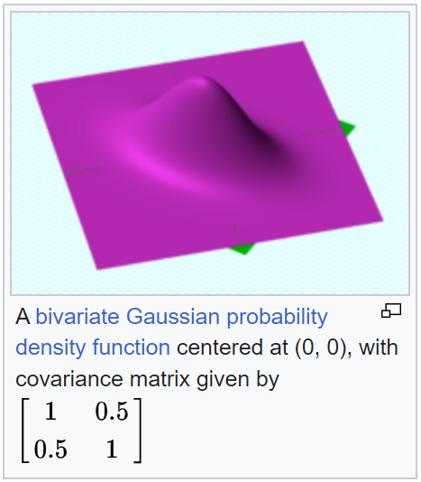
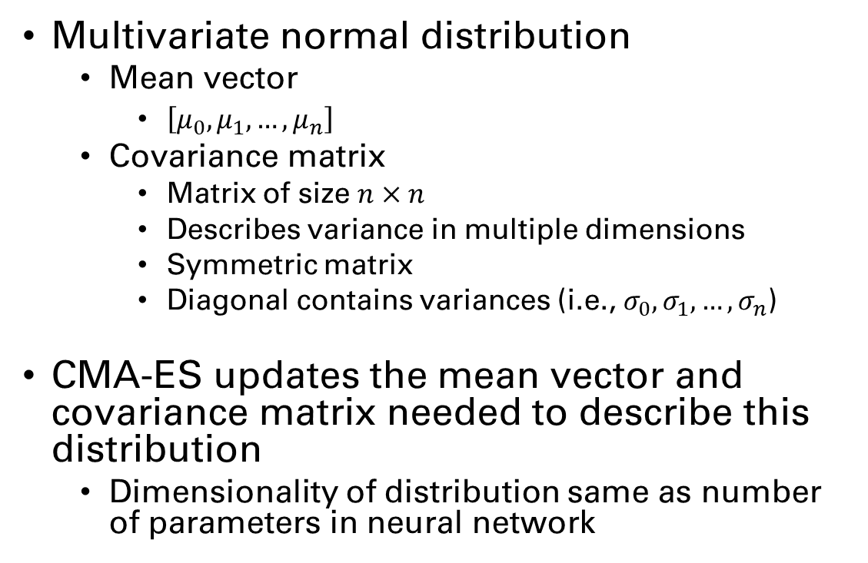
CMA-ES
Multivariate normal distribution
  Mean vector
    $\left[μ_{0}, μ_{1},…,μ_{n}\right]$
  Covariance matrix
    Matrix of size $n×n$
    Describes variance in multiple dimensions
    Symmetric matrix
    Diagonal contains variances (i.e., $σ_{0}, σ_{1},…,σ_{n}$)
CMA-ES updates the mean vector and covariance matrix needed to describe this distribution
  Dimensionality of distribution same as number of parameters in neural network
Image in public domain from source

Slide 19
CMA-ES
Ask
  Randomly sample solutions from multivariate normal distribution
  Utilizes covariance matrix and vector of per-dimension means
Eval
  Evaluate population of solutions sampled from distribution
Tell
  Rank solutions based on performance
  Calculate a weighted update to means and covariance matrix based on solution values
  Shift distribution towards known good solutions, away from bad

Slide 20
CMA-ES Population Size
Number of times distribution is sampled each generation
Smaller population -> local search
  Most samples near current means
Larger population -> global search
  Greater chance of samples farther from current means
Some CMA-ES variants alternate use of large and small population sizes
  Use global search until improvement stagnates
  Use local search to fine tune on current means until convergence
  Double population size from global search step
  Repeat

Slide 21
NEAT
Neuroevolution of augmenting topologies
  2002 – Kenneth Stanley and Risto Mikkulainen
GA approach
  Maintains a persistent population (as opposed to CMA-ES)
Uses a direct encoding scheme
  Directly represents every neuron and connection in a neural network
Lots of variations introduced by Mikkulainen, Stanley, and others

Slide 22
Quality Diversity
(Pause for questions)

Slide 23
Quality Diversity
In my opinion, one of the most promising areas of active research
Originally based in research into artificial life (A.K.A. A life)
  Open ended evolution based on diversity
  Typically used to study environment dynamics rather than optimization

Slide 24
Quality Diversity
Optimize with respect to behavioral diversity
  Emphasis on direct performance is often secondary
  Allows for alternate definitions of success that may be further optimized
  Can outperform direct optimization
Commonly uses neuroevolution
  Underlying methodology not inherently restricted to neuroevolution
    E.g., QD algorithms for GP are possible

Slide 25
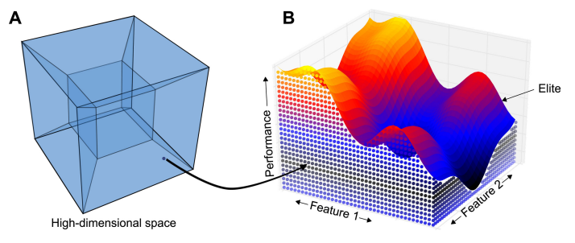
MAP-Elites
Multi-dimensional Archive of Phenotypic Elites
Archive model population
  Define grid based on discretized behavioral features
    E.g., percentage of time a bipedal robot had each foot off ground
  Phenotype corresponds to specific archive location
  Save solution to archive location if empty or fitness is better
Randomly select parent from archive
Mutate selected parent to generate child
Image from
Mouret, J. B., & Clune, J. (2015). Illuminating search spaces by mapping elites. arXiv preprint arXiv:1504.04909.

Slide 26
MAP-Elites
Requires careful definition of behavioral features
  Define structure of archive
  Indirectly related to performance
  Studies typically perform ablation with combinations of features
  Too many features hinders optimization performance
Predicated on effective mutation operations
  Hallmark of neuroevolution
More akin to GA than ES
  Children can replace population members other than parent
  A persistent (steady-state) population is maintained be archive

Slide 27
Closing remarks
Problems well-suited to deep learning
  Deep learning is typically faster and more performant
  No small amount of effort goes into reformatting problems to become well-suited (the results should not be dismissed though)
Neuroevolution benefits from architectural advances in neural networks (typically brought about by deep learning)
Neuroevolution can do some things deep learning can’t
  Optimize non-differentiable network architectures (e.g., spiking neural networks)
  Optimize problems with no or ill-suited loss/reward functions

Slide 28
Closing remarks
Newer variants of neuroevolution and quality diversity algorithms are adding deep learning mechanisms
Some domains like NLP are gaining interest in neuroevolution to evolve novel neural network architectures
Neural networks aren’t necessarily the best solution to some problems
  E.g., discrete optimization, combinatorial optimization, certain ill-suited automated design problems (at least currently)
This presentation only scratches the surface of these topics
AI isn’t magic

Slide 29
Questions?

