Slide 1
AI Software Development
Tips, tricks, and pitfalls for writing AI (mostly EC) code in 2024
By Deacon Seals

Slide 2
Please Keep in Mind
Software development is an inherently subjective topic filled with lots of opinions
There is no “one size fits all” approach to writing software as any supposedly optimal approach often varies by expertise, resources, and domain
Goals:
  Provide an awareness of the current state of AI computing
  Give tips for project success
  Make you aware of tools
  Highlighting when to use different tools

Slide 3
Abridged Qualifications
Undergrad (2013-2018)
  Missouri University of Science and Technology
  Electrical Engineering, Computer Engineering, and Computer Science
  2 years as a design lead on a student design team
    Year 1 – Lead of Electronics
      One-person team under higher-ranking project lead
      Poorly planned project that failed
      Learned a lot about how not to plan a project
    Year 2 – Lead of Innovation
      Recruited students from my majors
      Leveraged existing experiences to design a project I could solo if necessary
      Won 2nd place innovation reward at international engineering competition
  Rapid prototyping internship between design lead positions
  Led 2 semester senior design team of 2 other electrical engineers
    Machine that creates artificial muscles from fishing line

Slide 4
Abridged Qualifications
Teaching Assistant
  Started as undergrad in 2018 for AI course
  Added EC in 2018 as grad student
    Became Lead TA in 2019
    Assignment Curriculum Designer in 2021
    Mentor TA starting in 2022
Research
  Started on poorly-planned solo project in 2018
  Joined CEADS-LIN in 2019
    Collaboration with Los Alamos National Lab
    Became Technical Project Lead in 2020
    More than a dozen members at peak
  Published the Maelstrom framework at GECCO ‘23 pip install maelstrom-evolution
Served as a mentor or advisor on at least a dozen other projects
  Senior capstones, Master’s theses, research projects, etc.
Current instructor of COMP 2210 and all CSSE sections of ENGR 1110

Slide 5
Some observations
Many demonstration of what not to do
  Fear Ambiguity is the mind-killer
  Beware scope creep
  The sunk-cost fallacy
    Reluctance to abandon something because of
    heavy investment
  Project failure can be the most valuable experience (in moderation and with added effort)
Engineers and software developers love to make everything from scratch
  Partially driven by ambition (wanting to make something!)
  Sometimes an unwilling to learn new tools
    Not throwing stones - I’m not a graceful learner without an immediate knack

Slide 6
Some observations
Human nature is always at play
  Being a human is weird/hard
  Useful characteristics (in excess) can stifle a project
    Tenacity -> stubbornness
    Flexibility -> flighty
    Optimism -> audaciousness
    Ambitiousness -> unrealistic
    Creativity -> scope creep
  Project members sometimes lose the plot
    Frequent context switching between projects and limited bandwidth
    Limited consideration of project outside of meetings
    Can result in knee-jerk tasking (scope creep)

Slide 7
Some observations
Human nature is always at play
  People will go through great lengths to minimize attention and/or critical thought
    Hope for unsolvable or niche problems (e.g., novel compiler bugs)
    Hail Mary solutions
      Delete and rewrite code
      Ask ChatGPT
    Don’t Make Me Think: A Common Sense Approach to Web Usability - Steve Krug
      Discusses tendency to personify inanimate objects
        Requires less thought
      Hypothesizes that there’s an evolutionary benefit from thinking less
        Brains use a lot of energy/calories!

Slide 8
Common Pitfalls
Blind/dogmatic use of a programming language, tool, or technique
  When you have a hammer, everything looks like a nail
Failing to prioritize project success
  Building everything from scratch and/or reinventing the wheel
  Sacrificing progress for the sake of a tangent
    Adding features (scope creep)
    Using a project to “learn a new language” (or similar)
Never clearly establishing project goals or scope
Failure to adapt to changing requirements or needs

Slide 9
Overview
Projects
Development
Tools
Starting a project
Executing a project
Working on a team
Tips for research
Current state of computing for AI
Picking a programming language
When to make a new tool
Lots of slides about Python development
Recommendations to build on top of

Slide 10
Projects

Slide 11
Starting a Project
Is the primary goal learning a skill or completing a task?
  Beware inadvertently swapping these during the project
  Differentiate between these projects
  Establish dedicated learning projects if necessary
Define clear project goals and scope
Establish criteria for project success
  E.g., the existence of a specific set of features, data on the performance of a new mutation operator, etc.
Determine milestones required to satisfy success criteria and meet project goals
Pick the right tools for the job (more on this later)

Slide 12
Executing a Project
Identify a minimum viable product (MVP)
  What components are hard requirements for project success?
  What components are optional?
  Can you complete the MVP and make optional components stretch goals?
Be pragmatic about project progress when considering tangents
  Is a new feature/task necessary for project success?
  Will a new feature/task significantly improve the success of the project?
  Be aware of timelines and deadlines (and beware scope creep)
Be prepared for failure and changing needs/requirements
  Fail fast!
  Determine failure criteria for rapid iteration

Slide 13
Working on a Team
Effective teams have 2 obvious characteristics:
  Accountability
    Establish clear expectations/responsibilities
    Check progress/completion as a group
  Good communication
    Clear
    Transparent/honest
    Robust (especially for critical systems)

Slide 14
Tips for Research
Build off existing work
  Much easier to determine originality of ideas
  Good way to get citations
Do literature review early
  Determining work originality after the fact is nerve-racking
  Allows you to identify problems your work could address
Think like a scientist!
  Define clear, measurable goals from the onset
    Including success and failure criteria
  Failure as a finding is a valuable project characteristic

Slide 15
Development

Slide 16
Current State of Computing for AI
Historical context:
  AI researchers have endured several periods where funding was difficult to obtain
  Often referred to as the AI winters
  Causes
    XOR problem
    Limitations of computation resources
Important concepts:
  The slow, but eventual, death of Moore’s Law
  AI “winning the hardware lottery”

Slide 17
Moore’s Law
Observation made by Gordon Moore
  Co-founder of Fairchild Semiconductor and Intel
  Noted in 1965 that transistor density doubled every 12 months
Greater transistor density enables:
  Increased operating frequency (faster chips)
  Decreased energy consumption
  More stuff per chip (memory, compute cores, etc.)

Slide 18
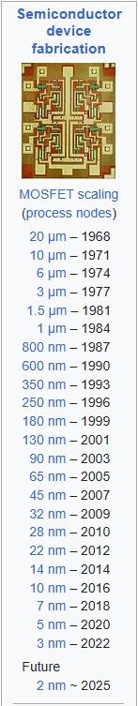
Moore’s Law
Based on observations about how transistor manufacturing technology was advancing
  Improvements to precision enabled smaller transistors
  There are physical limits to how small transistors/wires can be
Rate of doubling has slowed over time
  12 months
  18 months
  24 months
Is Moore’s Law dead?
https://en.wikipedia.org/wiki/Moore%27s_law

Slide 19
Post Moore-tem Computing
Performance of general CPU cores will stagnate
  Add more cores
  Make chips bigger
  Overclock and use more aggressive cooling
Amdahl’s law
  Speedups from parallelization are limited by sequential program sections
  Most algorithms/programs are only partially parallelizable
  Programs contain sections that must be evaluated sequentially
  These sections place an upper bound on speedups from parallelization

Slide 20
Post Moore-tem Computing
Change computing paradigms
  Quantum computing
Application-specific integrated circuits (ASIC)
  Hardware specialized for only a specific task
  Floating point coprocessors
    Eventually became part of x86 architecture
  Bitcoin miners
    Specialized hardware for accelerated hashing
  Graphics processing unit (GPU)
    Designed for graphics rendering tasks
    Specialized hardware for matrix operations

Slide 21
The Hardware Lottery
In 2012/2013, AlexNet demonstrated the ability to accelerate deep learning with a graphics card (GPU)
  Achieved unprecedented performance on a highly-competitive computer vision problem
  Extreme acceleration of deep learning via GPU since referred to as “winning the hardware lottery”
    Serendipitous ~80x speedup by capitalizing on previously unrelated technological advances
  Set off a huge boom in deep learning research still going today
First viable path around death of Moore’s Law

Slide 22
The Hardware Lottery
Nvidia capitalized on this with CUDA
  Heavy investment to make CUDA industry standard
  CUDA implemented in C/C++
Deep learning built ecosystem of libraries around CUDA
  Many early libraries in C++
  Most current libraries are Python bindings for C/C++ backends
    Google: TensorFlow and JAX
    Meta: PyTorch
Other fields try to cash in on the hardware lottery
  Simulations/Scientific Computing
  Statistics/Data Science
  My own research in Evolutionary Computing
Java still does not have GPU support

Slide 23
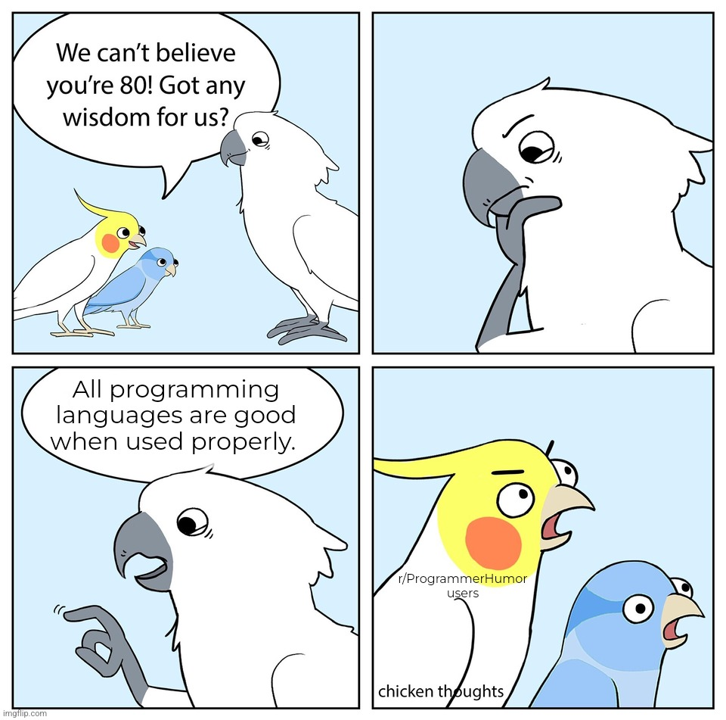
https://www.reddit.com/r/ProgrammerHumor/comments/wy7uxi/even_html/

Slide 24
Picking Programming Languages
View programming languages as a tool
  Use the right tool for the job
Let existing resources and tools guide you
  Are there existing implementations of important components of your target application?
    E.g., you need to use a complex physics simulation that is only implemented in C++
  What languages are these implementations in?
  Of the programming languages with rich library support, which one best suits your needs?
Pick languages at the right level of abstraction for your project
  Don’t ignore development time or only focus on compute time!
    Human development time is often expensive
    Let computers work for you
  Consider combinations of programming languages
  Consider high-level acceleration tools (e.g., GPU acceleration in Python)
  My advice: only use low-level languages if you have a specific reason

Slide 25
When to Use a Low-Level Language
Required tools are implemented without a high-level interface
  A complex physics simulation that only provides an interface in C
Your application is prohibitively computationally expensive, and that cost can’t be alleviated by higher-level parallelism or acceleration
  Consider only implementing required portions in a low-level language
Your project has the specific goal of learning a low-level language

Slide 26
When to make a new tool
Scenario 1: there no existing tools that satisfy your project’s required capabilities
  I.e., the thing you need completely does not exist
  This does not include performance requirements
Scenario 2: tools exist that satisfy your project’s required capabilities, but they suck “enough”
  Performance of existing tools is so poor that creating a replacement would be a meaningful contribution to your field
  Your use case of existing tools is so ill-suited to their intended use case that creating an alternative or wrapper would be a meaningful contribution to your field
  You have attempted to use existing tools and found their documentation so incomplete that using their code is impractical and creating an alternative or wrapper would be a meaningful contribution to your field
  Litmus test: would a new tool be a meaningful contribution to your field?
    Are there specific improvements you could provide or use cases you could expand support to?

Slide 27
Lots of Slides about Python
Python became incredibly popular in the AI community
  Replaced LISP, Java, C++, and other lower-level languages
Library support is very good
  Mature, well-optimized libraries developed and funded by Google, Meta (Facebook), and others
  Frequently use faster, low-level languages under the hood (more on this later)
Python has a high level of abstraction
  Great for rapid prototyping
  First-party libraries like multiprocessing and random are performant and feature rich
  Flexibility enables lots of footguns (more on this later)

Slide 28
Required Development time by Programming language
Pure
Python*
Python with low-level components
Pure low-level language development

Slide 29
Caveats of Python
Prone to abusive programming practices
  Using dictionaries instead of classes
  Inconsistent use of variable names and data types
High-level abstractions can obscure computational cost
  Example:
  if individual in population:
  # do something
  O(n) if population is a list
  O(1) if population is a set or dictionary

Slide 30
Caveats of Python
Python doesn’t support sharing Python variables in memory between processes
  Must use shared ctype variables or a manager process that host variables
Python has quirks that are unintuitive when compared to other languages
  Implicit pass-by-reference and pass-by-value
  Multithreading vs multiprocessing

Slide 31
“Python is slow”
Optimized compiled code is typically faster than equivalent interpreted code (Python)
Algorithmic time complexity still dominates language-based performance differences in most cases
Development time is often far more expensive/valuable than compute time
  The primary exceptions to this are caused my severe computation resource constraints (e.g., embedded devices or very large amounts of data)

Slide 32
Making Python “Fast enough”
Using a C/C++ core and/or accelerators
PyTorch, Tensorflow, NumPy, JAX, scikit-learn, iGraph, and many more
A very common trend for domains known for high computation cost
Just-in-time compilation
Compile portions of Python code at runtime (e.g., PyPy, Numba, and JAX)
Potential performance improvements vary by workload
Use a profiler (please)
python –m cProfile -s tottime myPythonProgram.py

Slide 33
Tips for Writing better Python
Know when to use different data structures
  List vs set vs heap
  Applicable to all programming languages
Pay attention to data type and what’s happening “under the hood”
  Membership check on list vs set
Use multiprocessing pools and multiprocessing.pool.starmap_async() to easily parallelize function calls
  Know when to use multiprocessing (concurrent execution) vs multithreading (sequential execution) too

Slide 34
Tips for Writing better Python
List comprehension can be faster than a for loop
  Be careful to maintain legibility though
  Tutorial: https://realpython.com/list-comprehension-python/
Generators can improve memory utilization and compute time
  Tutorial: https://realpython.com/introduction-to-python-generators/

Slide 35


What About using Python with Other Languages?
Cython
PyO3
C extensions for Python
  Not to be confused with CPython (the default Python interpreter written in C)
Generates C/C++ code and Python wrapper code
C functions can be called from pure Python wrapper functions
Rust bindings for Python
Creates native Python modules from compiled Rust
Interoperable with PyPy just-in-time compiler
Allows Rust code to call Python as well

Slide 36
Tools

Slide 37
Notable Libraries
Jax
Tensorflow / Pytorch
Accelerated linear algebra for Python
Includes JIT compiler
Auto-differentiation and GPU/TPU support
Deep learning libraries for accelerated gradient-based optimization
Feature rich with some caveats
Gym
OpenSpiel
RL environments with a standardized interface
Brax (gym in JAX)
May have migrated
RL environment for games
C++ (typically) wrapped for Python use
Link

Slide 38
Notable Libraries
evosax
QDax
Evolution strategies in JAX
Accelerated neuroevolution library
Primarily focused on CMA-ES
Accelerated Quality-Diversity
QD neuroevolution library
DEAP
Stable Baselines3
Distributed Evolutionary Algorithms in Python
GP, GA, MOEA, CMA-ES
Reliable reference implementation of deep RL algorithms
Useful if applicable

Slide 39
Legacy Libraries
ECJ
PyTorch NEAT
Java-based Evolutionary Computation Research System
Useful if your application domain meshes with Java
Support for wide variety of NEAT algorithms
Uses a very old version of PyTorch

Slide 40
Closing Remarks
Be realistic and practical
  Set project goals and stick to them
  Fail fast
  Use the right tools for the job
Learning new tools is valuable experience
  Form good reasons for what you do and don’t like about existing tools
Your time is valuable
  Let computers work for you
  Stand on the shoulders of giants (and all that)

Slide 41
THANK YOU
Questions?

