Slide 1
CoEvolutIONARY ALGORITHMS
A Recombination of Dr. T’s and Deacon Seals’ CoEA Presentations

Slide 2
Definition
A Coevolutionary Algorithm (CoEA) is special type of EA where the fitness of an individual is dependent on other individuals. (i.e., individuals are explicitly part of the environment).

Slide 3
Two-Population CoEA Example
Parent Selection
Child Generation
Fitness Evaluation
Survival Selection
Termination Check
Parent Selection
Child Generation
Fitness Evaluation
Survival Selection
Termination Check
Fitness Evaluation Interaction

Slide 4
Types of Coevolution
Cooperative coevolution
  Evolving subcomponents of a whole solution
  Ghost and map co-evolution
Competitive coevolution
  Evolving conflicting solutions with conflicting fitness values
  Test-based coevolution
    Evolve a harder challenge to encourage refinement of the primary solution of interest
    Pac-Man and map coevolution
    Hillis, W. D. (1990). Co-evolving parasites improve simulated evolution as an optimization procedure. Physica D: Nonlinear Phenomena, 42(1–3), 228–234. https://doi.org/10.1016/0167-2789(90)90076-2
  Interactive coevolution
    Evolve solutions that dynamically interact with one another
    Ghost and Pac-Man coevolution

Slide 5
Interactive Competitive Problems
Often games
Symmetric games
  Players conflict over shared objective(s)
  Players typically have access to the same capabilities
  Can be explored with single-population self-play
Asymmetric games
  Players have distinct notions of success that may conflict indirectly
  Players may have access to different capabilities
  Canonically explored using multiple types of agent (species)

Slide 6
Classic CoEA Issues
Known stability pathologies
  Cycling (forgetting with repeated rediscovery)
    Rosin’s Hall of Fame
  Mediocre stability (premature convergence to suboptimal equilibrium)
  Disengagement (vanishing search gradient)
    Rosin’s Phantom Parasite
  Overspecialization (overfitting in ML)
Fitness sampling cost
  Required number of fitness evaluations to achieve accurate estimation can grow exponentially with population sizes
  Exacerbated by intransitivity in the problem
  Methods like genetic programming are known to benefit from very large population sizes
    Koza used population sizes in the millions
Asymmetric games can exacerbate disengagement
  Species may have an easier or harder improving/finding a search gradient

Slide 7
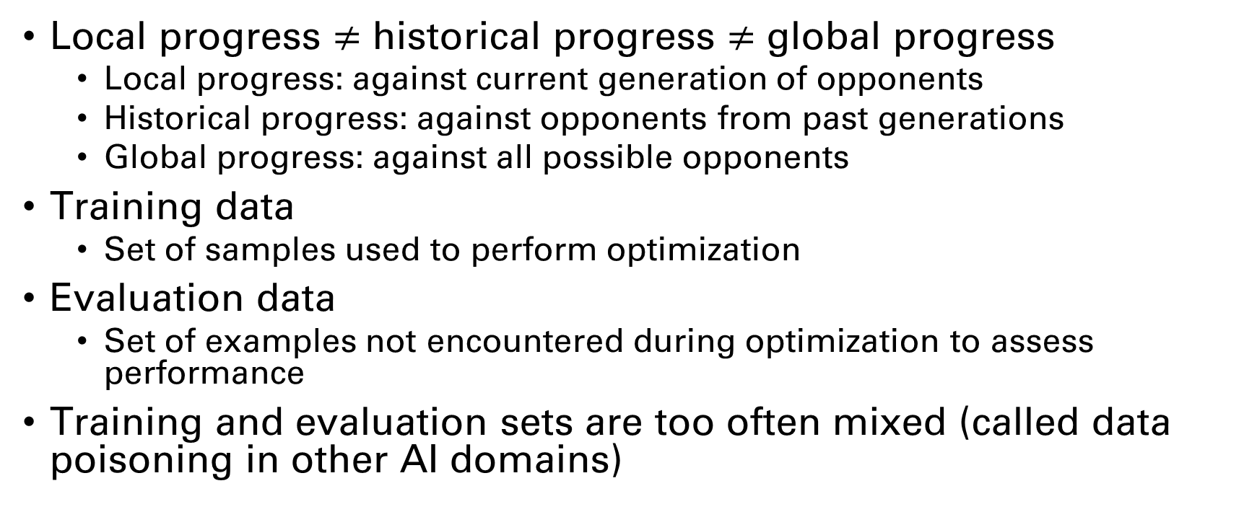
Modern CoEA Issues
Local progress $≠$ historical progress $≠$ global progress
  Local progress: against current generation of opponents
  Historical progress: against opponents from past generations
  Global progress: against all possible opponents
Training data
  Set of samples used to perform optimization
Evaluation data
  Set of examples not encountered during optimization to assess performance
Training and evaluation sets are too often mixed (called data poisoning in other AI domains)
Miconi, T. (2009). Why Coevolution Doesn’t “Work”: Superiority and Progress in Coevolution. Lecture Notes in Computer Science (Including Subseries Lecture Notes in Artificial Intelligence and Lecture Notes in Bioinformatics), 5481 LNCS, 49–60. https://doi.org/10.1007/978-3-642-01181-8_5

Slide 8
Modern CoEA Issues
Historical progress can be deceptive and is often conflated with global progress
  Run with poor historical progress outperformed run with good historical progress in global performance approximation
  This might call into question the impact of pathologies predicated on historical progress in interactive competitive problems
Hall of fame methods can hinder global progress by overemphasizing progress against historical opponents
So-called evolutionary arms races seem to ignore fundamental characteristics of global optimality
How to tune CoEAs?!?
Miconi, T. (2009). Why Coevolution Doesn’t “Work”: Superiority and Progress in Coevolution. Lecture Notes in Computer Science (Including Subseries Lecture Notes in Artificial Intelligence and Lecture Notes in Bioinformatics), 5481 LNCS, 49–60. https://doi.org/10.1007/978-3-642-01181-8_5

Slide 9
Miscellaneous Additional Publications
Multi-population (not quite island model) single species co-evolution with comparison of GP and neuroevolution
  Togelius, J., Burrow, P., & Lucas, S. M. (2007). Multi-population competitive co-evolution of car racing controllers. 2007 IEEE Congress on Evolutionary Computation, CEC 2007, 4043–4050. https://doi.org/10.1109/CEC.2007.4424998
Stable competitive co-evolution with clustering-based opponent selection and alternating population freezing
  Simione, L., & Nolfi, S. (2018). Achieving long-term progress in competitive co-evolution. 2017 IEEE Symposium Series on Computational Intelligence, SSCI 2017 - Proceedings, 2018-January, 1–8. https://doi.org/10.1109/SSCI.2017.8280898
  Skirts the analysis problem by “observing behavioral complexification?”

