Slide 1


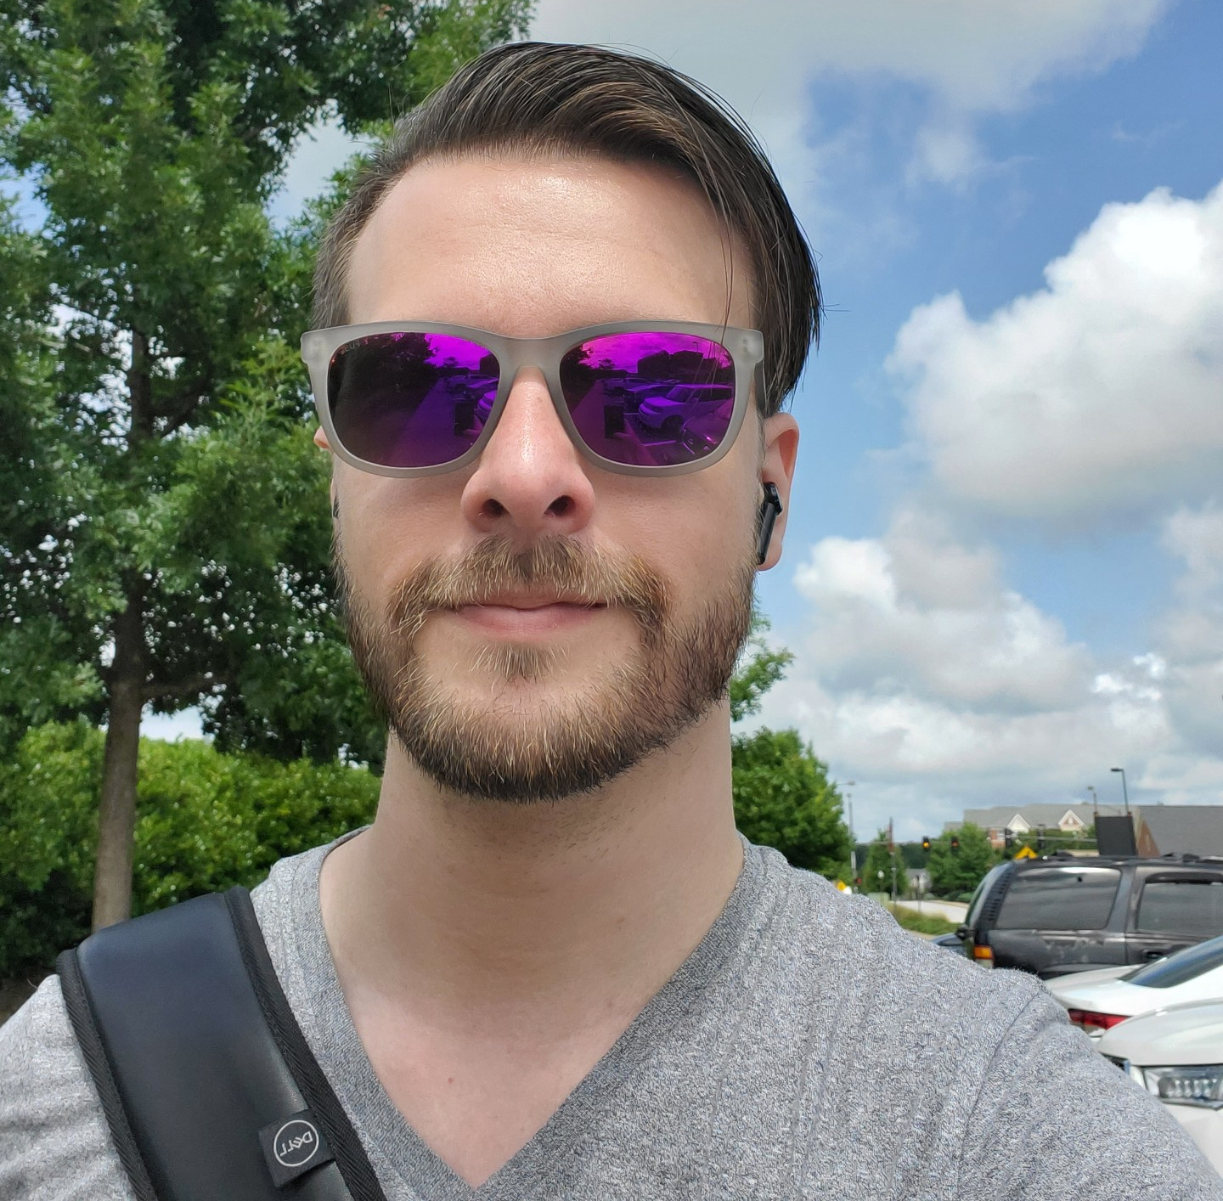
Assignment 0
Presented by Braden Tisdale
Slides by Deacon Seals (1994-2024)
Assignment Creator and seasoned TA

Slide 2
Typical Assignment Workflow
Read assignment description document on class website
Use GitHub Classroom invitation link to create assignment repo
Complete Jupyter Notebook and required deliverables
  Commit and push regularly
Use finalize.sh script to mark repo as ready for grading
Push finalized repo to GitHub

Slide 3
Assignment 0
Make a GitHub account (if you don’t already have one)
Set up an Ubuntu environment and install Anaconda
Get an assignment repo, run the finalize.sh script, and submit

Slide 4
Ubuntu Environment Options
Official methods
Use Windows Subsystem for Linux (WSL)
Strongly recommended – works great if you’re on Windows (this is what I use)
Unofficial methods
Install Ubuntu on bare metal
Install Anaconda on the Tux machines
Requires some SSH configuration and port forwarding
Unsure if IT wants us to do this but it works ¯\_(ツ)_/¯
Make an Ubuntu virtual machine (VM)
A fine option for Windows and (some) Mac users

Slide 5
Some Additional Points
Installing Anaconda sets up the base Conda environment that we’ll use for the duration of the class
  Includes useful packages like Jupyter, Numpy, and Matplotlib
Some of our notebooks will call Bash scripts
  We also use Bash for the finalize script
  This will break if running directly on Windows or Mac
  Other Linux distros probably work fine though
If you run something like ChromeOS or can’t get a VM to install on Mac, let us know and we’ll guide you through the Tux setup
Don’t ask for technical help if you’re not on Ubuntu
  Not our fault if things break because of environment discrepancies

Slide 6
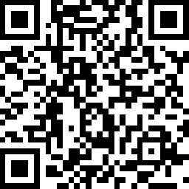
Contacting TAs
As a friendly reminder, your TAs are real human people with responsibilities outside the class
Discord is great for interactive (synchronous) discussion with peers, Dr. T, and TAs
  Discord is our primary channel for critical announcements
  This is a great way to contact TAs during regular business hours
  Don’t post code or grades here in the class Discord
  It’s very easy for messages to get lost and missed by TAs
Email is mandatory for official/sensitive conversations
  Must use your auburn.edu email account

Slide 7

Questions?

