Slide 1
Real-World Challenges
Researchers strive to make algorithms increasingly general-purpose
But practitioners have very specific needs
Designing custom algorithms tuned to particular problem instance distributions and/or computational architectures can be very time consuming

Slide 2
Automated Design of Algorithms
Addresses the need for custom algorithms
But due to high computational complexity, only feasible for repeated problem solving
Generative Hyper-heuristics accomplish automated design of algorithms by searching program space

Slide 3
Generative hyper-heuristics
Generative Hyper-heuristics are a special type of meta-heuristic
  Step 1: Extract algorithmic primitives from existing algorithms
  Step 2: Search the space of programs defined by the extracted primitives
While Genetic Programming (GP) is particularly well suited for executing Step 2, other meta-heuristics can be, and have been, employed
The type of GP employed matters [24]

Slide 4
Relationship between Hyper-heuristics, Genetic Programming, and Genetic Improvement
Heuristics
Exact methods
Meta-heuristics and hyper- heuristics
Genetic Programming
Genetic Improvement
Selection Hyper-heuristics
Generative Hyper-heuristics
Automatic Parameter Tuning
Auto ML (machine learning)

Slide 5
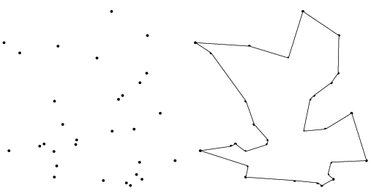
Conceptual Overview
Combinatorial problem e.g. Travelling Salesman
Exhaustive search ->heuristic?
Genetic Algorithm
heuristic – permutations
Travelling Salesman
Tour
Single tour NOT EXECUTABLE!!!
Genetic Programming
code fragments in for-loops.
Give a man a fish and he
will eat for a day.
Teach a man to fish and he
will eat for a lifetime.
Travelling Salesman Instances
TSP algorithm
Scalable? General?
New domains for GP
EXECUTABLE on MANY INSTANCES!!!
Notes:
If you are in the wrong room

Slide 6



One Man – One/Many Algorithm
Genetic Programming
{+, -, *, /}
{AND, OR, NOT}
First year university course
On Java, as part of a computer
Science degree
LARGE
Software
Engineering
Projects
Automatically
designed heuristics
(this tutorial)
Increasing “complexity”
Heuristic1
Heuristic1
Automatic
Design
Heuristic2
Heuristic2
Heuristic10,000
Heuristic3
Notes:
Ga
Ga’
Ga ‘ version 2.o
Ga ‘ version 2.o hydidized with knobs and whistles.

Slide 7
A Paradigm Shift?
One person
proposes one
algorithm
and tests it
in isolation.
One person proposes a
family of algorithms
and tests them
in the context of
a problem class.
Algorithms investigated/unit time
Human cost (INFLATION) machine cost MOORE’S LAW
conventional approach new approach
Previously one person proposes one algorithm
Now one person proposes a set of algorithms
Analogous to “industrial revolution” from hand made to machine made. Automatic Design.
Notes:
What could you do after this talk you could not do before.

Slide 8
Case Study 1: Evolving Multi-level Graph Partitioning Algorithms [28]

Slide 9
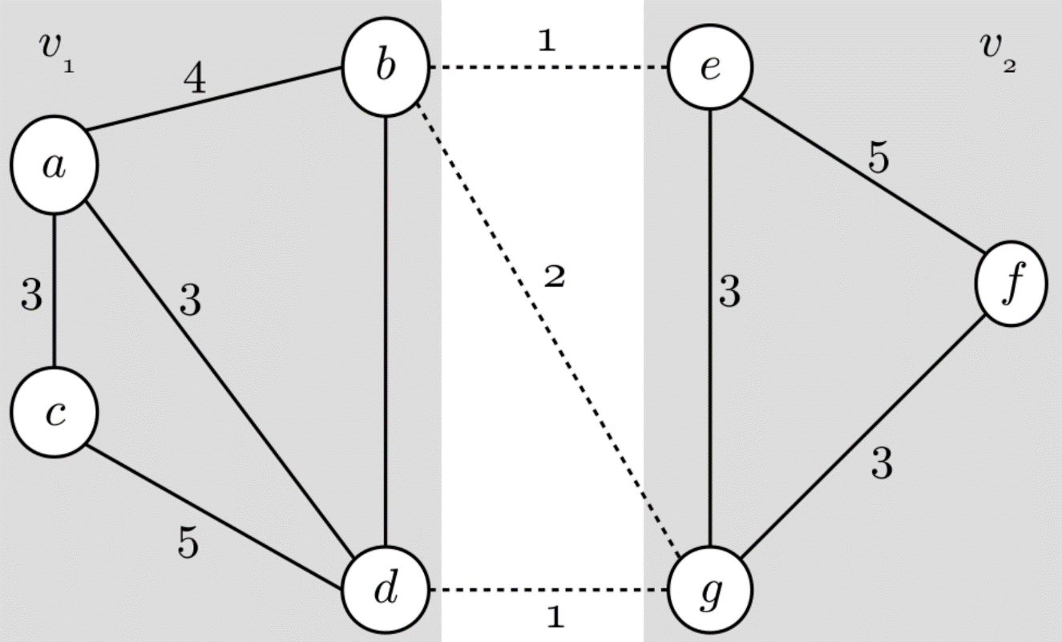
Graph Partitioning
Graph partitioning can be applied to several problems
  Parallel computation: minimize inter-process communication
  Network security: placing network traffic monitors at critical junctures
In general, optimal graph partitioning is NP-hard
Real-time applications require fast approximation heuristics

Slide 10
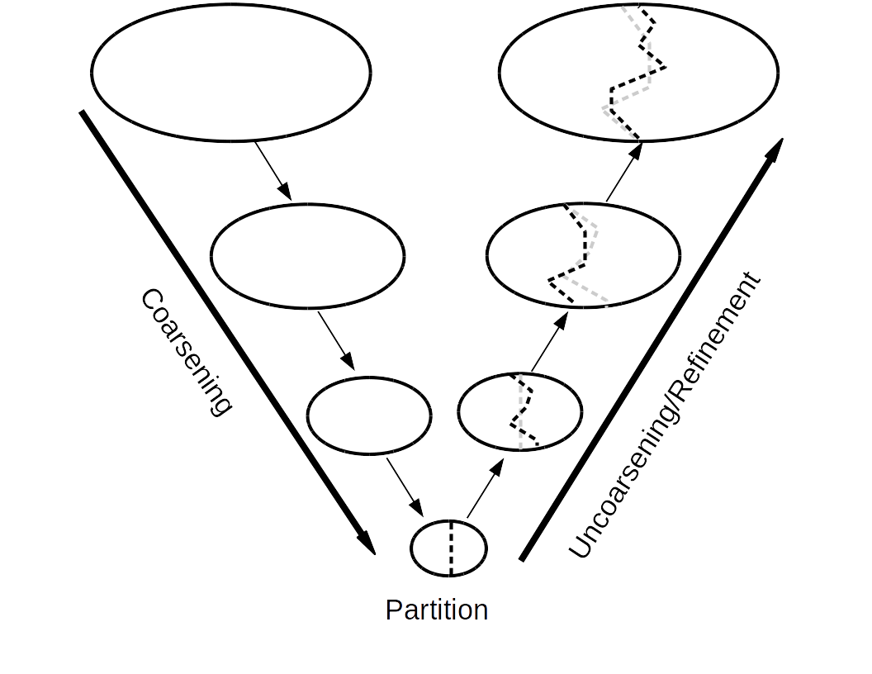
Multi-level Graph Partitioning
Approximate graph with sequence of smaller graphs
Quickly partition smallest graph
Use partition of smallest graph as an initial partition of the next smallest
Perform greedy search to improve the quality of the partition
Repeat steps 3 and 4 until partition is found for the original graph

Slide 11
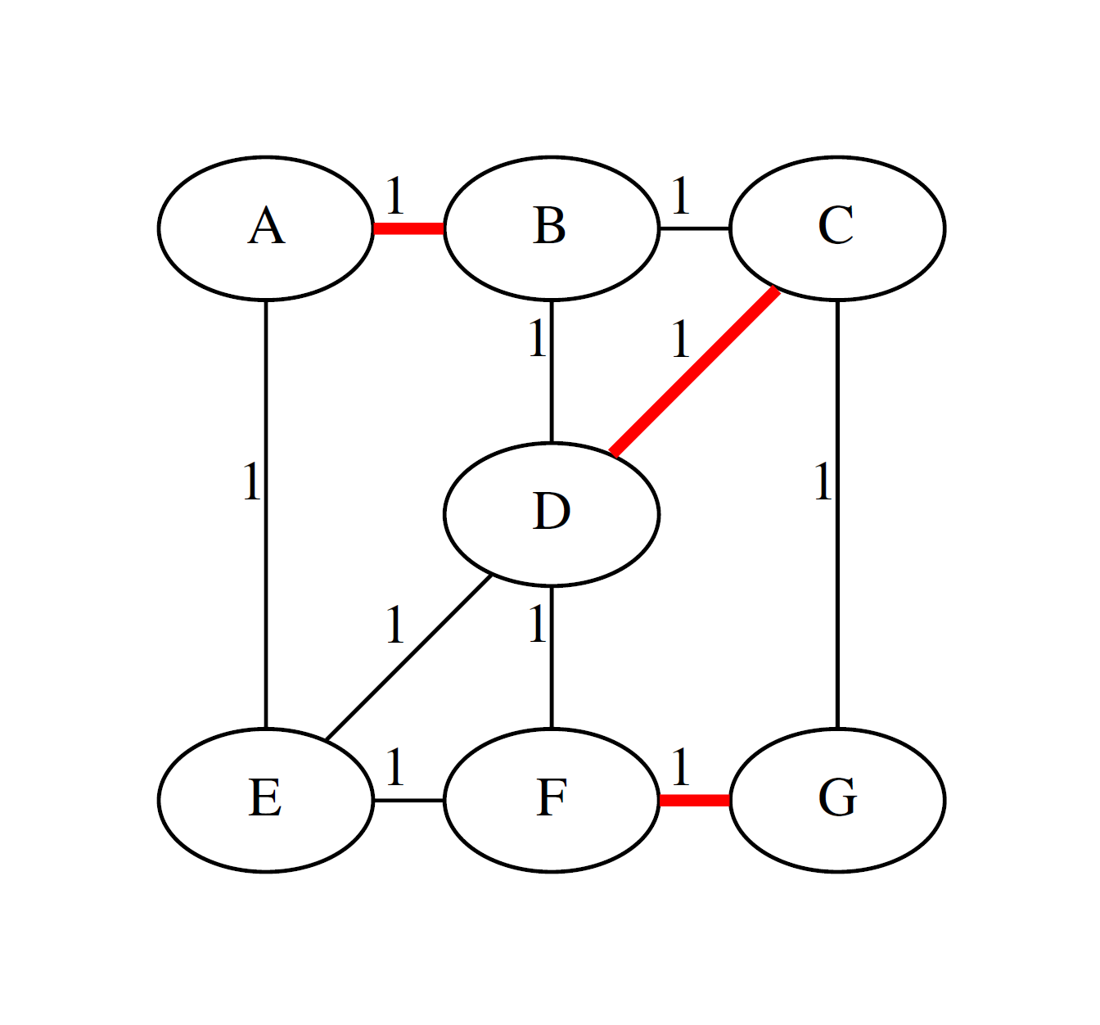
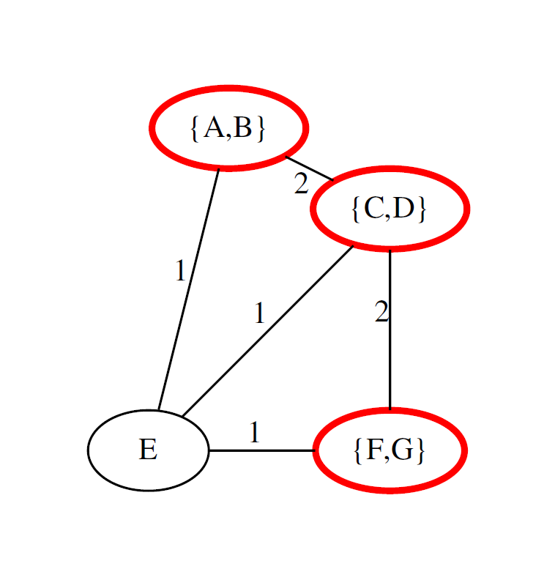

Coarsening: Matching Contraction

Slide 12
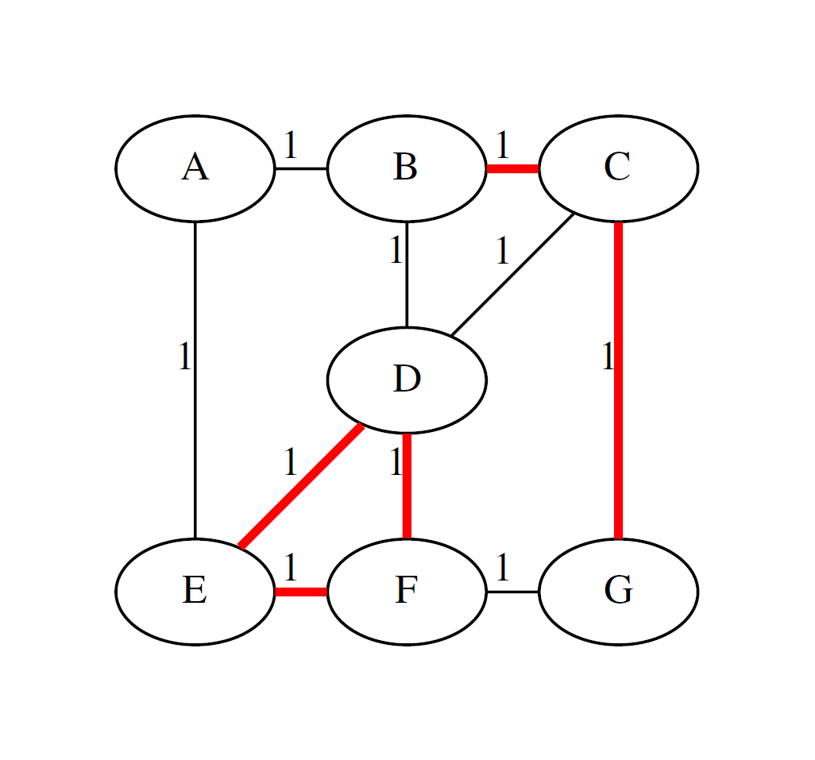
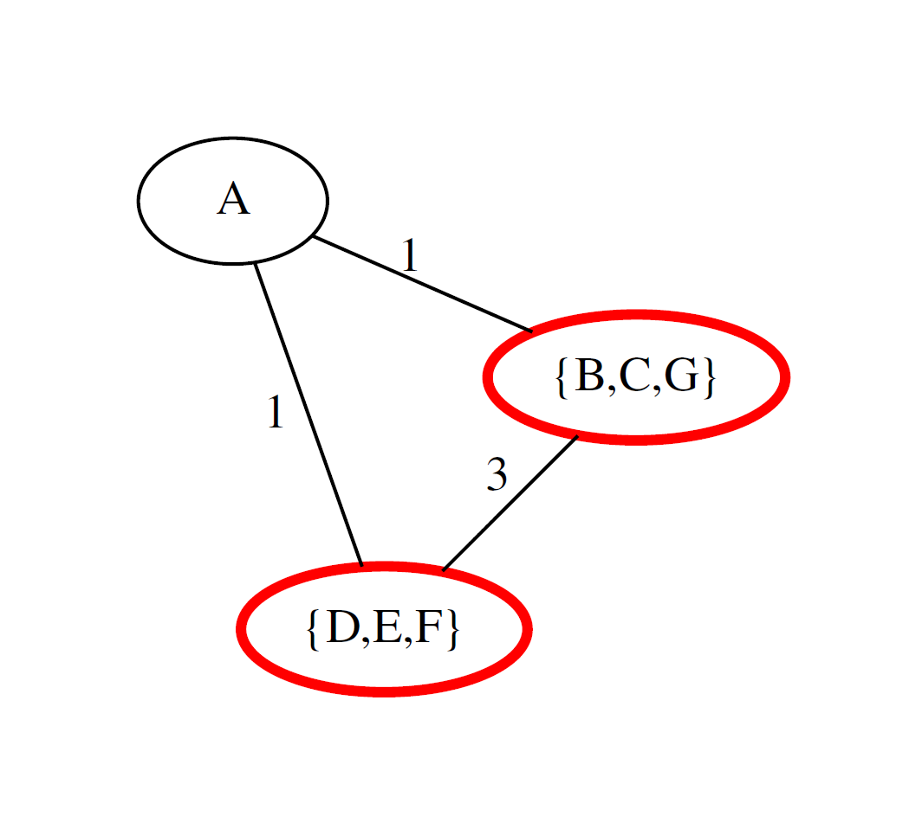
Coarsening: Subgraph Contraction

Slide 13
Optimizing Multi-level Partitioning
Multi-level partitioning of power-law graphs can be improved with specialized coarsening heuristics*
Demonstrates the potential to customize an algorithm for graphs with particular characteristics
Manually developing new heuristics can be expensive
Process can be automated using hyper-heuristics
*A. Abou-Rjeili and G. Karypis, “Multilevel Algorithms for Partitioning Power-law Graphs,” in Proceedings of the 20th International Parallel and Distributed Processing Symposium (IPDPS’06), IEEE, Rhodes Island, Greece, 2006.

Slide 14
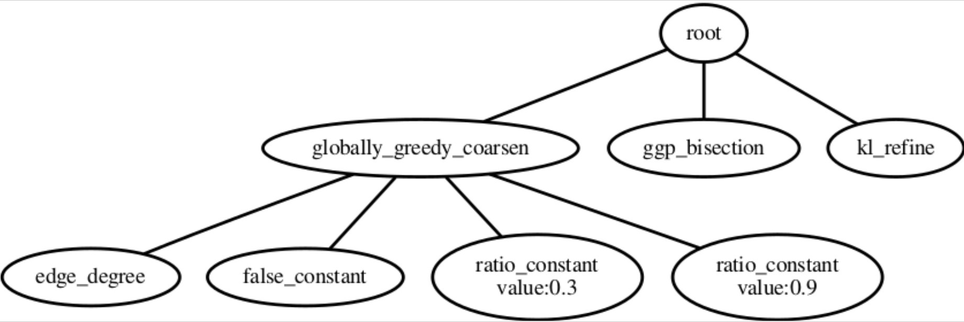
Hyper-heuristic Approach
Extract functionality from existing graph partitioning techniques
Use Genetic Programming (GP) to construct new algorithms

Slide 15
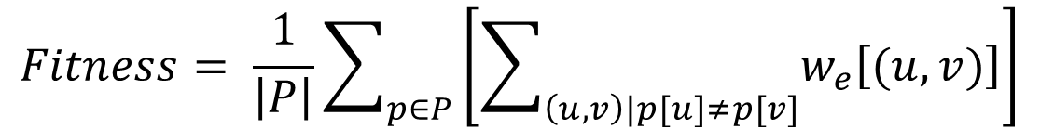
Methodology
Evolve a population of graph partition algorithms
Strongly typed parse tree representation
Evolution targeted at specific type of graph (e.g., random graph model, computer network)
Cost of partitions produced determines solution fitness (averaged over many graphs)
$$Fitness= \frac{1}{\left|P\right|}\sum_{p∈P}{\left[\sum_{\left(u,v\right)|p[u]≠p[v]}{w_{e}\left[(u,v)\right]}\right]}$$

Slide 16
Primitive Operations
Root node
  child node for each of: coarsening, partitioning, uncoarsening
Coarsening
  Traditional matching schemes: random, heavy edge, light edge
  Globally greedy: considers all edges in graph sorted by some metric
  Locally greedy: randomly visits vertices, considers incident edges
  Edge metrics: weight, degree, or core number of incident vertices, or edge weight (can be combined using math operators)

Slide 17
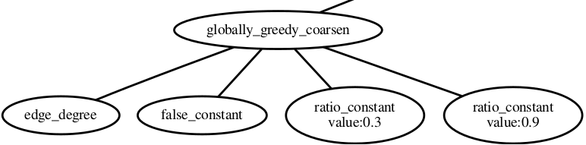
Globally and Locally Greedy Coarsening
Edge metric
Reverse ordering (maximize)
Maximum vertex weight ratio
Maximum contraction ratio

Slide 18
Primitive Operations (cont.)
Partitioning
  random, growth, greedy growth, spectral, Kernighan-Lin
Uncoarsening
  KL refinement, greedy refinement
Miscellaneous
  Constants: integers, ratios, booleans
  Random conditional: randomly true or false according to child probability value

Slide 19
Experiment
Partition algorithms are evolved targeting:
  Erdös-Rényi random graphs
  Barabási-Albert random graphs
  Los Alamos National Laboratory (LANL) authentication graphs
Performance is compared against METIS partitioning software as well as spectral partitioning

Slide 20
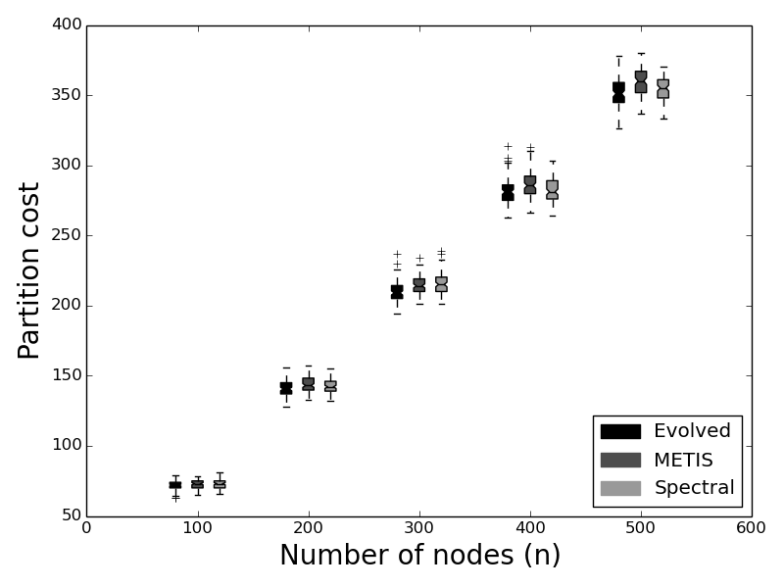
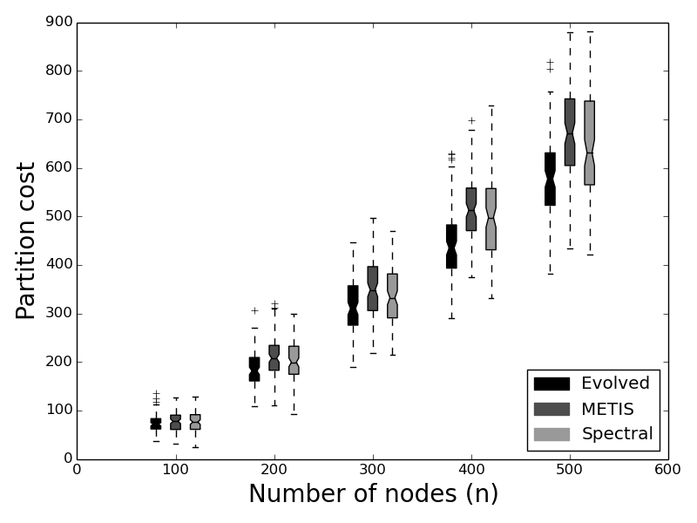
Results
Method | E_{ER} | E_{BA} | E_{LANL} | METIS | SP
E_{ER} | 0.0 | -0.06 | -0.38 | -0.06 | -4.55
E_{BA} | -0.53 | 0.0 | -0.12 | -0.72 | -0.92
E_{LANL} | -0.48 | -0.10 | 0.0 | -2.97 | -3.90
Barabási-Albert
LANL network

Slide 21
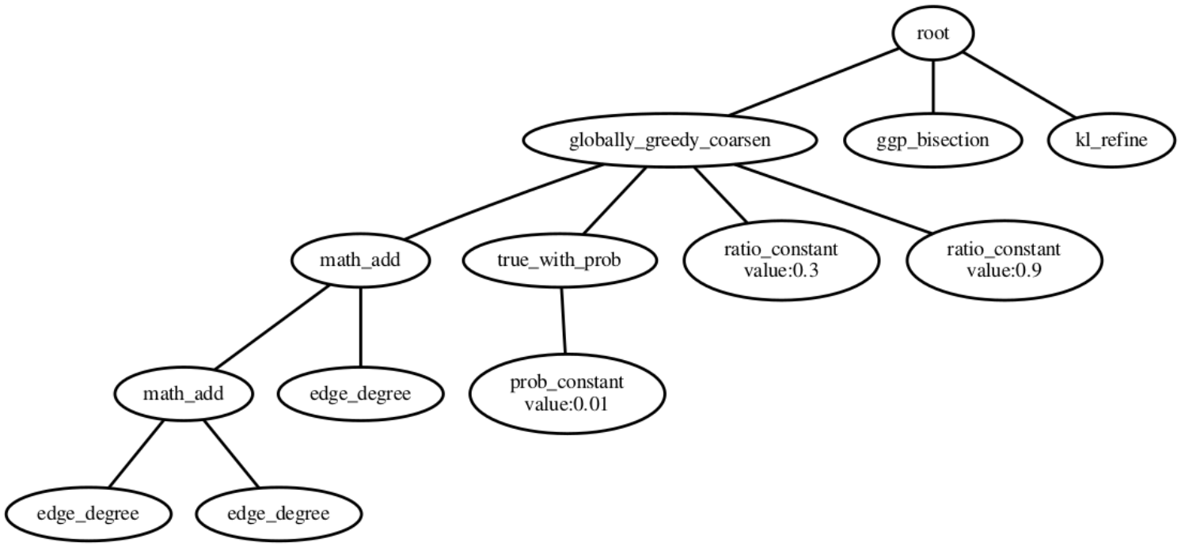
Representative High Fitness Final Evolved Solution (E_{BA})

Slide 22
Conclusion
Multi-level partitioning algorithms can be tailored to specific graph types, including real-world networks
These customized heuristics improve upon general purpose graph partitioning methods
The design process can be automated using hyper-heuristics

Slide 23
Case Study 2: The Automated Design of Mutation Operators for Evolutionary Programming

Slide 24
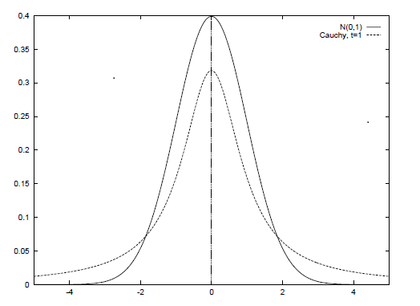
Designing Mutation Operators for Evolutionary Programming [18]
Evolutionary programing optimizes functions by evolving a population of real-valued vectors (genotype).
Variation has been provided (manually) by probability distributions (Gaussian, Cauchy, Levy).
We are automatically generating probability distributions (using genetic programming).
Not from scratch, but from already well known distributions (Gaussian, Cauchy, Levy). We are “genetically improving probability distributions”.
We are evolving mutation operators for a problem class (probability distributions over functions).
NO CROSSOVER
Genotype is
(1.3,...,4.5,…,8.7)
Before mutation
Genotype is
(1.2,...,4.4,…,8.6)
After mutation

Slide 25
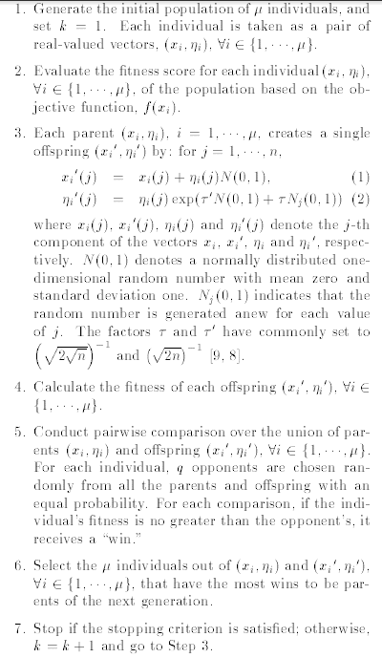
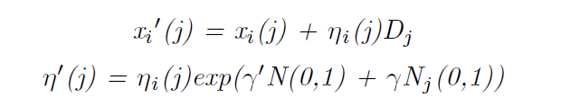
(Fast) Evolutionary Programming
Heart of algorithm is mutation
SO LETS AUTOMATICALLY DESIGN
EP mutates with a Gaussian
FEP mutates with a Cauchy
A generalization is mutate with a distribution D (generated with genetic programming)

Slide 26

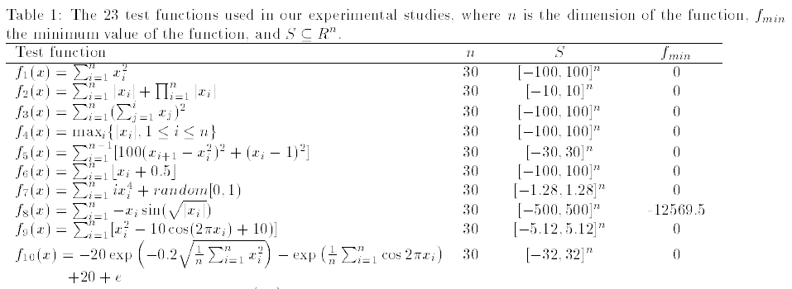
Optimization & Benchmark Functions
A set of 23 benchmark functions is typically used in the literature. Minimization
We use them as problem classes.

Slide 27
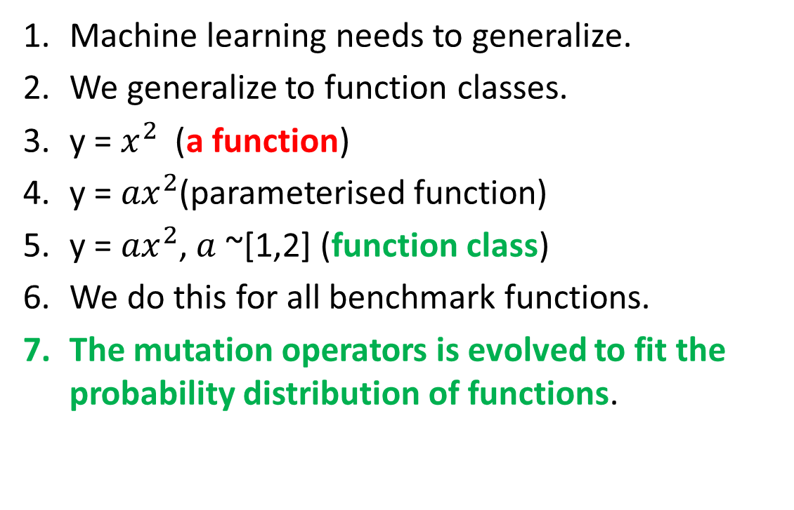
Function Class 1
Machine learning needs to generalize.
We generalize to function classes.
y = $x^{2}$(a function)
y = ${ax}^{2}$(parameterised function)
y = ${ax}^{2}$, $a$ ~[1,2] (function class)
We do this for all benchmark functions.
The mutation operators is evolved to fit the probability distribution of functions.

Slide 28
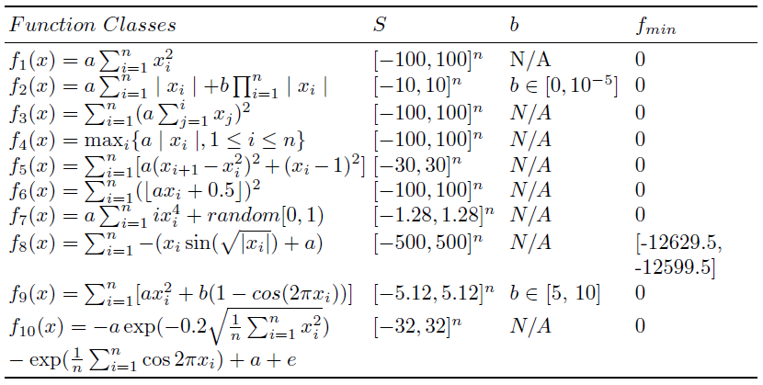
Function Classes 2

Slide 29
Meta and Base Learning
At the base level we are learning about a specific function.
At the meta level we are learning about the problem class.
We are just doing “generate and test” at a higher level
What is being passed with each blue arrow?
Conventional EP
Meta level
Function class
Probability
Distribution
Generator
Function to optimize
EP
base level

Slide 30
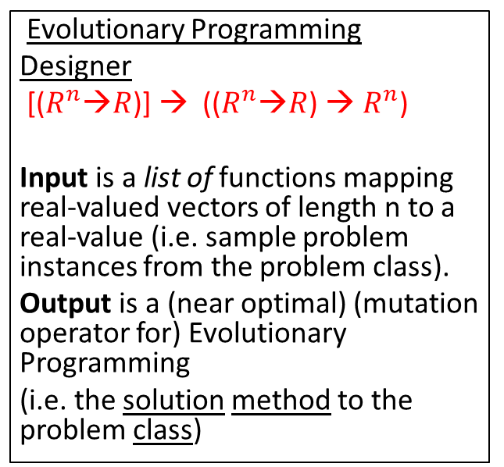
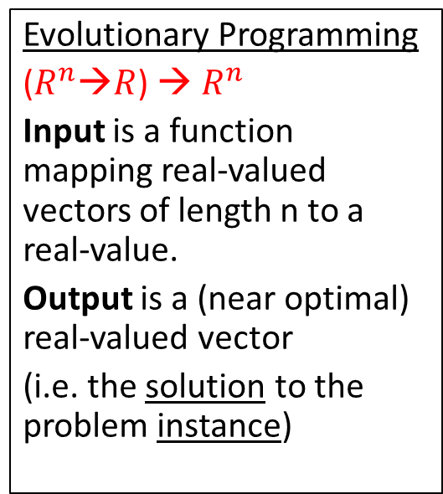
Compare Signatures (Input-Output)
Evolutionary Programming
($R^{n}$→$R$) → $R^{n}$
Input is a function mapping real-valued vectors of length n to a real-value.
Output is a (near optimal) real-valued vector
(i.e. the solution to the problem instance)
Evolutionary Programming
Designer
[($R^{n}$→$R$)] → (($R^{n}$→$R$) → $R^{n}$)
Input is a list of functions mapping real-valued vectors of length n to a real-value (i.e. sample problem instances from the problem class).
Output is a (near optimal) (mutation operator for) Evolutionary Programming
(i.e. the solution method to the problem class)
We are raising the level of generality at which we operate.

Slide 31
Genetic Programming to Generate Probability Distributions
GP Function Set {+, -, *, %}
GP Terminal Set {N(0, random)}
N(0,1) is a normal distribution.
For example a Cauchy distribution is generated by N(0,1)%N(0,1).
Hence the search space of probability distributions contains the two existing probability distributions used in EP but also novel probability distributions.
SPACE OF
PROBABILITY
DISTRIBUTIONS
GAUSSIAN
CAUCHY
NOVEL
PROBABILITY
DISTRIBUTIONS

Slide 32
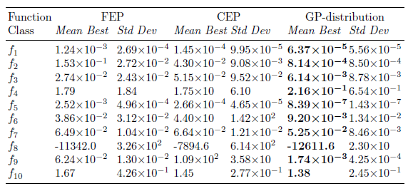
Means and Standard Deviations
These results are good for two reasons.
starting with a manually designed distributions (Gaussian).
evolving distributions for each function class.

Slide 33
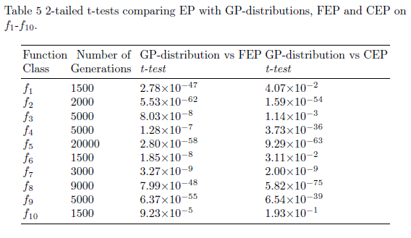
T-tests

Slide 34
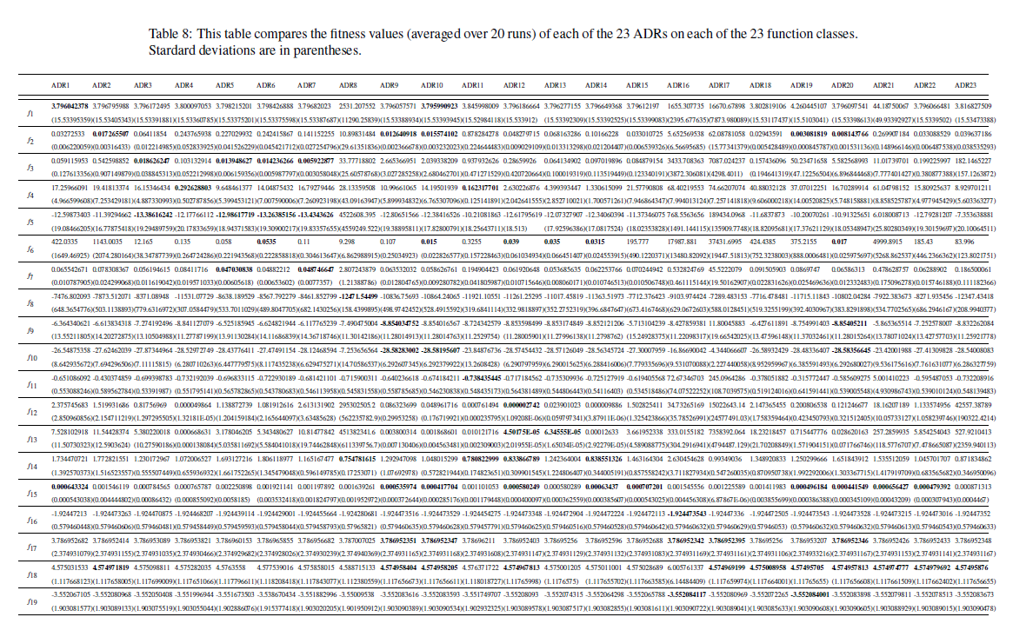
Performance on Other Problem Classes

Slide 35
Case Study 3: The Automated Design of On-Line Bin Packing Algorithms

Slide 36
On-line Bin Packing Problem [9,11]
A sequence of items packed into as few a bins as possible.
Bin size is 150 units, items uniformly distributed between 20-100.
Different to the off-line bin packing problem where the set of items.
The “best fit” heuristic, places the current item in the space it fits best (leaving least slack).
It has the property that this heuristic does not open a new bin unless it is forced to.
Array of bins
150 =
Bin
capacity
Range of
Item size
20-100
Items packed so far
Sequence of pieces to be packed

Slide 37
Genetic Programming applied to on-line bin packing
Not obvious how to link
Genetic Programming to combinatorial problems.
The GP tree is applied to each
bin with the current item and placed in the bin with
The maximum score
C capacity
E emptiness
Fullness is
irrelevant
The space is
important
Terminals supplied to Genetic Programming
Initial representation {C, F, S}
Replaced with {E, S}, E=C-F
F fullness
S size
S size

Slide 38
How the heuristics are applied (skip)
%
C
-
C
+
-15
-3.75
3
4.29
1.88
S
F
70
120
85
70
90
60
45
30
30

Slide 39
The Best Fit Heuristic
Best fit = 1/(E-S). Point out features.
Pieces of size S, which fit well into the space remaining E, score well.
Best fit applied produces a set of points on the surface,
The bin corresponding to the maximum score is picked.
emptiness
Piece size

Slide 40
Our Best Heuristic
Similar shape to best fit – but curls up in one corner.
Note that this is rotated, relative to previous slide.

Slide 41
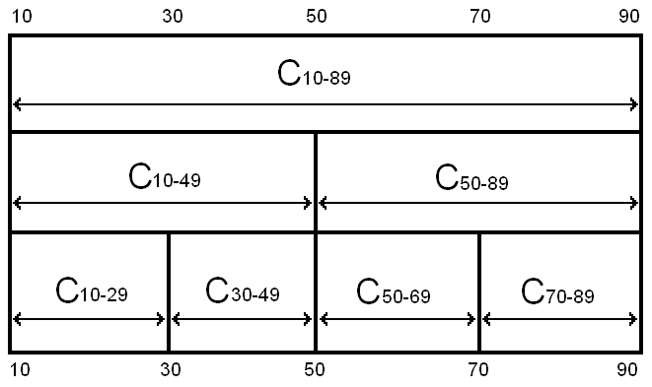
Robustness of Heuristics
= all legal results
= some illegal results
Notes:
Even though the problem is the same, and the hard constraints are the same, the heuristics can fail to stay within the hard constraints if they are asked to pack piece sizes they have not seen before
The safeguards against giving illegal solutions that work in one class will not work in another

Slide 42
Testing Heuristics on problems of much larger size than in training
Table I | H trained100 | H trained 250 | H trained 500
100 | 0.427768358 | 0.298749035 | 0.140986023
1000 | 0.406790534 | 0.010006408 | 0.000350265
10000 | 0.454063071 | 2.58E-07 | 9.65E-12
100000 | 0.271828318 | 1.38E-25 | 2.78E-32
Table shows p-values using the best fit heuristic, for heuristics trained on
different size problems, when applied to different sized problems
1. As number of items trained on increases, the probability decreases (see next slide).
2. As the number of items packed increases, the probability decreases (see next slide).

Slide 43
Compared with Best Fit
Amount
evolved
heuristics
beat
best fit by.
Number of pieces
packed so far.
Averaged over 30 heuristics over 20 problem instances
Performance does not deteriorate
The larger the training problem size, the better the bins are packed.

Slide 44
Compared with Best Fit
Zoom in
of previous
slide
Amount
evolved
heuristics
beat
best fit by.
The heuristic seems to learn the number of pieces in the problem
Analogy with sprinters running a race – accelerate towards end of race.
The “break even point” is approximately half of the size of the training problem size
If there is a gap of size 30 and a piece of size 20, it would be better to wait for a better piece to come along later – about 10 items (similar effect at upper bound?).

Slide 45
Step by Step Guide to Automatic Design of Algorithms [8, 12]
Study the literature for existing heuristics for your chosen domain (manually designed heuristics).
Build an algorithmic framework or template which expresses the known heuristics.
Let metaheuristics (e.g., Genetic Programming) search for variations on the theme.
Train and test on problem instances drawn from the same probability distribution (like machine learning). Constructing an optimizer is machine learning (this approach prevents “cheating”).

Slide 46
A Brief History (Example Applications) [5]
Image Recognition – Roberts Mark
Travelling Salesman Problem – Keller Robert
Boolean Satisfiability – Holger Hoos, Fukunaga, Bader-El-Den, Alex Bertels & Daniel Tauritz
Data Mining – Gisele L. Pappa, Alex A. Freitas
Decision Tree - Gisele L. Pappa et al
Crossover Operators – Oltean et al, Brian Goldman and Daniel Tauritz
Selection Heuristics – Woodward & Swan, Matthew Martin & Daniel Tauritz
Bin Packing 1,2,3 dimension (on and off line) Edmund Burke et. al. & Riccardo Poli et al
Bug Location – Shin Yoo
Job Shop Scheduling – Mengjie Zhang
Black Box Search Algorithms – Daniel Tauritz et al
Graph Algorithms – Aaron Pope & Daniel Tauritz

Slide 47
Case Study 4: The Automated Design of Black Box Search Algorithms [21, 23, 25]

Slide 48
Approach
Hyper-Heuristic employing Genetic Programing
Post-ordered parse tree
Evolve the iterated function

Slide 49
Our Solution
Initialization
Iterated Function
Check for Termination
Terminate

Slide 50
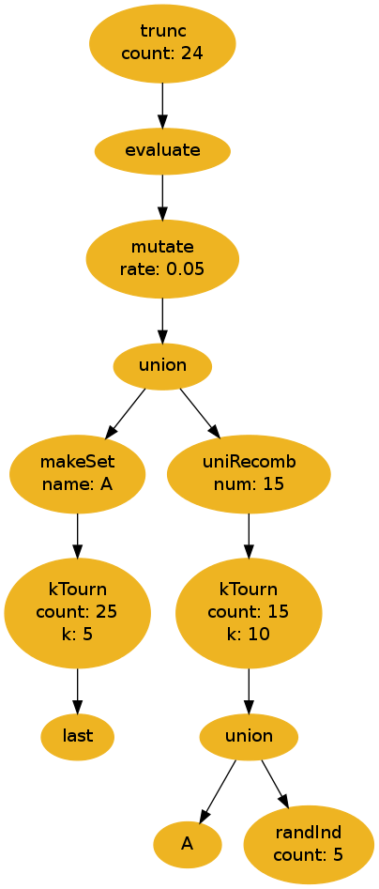
Our Solution
Hyper-Heuristic employing Genetic Programing
Post-ordered parse tree
Evolve the iterated function
High-level primitives

Slide 51
Parse Tree
Iterated function
Sets of solutions
Function returns a set of solutions accessible to the next iteration

Slide 52
Primitive Types
Variation Primitives
Selection Primitives
Set Primitives
Evaluation Primitive
Terminal Primitives

Slide 53
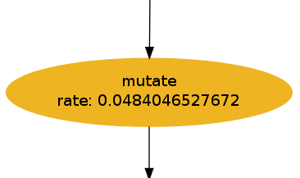
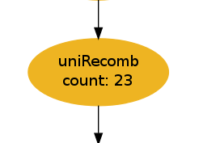
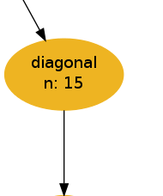
Variation Primitives
Bit-flip Mutation
  rate
Uniform Recombination
  count
Diagonal Recombination
  n

Slide 54
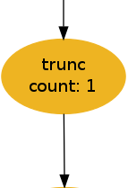
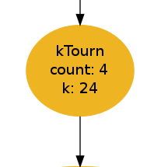
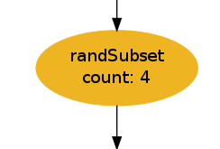
Selection Primitives
Truncation Selection
  count
K-Tournament Selection
  k
  count
Random Sub-set Selection
  count

Slide 55
Set-Operation Primitives
Make Set
  name
Persistent Sets
  name
Union

Slide 56
Evaluation Primitive
Evaluates the nodes passed in
Allows multiple operations and accurate selections within an iteration
  Allows for deception

Slide 57
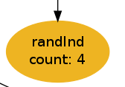
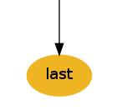

Terminal Primitives
Random Individuals
  count
`Last’ Set
Persistent Sets
  name

Slide 58
Meta-Genetic Program
Create Valid Population
Select Survivors
Check
Termination
Generate Children
Evaluate
Children

Slide 59

BBSA Evaluation
Create Valid Population
Select Survivors
Generate Children
Generate Children
Evaluate
Children

Slide 60
Termination Conditions
Evaluations
Iterations
Operations
Convergence

Slide 61
Proof of Concept Testing
Deceptive Trap Problem
0 | 0 | 1 | 1 | 0
0 | 1 | 0 | 1 | 0
1 | 1 | 1 | 1 | 0

Slide 62
Proof of Concept Testing (cont.)
Evolved Problem Configuration
  Bit-length = 100
  Trap Size = 5
Verification Problem Configurations
  Bit-length = 100, Trap Size = 5
  Bit-length = 200, Trap Size = 5
  Bit-length = 105, Trap Size = 7
  Bit-length = 210, Trap Size = 7

Slide 63
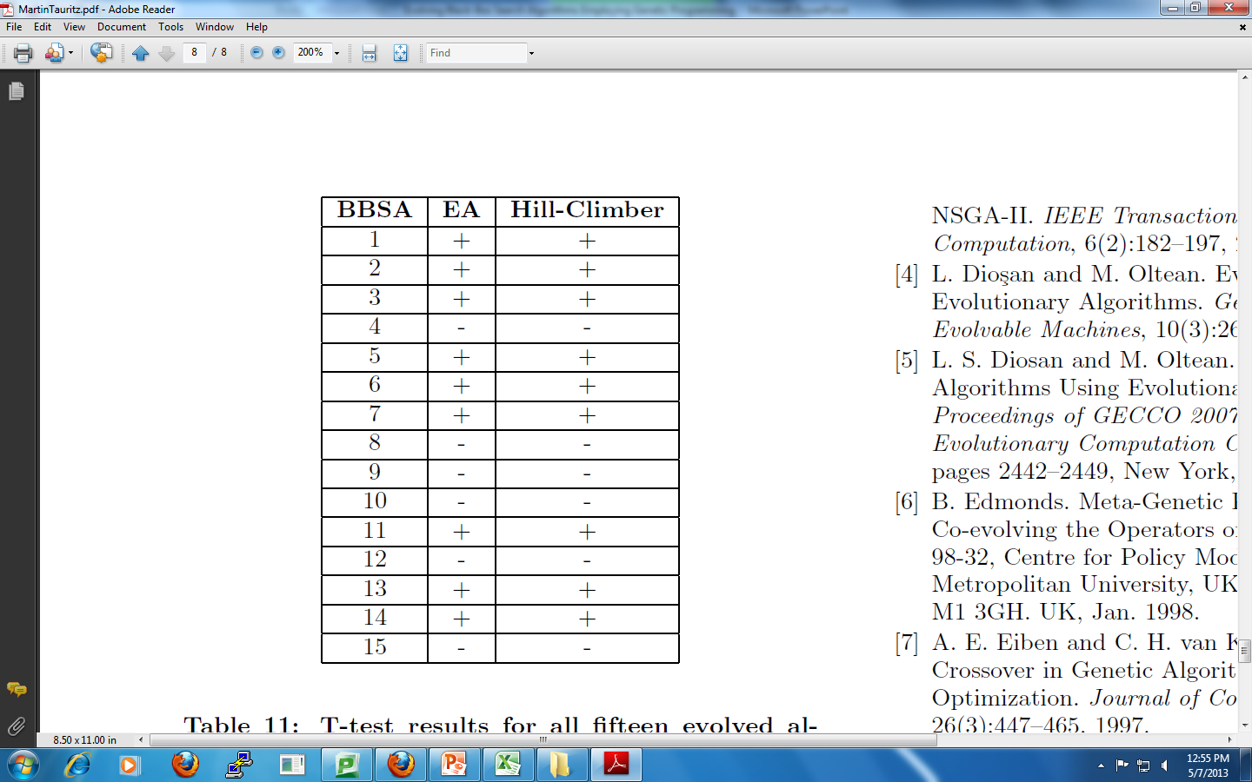
Results
60% Success Rate

Slide 64
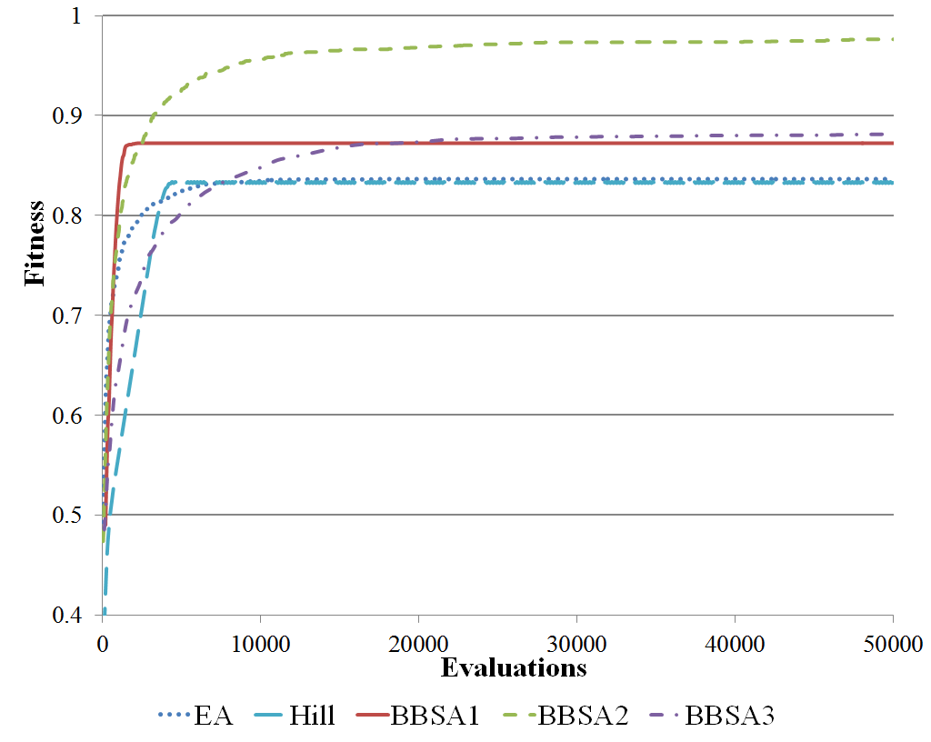
Results:
Bit-Length = 100
Trap Size = 5

Slide 65
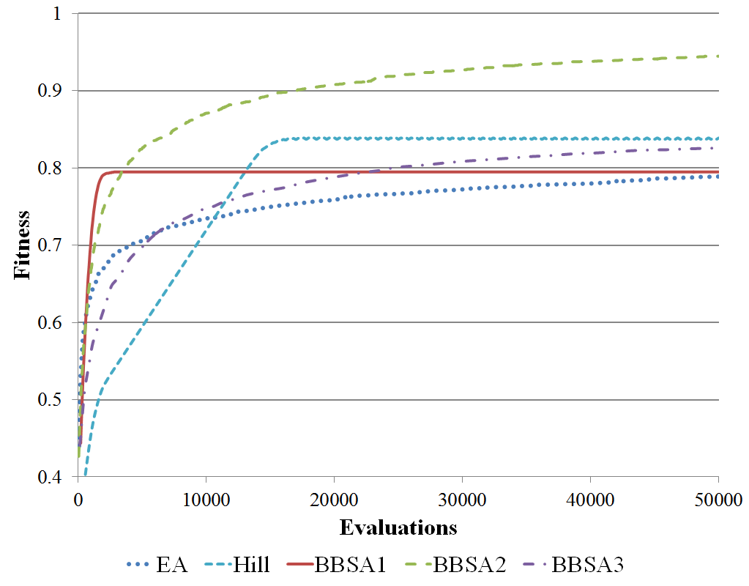
Results:
Bit-Length = 200
Trap Size = 5

Slide 66
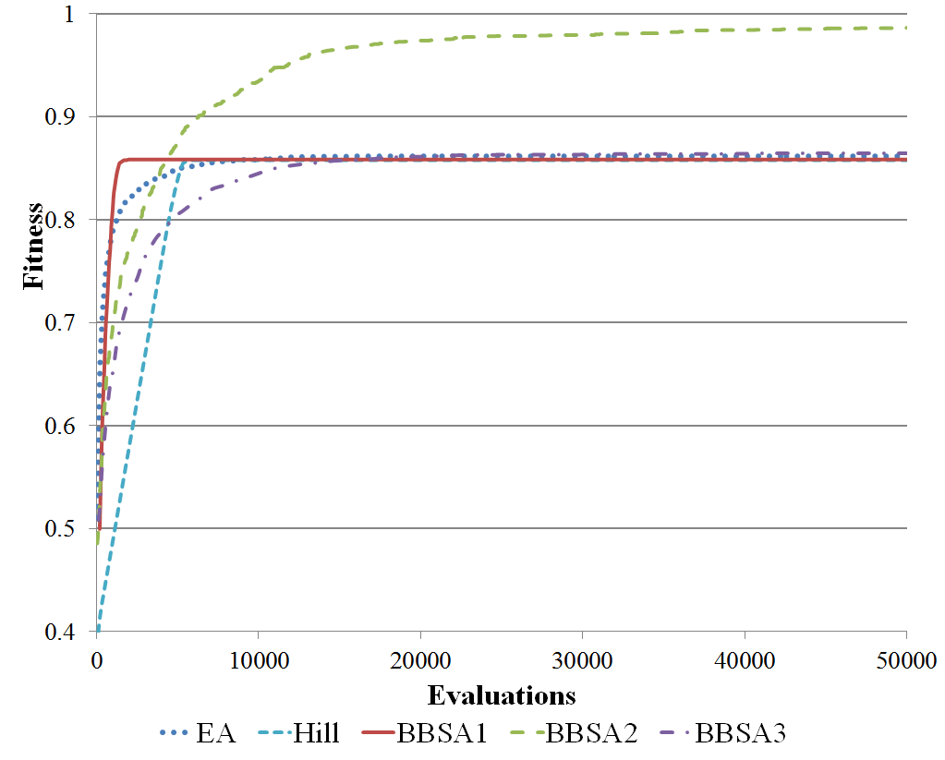
Results:
Bit-Length = 105
Trap Size = 7

Slide 67
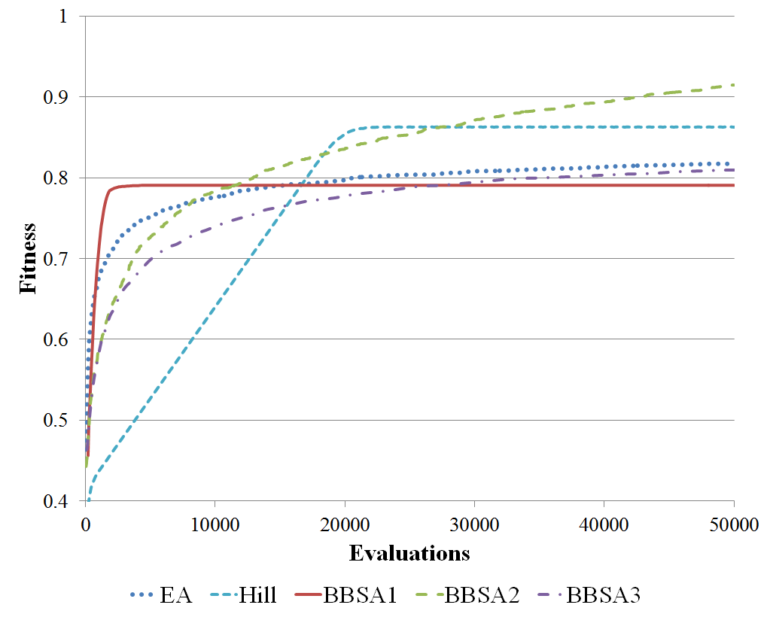
Results:
Bit-Length = 210
Trap Size = 7

Slide 68
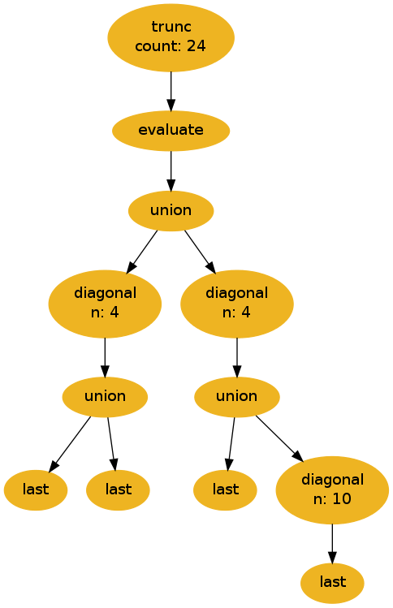
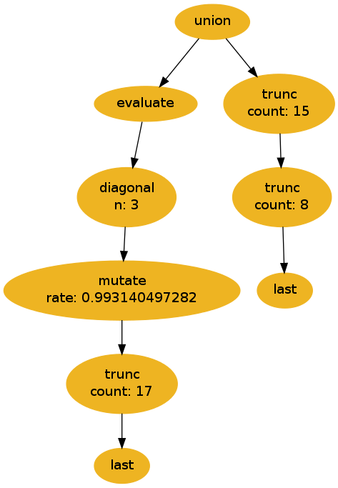
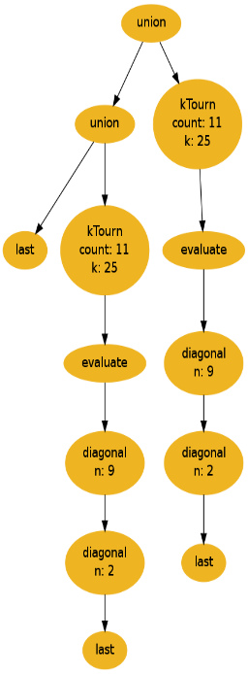
BBSA2
BBSA1
BBSA3

Slide 69
BBSA1

Slide 70
BBSA2

Slide 71

BBSA3

Slide 72
BBSA2

Slide 73
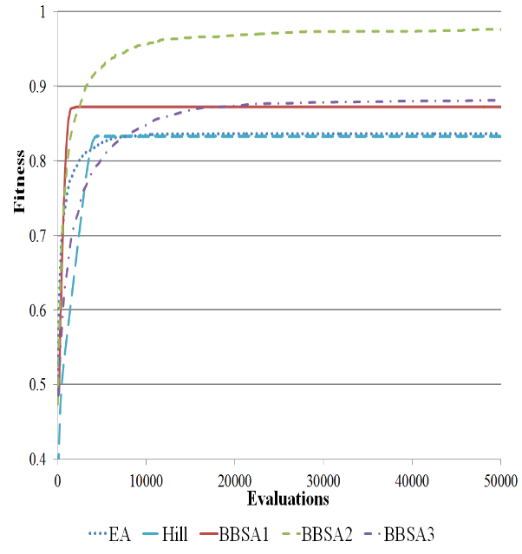
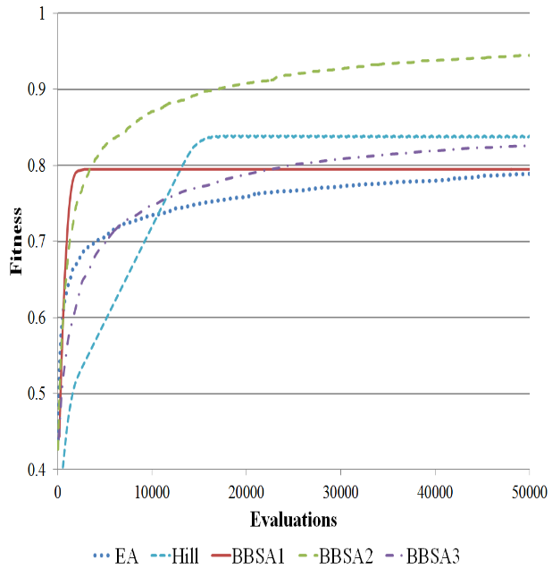
Over-Specialization
Trained Problem Configuration
Alternate Problem Configuration

Slide 74
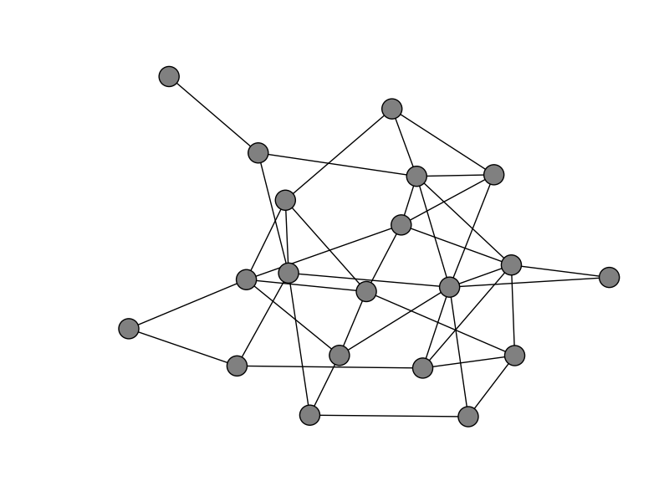
Case Study 5: Evolving Random Graph Generators: A Case for Increased Algorithmic Primitive Granularity [27]

Slide 75
Random Graphs
Graphs are a powerful modeling tool
  Computer and social networks
  Transportation and power grids
Algorithms designed for graphs
  Community detection and graph partitioning
  Network routing and intrusion detection
Random graphs provide test data
Prediction using random graphs
  Spread of disease
  Deployment of wireless sensors

Slide 76
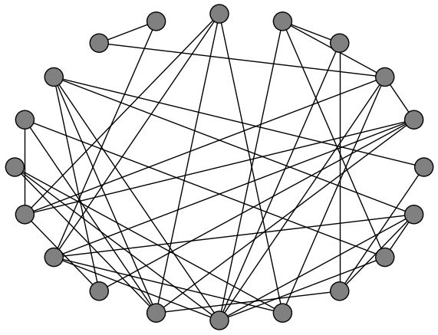
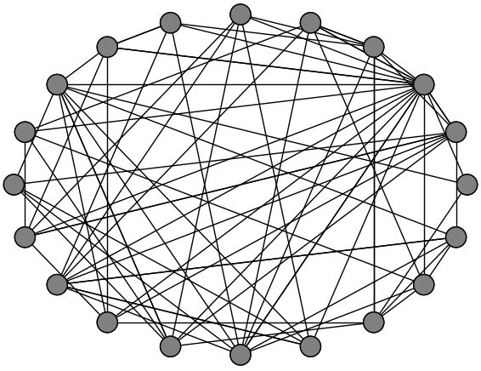
Traditional Random Graph Models
Erdös-Rényi
Barabási-Albert

Slide 77
Automated Random Graph Model Design
Random graph model needs to accurately reflect intended concept
Model selection can be automated, but relies on having a good solution available
Developing an accurate model for a new application can be difficult
Can the model design process be automated to produce an accurate graph model given examples?

Slide 78
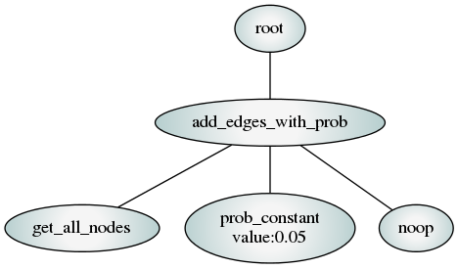
Hyper-heuristic Approach
Extract functionality from existing graph generation techniques
Use Genetic Programming (GP) to construct new random graph algorithms

Slide 79
Previous Attempts at Evolving Random Graph Generators
Assumes “growth” model, adding one node at a time
Does well at reproducing traditional models
Not demonstrated to do well at generating real complex networks
Limits the search space of possible solutions

Slide 80
Increased Algorithmic Primitive Granularity
Remove the assumed “growth” structure
More flexible lower-level primitive set
Benefit: Can represent a larger variety of algorithms
Drawback: Larger search space, increasing complexity

Slide 81
Methodology
NSGA-II evolves population of random graph models
Strongly typed parse tree representation
Centrality distributions used to evaluate solution quality (degree, betweenness, PageRank)

Slide 82
Primitive Operations
Terminals
Graph elements: nodes, edges
Graph properties: average degree, size, order
Constants: integers, probabilities, Booleans, user inputs
No-op terminators
Functions
Basic programming constructs: for, while, if-else
Data structures: lists of values, nodes, or edges, list
combining/selection/sorting
Math and logic operators: add, multiply, <, ==, AND, OR
Graph operators: add edges, add subgraph, rewire edges

Slide 83
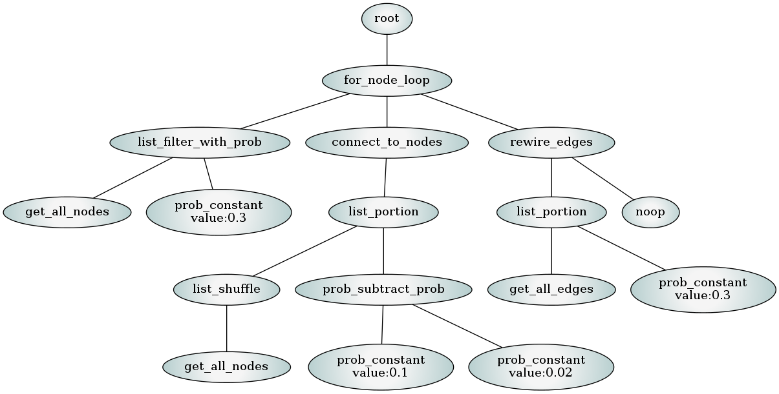
Example Evolved Random Graph Generator

Slide 84
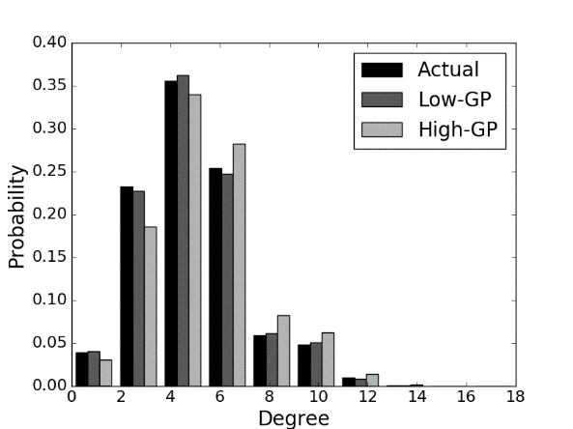


Reproducing Erdös-Rényi
 | Low-GP |  |  | High-GP
Metric | Mean | σ | Comparison | Mean | σ
Degree | 0.101 | 0.048 | = | 0.108 | 0.047
Betweenness | 0.104 | 0.031 | = | 0.105 | 0.033
PageRank | 0.110 | 0.032 | = | 0.112 | 0.029

Slide 85



Reproducing Random Community Graphs
 | Low-GP |  |  | High-GP
Metric | Mean | σ | Comparison | Mean | σ
Degree | 0.436 | 0.075 | < | 0.458 | 0.055
Betweenness | 0.209 | 0.105 | < | 0.320 | 0.126
PageRank | 0.127 | 0.029 | < | 0.150 | 0.036
Actual Graph Low-GP High-GP

Slide 86

Evolved Random Collaboration Network Generator

Slide 87
Conclusion
Traditional random graph models do not always produce appropriate representations of certain concepts
Accurate random graph model design can be automated using genetic programming
More flexible set of low-level primitive operations increases resulting model accuracy
Increase in a priori evolution time is amortized over repeated use of the evolved solutions

Slide 88
Some Final Thoughts

Slide 89
Challenges in Hyper-heuristics
Hyper-heuristics are very computationally expensive (use Asynchronous Parallel GP [26,30])
What is the best primitive granularity? (see next slide; also see [41])
How to automate decomposition and recomposition of primitives?
How to automate primitive extraction?
How does hyper-heuristic performance scale for increasing primitive space size? (see [25,27])

Slide 90
Primitive Granularity
Algorithm
Primitives
Full BBSAs
i.e., EA, SA, SAHC, etc.
Selective Hyper-heuristics
Generative Hyper-heuristics
High-level BBSA operations
i.e., Truncation Selection, Bit-Flip Mutation, etc.
Our Hyper-heuristic
Low-level BBSA operations
i.e., If Converged Statements, For loops, etc.
Genetic Programming
Turing Complete Set of Primitives

Slide 91
End of File ☺
Thank you for listening !!!
We are glad to take any
  comments (+,-)
  suggestions/criticisms
  Please email us any missing references!
  John Woodward’s website:
  https://www.lboro.ac.uk/departments/compsci/staff/john-woodward/
  Daniel Tauritz’ website:
  https://bonsai.auburn.edu/dtauritz/

Slide 92
References 1
John Woodward. Computable and Incomputable Search Algorithms and Functions. IEEE International Conference on Intelligent Computing and Intelligent Systems (IEEE ICIS 2009), pp. 871-875, 2009.
John Woodward. The Necessity of Meta Bias in Search Algorithms. International Conference on Computational Intelligence and Software Engineering (CiSE), pp. 1-4, 2010.
John Woodward & Ruibin Bai. Why Evolution is not a Good Paradigm for Program Induction: A Critique of Genetic Programming. In Proceedings of the first ACM/SIGEVO Summit on Genetic and Evolutionary Computation, pp. 593-600, 2009.
Jerry Swan, John Woodward, Ender Ozcan, Graham Kendall, Edmund Burke. Searching the Hyper-heuristic Design Space. Cognitive Computation, 6:66-73, 2014.
Gisele L. Pappa, Gabriela Ochoa, Matthew R. Hyde, Alex A. Freitas, John Woodward, Jerry Swan. Contrasting meta-learning and hyper-heuristic research. Genetic Programming and Evolvable Machines, 15:3-35, 2014.
Edmund K. Burke, Matthew Hyde, Graham Kendall, and John Woodward. Automating the Packing Heuristic Design Process with Genetic Programming. Evolutionary Computation, 20(1):63-89, 2012.
Edmund K. Burke, Matthew R. Hyde, Graham Kendall, and John Woodward. A Genetic Programming Hyper-Heuristic Approach for Evolving Two Dimensional Strip Packing Heuristics. IEEE Transactions on Evolutionary Computation, 14(6):942-958, 2010.
Edmund K. Burke, Matthew R. Hyde, Graham Kendall, Gabriela Ochoa, Ender Ozcan and John R. Woodward. Exploring Hyper-heuristic Methodologies with Genetic Programming, Computational Intelligence: Collaboration, Fusion and Emergence, In C. Mumford and L. Jain (eds.), Intelligent Systems Reference Library, Springer, pp. 177-201, 2009.
Edmund K. Burke, Matthew Hyde, Graham Kendall and John R. Woodward. The Scalability of Evolved On Line Bin Packing Heuristics. In Proceedings of the IEEE Congress on Evolutionary Computation, pp. 2530-2537, 2007.
R. Poli, John R. Woodward, and Edmund K. Burke. A Histogram-matching Approach to the Evolution of Bin-packing Strategies. In Proceedings of the IEEE Congress on Evolutionary Computation, pp. 3500-3507, 2007.
Edmund K. Burke, Matthew Hyde, Graham Kendall, and John Woodward. Automatic Heuristic Generation with Genetic Programming: Evolving a Jack-of-all-Trades or a Master of One, In Proceedings of the Genetic and Evolutionary Computation Conference, pp. 1559-1565, 2007.

Slide 93
References 2
John R. Woodward and Jerry Swan. Template Method Hyper-heuristics, Metaheuristic Design Patterns (MetaDeeP) workshop, GECCO Comp’14, pp. 1437-1438, 2014.
Saemundur O. Haraldsson and John R. Woodward, Automated Design of Algorithms and Genetic Improvement: Contrast and Commonalities, 4th Workshop on Automatic Design of Algorithms (ECADA), GECCO Comp ‘14, pp. 1373-1380, 2014.
John R. Woodward, Simon P. Martin and Jerry Swan. Benchmarks That Matter For Genetic Programming, 4th Workshop on Evolutionary Computation for the Automated Design of Algorithms (ECADA), GECCO Comp ‘14, pp. 1397-1404, 2014.
John R. Woodward and Jerry Swan. The Automatic Generation of Mutation Operators for Genetic Algorithms, 2nd Workshop on Evolutionary Computation for the Automated Design of Algorithms (ECADA), GECCO Comp’ 12, pp. 67-74, 2012.
John R. Woodward and Jerry Swan. Automatically Designing Selection Heuristics. 1st Workshop on Evolutionary Computation for Designing Generic Algorithms, pp. 583-590, 2011.
Edmund K. Burke, Matthew Hyde, Graham Kendall, Gabriela Ochoa, Ender Ozcan, and John Woodward. A Classification of Hyper-heuristics Approaches, Handbook of Metaheuristics, pp. 449-468, International Series in Operations Research & Management Science, M. Gendreau and J-Y Potvin (Eds.), Springer, 2010.
Libin Hong and John Woodward and Jingpeng Li and Ender Ozcan. Automated Design of Probability Distributions as Mutation Operators for Evolutionary Programming Using Genetic Programming. Proceedings of the 16th European Conference on Genetic Programming (EuroGP 2013), volume 7831, pp. 85-96, 2013.
Ekaterina A. Smorodkina and Daniel R. Tauritz. Toward Automating EA Configuration: the Parent Selection Stage. In Proceedings of CEC 2007 - IEEE Congress on Evolutionary Computation, pp. 63-70, 2007.
Brian W. Goldman and Daniel R. Tauritz. Self-Configuring Crossover. In Proceedings of the 13th Annual Conference Companion on Genetic and Evolutionary Computation (GECCO '11), pp. 575-582, 2011.
Matthew A. Martin and Daniel R. Tauritz. Evolving Black-Box Search Algorithms Employing Genetic Programming. In Proceedings of the 15th Annual Conference Companion on Genetic and Evolutionary Computation (GECCO '13), pp. 1497-1504, 2013.

Slide 94
References 3
Nathaniel R. Kamrath, Brian W. Goldman and Daniel R. Tauritz. Using Supportive Coevolution to Evolve Self-Configuring Crossover. In Proceedings of the 15th Annual Conference Companion on Genetic and Evolutionary Computation (GECCO '13), pp. 1489-1496, 2013.
Matthew A. Martin and Daniel R. Tauritz. A Problem Configuration Study of the Robustness of a Black-Box Search Algorithm Hyper-Heuristic. In Proceedings of the 16th Annual Conference Companion on Genetic and Evolutionary Computation (GECCO '14), pp. 1389-1396, 2014.
Sean Harris, Travis Bueter, and Daniel R. Tauritz. A Comparison of Genetic Programming Variants for Hyper-Heuristics. In Proceedings of the 17th Annual Conference Companion on Genetic and Evolutionary Computation (GECCO '15), pp. 1043-1050, 2015.
Matthew A. Martin and Daniel R. Tauritz. Hyper-Heuristics: A Study On Increasing Primitive-Space. In Proceedings of the 17th Annual Conference Companion on Genetic and Evolutionary Computation (GECCO '15), pp. 1051-1058, 2015.
Alex R. Bertels and Daniel R. Tauritz. Why Asynchronous Parallel Evolution is the Future of Hyper-heuristics: A CDCL SAT Solver Case Study. In Proceedings of the 18th Annual Conference Companion on Genetic and Evolutionary Computation (GECCO `16), pp. 1359-1365, 2016.
Aaron S. Pope, Daniel R. Tauritz and Alexander D. Kent. Evolving Random Graph Generators: A Case for Increased Algorithmic Primitive Granularity. In Proceedings of the 2016 IEEE Symposium Series on Computational Intelligence (IEEE SSCI 2016), 2016.
Aaron S. Pope, Daniel R. Tauritz and Alexander D. Kent. Evolving Multi-level Graph Partitioning Algorithms. In Proceedings of the 2016 IEEE Symposium Series on Computational Intelligence (IEEE SSCI 2016), 2016.
Islam Elnabarawy, Daniel R. Tauritz, Donald C. Wunsch. Evolutionary Computation for the Automated Design of Category Functions for Fuzzy ART: An Initial Exploration. In Proceedings of the 19th Annual Conference Companion on Genetic and Evolutionary Computation (GECCO’17), pp. 1133-1140, 2017.
Adam Harter, Daniel R. Tauritz, William M. Siever. Asynchronous Parallel Cartesian Genetic Programming. In Proceedings of the 19th Annual Conference Companion on Genetic and Evolutionary Computation (GECCO’17), pp. 1820-1824, 2017.

Slide 95
References 4
Marketa Illetskova, Alex R. Bertels, Joshua M. Tuggle, Adam Harter, Samuel Richter, Daniel R. Tauritz, Samuel Mulder, Denis Bueno, Michelle Leger and William M. Siever. Improving Performance of CDCL SAT Solvers by Automated Design of Variable Selection Heuristics. In Proceedings of the 2017 IEEE Symposium Series on Computational Intelligence (SSCI 2017), 2017.
John R. Woodward, Jerry Swan, "Why classifying search algorithms is essential", Progress in Informatics and Computing (PIC) 2010 IEEE International Conference on, vol. 1, pp. 285-289, 2010.
Samuel N. Richter and Daniel R. Tauritz. The Automated Design of Probabilistic Selection Methods for Evolutionary Algorithms. In Proceedings of the 20th Annual Conference Companion on Genetic and Evolutionary Computation (GECCO 2018), pp. 1545-1552, 2018.
Aaron Scott Pope, Robert Morning, Daniel R. Tauritz, and Alexander D. Kent. Automated Design of Network Security Metrics. In Proceedings of the 20th Annual Conference Companion on Genetic and Evolutionary Computation (GECCO 2018), pp. 1680-1687, 2018.
John R. Woodward and Ruibin Bai. Canonical representation genetic programming. In Proceedings of the first ACM/SIGEVO Summit on Genetic and Evolutionary Computation, pp. 585-592, 2009.
Saemundur O. Haraldsson, John R. Woodward, Alexander EI Brownlee, and Kristin Siggeirsdottir. Fixing bugs in your sleep: How genetic improvement became an overnight success. In Proceedings of the Genetic and Evolutionary Computation Conference Companion, pp. 1513-1520, 2017.
Aaron Scott Pope, Daniel R. Tauritz, and Melissa Turcotte. Automated Design of Tailored Link Prediction Heuristics for Applications in Enterprise Network Security. In Proceedings of the 21st Annual Conference Companion on Genetic and Evolutionary Computation (GECCO ’19), pp. 1634–1642, 2019.
Adam Harter, Aaron Scott Pope, Daniel R. Tauritz, and Chris Rawlings. Empirical Evidence of the Eﬀectiveness of Primitive Granularity Control for Hyper-Heuristics. In Proceedings of the 21st Annual Conference Companion on Genetic and Evolutionary Computation (GECCO ’19), pp. 1478–1486, 2019.
Aaron Scott Pope, Daniel R. Tauritz, and Chris Rawlings. Automated Design of Random Dynamic Graph Models. In Proceedings of the 21st Annual Conference Companion on Genetic and Evolutionary Computation (GECCO ’19), pp. 1504–1512, 2019.
Samuel N. Richter, Michael G. Schoen, and Daniel R. Tauritz. Evolving Mean-Update Selection Methods for CMA-ES. In Proceedings of the 21st Annual Conference Companion on Genetic and Evolutionary Computation (GECCO ’19), pp. 1513–1517, 2019.

Slide 96
References 5
Aaron Scott Pope and Daniel R. Tauritz. Automated Design of Multi-Level Network Partitioning Heuristics Employing Self-Adaptive Primitive Granularity Control. In Proceedings of the 22nd Annual Conference on Genetic and Evolutionary Computation (GECCO ’20), 1168–1176, Cancún, Mexico, July 8-12, 2020.
Braden N. Tisdale, Aaron Scott Pope, and Daniel R. Tauritz. Dynamic Primitive Granularity Control: An Exploration of Unique Design Considerations. In Proceedings of the 22nd Annual Conference Companion on Genetic and Evolutionary Computation (GECCO ’20), pages 1906– 1914, Cancún, Mexico, July 8-12, 2020.
Nathaniel R. Kamrath, Aaron Scott Pope, and Daniel R. Tauritz. The Automated Design of Local Optimizers for Memetic Algorithms Employing Supportive Coevolution. In Proceedings of the 22nd Annual Conference Companion on Genetic and Evolutionary Computation (GECCO ’20), pages 1889–1897, Cancún, Mexico, July 8-12, 2020.
Braden N. Tisdale, Deacon J. Seals, Aaron Scott Pope, and Daniel R. Tauritz. Directing Evolution: The Automated Design of Evolutionary Pathways Using Directed Graphs. In Proceedings of the 23rd Annual Conference on Genetic and Evolutionary Computation (GECCO ’21), pages 732-740, Lille, France, July 10–14, 2021.
Braden N. Tisdale and Daniel R. Tauritz. Breaking the Cycle: Exploring the Advantages of Novel Evolutionary Cycles. In Proceedings of the 2023 IEEE Symposium Series on Computational Intelligence (IEEE SSCI 2023), pages 355–360, Mexico City, Mexico, December 5–8, 2023.

