Slide 1
Coursework Overview
Assignment Series 1 & 2

Slide 2
Assignment Series 1: Cutting Stock
Highly tutorialized
1a – Random Search
  How to represent & create solutions
1b – Basic evolutionary algorithm (EA)
  How to select, recombine, & mutate solutions
  How to tune an EA
1c – Constraint satisfaction EA
  Penalty functions & handling invalidity
1d – Multi-objective EA (MOEA)
  Optimizing two conflicting objectives at once

Slide 3
Assignment Series 2: GPac
Less tutorialized
Creating agents to play Mrs. Pacman
2a – Random tree search
  How to represent & create algorithms as parse trees
2b – Genetic programming (GP)
  How to recombine & mutate parse trees
2c – Competitive co-evolution
  Multiple evolving populations playing against each other

Slide 4
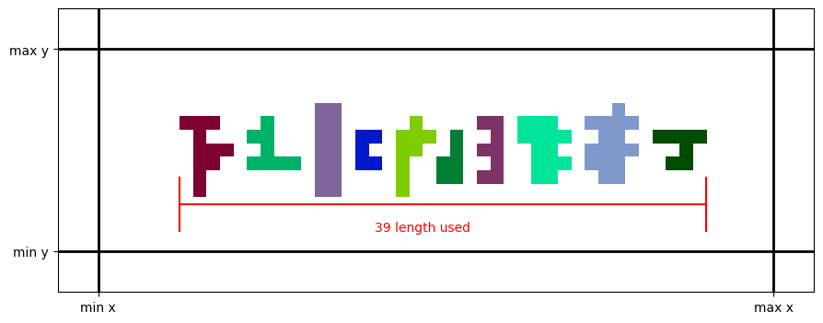
The Cutting Stock Problem
Rectangular sheet of stock
  Limited width, infinite length
Shapes to cut out of stock
Problem: placing shapes to minimize length

Slide 5
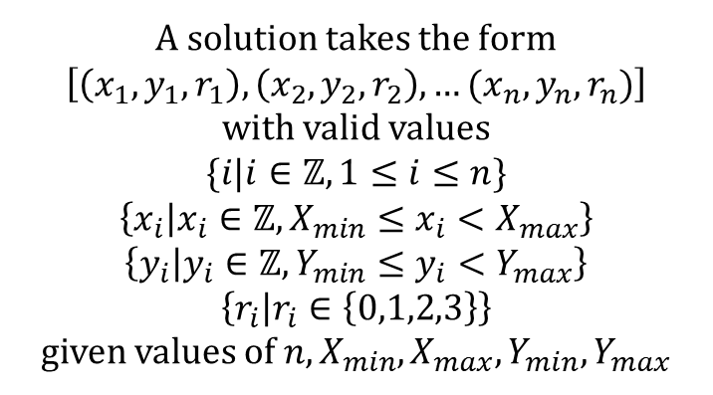
Solution Representation
n shapes to place on the stock
  n placements, one per shape
  p_{i} defines placement of i-th shape
  Fixed-length linear genotype
How would you specify a shape’s placement?
  Translation
    x & y
  Rotation
    90 degree clockwise turns (0, 1, 2, or 3)
  p_{i} = (x_{i}, y_{i}, r_{i})
p₁ | p₂ | p₃ | p₄ | p₅
x₁ | x₂ | x₃ | x₄ | x₅
y₁ | y₂ | y₃ | y₄ | y₅
r₁ | r₂ | r₃ | r₄ | r₅
A solution takes the form
$$\left[\left(x_{1},y_{1},r_{1}\right),\left(x_{2},y_{2},r_{2}\right),…(x_{n}, y_{n},r_{n})\right]$$
with valid values
$$\{i|i∈ℤ,1≤i≤n\}$$
$$\left\{x_{i} | x_{i}∈ℤ,X_{min}≤x_{i}<X_{max}\right\}$$
$$\left\{y_{i} | y_{i}∈ℤ,Y_{min}≤y_{i}<Y_{max}\right\}$$
$$\left\{r_{i} | r_{i}∈\left\{0,1,2,3\right\}\right\}$$
given values of $n,X_{min},X_{max},Y_{min},Y_{max}$

Slide 6
Assignment 1a Task
Implement random search
Generate one hundred thousand random solutions and evaluate them
  We call this one run with one hundred thousand evaluations (evals)
Do thirty runs
  For the assignments in this class, thirty runs make one full experiment
Record the fitness values during each run for analysis & plotting
Stairstep plot showing progress of search during a run
  x = evals (1 through 100,000)
  y = highest fitness seen so far at that eval in that run

Slide 7
Implementation
Plots
Visualize your results
Best solution
From the entire experiment
Statistical Analysis
Comparing experiments
Random search experiment
30 random search runs
Random search run
Make 100,000 random solutions
Random initialization
Make a random solution

Slide 8
Common Pitfalls
Starting too late
  Plan for multiple hours of compute for your experiment
  Report takes time to write
  TA lab hours Friday before the due date; have your questions ready before then
Making a “better” algorithm
  This is a blind random search
  It’s supposed to be pretty bad
  It will be used as a component of later assignments
Code legibility
  Remember someone else will read your code
  Legibility and understandability contribute to your grade
  You will reuse your code in future assignments
Jupyter Notebook misuse
  Out-of-order cell execution
  Global scope abuse
  Copy-and-paste
  Not saving experimental data

