Slide 1

REPORT
Dr. Chippewa Thomas
University Senate
February 14, 2017

Slide 2
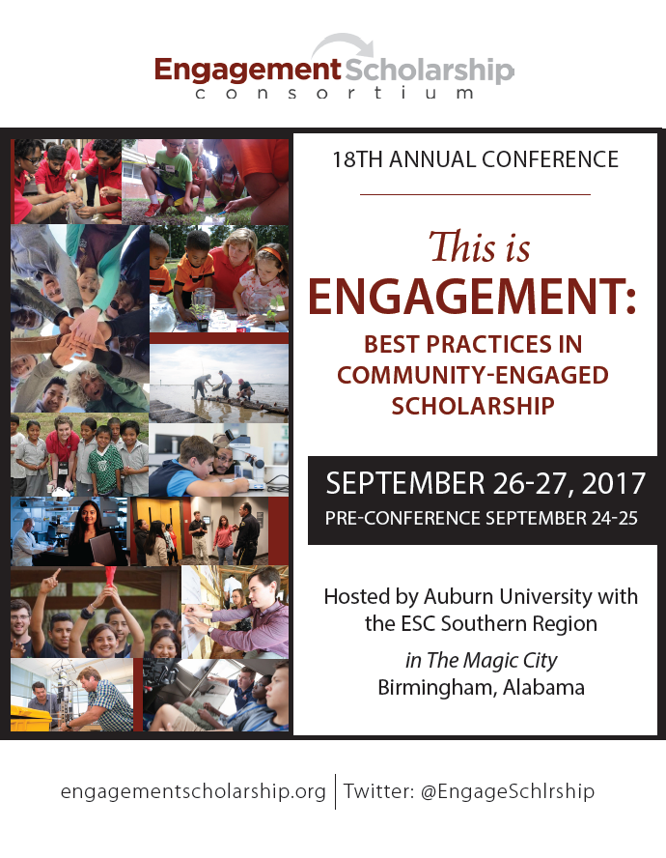

Slide 3
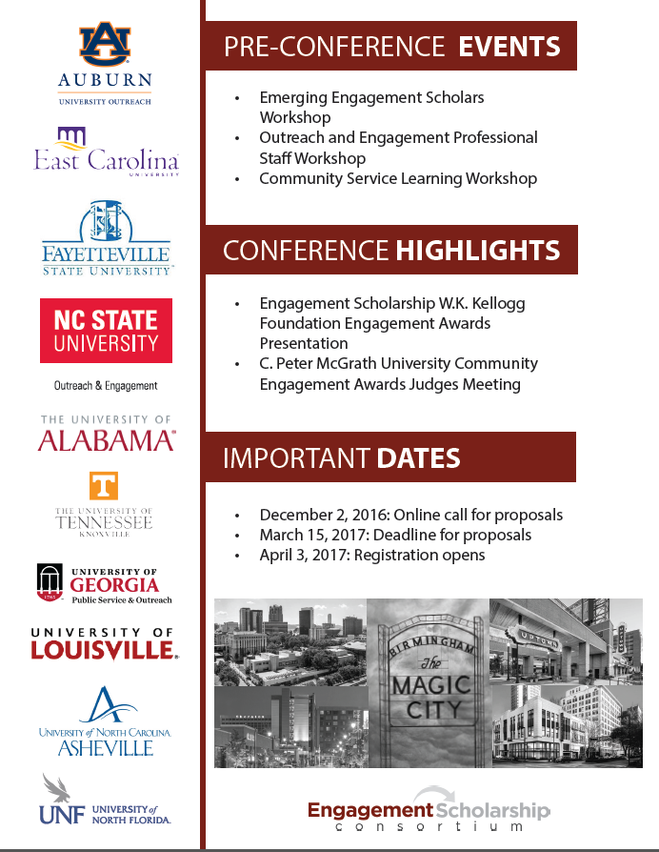

Slide 4
2017 Competitive Outreach Scholarship Grant Recipients
Enhancing Diversity in Health Research Investigating Youth with Developmental Disabilities
Dr. Melissa Pangelinan, Dr. Jared Russell, Dr. Danielle Wadsworth, Dr. Sheri Brock, Dr. Mary Rudisill, and Dr. Annie Newton
College of Education (School of Kinesiology) and School of Pharmacy (via College of Osteopathic Medicine/Pharmacy Health Services)
Amount: $20,000
Improving Elder Care with Interprofessional Mobile Clinics
Dr. Kathy Jo Ellison, Dr. E. Jean Dubois, Dr. Kristen Helms, Dr. Margaret Williamson, Dr. Patricia Marincic, and Dr. Emily Myers
School of Nursing, School of Pharmacy (Pharmacy Practice and Experiential Learning), College of Human Sciences (Nutrition, Dietetics and Hospitality Management) and College of Liberal Arts (Sociology, Anthropology and Social Work)
Amount: $19,999
Serving Alabama Fosters through Engagement (SAFE): A Pilot Program
Dr. Amanda M. Evans and Dr. Jessica Fripp
College of Education (Special Education, Rehabilitation, and Counseling)
Amount: $20,000
Improving Hearing Conservation Program Effectiveness for Alabama Industries
Dr. Richard Sesek, Dr. Mark C. Schall, Jr., Dr. Sridhar Krishnamurti, and Dr. Norman E. Youngblood
Samuel Ginn College of Enginering (Industrial & Systems Engineering) and College of Liberal Arts (Communication Disorders, Communication and Journalism)
Amount: $19,984
COPE – Canine Outreach Promoting Engagement
Dr. Morgan Yordy and Dr. W. Stuart Pope
School of Nursing
Amount: $19,876
Notes:
First conceptualized and described in the early 1990’s by Earnest Boyer, the “scholarship of engagement” is an “emergent concept that redefines faculty scholarly work from application of academic expertise to community engaged scholarship that involves the faculty member in a reciprocal partnership with the community. It can be characteristically interdisciplinary, and integrates faculty roles of teaching, research, outreach and service” (NERCHE, 2013). Annually faculty produce engaged scholarship with the intramural support of the University Outreach Competitive Outreach Scholarship Grant program. Five grants in support of faculty engagement have been awarded this year. COSG recipients and collaborating community partners will be recognized at the Outreach and Engaged Scholars Luncheon February 22, 11-1pm at the ALFA Pavilion (Red Barn) on Auburn University’s campus.

Slide 5
Please RSVP HERE
by February 17th or call
334-844-5700 for more information

