Slide 1




To replace these photos with your own,
delete the images and then click on the photo icon to add your own photo
Auburn University’s Health and Wellness Benefits:
An Overview of Optional Benefits
Dr. Kimberly Braxton Lloyd
November 15, 2016
Updated November 3, 2016

Slide 2
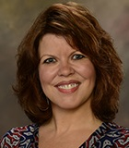
Objectives:
Describe the health services and resources that are available for AU employees and their insured dependents on campus:
  AU Employee Pharmacy Services
  TigerMeds
  AU Pharmaceutical Care Center Services
  Healthy Tigers
  Healthy Tigers Lunch and Learns
  TigerFit
  Pharmacy Health Services Research Projects
Presented By:
Dr. Kimberly Braxton Lloyd
Assistant Dean of Health Services
Auburn University’s Harrison School of Pharmacy
And AU Pharmacy Officer, AU Human Resources

Slide 3
What is Pharmacy Health Services (PHS):
A service unit within Auburn University’s (AU) Harrison School of Pharmacy (HSOP) that provides healthcare, wellness, and pharmacy services for the AU family. PHS includes:
  2 pharmacies:
    The AU Student Pharmacy (AUSP)
    The AU Employee Pharmacy (AUEP)
  1 clinic:
    The Auburn University Pharmaceutical Care Center (AUPCC)
  Also, the State Wellness Center Pharmacy and Clinic

Slide 4
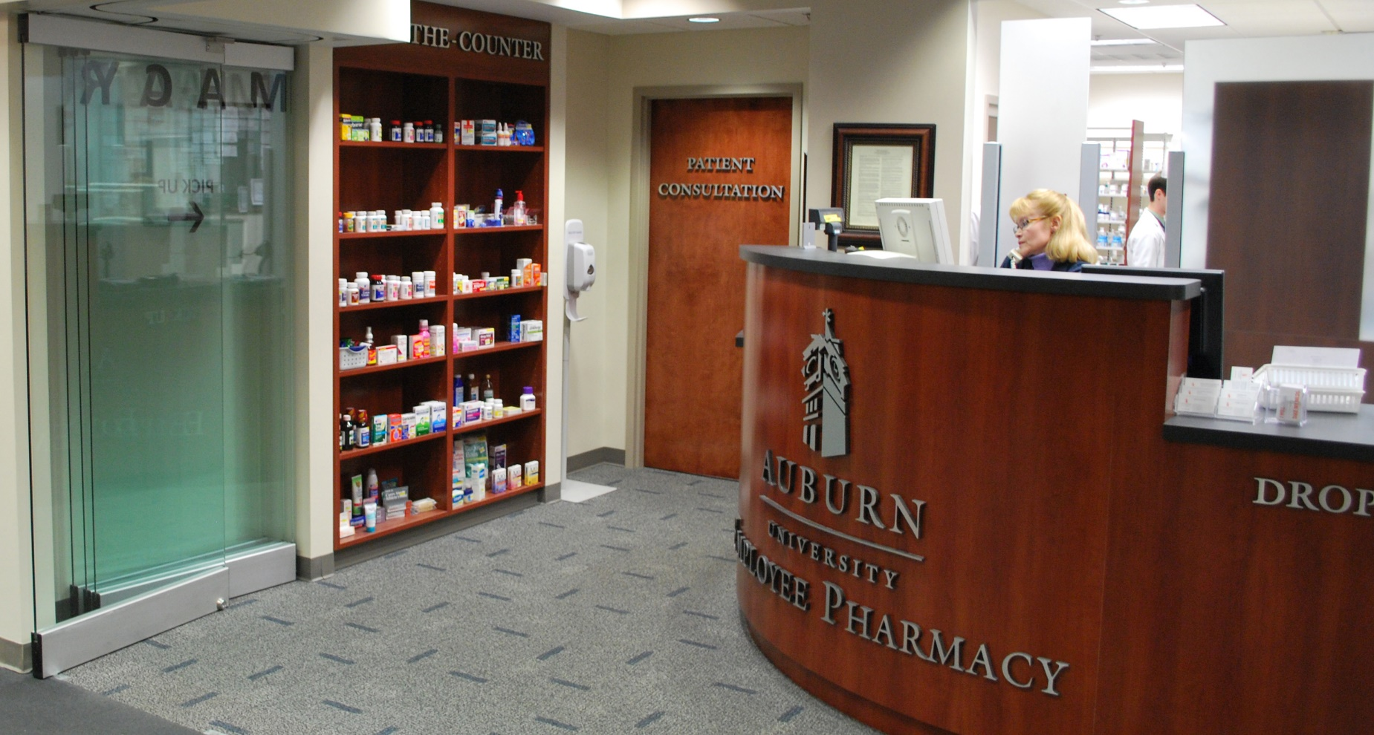
The AU Employee Pharmacy:
Auburn University Employee Pharmacy
2150 Walker Building
132 East Thach Avenue
Auburn University, AL 36849-5506
P: (334) 844-8938
F: (334) 844-8983
auemployeerx@auburn.edu
Notes:
“We take pride in providing personal, individualized care for patients. It is the Auburn way.”- Dr. Kimberly Braxton Lloyd

Slide 5
AU Employee Pharmacy
A full-service pharmacy that exclusively serves:
  AU employees
  AU insured dependents
  AU retirees
It is the preferred pharmacy on the AU health insurance plan:
  Tier 1 generic medications have $0 co-pay
  (versus $10-$20 at other pharmacies)
  Tier 2 generic medications have a $10 co-pay
  (versus $20-$30 at other pharmacies)
Notes:
Employee Pharmacy | 2150 Walker Building | Phone: (334) 844-8938
Auburn University is proud to offer an on-campus pharmacy that exclusively serves our Auburn University employees and their dependents. This FULL-SERVICE pharmacy is conveniently located on the main Auburn Campus on the second floor of the Harrison School of Pharmacy (2155 Walker Building). We offer quality services for our patients to make sure that each of our patients’ medications are safe, effective affordable, and conveniently available.
The AUEP is not open to the general public, but is designed to serve AU’s specific patient populations. In the AUEP, professional Pharm.D. students and post-doctoral pharmacy residents train with our experienced faculty and staff. We take pride in providing advanced clinical pharmacy services for our patients through the AUEP. Our students and residents learn to be caring, responsible, and knowledgeable pharmacy practitioners, and gain experience in many aspects of community practice.
The AUEP is the preferred pharmacy for our employees and their dependents that are insured on our health insurance plan. We offer lower co-pays on generic medications than are offered at other pharmacies in the AU health plan network.

Slide 6
TigerMeds Program
TigerMeds Program offered through AUEP:
  Decreased co-pay on generic medications
  Free baseline medication check-up
  Assist with medication-related problems
  Free on-campus delivery (including AUM)

Slide 7
AUEP Specialty Medication Program
AUEP is an approved specialty medication program for AU employees
  Serves as a local resource for specialty medications
  Assists you with decreasing out-of-pocket co-payments when possible
  Provides education and training
  Monitors efficacy and safety
  Communicates with prescriber

Slide 8
Hometown Pharmacy Experience
An on-call pharmacist is available 24/7 (for patients and physicians) to handle any of your medication emergencies.
  If you need a pharmacist, call (334) 750-1048 to speak to the PHS on-call pharmacist.
The AUEP offers FREE drug information services for our patients, and FREE medication monitoring services for most medications.
We have reserved parking on War Eagle Way for our patient’s use.

Slide 9
Did You Know?
PHS is a convenient source for adult vaccinations including flu, Pneumovax®, Zostavax®, and Tdap®
The AUEP is a training site for fourth year Doctor of Pharmacy students and post-doctoral residents
  These students and residents are eager to help you with your drug information questions and medication needs
  For more information about the AUEP, visit the following website:
  http://www.auburn.edu/academic/pharmacy/phs/pharmacy/employee.html

Slide 10
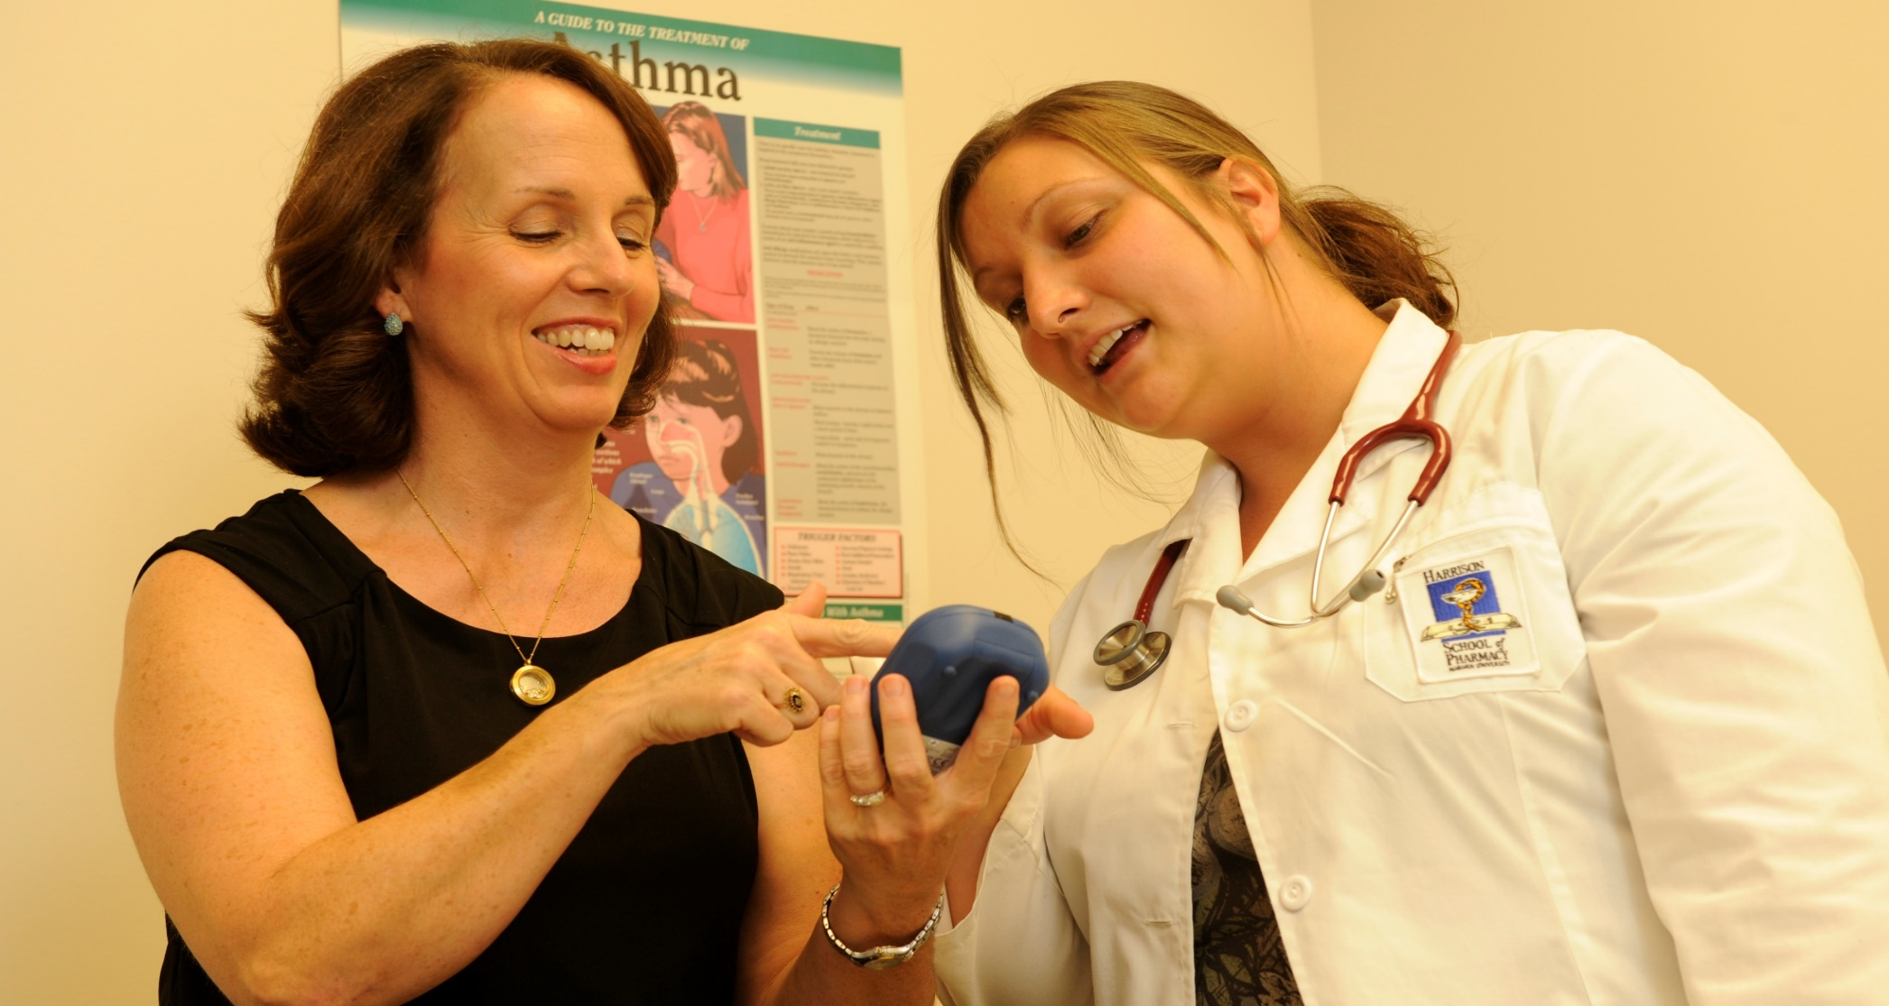
The AU Pharmaceutical Care Clinic (AUPCC)
AU Pharmaceutical Care Center (or Clinic)
2155 Walker Building within HSOP
362 Thach Concourse
Auburn University, AL 36849-5506
P: (334) 844-4099 | F: (334) 844-4019
Email: aupcc4u@auburn.edu
Notes:
AUPCC Hours
Mondays - Wednesdays: 8 a.m. - 5 p.m.
Thursdays: 9 a.m. - 5 p.m.
Fridays: 8 a.m. - 5 p.m.
Weekends and Holidays: Closed
On call pharmacist available 24/7
The Walker Building, home of the Harrison School of Pharmacy and the AUPCC, is located on War Eagle Way and the Thach Concourse in the heart of Auburn's campus. The pharmacy is easily walkable from most areas of campus and convenient parkins spaces are located on War Eagle Way. If you have trouble finding us, call (334) 844-8348 for more information, directions, and guidance.

Slide 11
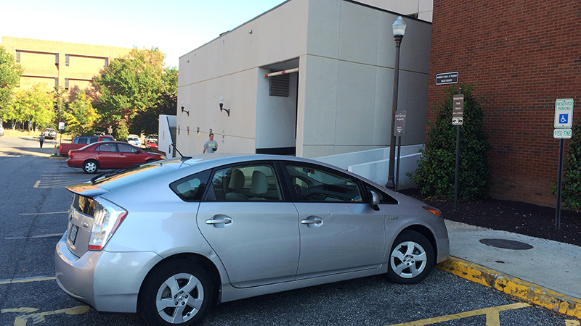
Parking for AUEP and AUPCC:
Notes:
AUPCC Hours
Mondays - Wednesdays: 8 a.m. - 5 p.m.
Thursdays: 9 a.m. - 5 p.m.
Fridays: 8 a.m. - 5 p.m.
Weekends and Holidays: Closed
On call pharmacist available 24/7
There are reserved parking spaces available on War Eagle Way directly behind the Walker Building and a few beside Miller Hall. When you park in these spaces, leave your hazard lights flashing and come into the AUPCC and the AUPCC receptionist will issue a parking pass for your car. You will need to return to your car and display this permit on the dash of your car to indicate that you have an appointment in the AUPCC. An AUPCC parking pass will be needed even if you have an AU hangtag

Slide 12
Medication Therapy Management (MTM):
Baseline medication check-ups
Ongoing medication therapy management
Medication therapy monitoring (efficacy and safety):
  INR monitoring for patients taking warfarin (Coumadin)
  Hgb A1C monitoring for patients taking diabetes medications
  Blood pressure monitoring for patients taking blood pressure medications
Notes:
At the Auburn University Pharmaceutical Care Center, pharmacists become an active member of your healthcare team, and work closely with your doctors and other healthcare providers to make sure that you are getting the absolute most from the medications that you take. The AUPCC pharmacists are experienced medication experts and have been working closely with many physicians and prescribers in the Auburn University, Auburn, Opelika, and surrounding communities since 2000.
In the AUPCC, the central focus of the clinic’s practice is Medication Therapy Management (MTM). The term MTM is used to describe a broad range of healthcare services that pharmacists provide when they evaluate the medical care of a patient from the pharmacist’s perspective as a medication expert. To learn more about MTM, click here.
When a patient comes to the AUPCC, the appointment is very personalized based on the individual needs of the specific patient. The focus of the visit might be on medication education and training; collecting a lab to monitor a medication; discussing cost-savings options on medications; resolving a potential drug interaction; or developing a self-monitoring plan for home. It is just like going to a doctor for care, every visit is different and depends on your specific needs.
At the AUPCC, we are dedicated to spending time with you to make sure you understand your disease states, why you are taking your medications, how you should take your medications appropriately, what you should expect from your medications, and when you should report to your physician or prescriber for follow-up. We take personal responsibility for making sure your medications are working the best for YOU.

Slide 13
Disease State Management:
Pre-diabetes screening and education
“Diabetes and You” diabetes program
“Breathe Easy” Asthma and COPD program
“War Eagle Women’s Health Program”
  Breast cancer risk assessment and self exam education
  Osteoporosis screening and education
  Cardiovascular risk reduction interventions
  Weight management
  Hormone therapy consultations
Notes:
At the Auburn University Pharmaceutical Care Center, pharmacists become an active member of your healthcare team, and work closely with your doctors and other healthcare providers to make sure that you are getting the absolute most from the medications that you take. The AUPCC pharmacists are experienced medication experts and have been working closely with many physicians and prescribers in the Auburn University, Auburn, Opelika, and surrounding communities since 2000.
In the AUPCC, the central focus of the clinic’s practice is Medication Therapy Management (MTM). The term MTM is used to describe a broad range of healthcare services that pharmacists provide when they evaluate the medical care of a patient from the pharmacist’s perspective as a medication expert. To learn more about MTM, click here.
When a patient comes to the AUPCC, the appointment is very personalized based on the individual needs of the specific patient. The focus of the visit might be on medication education and training; collecting a lab to monitor a medication; discussing cost-savings options on medications; resolving a potential drug interaction; or developing a self-monitoring plan for home. It is just like going to a doctor for care, every visit is different and depends on your specific needs.
At the AUPCC, we are dedicated to spending time with you to make sure you understand your disease states, why you are taking your medications, how you should take your medications appropriately, what you should expect from your medications, and when you should report to your physician or prescriber for follow-up. We take personal responsibility for making sure your medications are working the best for YOU.

Slide 14
AUPCC Health and Wellness Programs:
“Healthy Tigers” health and wellness program
“Pack It Up” smoking cessation program
“Be Wise, Be Immunized” immunization program
  Flu, Pneumonia, Tetanus, Shingles vaccines
“Osteoporosis Screening” program
“Healthy Habits” weight management program
Referrals to “TigerFit” kinesiology fitness assessment program
“Walk at Lunch” programs and “Lunch and Learns”
Notes:
At the Auburn University Pharmaceutical Care Center, pharmacists become an active member of your healthcare team, and work closely with your doctors and other healthcare providers to make sure that you are getting the absolute most from the medications that you take. The AUPCC pharmacists are experienced medication experts and have been working closely with many physicians and prescribers in the Auburn University, Auburn, Opelika, and surrounding communities since 2000.
In the AUPCC, the central focus of the clinic’s practice is Medication Therapy Management (MTM). The term MTM is used to describe a broad range of healthcare services that pharmacists provide when they evaluate the medical care of a patient from the pharmacist’s perspective as a medication expert. To learn more about MTM, click here.
When a patient comes to the AUPCC, the appointment is very personalized based on the individual needs of the specific patient. The focus of the visit might be on medication education and training; collecting a lab to monitor a medication; discussing cost-savings options on medications; resolving a potential drug interaction; or developing a self-monitoring plan for home. It is just like going to a doctor for care, every visit is different and depends on your specific needs.
At the AUPCC, we are dedicated to spending time with you to make sure you understand your disease states, why you are taking your medications, how you should take your medications appropriately, what you should expect from your medications, and when you should report to your physician or prescriber for follow-up. We take personal responsibility for making sure your medications are working the best for YOU.

Slide 15
Collaborative Care
Faculty:
  HSOP faculty, pharmacists, residents
  VCOM Pharm.D.
  VCOM Ph.D., RD dietician
  Kinesiology faculty
Students:
  P4 Student pharmacists
  Kinesiology interns
  VCOM students
Notes:
At the Auburn University Pharmaceutical Care Center, pharmacists become an active member of your healthcare team, and work closely with your doctors and other healthcare providers to make sure that you are getting the absolute most from the medications that you take. The AUPCC pharmacists are experienced medication experts and have been working closely with many physicians and prescribers in the Auburn University, Auburn, Opelika, and surrounding communities since 2000.
In the AUPCC, the central focus of the clinic’s practice is Medication Therapy Management (MTM). The term MTM is used to describe a broad range of healthcare services that pharmacists provide when they evaluate the medical care of a patient from the pharmacist’s perspective as a medication expert. To learn more about MTM, click here.
When a patient comes to the AUPCC, the appointment is very personalized based on the individual needs of the specific patient. The focus of the visit might be on medication education and training; collecting a lab to monitor a medication; discussing cost-savings options on medications; resolving a potential drug interaction; or developing a self-monitoring plan for home. It is just like going to a doctor for care, every visit is different and depends on your specific needs.
At the AUPCC, we are dedicated to spending time with you to make sure you understand your disease states, why you are taking your medications, how you should take your medications appropriately, what you should expect from your medications, and when you should report to your physician or prescriber for follow-up. We take personal responsibility for making sure your medications are working the best for YOU.

Slide 16
Collaborative Voluntary Research
Pre-Diabetes study
Student pharmacy empathy study
Medication compliance studies
Behavioral economics studies
Medication-induced secondary osteoporosis study
Wellness challenges in the academic environment studies
Notes:
At the Auburn University Pharmaceutical Care Center, pharmacists become an active member of your healthcare team, and work closely with your doctors and other healthcare providers to make sure that you are getting the absolute most from the medications that you take. The AUPCC pharmacists are experienced medication experts and have been working closely with many physicians and prescribers in the Auburn University, Auburn, Opelika, and surrounding communities since 2000.
In the AUPCC, the central focus of the clinic’s practice is Medication Therapy Management (MTM). The term MTM is used to describe a broad range of healthcare services that pharmacists provide when they evaluate the medical care of a patient from the pharmacist’s perspective as a medication expert. To learn more about MTM, click here.
When a patient comes to the AUPCC, the appointment is very personalized based on the individual needs of the specific patient. The focus of the visit might be on medication education and training; collecting a lab to monitor a medication; discussing cost-savings options on medications; resolving a potential drug interaction; or developing a self-monitoring plan for home. It is just like going to a doctor for care, every visit is different and depends on your specific needs.
At the AUPCC, we are dedicated to spending time with you to make sure you understand your disease states, why you are taking your medications, how you should take your medications appropriately, what you should expect from your medications, and when you should report to your physician or prescriber for follow-up. We take personal responsibility for making sure your medications are working the best for YOU.

Slide 17

Questions
Presented By:
Dr. Kimberly Braxton Lloyd
Assistant Dean of Health Services
Auburn University’s Harrison School of Pharmacy
And AU Pharmacy Officer, AU Human Resources
Notes:
At the Auburn University Pharmaceutical Care Center, pharmacists become an active member of your healthcare team, and work closely with your doctors and other healthcare providers to make sure that you are getting the absolute most from the medications that you take. The AUPCC pharmacists are experienced medication experts and have been working closely with many physicians and prescribers in the Auburn University, Auburn, Opelika, and surrounding communities since 2000.
In the AUPCC, the central focus of the clinic’s practice is Medication Therapy Management (MTM). The term MTM is used to describe a broad range of healthcare services that pharmacists provide when they evaluate the medical care of a patient from the pharmacist’s perspective as a medication expert. To learn more about MTM, click here.
When a patient comes to the AUPCC, the appointment is very personalized based on the individual needs of the specific patient. The focus of the visit might be on medication education and training; collecting a lab to monitor a medication; discussing cost-savings options on medications; resolving a potential drug interaction; or developing a self-monitoring plan for home. It is just like going to a doctor for care, every visit is different and depends on your specific needs.
At the AUPCC, we are dedicated to spending time with you to make sure you understand your disease states, why you are taking your medications, how you should take your medications appropriately, what you should expect from your medications, and when you should report to your physician or prescriber for follow-up. We take personal responsibility for making sure your medications are working the best for YOU.

