Slide 1

Academic Goals & Initiatives
Student Government Association

Slide 2
Implement a Campus-Wide Syllabus Bank

Slide 3
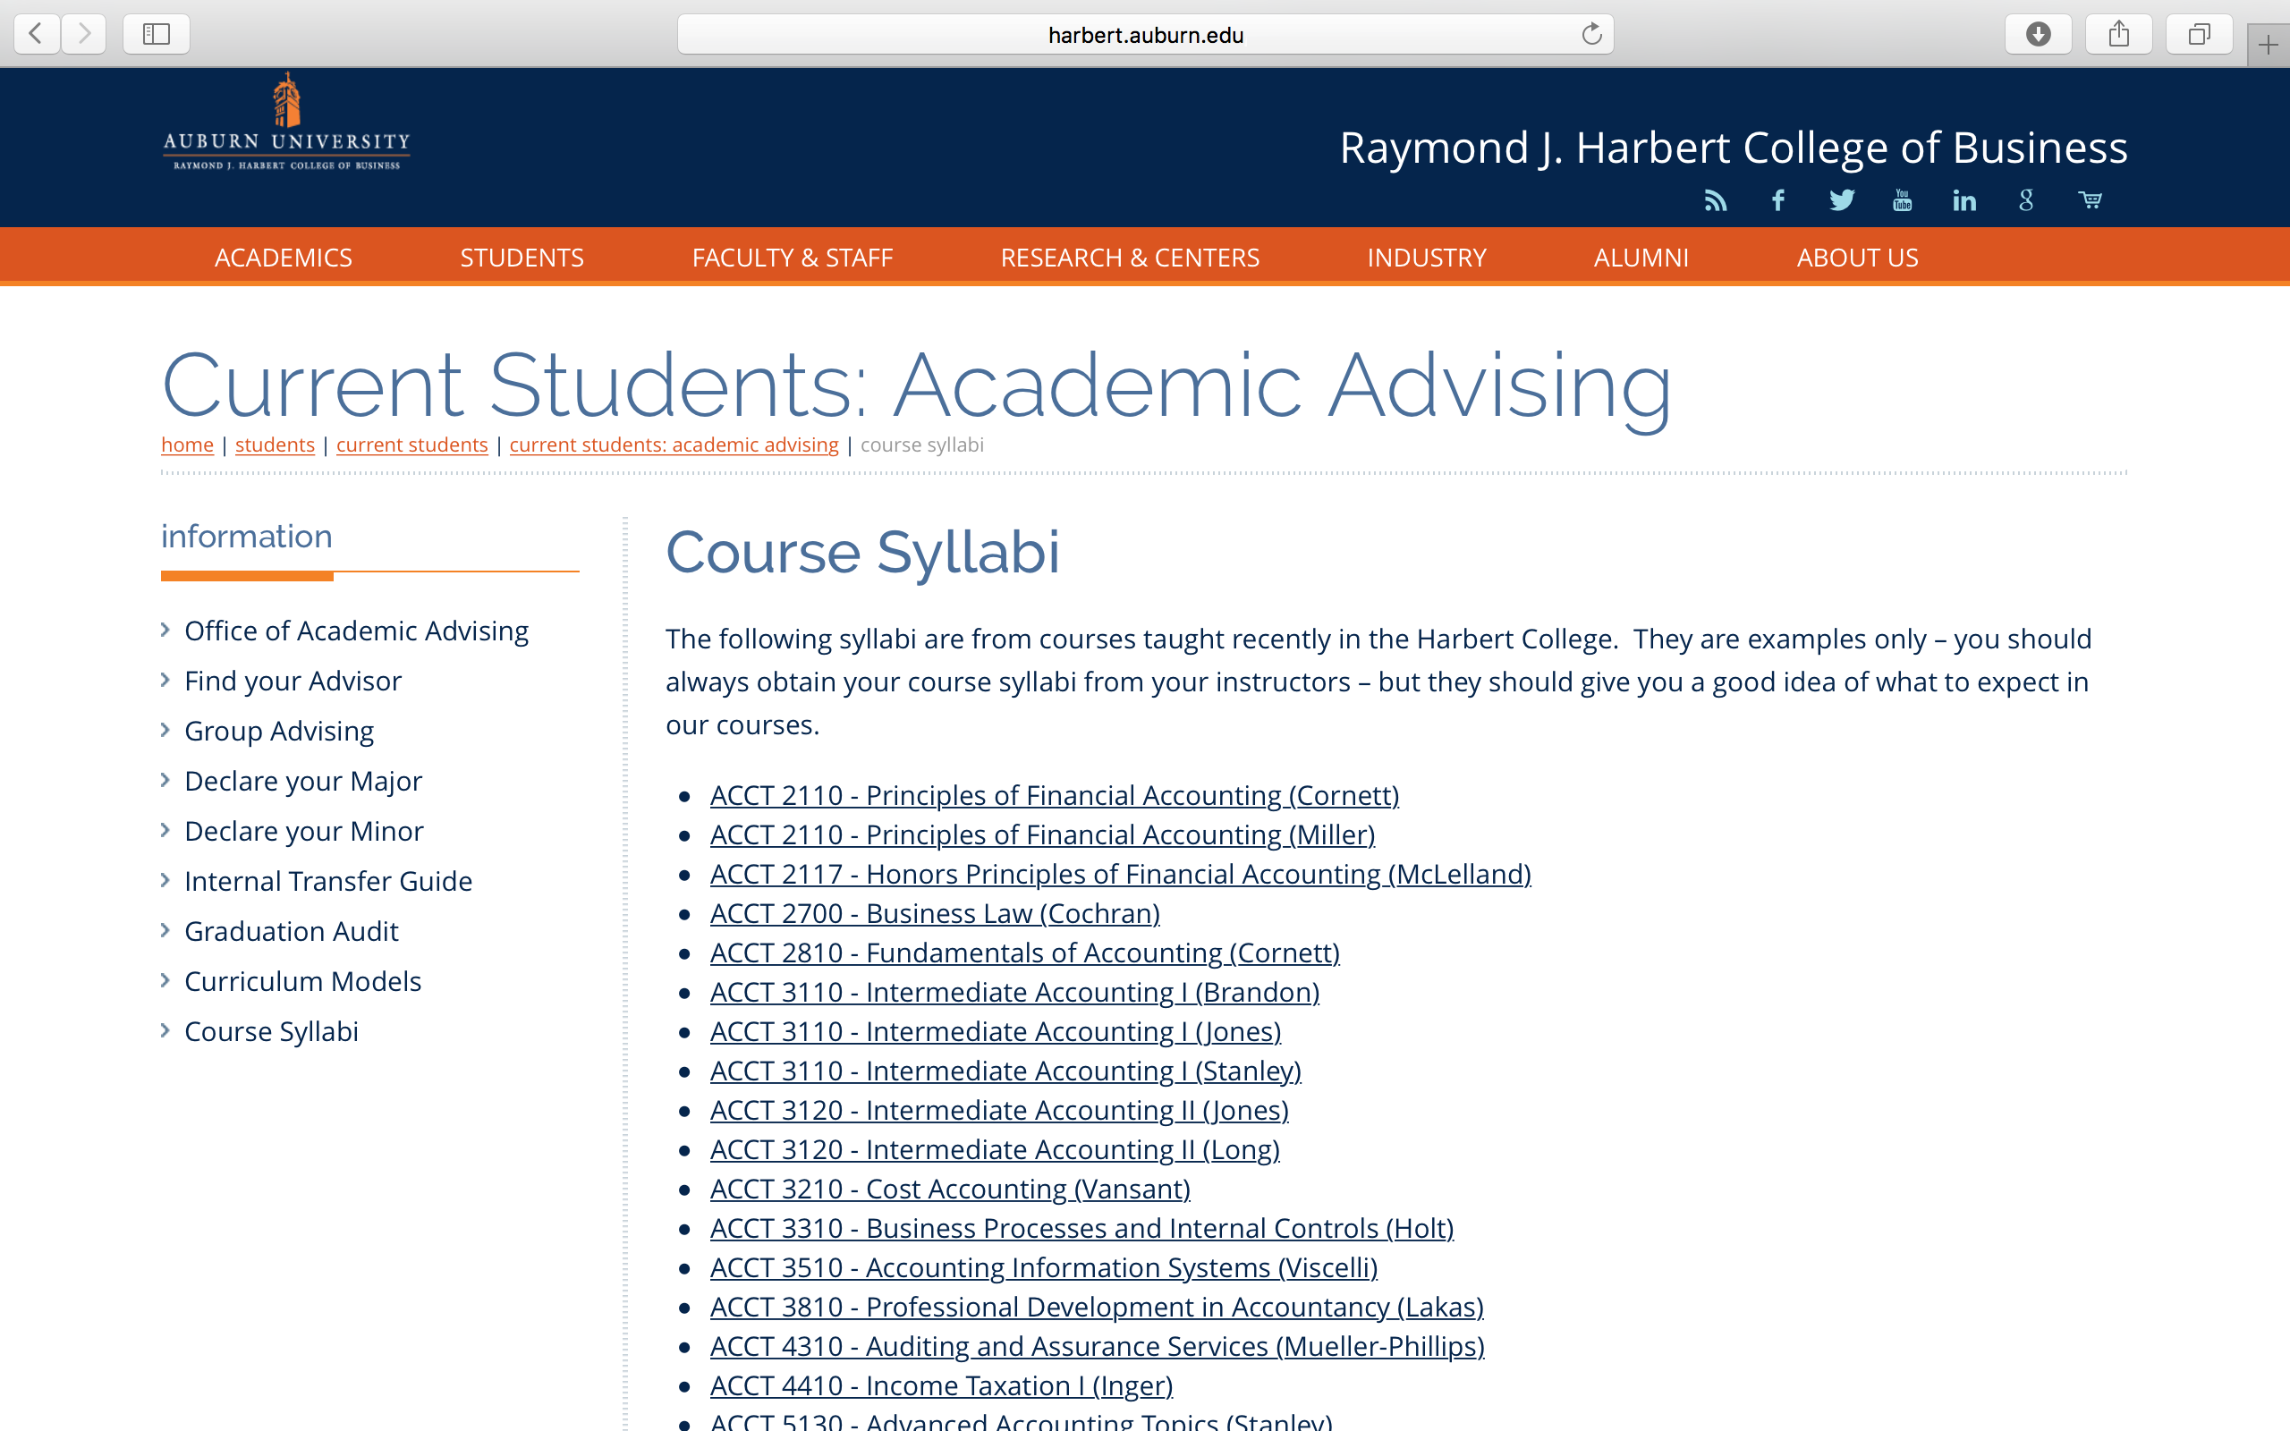
College of Business Example

Slide 4
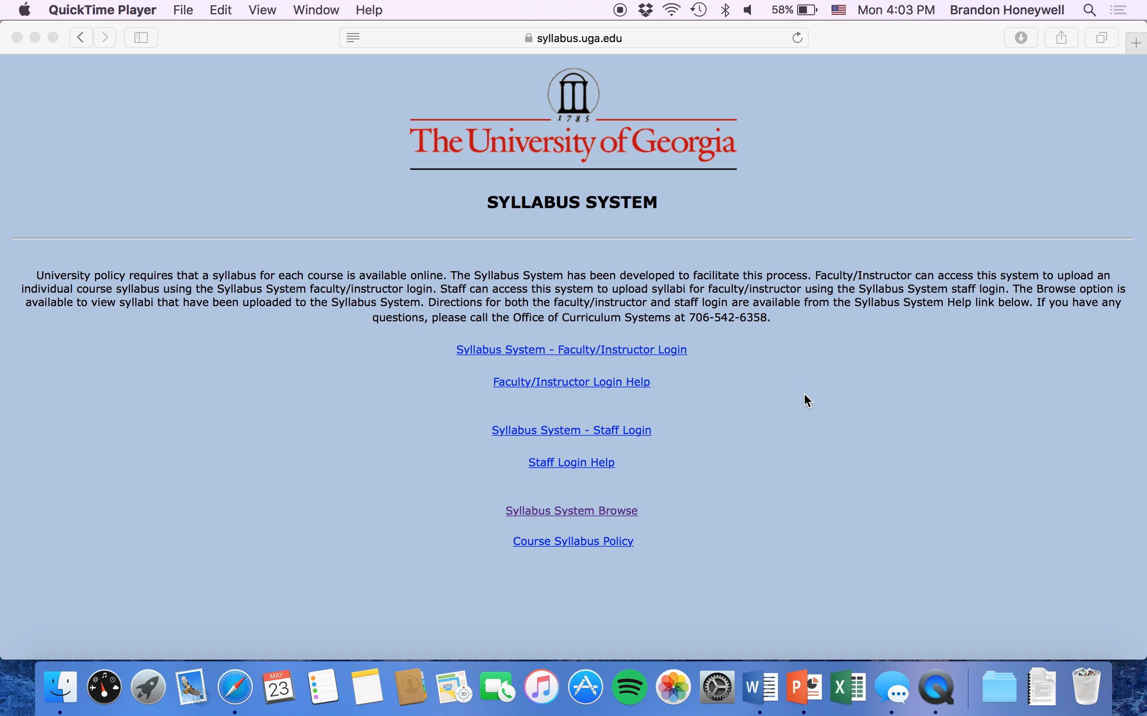
University of Georgia Example

Slide 5
Decrease the Number of Unassigned Courses During Class Registration

Slide 6
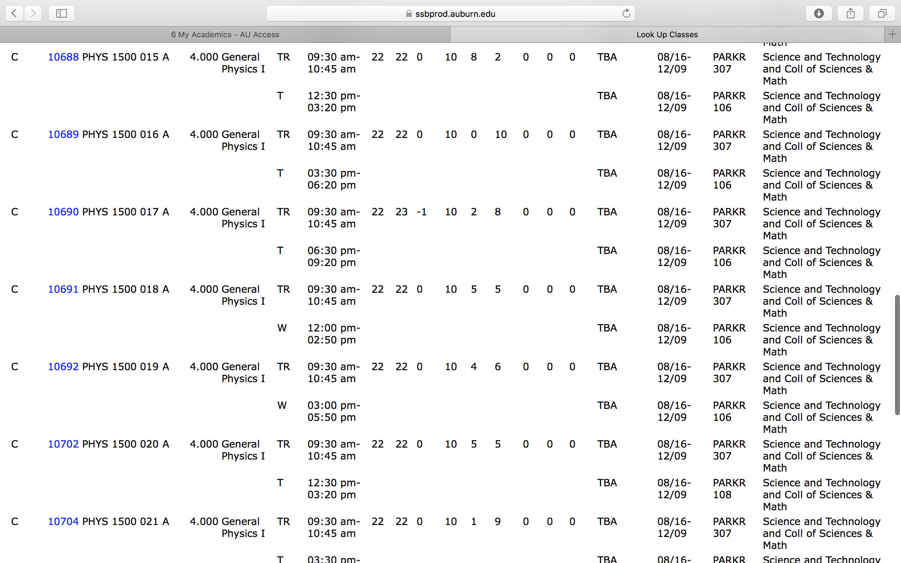

Slide 7
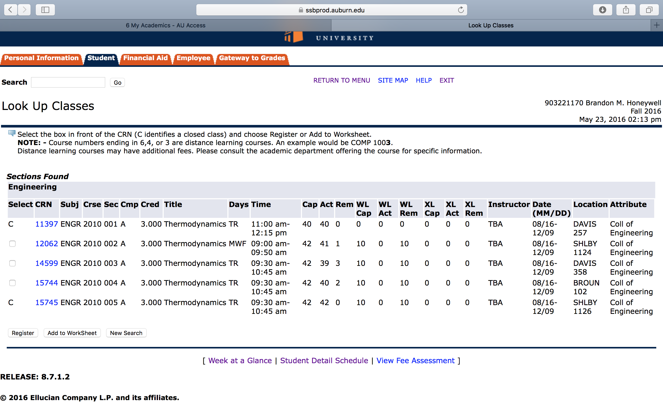

Slide 8
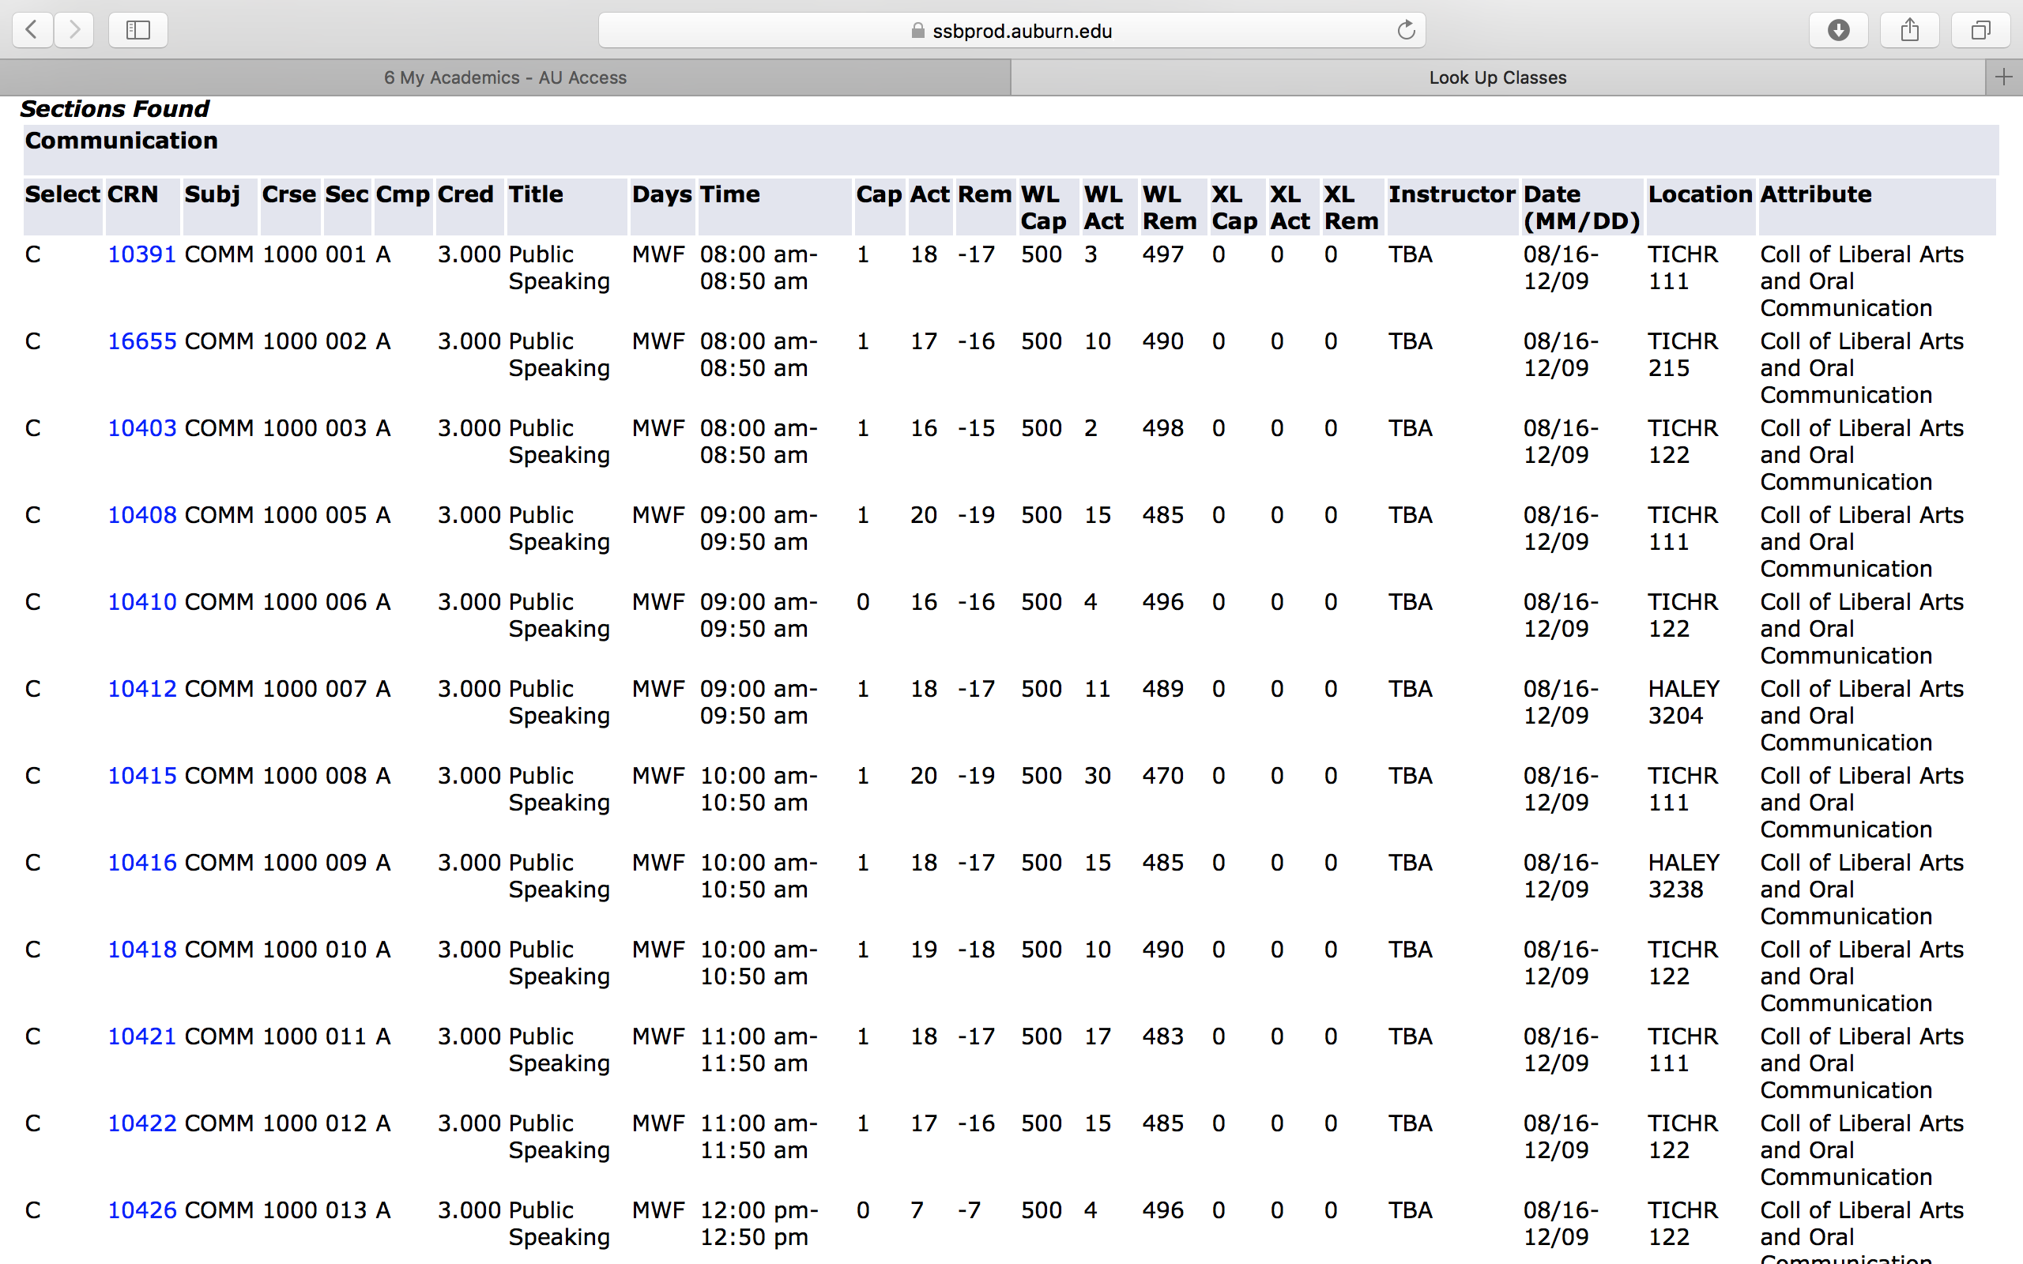

Slide 9
Implement a Pre-Finals Week Course Assignment Policy

Slide 10
Advocate Upgrading the Current Grade Reporting Policy

Slide 11
Advocate for
Textbook Alternatives

