Slide 1

Green Dot Training
General Faculty Meeting Oct. 4, 2016
Emily W. Myers, Associate Clinical Professor
Social Work Program
Notes:
Tess/Lady

Slide 2
The Problem
Power Based Personal Violence=RED DOTS
Sexual Assault
Domestic/Dating Violence
Stalking
1 in 4 women during College years
1 in 10 men
Many bystanders watching and doing nothing
(Most often occurs freshman or sophomore year)
75-80% - attackers are known (classmate, friend, etc.)
White House Task Force, 2014
Notes:
Tess

Slide 3
What is Green Dot?
A campus wide training program aimed at Prevention and reduction of Power Based Personal Violence
Targets Bystanders vs. perpetrators
Aims to create Culture Change: everyone does their part
A belief that individual Safety is a Community responsibility!!
Part of being in The AUBURN FAMILY!!
https://www.youtube.com/watch?v=LNVFPkmZTQ4
Notes:
Lady

Slide 4
Green Dot at Auburn University
August 2015 – 40+ facilitators trained
October 2015 – Green Dot Launch
October 18, 2016 – National training day
Over 7,000 students, staff, faculty, and administrators have been trained!
Notes:
Lady

Slide 5
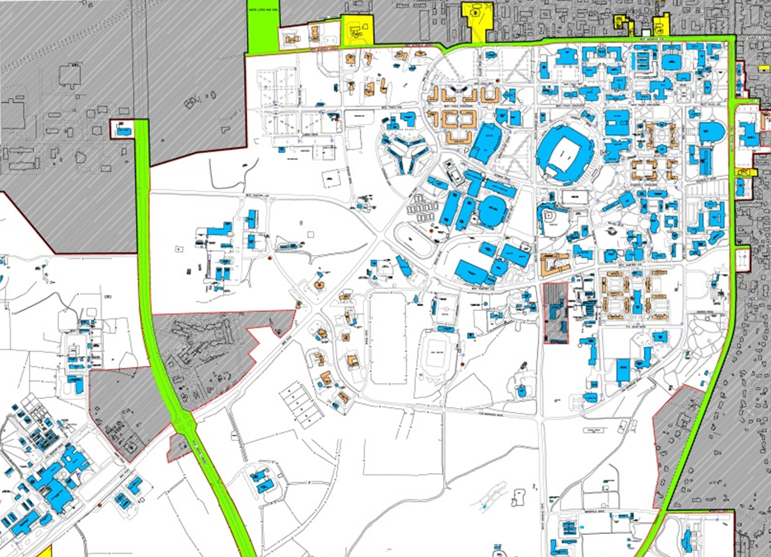
VIOLENCE IS NOT TOLERATED!
Notes:
Lady
Red Dot 1: A girlfriend hitting her boyfriend during an argument in a parking lot.
Green Dot 1: A bystander calling police when they observe the assault (or stepping in to ask if everything is okay beforehand, if they feel comfortable).
Red Dot 2: A student following another student and repeatedly waiting for her outside of class.
Green Dot 2: A classmate telling the professor that he or she thinks the behavior is sketchy/concerning.
Red Dot 3: A husband and wife getting into an argument in a parking lot and one threatening the other.
Green Dot 3: A coworker stepping in to de-escalate the argument.
Red Dot 4: A male at a fraternity party pushing a female to drink when she seems like she’s had enough.
Green Dot 4: A friend offering to give her a ride home before she leaves with someone who might take advantage.
Red Dot 5: Someone slipping a drug into someone else’s drink at a local bar.
Green Dot 5: A bystander dumping out the drink and calling police.
Red Dot 6: A man making unwanted sexual advances toward a female in her residence hall suite.
Green Dot 6: Her roommate noticing and suggesting they need to go out for something to get her out of the situation.
Red Dot 7: A woman sending unwanted text messages to a classmate.
Green Dot 7: Her friend telling her that she thinks she’s gone too far with the texting.

Slide 6

Notes:
Lady

Slide 7
Direct
Directly do something yourself.
  Intervene.
  Ask someone to stop what they are doing.
  Check on someone you might be worried about.
Notes:
Tess

Slide 8
Delegate
If you feel you can’t do something yourself, delegate to someone else.
  Call the police.
  Talk to a faculty or staff member.
  Tell a business owner or staff member.
Notes:
Lady
Talk about barriers – afraid your friends will get mad, afraid you will get hurt. For me – my girls.

Slide 9
Distract
Use a distraction to diffuse the situation.
  “Accidentally” spill a drink.
  Ask to borrow the phone of someone who is in a risky situation.
  Ask for a ride.
  Start an unrelated conversation.
Notes:
Tess

Slide 10
How can you encourage Green Dot participation in your classroom?
Notes:
Tess

Slide 11
Proactive Green Dots
Syllabus
Email signature
Dots/signs/stickers/pins
Extra Credit Opportunities
Paper/journal topics/Team projects
Slides
Applaud students doing Green Dots
Schedule an overview talk in class/faculty meeting/student group
Notes:
Tess

Slide 12
Reactive Green Dots
If you see signs of distress, check-in: ask if everything is okay.
Direct a student to:
SAFE HARBOR: 334-844-7233 (SAFE)
Student Counseling: 334-844-5123
Title IX: 334-844-4794
If you hear about an incident, report it.
Report all Green Dot moments to Health Promotion and Wellness Services
Notes:
Tess

Slide 13
CHANGE THE NORMS
Get trained, train others
Wear a pin
Spread the word through social media
Use your leadership status to promote Green Dot
Place a Green Dot on your door
Become a GREEN DOT Bystander!

Slide 14
Thanks and WAR EAGLE!!
Questions?
Notes:
Tess

Slide 15
Contact Information:
Health Promotion and Wellness Services
1206 Student Center
(334) 844-1528
Melissa McConahay
auburn.edu/wedotauburn
Notes:
Tess

