Slide 1

This is Sustainability
STARS 2.0 Report
Nanette Chadwick, Academic Sustainability Programs
Mike Kensler, Office of Sustainability

Slide 2

Sustainability
“Meeting human needs now and in the future
in a fair, just, and equitable way
while protecting and maintaining healthy ecosystems in perpetuity.”

Slide 3

Sustainability Compass
Nature
Wellbeing
Economy
Image by Courtney Windham
Society
©AtKisson, Inc.

Slide 4
Auburn University
Sustainability Policy
“….Auburn University considers sustainability a core value and strives for excellence in sustainability through continuous assessment and improvement.”

Slide 5



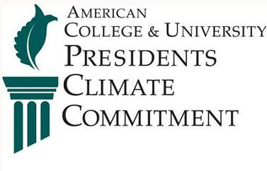



Auburn University

Slide 6
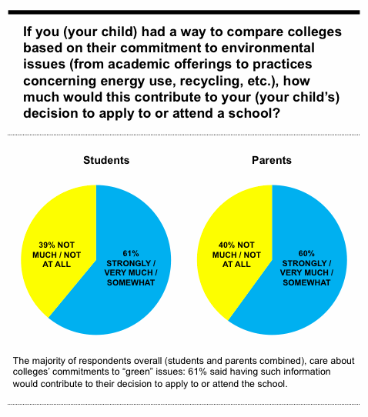



Slide 7

755 Members
170 Assoc Members
est. 2005

Slide 8

Sustainability Tracking Assessment & Rating System
779 Institutions
27 Countries
6 Continents
est. 2010

Slide 9
STARS 2.0 CATEGORIES
ENGAGEMENT
21%

Slide 10

STARS 1.2 & 2.0 RATINGS
Avg. Score 37.32
Avg. Score 52.42
Avg. Score 69.12
Score
85.29
Auburn 53.62
Reporter
17
Bronze
38
Silver
137
Gold
96
Platinum
1
POINTS:
25
45
65
85

Slide 11
AUBURN THEN: 2013
: 2016
& NOW
2013
2016

Slide 12
BENCHMARKING
AUBURN
Plat.
Gold
Silver

Slide 13
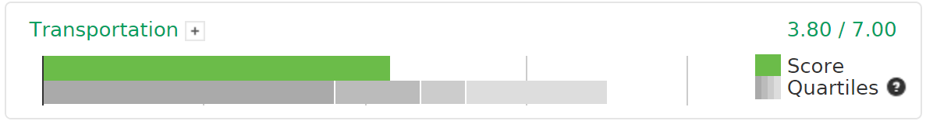
STARS 2016
Average 56%
54%

Slide 14
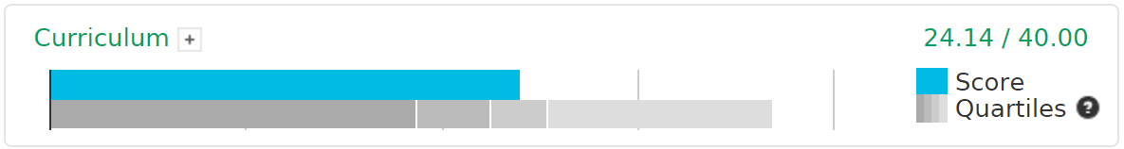
STARS 2016
Curriculum
ACADEMICS
Average 55.7%
60%
Highlights
Opportunities
Minor in Sustainability Studies
Option in the Core Curriculum
Faculty curriculum workshop and awards
Campus as a Living Laboratory
Increasing enrollment and diversity of courses and degree programs
Sustainability Literacy Assessment
Expansion to under-represented colleges
Graduation Requirement

Slide 15
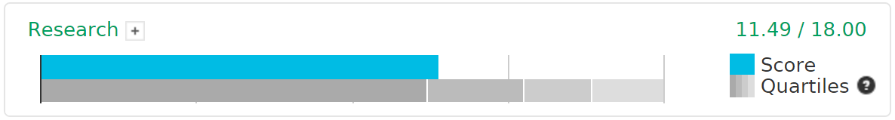
STARS 2016
Research
ACADEMICS
Average73.8%
64%
Highlights
Opportunities
Research inventory & networking
Increasing percent of faculty and
departmental engagement
Interdisciplinary cluster hires
to enhance faculty expertise
Incentives for research
Seed grant program
Open access policy for research results
Criterion for tenure and promotion

Slide 16
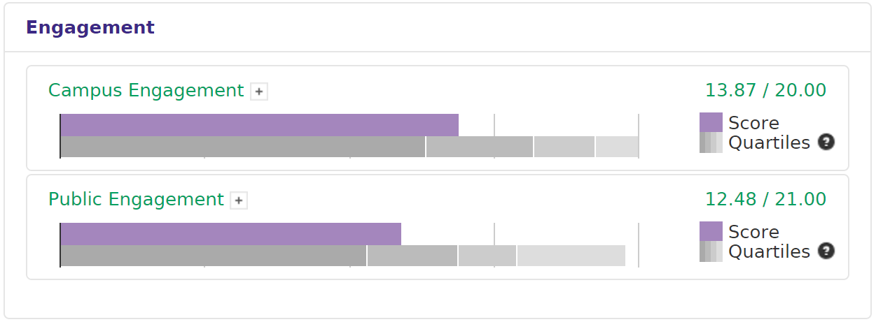
STARS 2016
Engagement
THE RESULTS
Average 78%
69%
68%
59%
Highlights
Opportunities
Student & Employee Orientation
Outreach Materials & Publications
Staff Professional Development
Continuing Education
Community Partnerships
Inter-Campus Collaboration
Student & Employee Peer Engagement
Campus-wide Engagement Campaigns
Community Service
Stakeholder Engagement
Participation in Public Policy

Slide 17
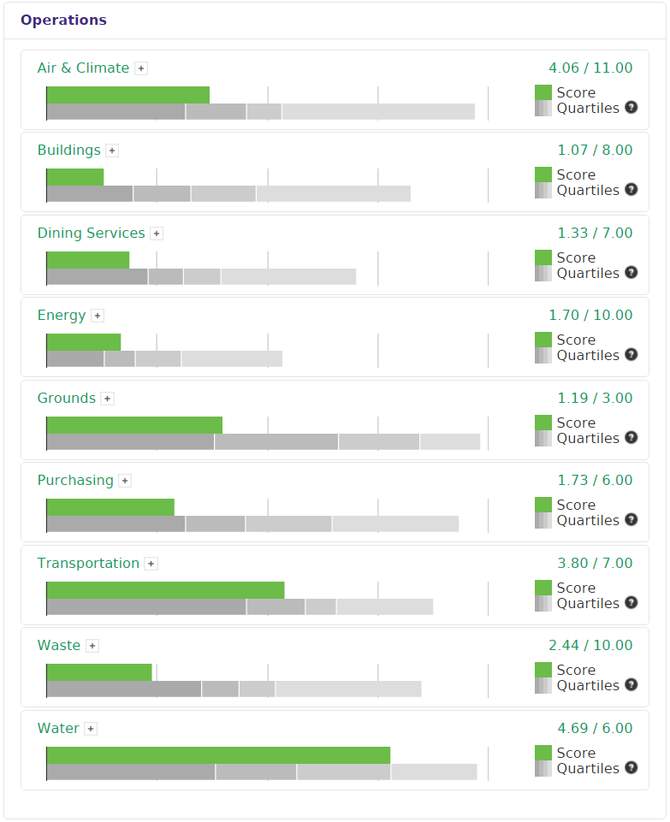
STARS 2016
Operations
Auburn 37%
Average
44%
THE RESULTS
13%
36%
Highlights
Indoor Air Quality Management
Low-Impact Dining Options
Student Commuting Choices
Support for Sustainable Transportation
Hazardous Waste Management
Water Management
30%
19%
17%
20%
40%
61%
Opportunities
29%
48%
Sustainable Design, Construction, Operation & Maintenance of Campus Buildings
  LEED Certification of Buildings
Increase Local Food Purchases
Financing Mechanism for Efficiency Improvements
Sustainable Purchasing Practices
Expand Waste Elimination, Recycling, & Composting
Lower Greenhouse Gases
54%
57%
24%
46%
57%
78%

Slide 18
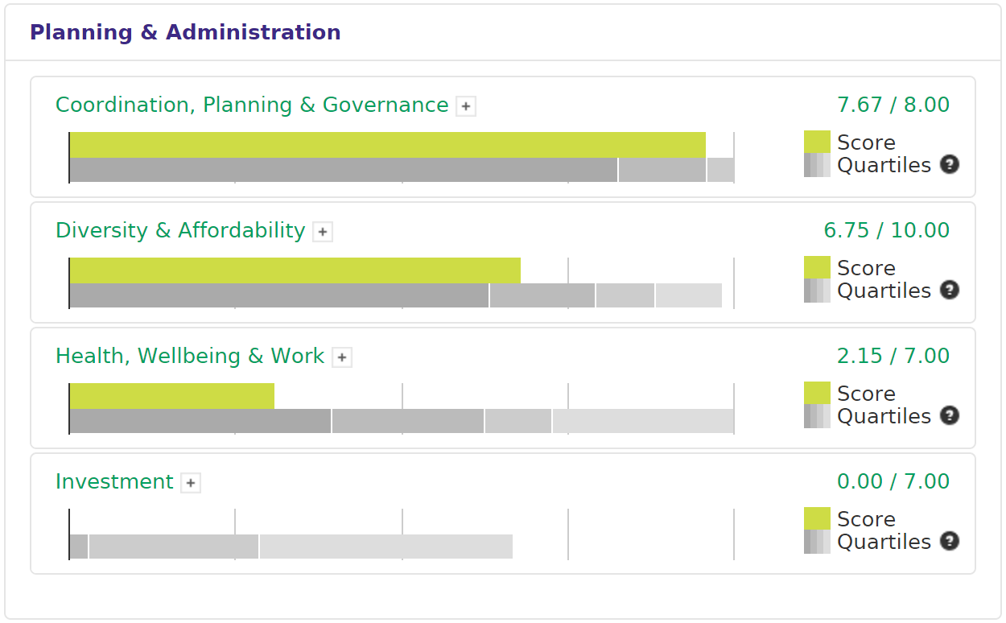
STARS 2016
Planning & Administration
THE RESULTS
Average 88%
96%
68%
78%
58%
31%
16%
0%
Highlights
Opportunities
Sustainability Office
Academic Programs Director
Sustainability Policy
Climate Action Plan
Participatory Governance
Comprehensive Sustainability Strategic Plan
All-Employee Job Satisfaction Survey
Living Wage Standard and Living Wage Compensation for All Employees
Sustainability Screens for Investments
Public Reporting of Investment Distribution

Slide 19
This is Sustainability
STARS 2.0 Report
Questions?
Nanette Chadwick, Academic Sustainability Programs
Mike Kensler, Office of Sustainability

Slide 20
STARS RESULTS
SUBCATEGORY
11
16
28
15
4

