Slide 1
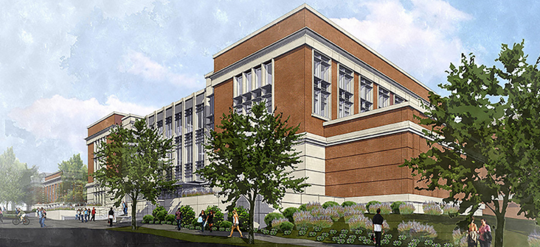
Mell Classroom @ RBD:
Teaching and Learning Update

Slide 2

Instructional Support
102 of 124 faculty, GTAs and instructional staff have participated in some form of calibrated development related to maximizing learning success in Engaged & Active Student Learning (EASL spaces)
Welcome Week sessions for students

Slide 3
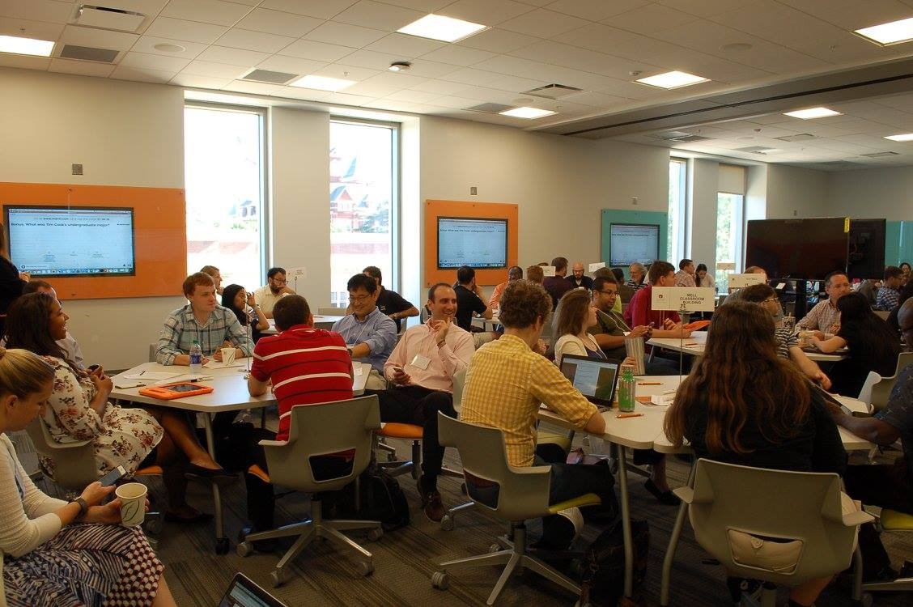

Slide 4
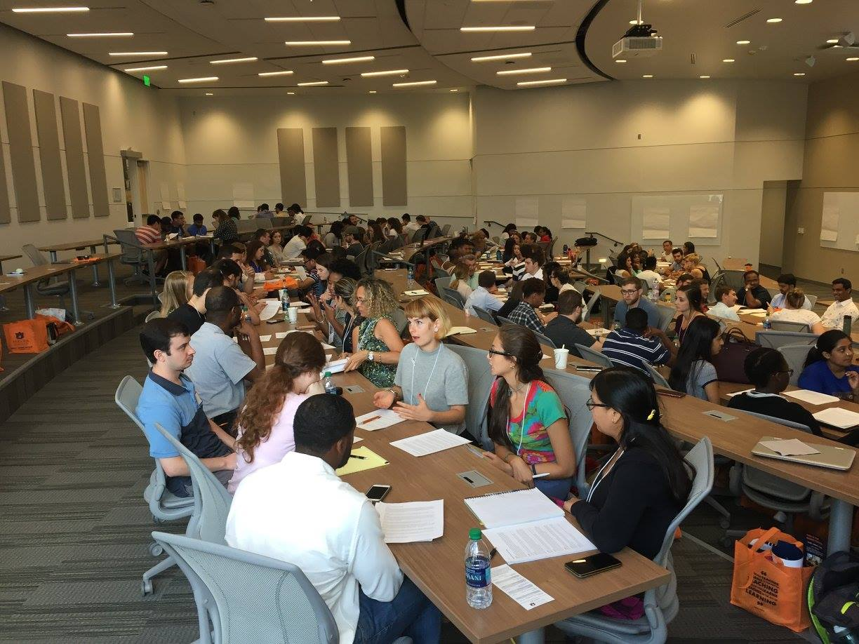

Slide 5
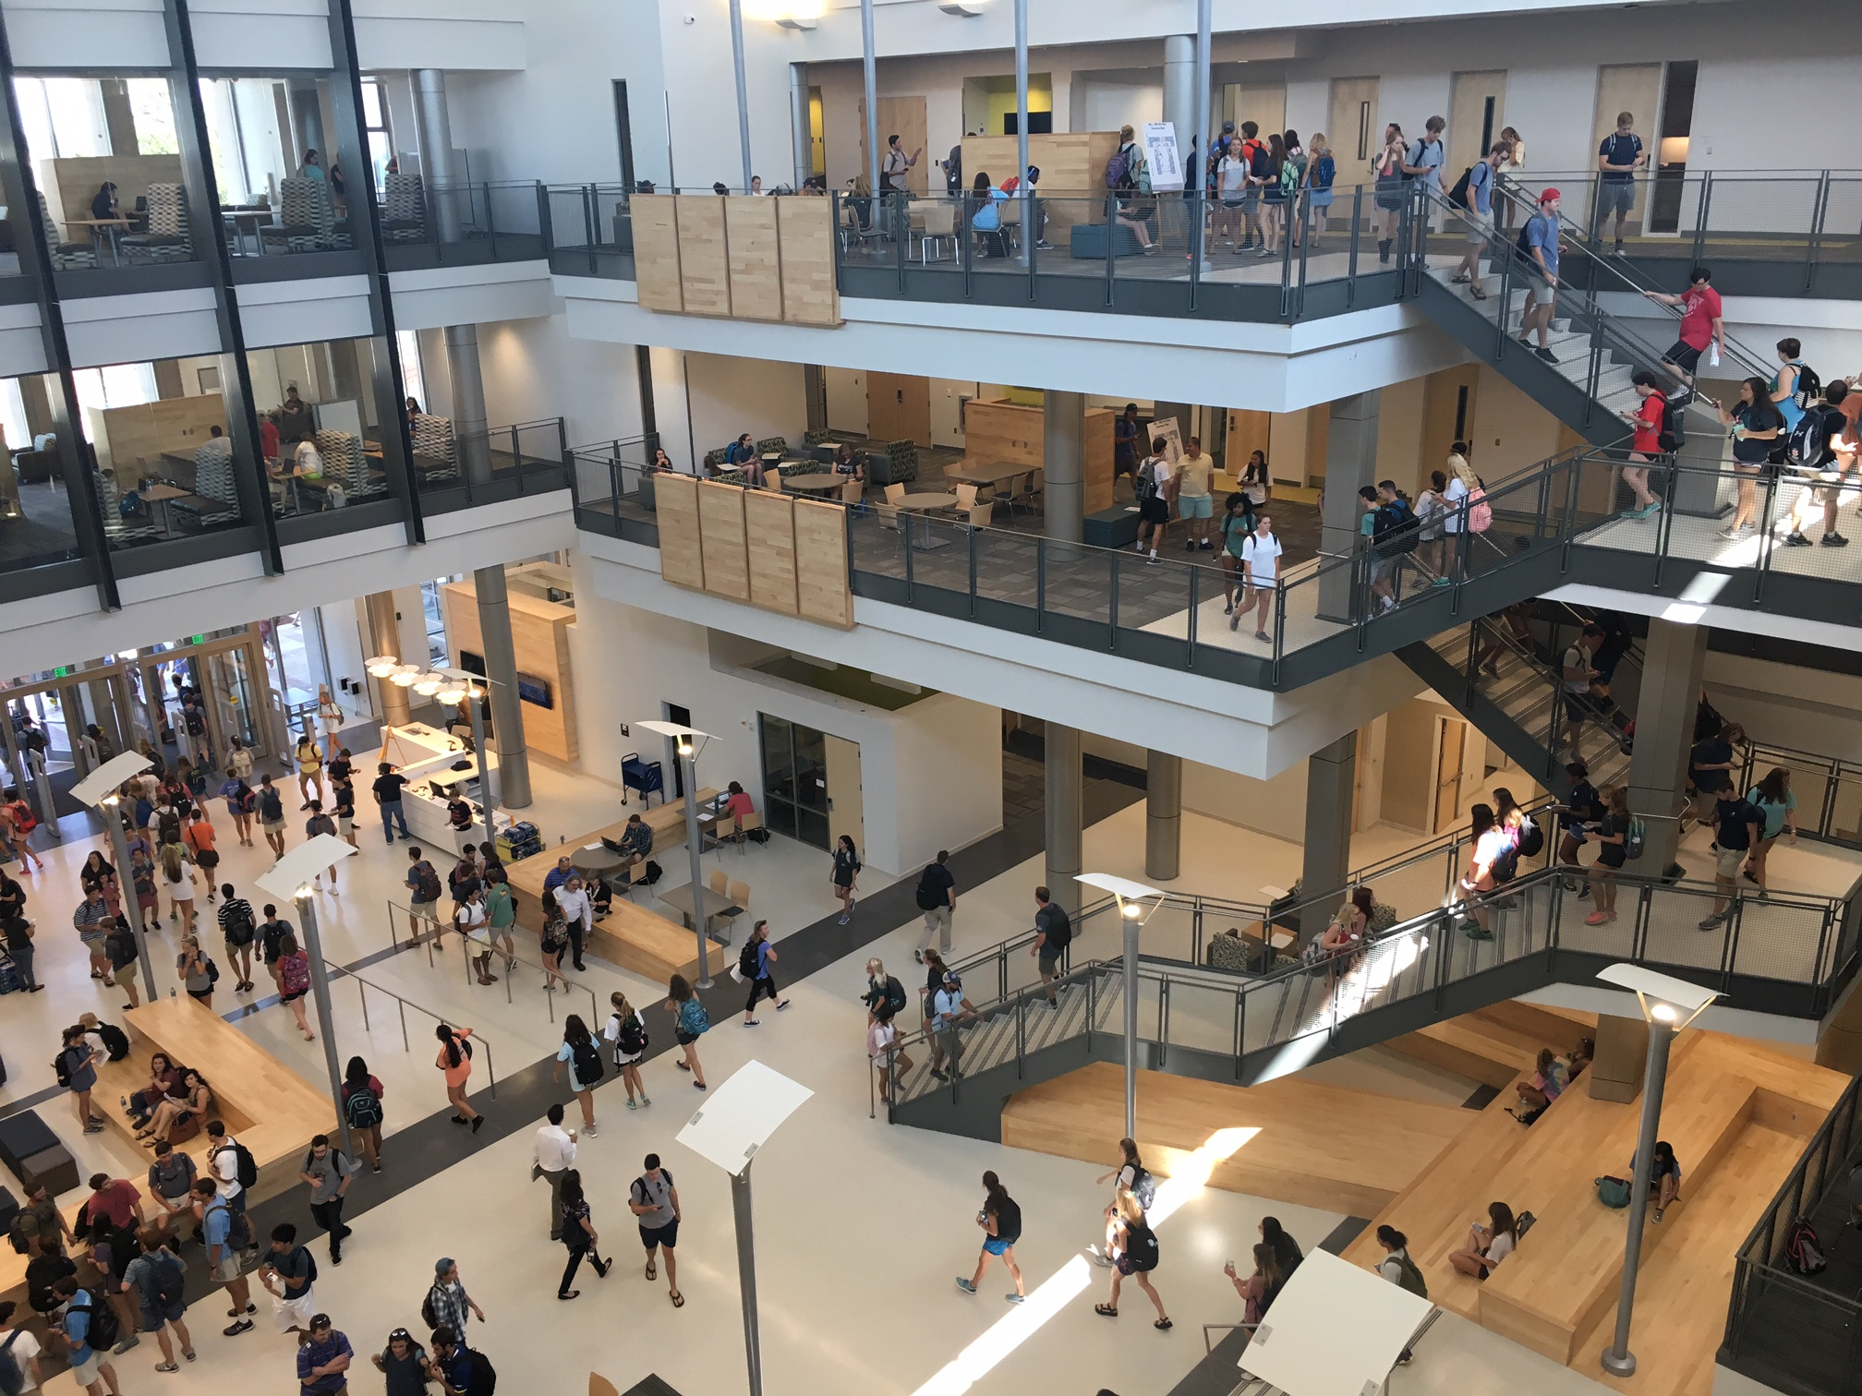

Slide 6
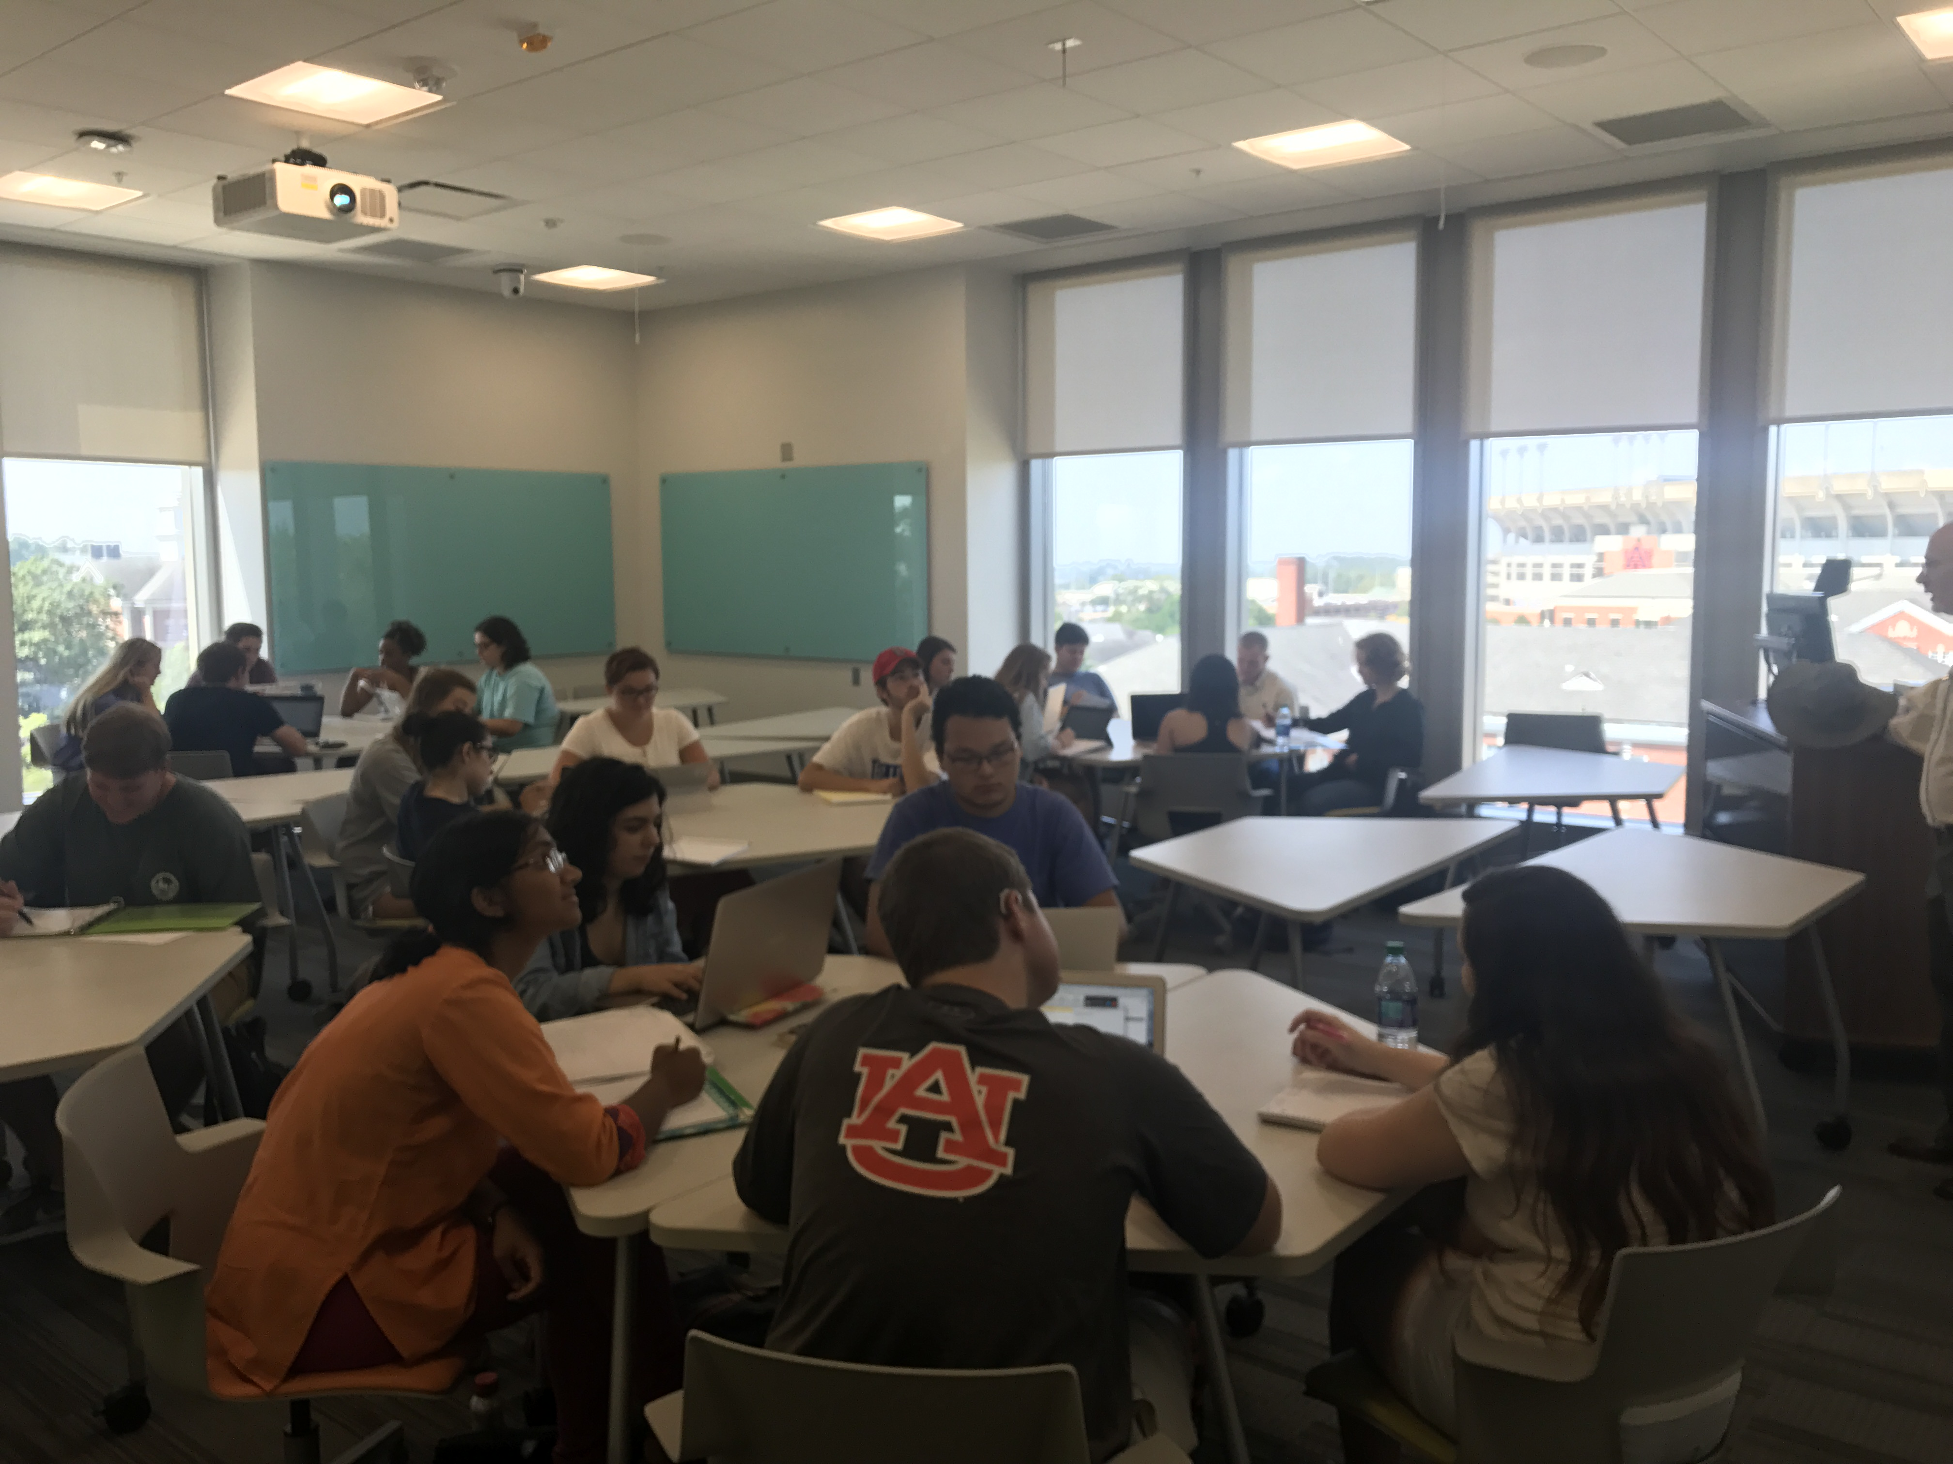

Slide 7
Learn More
Wiebke Kuhn: kuhnwi1@auburn.edu
auburn.edu/mell

Slide 8
