Slide 1

Presidential Awards for Interdisciplinary Research (PAIR)
Putting Good Ideas to Work

Slide 2
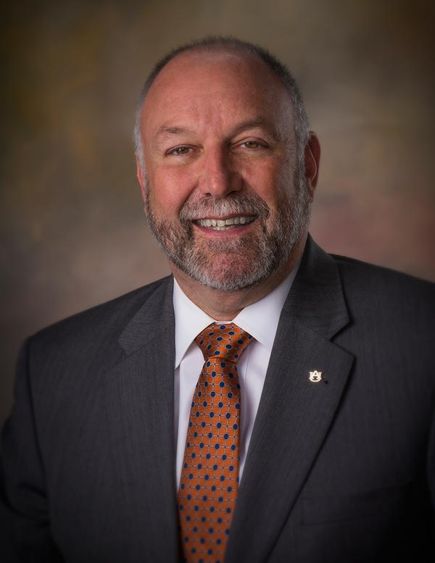
Auburn University President Steven Leath’s
Focus on Research
His remarks to the Board of Trustees, September 15, 2017:
“…You made it clear early on that you want to increase Auburn research and scholarship, and so do I. We already have bright students, expert faculty, hard-working staff, dedicated alumni and enthusiastic partners in business, industry and government. So, my role is to work in collaboration with all who have an interest in Auburn to take us to the next level. My goal is to elevate Auburn to the Carnegie research one classification, which places us among the nation’s elite in terms of research and creative scholarship. We can and we will get there.
What Auburn does particularly well is align research and scholarship with priorities outlined by government agencies. So, one of our tasks in achieving R1 status is doing an even better job of positioning Auburn expertise in front of state and federal research sectors to maximize opportunities for partnership. Similarly, partnerships will also be ramped up with the business sector and soon we will be known as a great partnership university.”

Slide 3
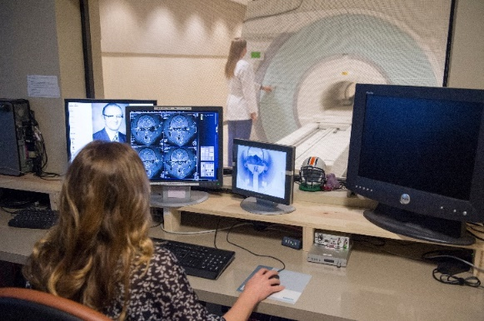
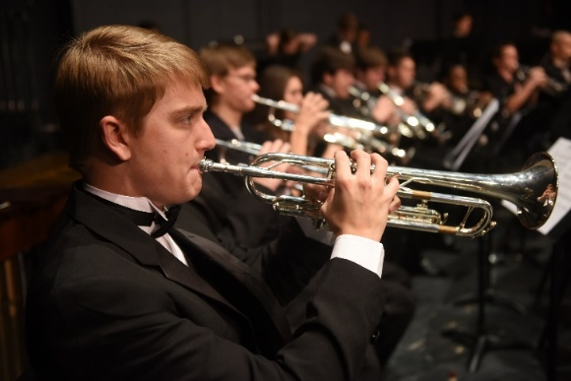
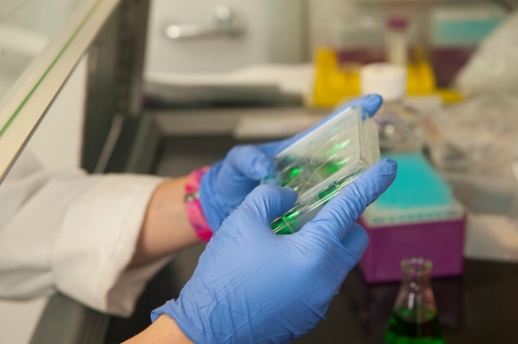
The Presidential Awards for Interdisciplinary Research (PAIR) program supports ideas that foster creativity, facilitate collaboration, and assist Auburn University in reaching new levels of distinction. PAIR funds interdisciplinary research teams for up to 3 years.
Teams are expected to define an integrated interdisciplinary research effort distinguished by intellectual excellence and driven by a clear vision of fundamental scholarly advances, innovative discoveries, or technological developments having broad economic and societal impact.
PAIR is intended for investigators who seek to enhance their external research sponsorship through multiple, interdisciplinary collaborations.
PAIR draft document was reviewed by a faculty workgroup (Jennifer Kerpelman, Karen Rogers, Ed Thomas, Paula Bobrowski, Bob Ashurst, Bob Holm) on October 6th.
Further vetting took place at October 11th luncheon that included all ADRs, FRC members, and Strategic Hiring Initiative cluster leaders.

Slide 4
Commensurate with the level of funding requested, it is anticipated that PAIR funding may support the following categorical activities:
(Tier I – Early Career Award) Activities that advance small teams’ scholarly efforts with the potential of seeding new initiatives. A Tier I team should consist of faculty members from different disciplines who seek to form a closer partnership and to develop a track record of collaborative scholarly and/or creative endeavors (maximum of $100,000 annually). The lead investigator must be a tenure-track member of the Auburn University faculty. Potential outcomes of Tier I funding should reflect a team that is strongly positioned to pursue interdisciplinary funding opportunities from both federal and non-federal entities such as (but not limited to) NEH Collaborative Research grants; NIH R15 and R21 grants, foundation grants, industry funding, federal/non-federal planning grants, etc.;
(Tier II – Established Investigator Award) Activities that may result in the creation or development of new Auburn initiatives (e.g., a new research area). A Tier II team should consist of faculty that have a track-record of collaborative scholarly activities (joint presentations, papers, books; the design and generation of processes, products, artifacts, performances, etc.) and who seek to expand and enhance that collaboration by sustaining its operations via external sponsorship (maximum of $250,000 annually). The lead investigator must be a tenured member of the Auburn University faculty. Potential outcomes of Tier II funding should reflect a team that is well-positioned to pursue highly competitive federal and non-federal funding opportunities such as (but not limited to) NIH R01 grants, NSF INSPIRE grants, Gates Foundation Grand Challenges, etc.;

Slide 5
(Tier III – High Impact Research Award) Activities that would position the team to be highly competitive for both federal and non-federal large-scale funding opportunities (e.g., externally funded “Center” grants) to address research questions of national and/or global significance. A Tier III team should have a significant track-record of scholarly and/or creative collaboration, some level of externally funded research activities, and should be poised to make ground-breaking advances through a large, nationally recognized, externally sponsored effort (maximum of $500,000 annually). The lead investigator must be a tenured member of the Auburn University faculty. Potential funding opportunities that may be pursued through Tier III funding may include (but is not limited to) NSF Center grants, NIH Program or Center grants, etc.
The funds are principally intended to support the organization and development of teams including faculty, undergraduates, graduate students, post-doctoral fellows, and staff. Funds are to be used for meeting planning and participation, preparation of planning documents, proposal development and commensurate activities including but not limited to the purchase of research-specific equipment, supplemental data collection, travel costs and other related expenses eventually leading to external sponsorship of the proposed scholarly efforts.

Slide 6
PAIR timeline:
RFP released December 1, 2017
PAIR open forum (1 of 2) – January 16, 2018, 10:00 - 11:30 a.m., 109 CASIC Bldg.
Dr. John Mason PAIR presentation to University Senate – January 16, 2018, 3:30 p.m.
PAIR open forum (2 of 2; same content as Jan. 16th) – January 22, 2018, 3:00 – 4:30 p.m., 109 CASIC Bldg.
Proposals due March 2, 2018, by 4:45 p.m., via AU Competition Space
Anticipated announcement of awards in April 2018, with projects beginning in June.
For additional information, contact
Tony Ventimiglia, ventiaf@auburn.edu (faculty support for proposal development)
Robert Holm, rzh0021@auburn.edu (application and review process)
For full program guidelines, visit the PAIR webpage at https://cws.auburn.edu/OVPR/pm/pair.

Slide 7

Open Discussion
Questions?
Comments?
Putting Good Ideas to Work

