Slide 1
This is Research 2018
Steve Taylor
Chair, This is Research Committee
Associate Dean for Research, Samuel Ginn College of Engineering
University Senate
January 16, 2018

Slide 2
This is Research 2018
Three events in 2018
Student Symposium – March 26
Faculty Symposium – TBA this fall
Creative Scholarship Showcase – TBA this fall

Slide 3
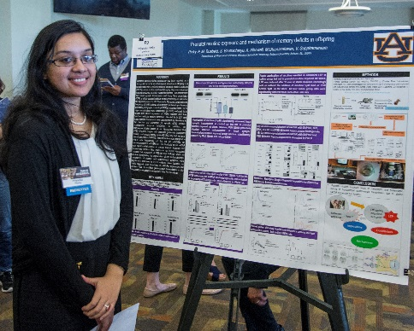
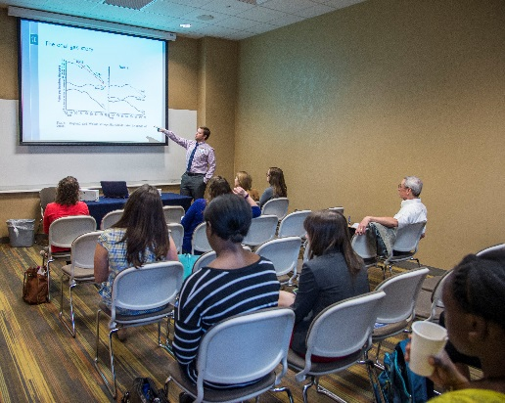
This is Research 2018
Student Symposium
Abstract Submission: January 11 - February 1
Graduate and undergraduate student researchers are encouraged to present their work
Oral and Poster Presentations
Abstracts accepted January 11-February 1, 2018
Symposium – March 26
Awards – April 3

Slide 4

Judges Needed!
Our greatest challenge each year is recruiting enough judges for the student symposium.
Having enough judges is one of the most important ways to support our students.
Please encourage your faculty to sign up to judge student presentations. An online sign-up link will be sent soon.

Slide 5
This is Research 2018
Steve Taylor – Chair
Jennifer Kerpelman – Past Chair
Henry Fadamiro – Chair Elect
Lorraine Wolf – Director of Undergraduate Research
Fereshteh Rostampour – Showcase Coordinator

