Slide 1
Office of AA/EEO & Title IX Coordinator
Kelley Taylor, Director
317 Foy Hall ph. 844-4794 taylokg@auburn.edu

Slide 2
AU’s EEO Policies
Auburn University prohibits Discrimination, Harassment, or Retaliation based on:
  Race
  Color
  National Origin
  Religion
  Age
  Disability
  Protected Veteran Status
  Sex (including Sexual Orientation, Gender Identity or Gender Expression)

Slide 3
AU’s EEO Policies Protect All Members of the AU Community:
Faculty
Staff
Undergraduate Students
Graduate Students

Slide 4
AU’s Sexual Misconduct Policy Specifically Prohibits:
Sexual Harassment of students and employees.
Sexual Assault by one campus community member against another.
Dating violence or domestic violence between campus community members.
Stalking by one campus community member against another.
Retaliation against a person who complained or participated in an investigation.

Slide 5
Responsible Employees
All “Responsible Employees” at Auburn University MUST REPORT potential Title IX violations when they become aware of them to the Title IX Office (e.g., sexual harassment, sexual assault, dating/domestic violence, stalking, retaliation) either by phone, email, or at our website: www.auburn.edu/titleix.

Slide 6
Responsible Employees
All faculty, staff, and graduate students (in their GA roles) are Responsible Employees under Auburn’s Sexual Misconduct Policy.
Exceptions are the Ombuds, licensed counselors in the Student Counseling Center, and employees of Safe Harbor advocacy center.

Slide 7
Responsible Employees
If approached by a student or employee to discuss a “confidential matter,” RESPONSIBLE EMPLOYEES CANNOT PROMISE COMPLETE CONFIDENTIALITY for situations involving sexual misconduct.
Suggest that students or employees desiring complete secrecy contact a TRULY confidential campus resource.

Slide 8
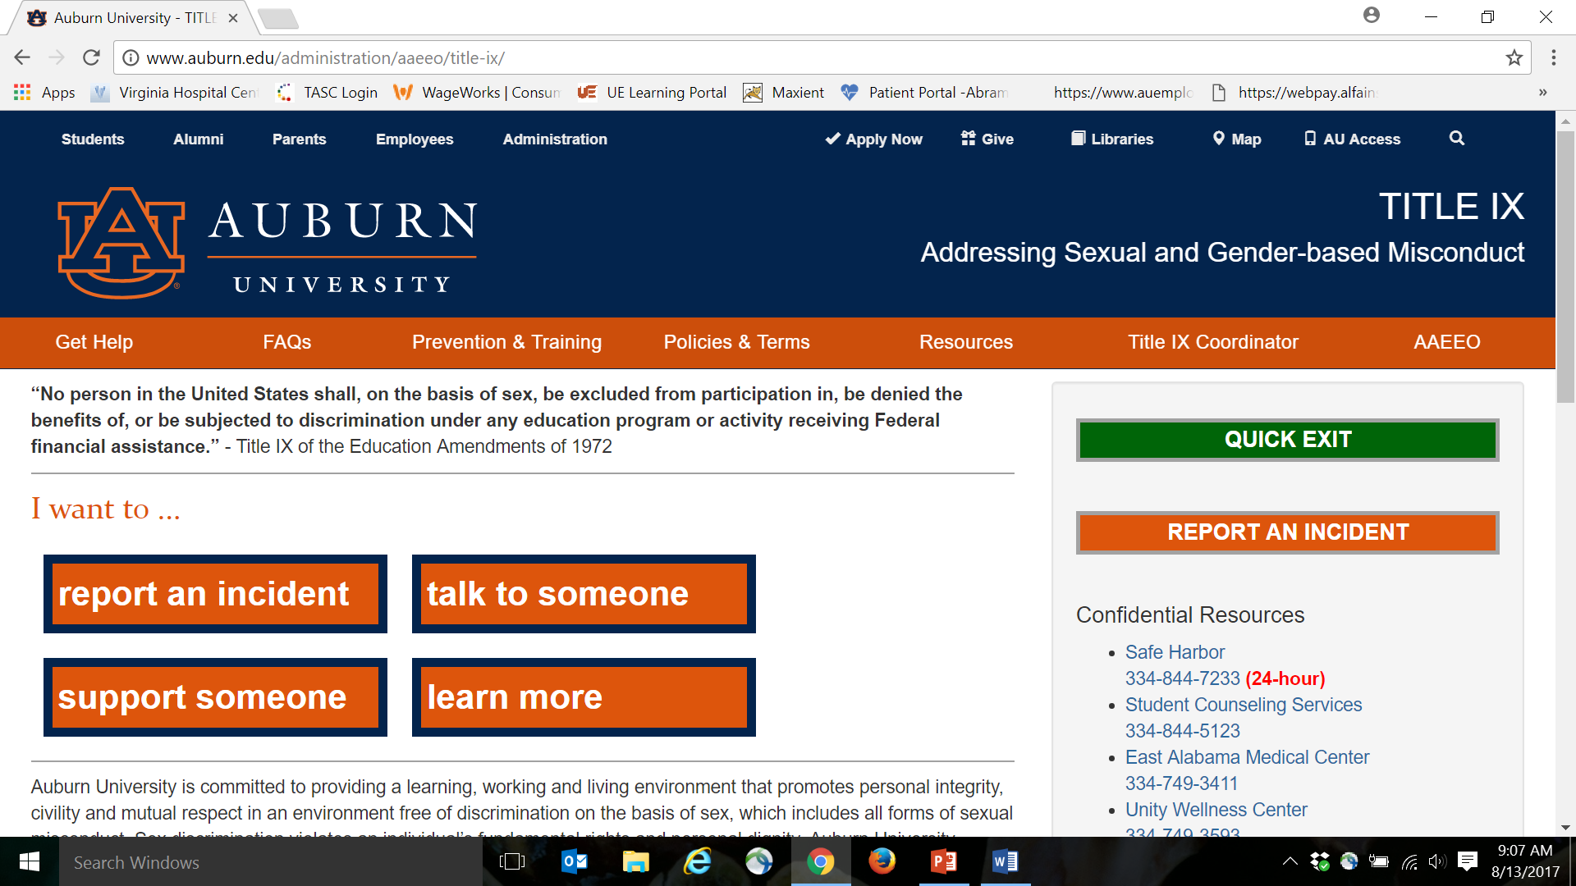

www.auburn.edu/titleix

Slide 9
ALSO:
Faculty, Staff, and GA’s are FORBIDDEN from dating, making advances toward, or romantically pursuing students or employees they teach or directly supervise, even if the relationship is consensual.
Title IX regulations REQUIRE universities to accommodate pregnant students in class and other activities.

Slide 10
ALSO:
Title IX’s pregnancy protections may include excusing pregnancy-related medically-documented absences in excess of the absence limit stated in your syllabus.
For assistance, consult with the Title IX Coordinator, or refer to: http://www2.ed.gov/about/offices/list/ocr/docs/dcl-know-rights-201306-title-ix.pdf.

Slide 11
Questions?
Office of AA/EEO & Title IX
www.auburn.edu/titleix
317 Foy Hall
844-4794
eeo@auburn.edu
taylokg@auburn.edu

