Slide 1
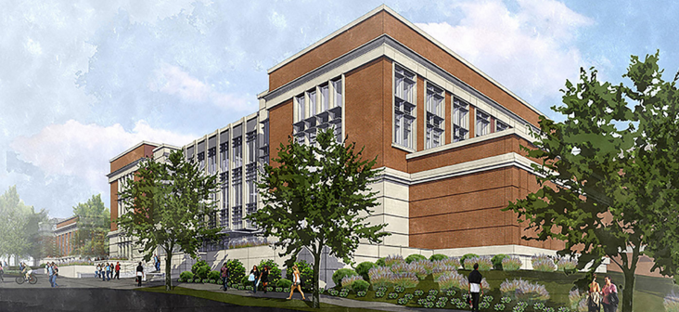
Mell Classroom @ RBD:
Mid-term Teaching and Learning Update
General Faculty Meeting 10.03.17
Diane. E. Boyd, PhD, Director

Slide 2
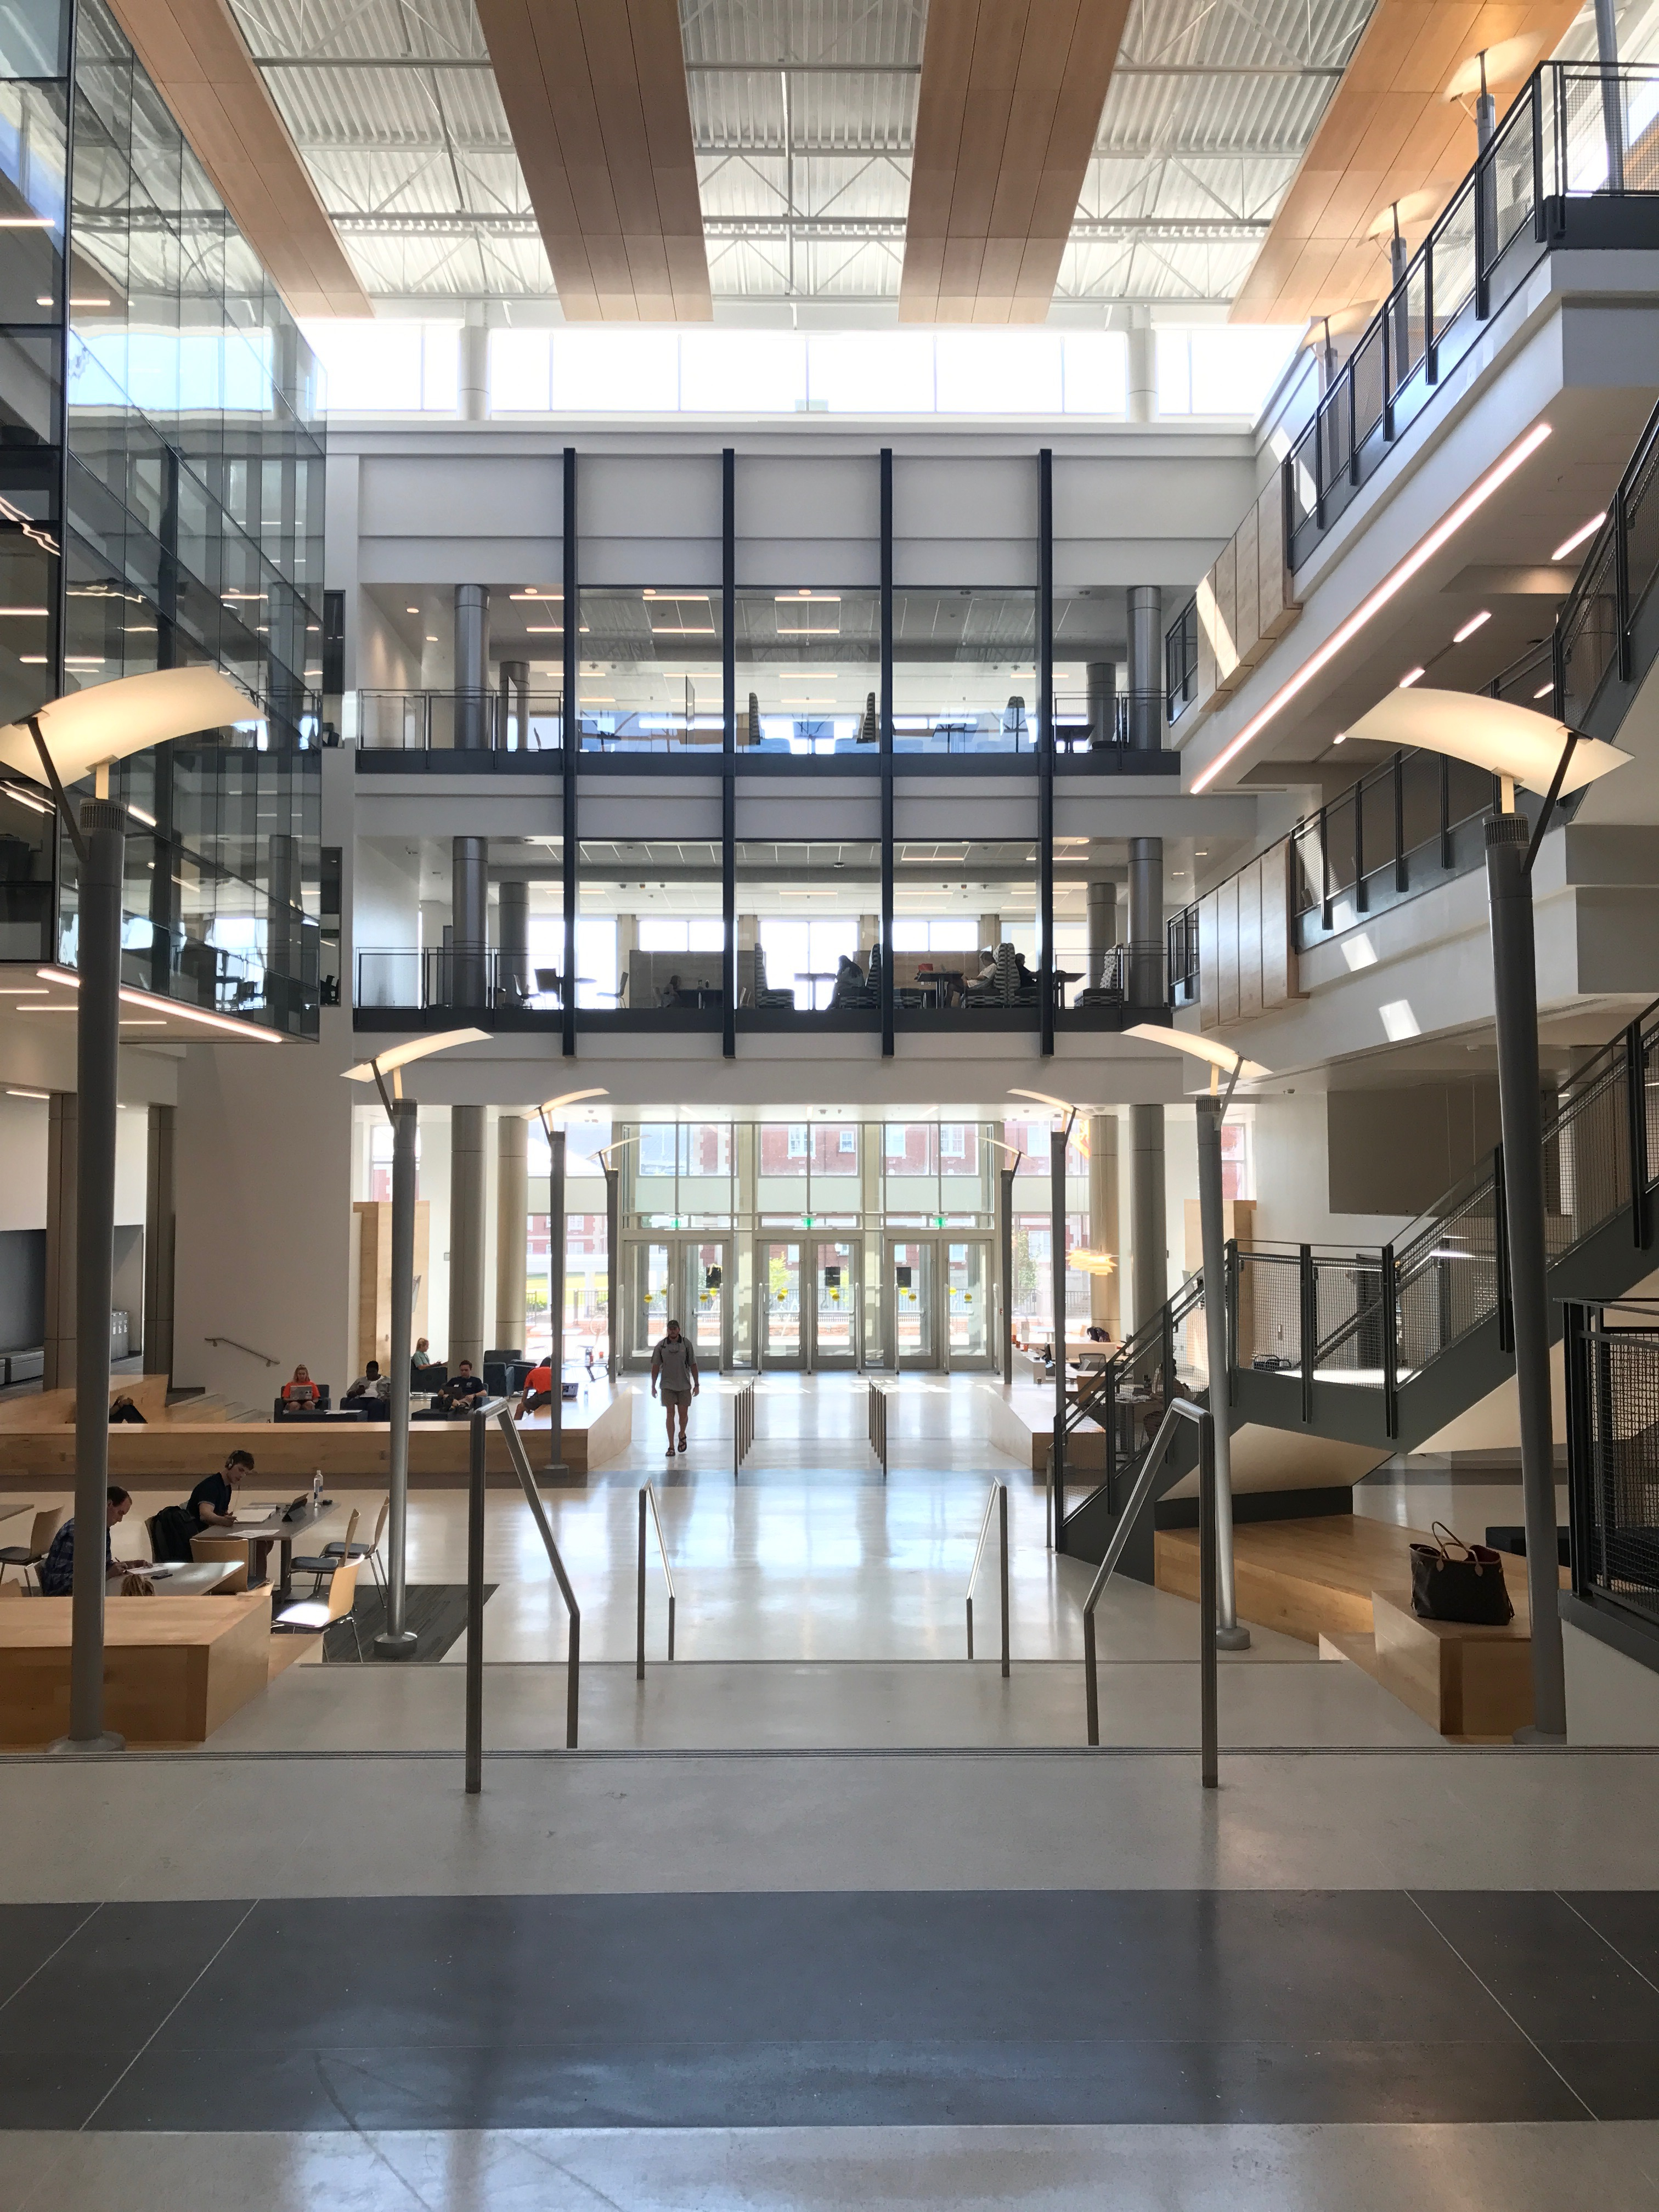

Instructional Support
102 of 124 faculty, GTAs and instructional staff have participated in some form of calibrated development related to maximizing learning success in Engaged & Active Student Learning (EASL spaces)
Welcome Week sessions for students

Slide 3
Instructional Support
102 of 124 faculty, GTAs and instructional staff have participated in some form of calibrated development related to maximizing learning success in Engaged & Active Student Learning (EASL spaces)
Welcome Week sessions for students
7017 “enrolled seats” in EASL classrooms

Slide 4
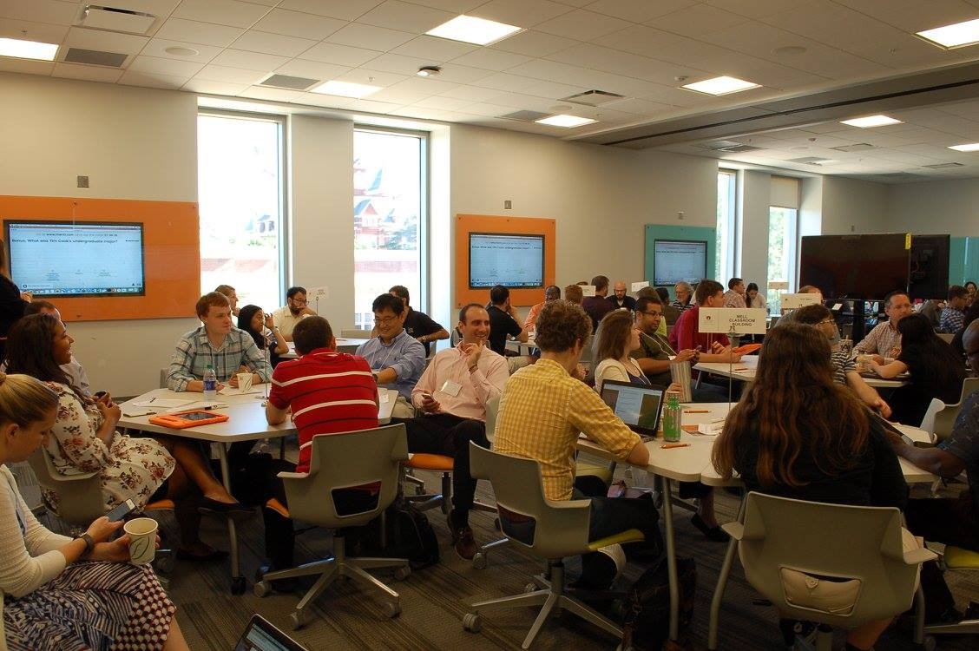
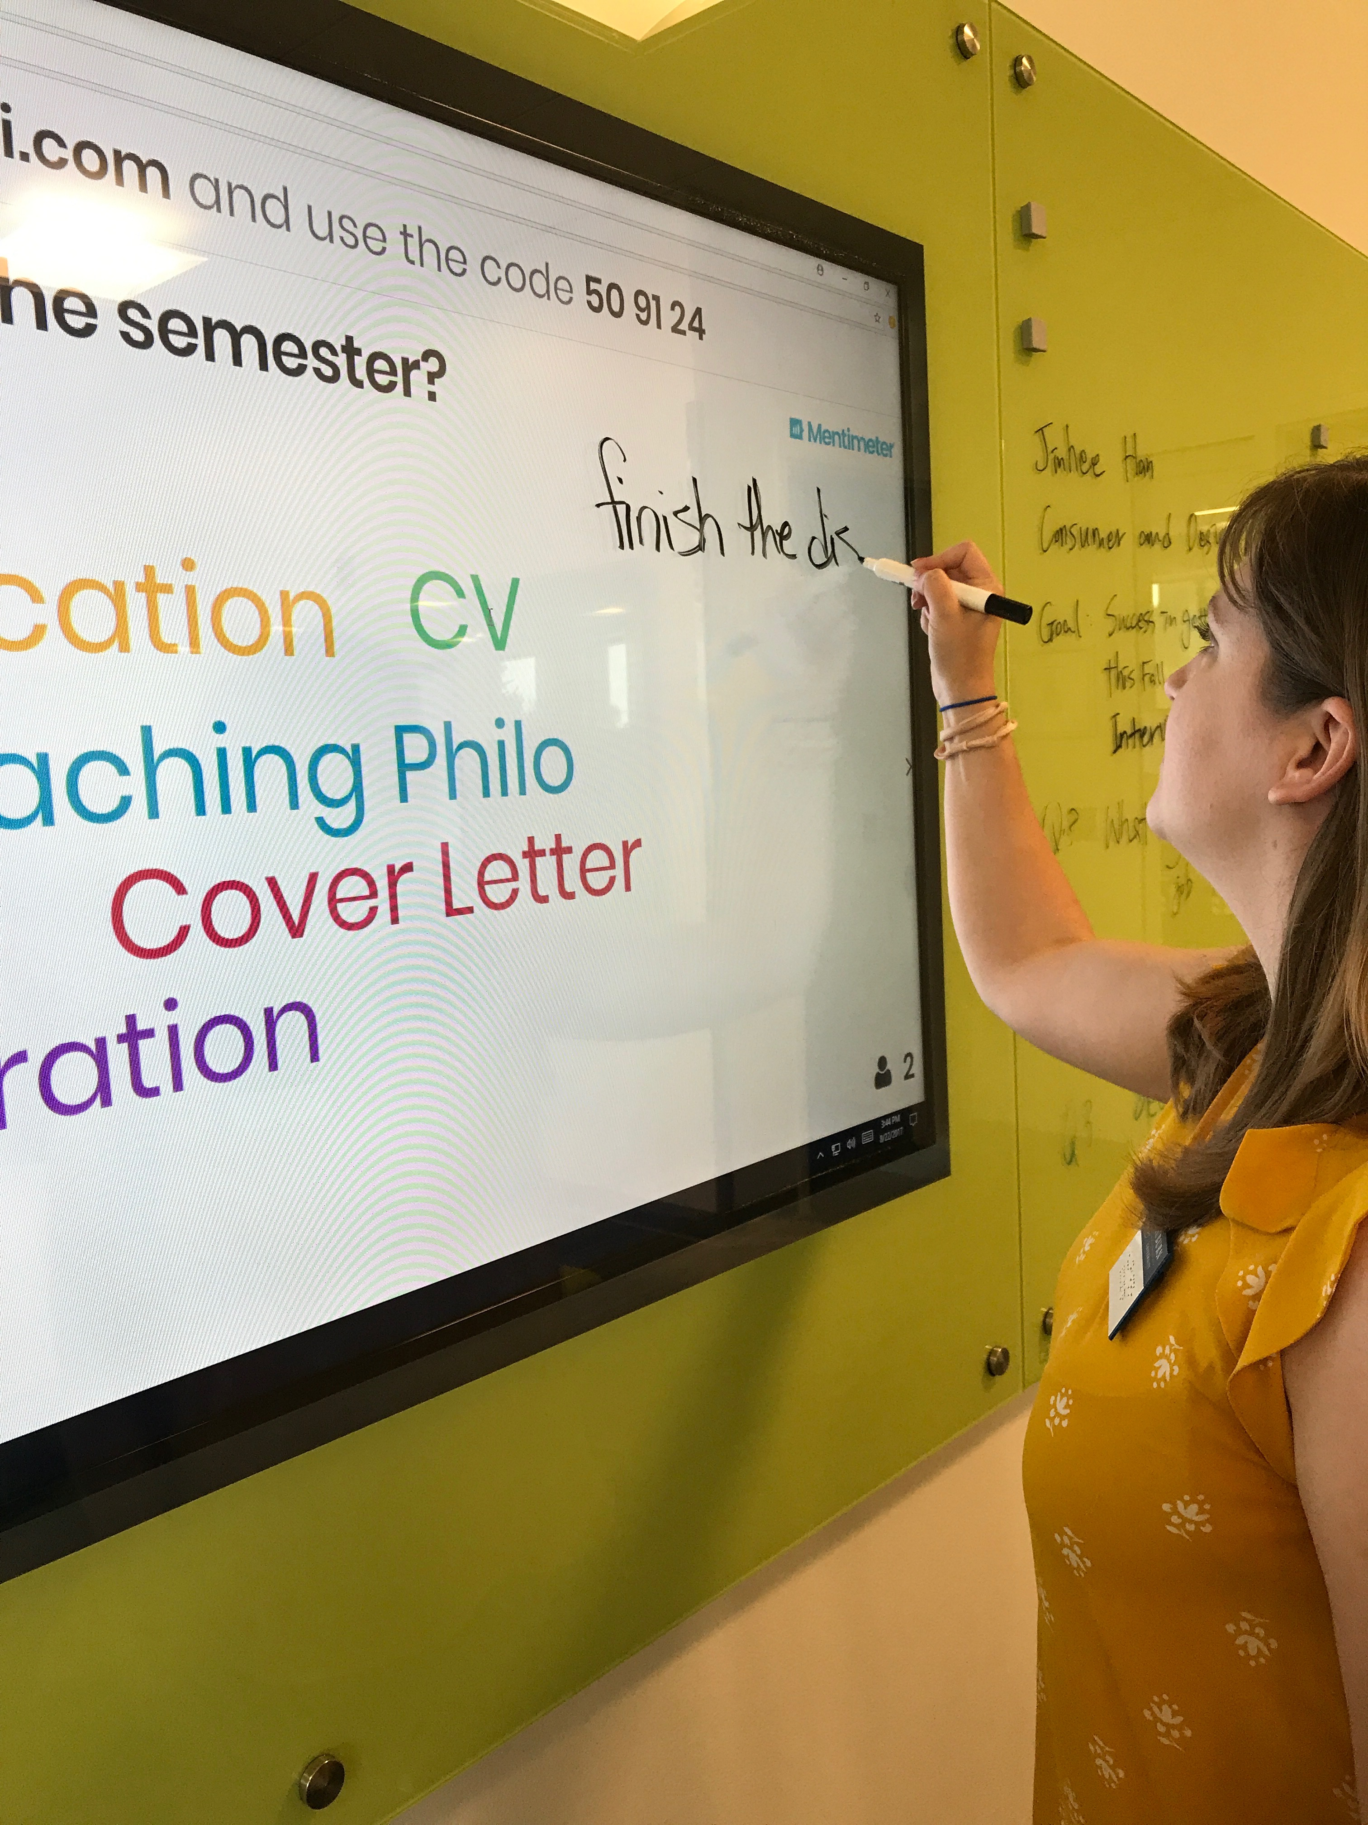
Technology and Space Affordances

Slide 5
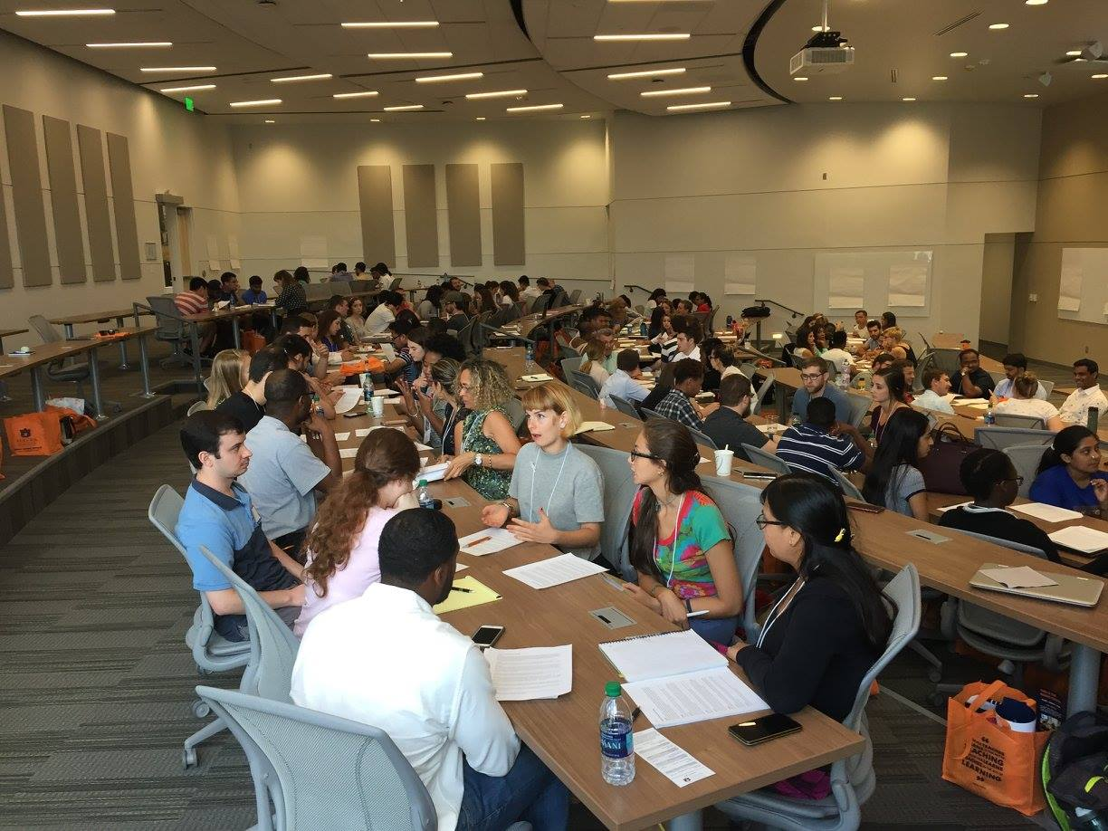

Slide 6
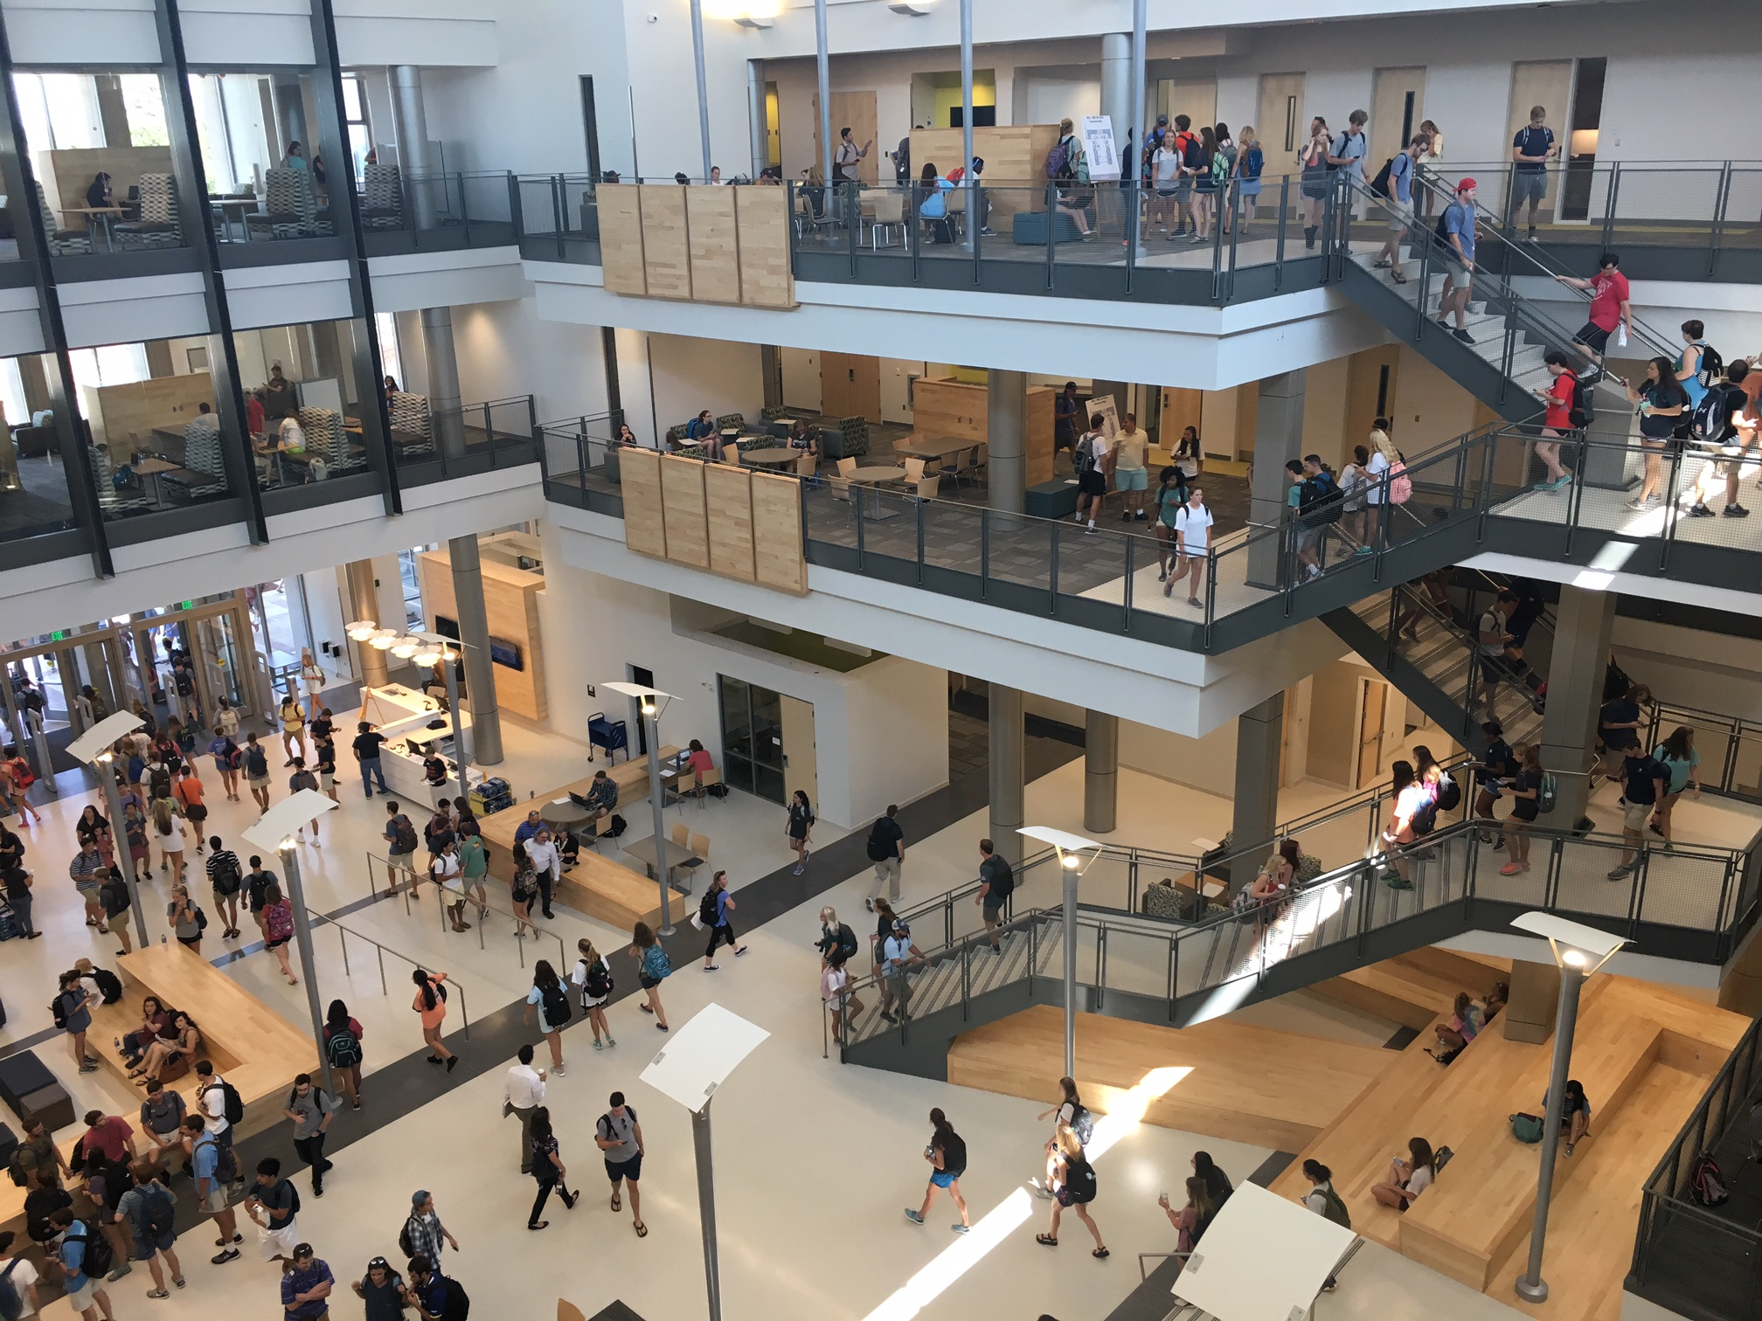

Slide 7
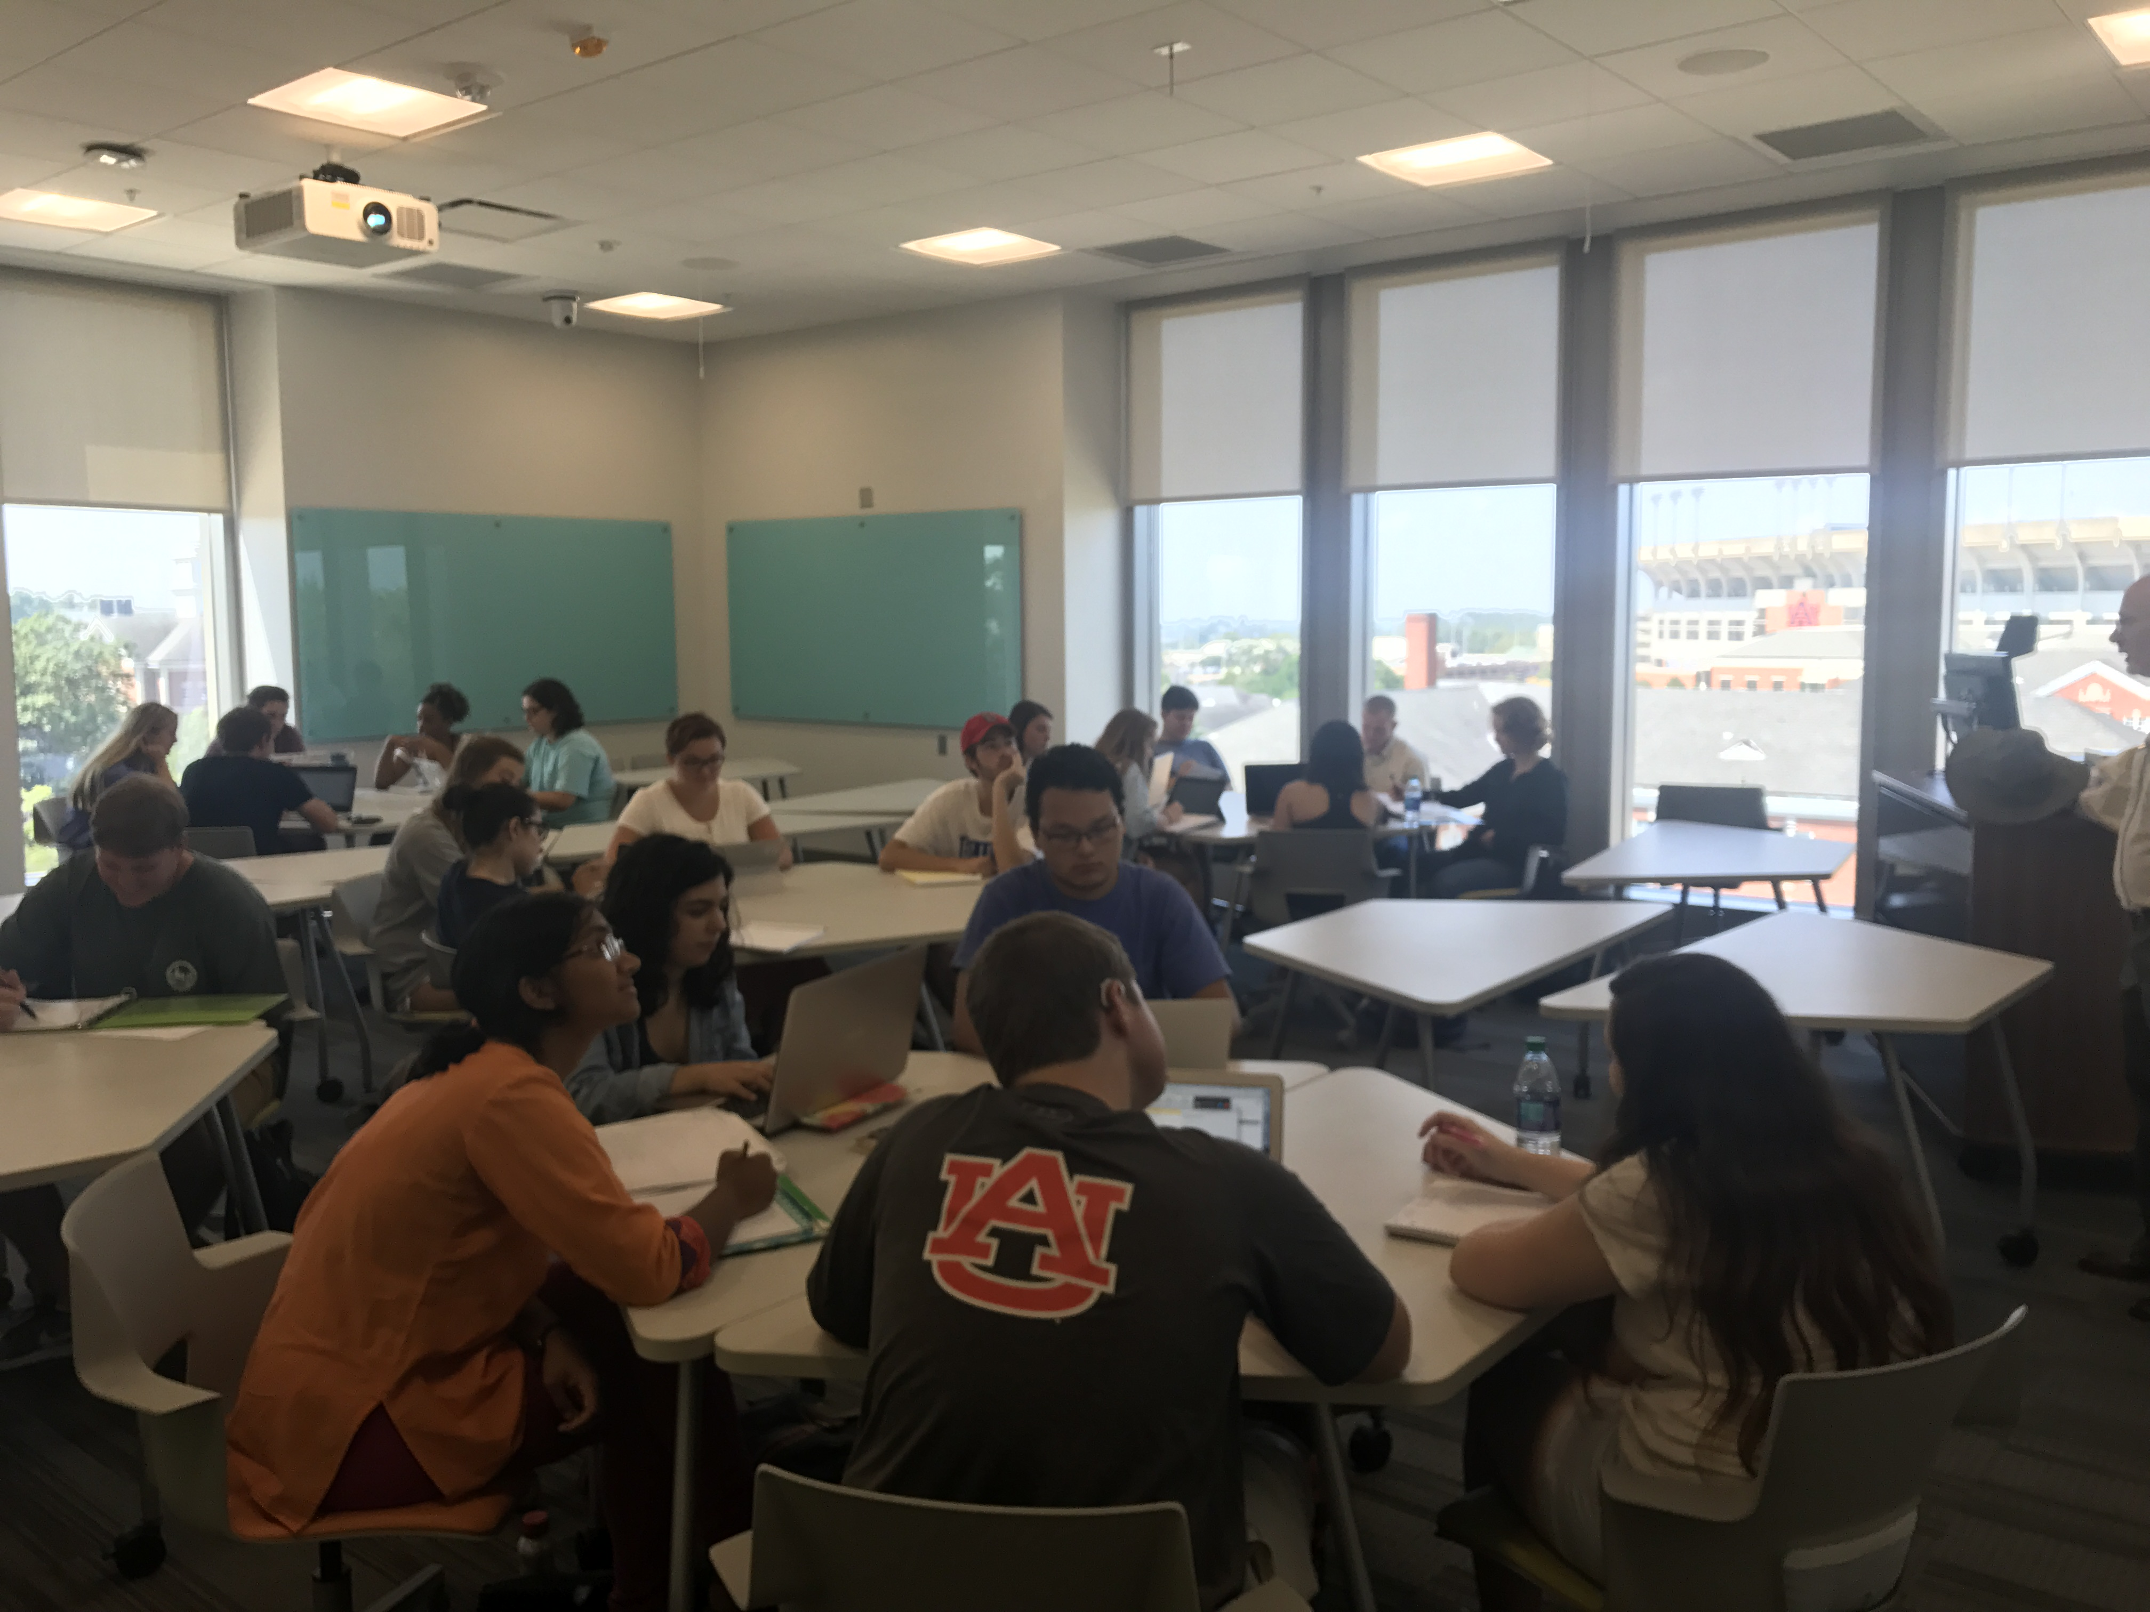

Slide 8
Learn More
Wiebke Kuhn: kuhnwi1@auburn.edu
auburn.edu/mell

Slide 9
