Slide 1
Proposed Revisions to General Education Student Learning Outcomes
Auburn University Senate
September 2017

Slide 2
SACSCOC & Student Learning Outcomes
3.5.1 The institution identifies college-level general education competencies and the extent to which students have attained them.

Slide 3
Current General Education Student Learning Outcomes (SLOs)
Information Literacy
  1. Students will be information literate.
Analytical Skills and Critical Thinking
  2. Students will be able to read analytically and critically.
  3. Students will be able to critique and construct an argument effectively.
  4. Students will be able to apply simple mathematical methods to the solution of real-world problems.
  5. [Deleted Fall 2014]
Effective Communication
  6. Students will be able to write effectively.
  7. Students will demonstrate effective oral communication skills.
Informed and Engaged Citizenship
  8. Students will be informed about world geopolitical systems.
Intercultural Knowledge and Diversity Awareness
  9. Students will understand and appreciate the diversity of and within societies of the United States and the world.
Scientific Literacy
  10. Students will understand and appreciate methods and issues of science and technology.
Aesthetic Appreciation and Engagement
  11. Students will understand and appreciate the arts and aesthetics as ways of knowing and engaging with the world.

Slide 4
Proposed General Education Student Learning Outcomes (approved by the CCGEC Spring 2017)
In order to become lifelong learners and use their education to solve practical problems, by the time of graduation, students will be able to effectively:
a. locate, evaluate, and use information.
b. read and think critically.
c. apply mathematical methods.
d. write and revise for a variety of purposes.
e. create and deliver oral presentations.
f. analyze their own society and its relationship to the larger global context.
g. interact in intercultural situations.
h. apply scientific principles.
i. analyze and value creative artistic endeavors.
.

Slide 5
What prompts the revision proposal?
Year of Reflection (2015-2016) focus group feedback led the CCGEC to decide to focus on assessing graduating seniors and centralizing assessment.
With the new focus on seniors, 9 faculty working groups sought to redefine the student learning outcomes and select/design measurement tools to assess each outcome.

Slide 6
Who has been involved in developing the revised outcomes?
2016-2017 CCGEC Members
Toni Carter, Library
Annette Kluck, Education
Missy Josephson, CVM
Karol Renfroe, Nursing
Angela Calderon, Pharmacy
Susanna Morris/Hilary Wyss, CLA
Robert Norton, Agriculture
Robert Gitzen, SFWS
Cliff Defee, HCOB
John Pittari, CADC
Stuart Wentworth, SGCOE
Chuck Savrda, COSAM
Mark DeGoti, CLA
James Shelley, CLA
Matt Malczycki, CLA
Murray Jardine. CLA
Michel Smith, COSAM
Yee Ming Lee, Human Sciences
Brandon Honeywell/Justin Smith, SGA

Slide 7
Who else has been involved in developing the revised outcomes?
2016-2017 Outcome Working Group Members
Intercultural Competency
Carmen Brysch (COSAM)
Jessica Fripp (ED)
Arianne Gaetano (CLA)
Kelly Kennington (CLA)
Annette Kluck (ED)
Chandana Mitra (COSAM)
Traci O’Brien (CLA)
Jorge Ogayar (CLA)
Tal Peretz (CLA)
Robin Sabino (CLA)
Steven Shapiro (CLA)
Information Literacy
Toni Carter (LIB)
Bridget Farrell (LIB)
Sharyn Pulling (CLA)
Juliet Rumble (LIB)
Engaged Citizenship
Nanette Chadwick (COSAM)
Cliff Defee (BUS)
Trey Fields (SGA)
Charles Israel (CLA)
Soren Jordan (CLA)
Matt Malczycki (CLA)
Chris Vickers (CLA)
Mark Wilson (CLA)
Hilary Wyss (CLA)
Critical Thinking
Miriam Clark (CLA)
James Shelley (CLA)
Michael Watkins (CLA)
Quantitative Literacy
Ulrich Albrecht (COSAM)
Melissa Baumann (ENG)
Regina Jackson (COSAM)
Michel Smith (COSAM)
Oral Communication
Charles Israel (CLA)
Jennifer Johnson (CLA)
Roy Knight (ENG)
Michael Milford (CLA)
Martin O’Neill (HS)
Scientific Reasoning
Scott Bowling (COSAM)
Vince Cammarata (COSAM)
Bob Gitzen (SFWS)
Stuart Loch (COSAM)
Bob Norton (AG)
Chuck Savrda (COSAM)
Stu Wentworth (ENG)
Creative Endeavor
Chase Bringardner (CLA)
Mark DeGoti (CLA)
Joyce DeVries (CLA)
Karen Rogers (CADC)
Written Communication
Chris Keirstead (CLA)
Chad Wickman (CLA)

Slide 8
Next Steps for the CCGEC?
Faculty development discussions to help faculty to think through how to embed these outcomes in their courses (Fall 2017)
Continued end-of-program assessment pilot with volunteered students and all graduating seniors in one college (Fall 2017-Spring 2018. Goal: full implementation by Spring 2019)
Efforts to strengthen awareness across campus of the links between the general education learning outcomes and the career readiness skills students need (2017-2018).

Slide 9
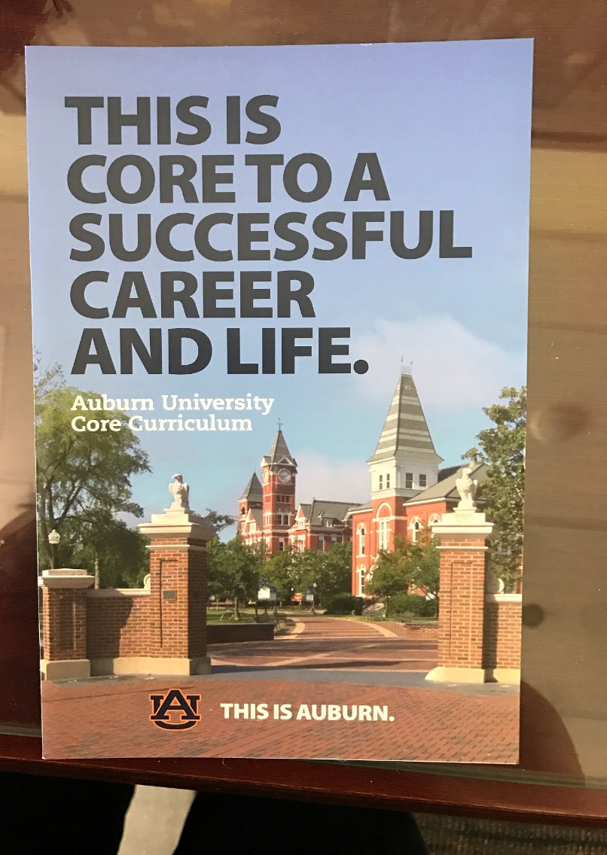

Slide 10


