Slide 1

Academic Misconduct
Bylaw 14.02

Slide 2
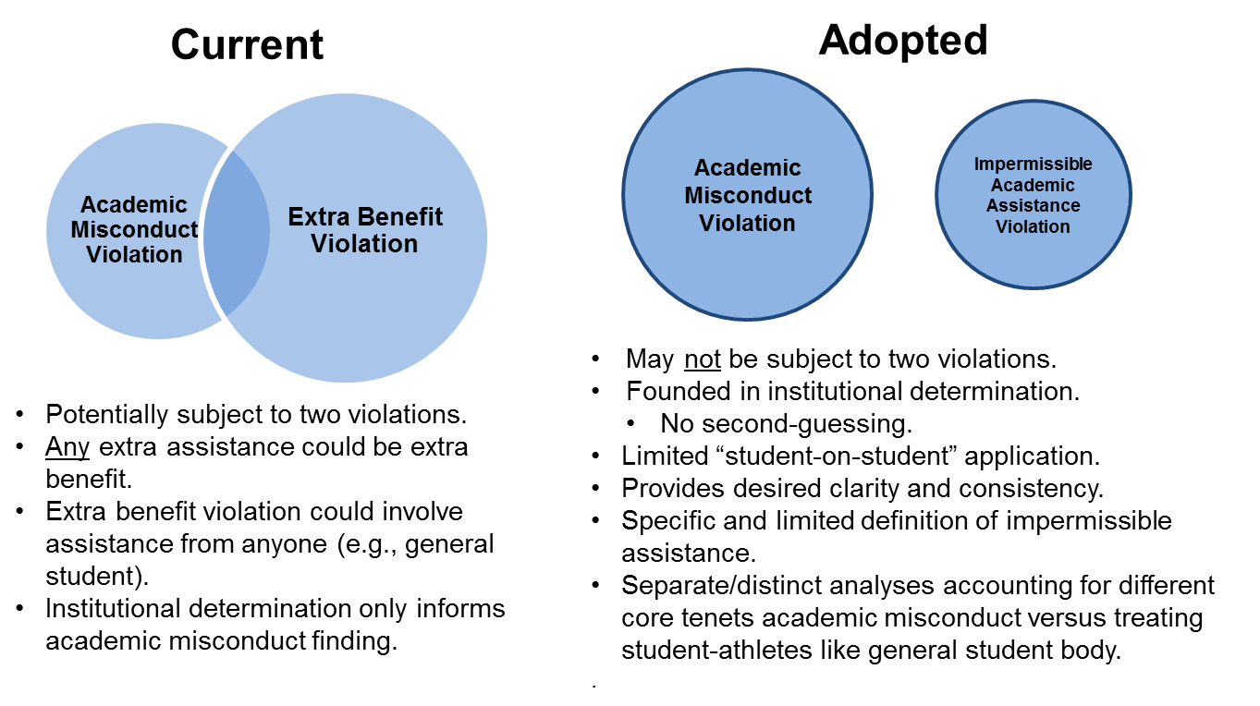

OLD NEW

Slide 3
New Legislation – 14.02.1
All institutional staff members and student-athletes are expected to act with honesty and integrity in all academic matters. Post-enrollment academic misconduct includes any violations or breach of an institutional policy regarding academic honesty or integrity (e.g. academic offense, academic honor code violation, plagiarism, academic fraud).

Slide 4
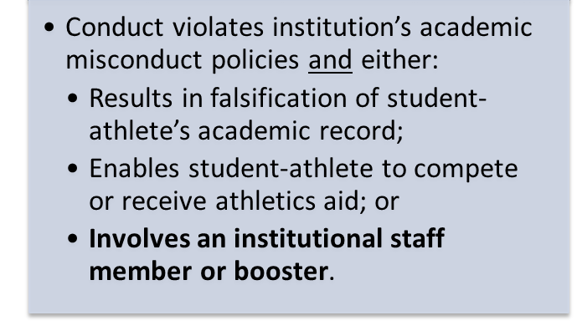
Academic Misconduct

Slide 5
Staff Involvement
Institutional staff members shall not be involved in:
  Conduct that violates the institution’s written policies & procedures regarding academic misconduct;
  Falsification or alteration of the student-athlete’s academic record;
  Knowing submission of erroneous APP data; nor,
  Impermissible academic assistance.
Institutional Staff Members
Non-Student Staff | Student Employees
Performs work for institution. Regardless of compensation. Includes work within the athletics department. | Responsibilities include the provision of academic services to student-athletes; OR, Engages in academic misconduct or impermissible academic assistance at the direction of nonstudent staff or a booster.

Slide 6
New Legislation – 14.02.10
Impermissible academic assistance by a current or former institutional staff member or a booster includes, but is not limited to, the provision of or arrangement of:
  Substantial assistance that is not generally available to Auburn students, which results in the certification of eligibility; or
  An academic exception that results in a grade change, academic credit, or fulfillment of a graduation requirement, when such an exception is not generally available to Auburn students.

Slide 7
Impermissible Academic Assistance
Extra Benefit
Must meet all legislated criteria:
Assistance/exception does not violate institution’s misconduct policies; however,
Assistance/exception provided is not generally available to all students;
Assistance/exception provided is not permitted via NCAA Bylaw 16.3;
Assistance/exception was substantial;
Institutional staff member/booster was involved; and
Leads to eligibility.
Impermissible Academic Assistance

Slide 8
Adopted Framework
Did conduct violate the institution’s academic misconduct policies & procedures?
If Yes
If No
Alteration or Falsification of Transcript or Academic Record?
Institutional Staff or Booster Involvement?
Competed or Received Aid Based on Erroneous Declaration of Eligibility?
Substantial academic assistance or exception;
Not generally available to institution’s students;
Not permissible under Bylaw 16.3;
Provided by current or former institutional staff or representative of athletics interests; and
Results in certification of eligibility.
Yes to any?
-or-
No to all?
Yes to all?
No to any?
NCAA
Academic Misconduct Violation
No NCAA Violations
NCAA Impermissible Academic Assistance
Violation
No NCAA Violations

Slide 9
Ask before you act!
If you see something, say something!
    www.ethicspoint.com

Slide 10
WAR EAGLE!

