Slide 1

3 Tools to Enhance Teaching & Learning
New
Digital Badges
Canvas Design Tools
Canvas Feedback Tool

Slide 2

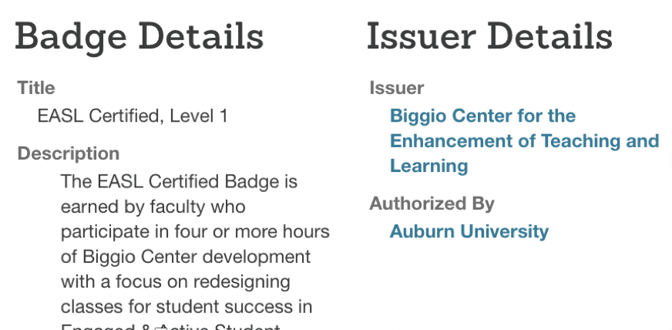
What’s a Badge?
Digital Credential =
Icon +
Meta-Data
Notes:
The Office of Auburn Online has partnered with Credly to offer AU Certified digital badges. Units can collaborate with AU Online to create badges. Biggio Center has taken the lead by issuing the first badge – EASL Certified. A badge is a certificate in a digital format. Like girl scouts but instead of sewing it to a sash, you share it on your professional website, electronic CV, or social media.
Badge consists of the icon and the meta-data: what pops up when you click on the icon. Descripriton & criteria. Issuer Details.

Slide 3
What’s the Value of a Badge?
Heads & Chairs value:
Evidence of teaching effectiveness:
Strives to Be a Better Teacher (Teaching Behaviors Checklist; Buskist et al. 2002)
Faculty value:
Specific tasks to improve
Getting feedback
Sharing on websites, LinkedIn
Recognition on Biggio website
Fun
Notes:
Evidence of teaching effectiveness – invests time in professional development; print certificate or digital certificate;

Slide 4





Biggio Badges
Notes:
Biggio badges certify professional development in CRD, Active Learning, and the PFF program. This year we are releasing at least two more. One for NFS and one for Teaching Feedback

Slide 5
Canvas Design Tools
Improves the student experience
  ↑ Quality
  ↑ Consistency
  ↑ Accessibility
Requires less faculty time
  Customize the look
  Multi-Tool: templates; module builder; due date modifier
  Upload/Embed Image Tool
Notes:
Cidi Design Tools is open source software that simplifies the way instructors build course shells and style content in Canvas.

Slide 6
Biggio Tech: Design Tool Training
“Launch Your Canvas Courses to the Next Level with Design Tools”
  August 28th, 2 – 3:00 pm
  Foy 145 (The Learning Lounge) This session took place today
“How to Create a Consistent and User-Friendly Canvas Course With the Multi-Tool”
  August 29th, 10 – 11:00am
  Foy 145 (The Learning Lounge)

Slide 7
Canvas Feedback Tool
Teach students how to give feedback
Get feedback throughout the semester
Increase response rate and quality of AUeValuate feedback

Slide 8
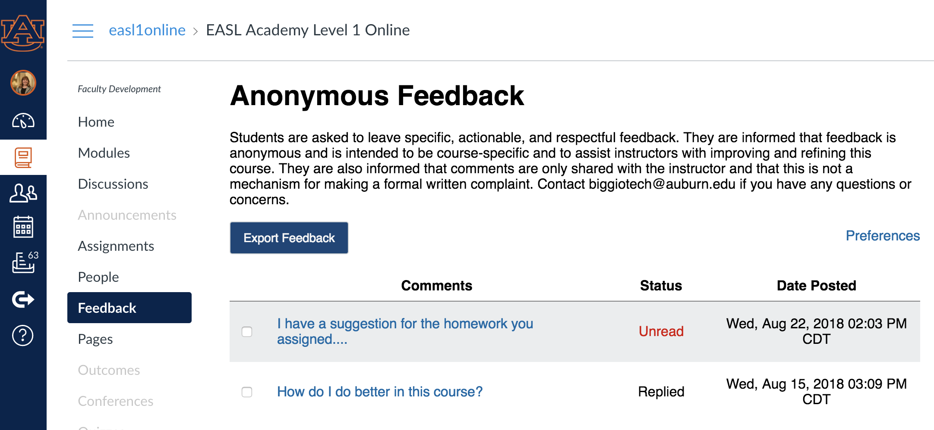
Instructor View
View Comments

Slide 9
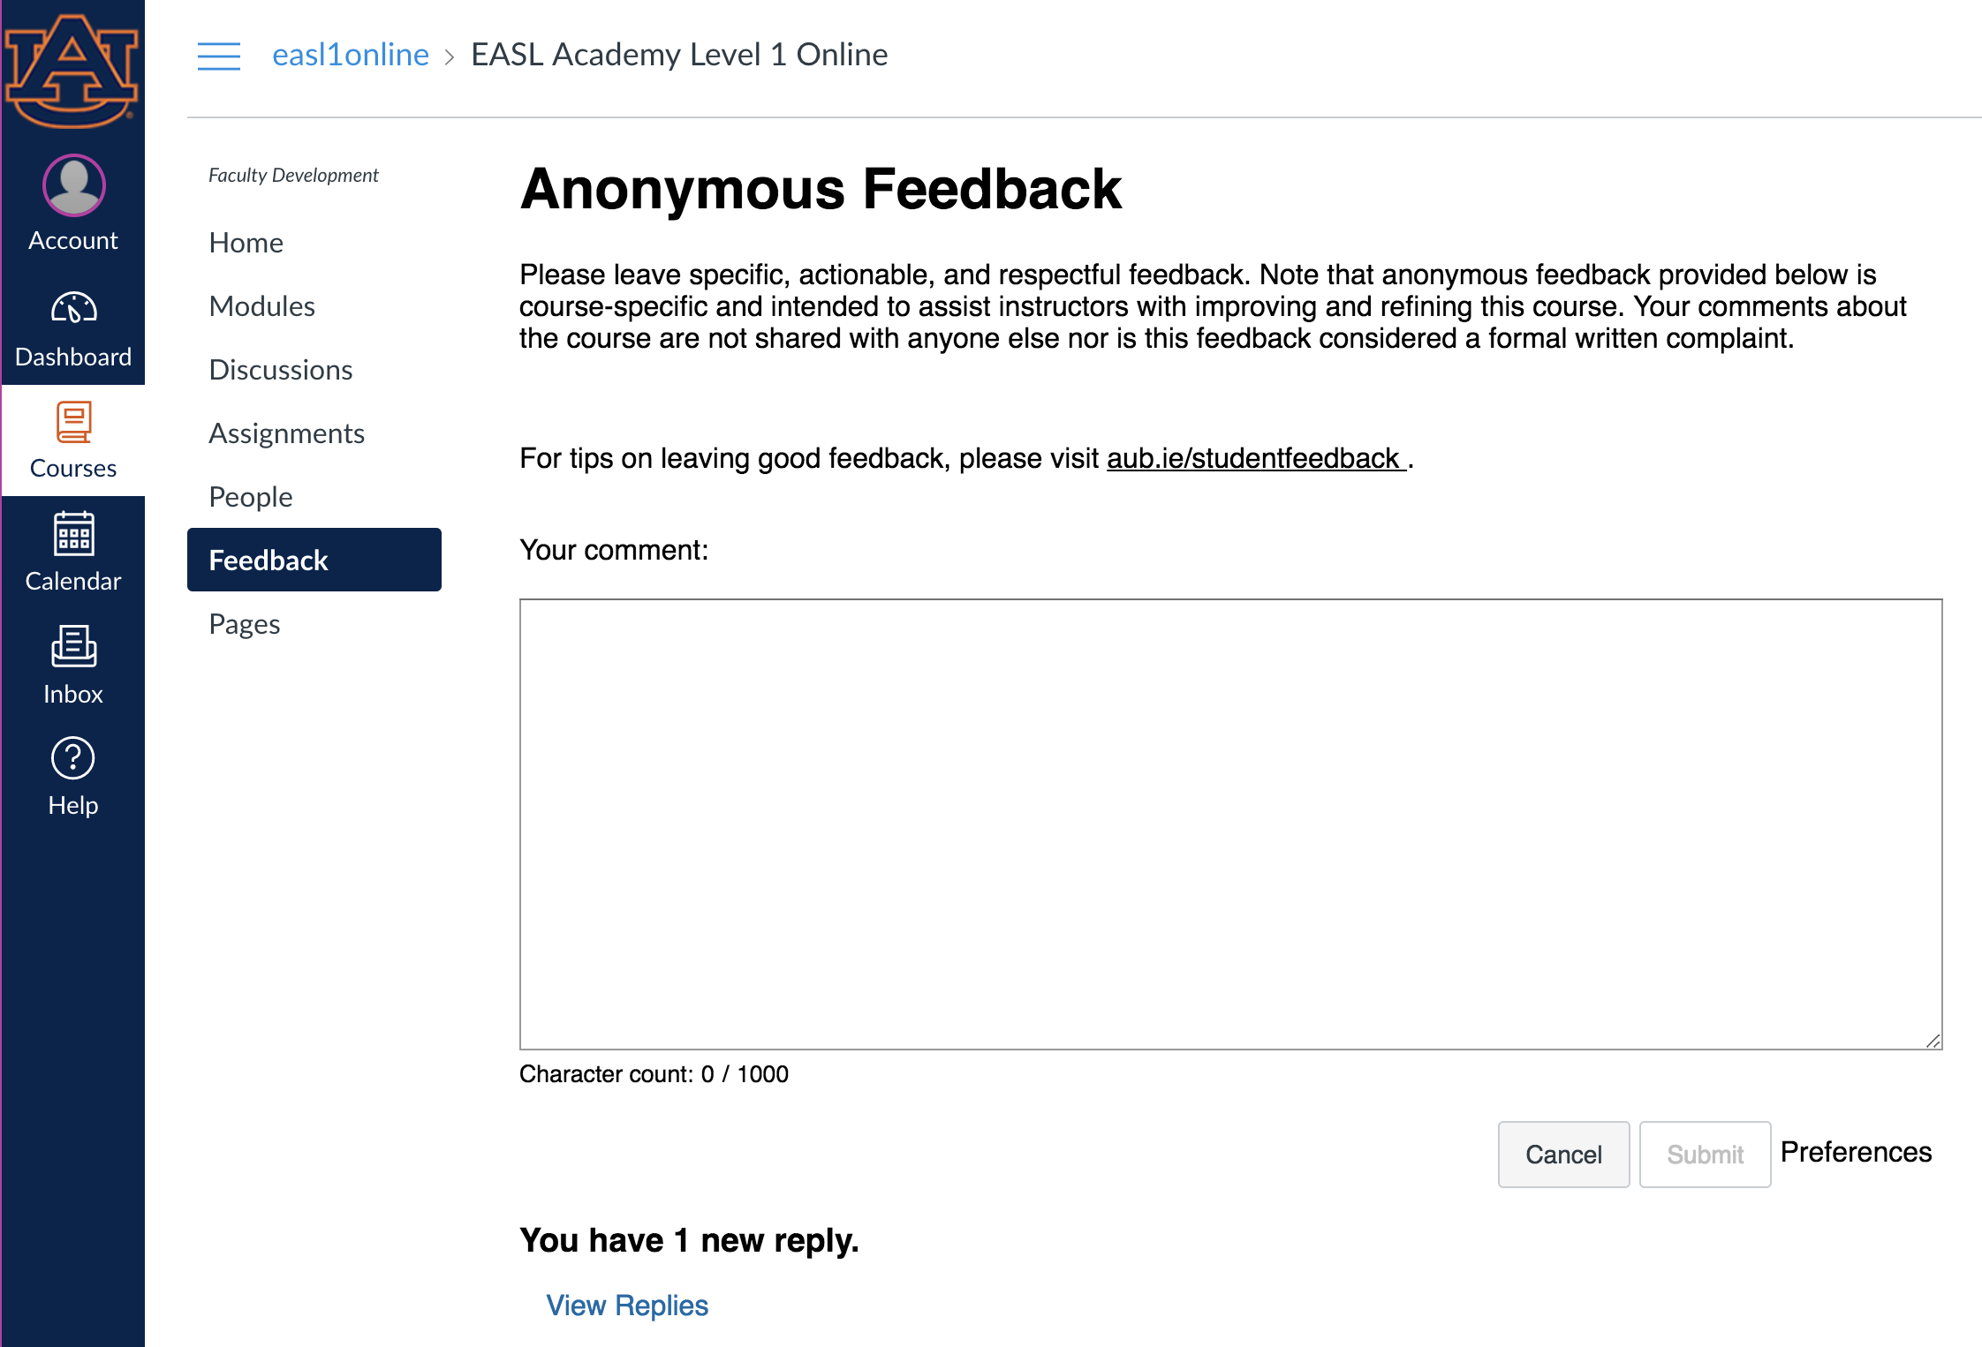
Student View
Video tutorial: How to give Specific, Actionable, Respectful Feedback
Student leaves anonymous feedback.
If a student abuses this privilege,
you can block them.
Student is notified when you reply

Slide 10
Thank you!
Notes:
Biggio badges certify professional development in CRD, Active Learning, and the PFF program. This year we are releasing at least two more. One for NFS and one for Teaching Feedback

