Slide 1

Transportation Services
Don Andrae,
Director

Slide 2
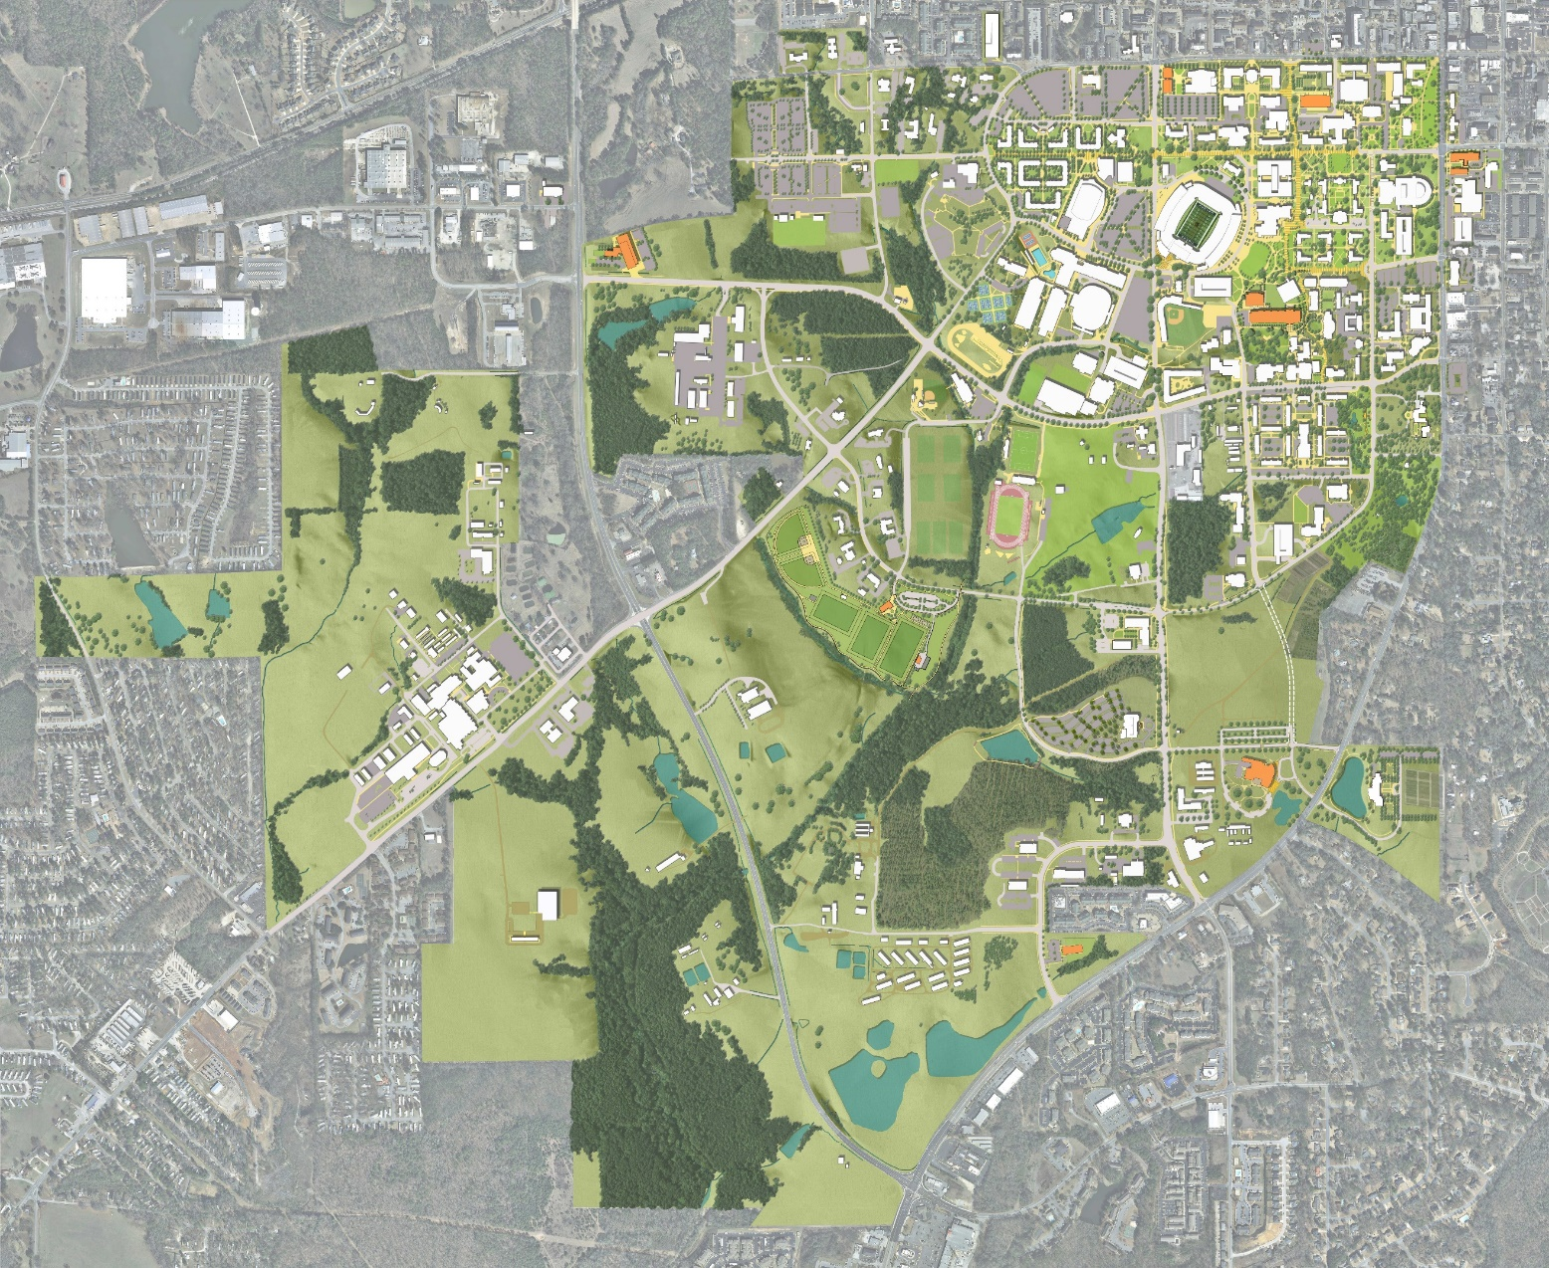
Capital Project Update
Impacts to Parking
Graduate Business Education Building (+136)
Brown Koppel Engineering Achievement Center (+3)
South College Parking Garage (+239)
Academic Classroom and Laboratory Center (-94)
Goodwin Hall Addition
Leach Science Center
Student Housing
Rane Culinary Science Center (-103)
Advanced Structural Testing Laboratory
Recreation Fields Expansion
Gogue Performing Arts Center
Child Care Center
Poultry Farm Research Unit Relocation
1
2
8
3
4
Notes:
Program Requirements: The project will renovate the existing 3rd & 4th level East suites to include new operable windows and fans.
Budget: $4.5 million to be finances by the Athletics Department
Project Location: The renovation will take place in the 3rd and 4th level East suites in Jordan-Hare

Slide 3
Citation and Appeals
Data Overview
 | 2013 | 2014 | 2015 | 2016 | 2017 | 2018
Citations | 3,835 | 5,253 | 5,277 | 8,372 | 5,195 | 3,918
Wheel Locks | 56 | 68 | 20 | 68 | 158 | 111
Tows | 163 | 205 | 44 | 169 | 385 | 587
The number of citations was lower in August/September 2018 than in previous years due to the fact that the student permits were assigned incorrectly by the parking management system. Because of this we only enforced the Faculty/Staff lots for the first 4 weeks of the period.
 | 2017 | 2018
Denied | 121 | 103
Cancelled | 122 | 119
Adjusted | 15 | 25
Approved | 29 | 11
The appeals for the last two years for the August/September time period are as shown:
Notes:
Program Requirements: The project will renovate the existing 3rd & 4th level East suites to include new operable windows and fans.
Budget: $4.5 million to be finances by the Athletics Department
Project Location: The renovation will take place in the 3rd and 4th level East suites in Jordan-Hare

Slide 4
Citation Pricing
Data Overview
 | 2014-2017 | 2018
1st | $10 | $20
2nd | $20 | $40
3rd | $40 | $60
4th or more | $50 | $60
The count is reset at the start of the academic year. Also the tow and wheel lock fee starting with the 2018 academic year was changed to $100 from the $85 for the previous years.
Notes:
Program Requirements: The project will renovate the existing 3rd & 4th level East suites to include new operable windows and fans.
Budget: $4.5 million to be finances by the Athletics Department
Project Location: The renovation will take place in the 3rd and 4th level East suites in Jordan-Hare

Slide 5
Employee Express Shuttle Service
Primary Objective:
Shuttle service for faculty and staff with regular fixed route hours of operation which are as follows:
Designated stops
Facilities Division
Thach Ave. on College St.
Biggin Hall/Ramsay Hall
Lowder Hall/Shelby Center
Operational Hours
Monday – Friday
7:00 a.m. – 9: a.m.
11:00 a.m. – 1:00 p.m.
For personal services outside of the hours above or for on-campus meetings:
(334) 844-8600
Operation Specifics:
Those utilizing the Employee Express services will park their vehicles in the Facilities parking lot located on Samford Avenue. Individuals are also able to track the shuttles with real-time tracking provided through Tiger Transit’s tracking feature on their TransLoc app.
Notes:
Program Requirements: The project will renovate the existing 3rd & 4th level East suites to include new operable windows and fans.
Budget: $4.5 million to be finances by the Athletics Department
Project Location: The renovation will take place in the 3rd and 4th level East suites in Jordan-Hare

Slide 6
Questions?
Director of Transportation Services
Don Andrae
(334) 844-4143
dza0015@auburn.edu

