Slide 1


Slide 2
SCORE Overview
A new “pre-graduation expectation” for graduating seniors
One-hour test taken at Biggin Hall in Testing Services
Test aligned with a Core Curriculum Student Learning Outcome
Product of the Core Curriculum General Education Committee (CCGEC)
Link to FAQ

Slide 3
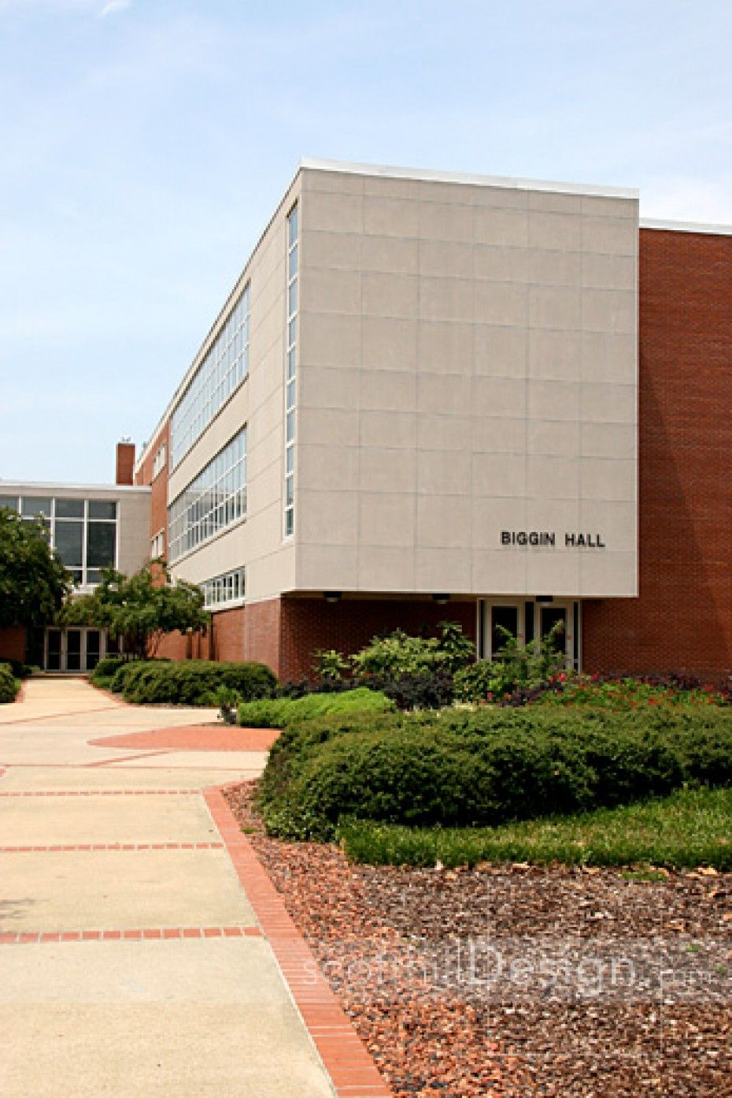



Student Experience
Notification of SCORE and AT Hold* Placed on Account
Enroll in UNIV 4AA0 – University Graduation
Remove Hold
Semester begins
WAIVER
*AT Hold – Restricts access to the Diploma Application

Slide 4
Summer 2018
~520
Notification of SCORE and AT Hold* Placed on Account
Enroll in UNIV 4AA0 – University Graduation
712
Remove Hold
Semester begins
WAIVER
719
~192
*AT Hold – Restricts access to the Diploma Application

Slide 5
Summer 2018 SCORE Summary
Compliance (712)
Non-Compliance (7)
  5 truly non-compliant
  2 eligible for a waiver
712/719
99%
1%
520/712
73%
TEST
192/712
27%
Waiver
Note- 18 students did not fill out the Diploma Application

Slide 6
What Data were Collected this Summer/Fall?

Slide 7
Revised Core Student Learning Outcomes (10/17)
In order to become lifelong learners and use their education to solve practical problems, by the time of graduation, students will be able to effectively:
a. locate, evaluate, and use information.
b. read and think critically.
c. apply mathematical methods.
d. write and revise for a variety of purposes.
e. create and deliver oral presentations.
f. analyze their own society and its relationship to the larger global context.
g. interact in intercultural situations.
h. apply scientific principles.
i. analyze and value creative artistic endeavors.

Slide 8
Summer/Fall 2018
Spring 2019
A - Locate, evaluate, and use information
B - Read and think critically
D - Write and revise for a variety of purposes
F - Analyze their own society and its relationship to the larger global context
G - Interact in intercultural situations
I - Analyze and value creative endeavors
Assessment Method Overview
Summer/Fall 2019
Spring 2020
C - Apply mathematical methods
E - Create and deliver oral presentations
H - Apply scientific principles (*note, as this test is developed additional data may be collected across the 2018-19 academic year)
A - Locate, evaluate, and use information
B - Read and think critically
D - Write and revise for a variety of purposes
Summer/Fall 2020
Spring 2021
F - Analyze their own society and its relationship to the larger global context
C - Apply mathematical methods
G - Interact in intercultural situations
I - Analyze and value creative endeavors
E - Create and deliver oral presentations
H - Apply scientific principles (*note, as this test is developed additional data may be collected across the 2018-19 academic year)
Cycle continues.

Slide 9
Summer & Fall 2018
Summer/Fall 2018
  A - Locate, evaluate, and use information
  B - Read and think critically
  D - Write and revise for a variety of purposes

Slide 10
 | Information Literacy | Critical Thinking | Written Communication
Detailed Definition | identify relevant sources for specific information needs and use appropriate search tools and search strategies to access the needed information. recognize research and inquiry as iterative processes and recognize the contributions of scholarly communication and other information sharing networks to the creation of new knowledge. apply their knowledge of the capabilities and constraints of information developed through various creation processes when assessing the alignment of information products and information needs and apply knowledge of the constructed and contextual nature of authority when evaluating the credibility of claims recognize that information possesses value and that legal, social, and economic factors influence information production, dissemination, and access and deploy this understanding to make informed and ethical decisions about how they access and use information. | identify the genre of the text, make reasonable inferences about its central purpose or argument, define its key components, and show how the writer uses these to reach a conclusion or create meaning or impact. engage the text dialogically, questioning its premises, identifying its limitations, or advancing alternative perspective. construct a strong, well-reasoned argument by determining which conclusion is supported by the strongest evidence. | analyze contexts and audiences and then act on that analysis in comprehending and creating texts (Rhetorical Knowledge). analyze, synthesize, interpret, and evaluate ideas, information, situations, and texts (Critical Thinking). recognize and use multiple strategies, to conceptualize, develop, and finalize projects (Writing Processes). recognize formal rules and informal guidelines that define genres, and shape readers’ and writers’ perceptions of correctness or appropriateness (Knowledge of Conventions). compose text using a range of media (from traditional pen and paper to digital technologies; Composing).
Test | TATIL – Carrick Enterprises | ETS - HEIghten | ETS - HEIghten

Slide 11
Opportunities SCORE presents
Resource for better understanding student learning at Auburn
Process will
  Allow Auburn to tell a story about student learning
  Allow Auburn to systematically investigate learning research questions
  Allow Auburn to create improvement initiatives where learning discrepancies are identified

Slide 12

Spring 2019 – UNIV 4AA0
Currently graduating seniors receive multiple messages about graduation
Spring 2019

